Slide 1
JavaScript: DOM

Slide 2

The Document Object Model gives you scripting access to all
the elements on a web page. It defines
HTML5 elements as objects
The Properties of all HTML elements
The methods to access all HTML elements
The events for all HTML elements
©1992-2012 by Pearson Education, Inc. All Rights
Reserved.
2

Slide 3
Using JavaScript, you can create, modify and remove elements in the page dynamically.
Change all the HTML elements in the page
Change all the HTML attributes in the page
Change all the CSS styles in the page
Remove existing/add new HTML elements and attributes
React to all existing HTML events in the page
Create new HTML events
©1992-2012 by Pearson Education, Inc. All Rights
Reserved.
3

Slide 4
The nodes in a document make up the page’s DOM tree, which describes the relationships among elements
Nodes are related to each other through child-parent relationships
A node can have multiple children, but only one parent
Nodes with the same parent node are referred to as siblings
The html node in a DOM tree is called the root node, which is the
parent node of all HTML elements in the page
©1992-2012 by Pearson Education, Inc. All Rights
Reserved.
4

Slide 5
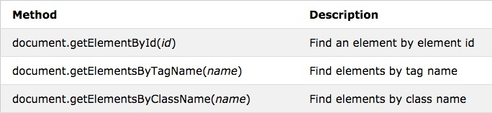
var myElement = document.getElementByID("intro"); //returns the element object with id="intro"
var x = myElement.document.getElementsByTagName("p");
//returns all <p> elements as an
//array inside myElement
var x = document.getElementsByClassName("major");
//returns all elements with class="major"
©1992-2012 by Pearson Education, Inc. All Rights
Reserved.
5

Slide 6
Example: Returns all <p> elements with class="intro"
var x=document.querySelectorAll("p.intro");
©1992-2012 by Pearson Education, Inc. All Rights
Reserved.
5

Slide 7
Use the dot (.) operator to access element attribute values
Example:
<html>…
<img id=“myImage” src=“oldpic.jpg”> …
</html>
var x=document.getElementById(‘myImage’); x.src = “newpic.jpg”;
©1992-2012 by Pearson Education, Inc. All Rights
Reserved.
5

Slide 8
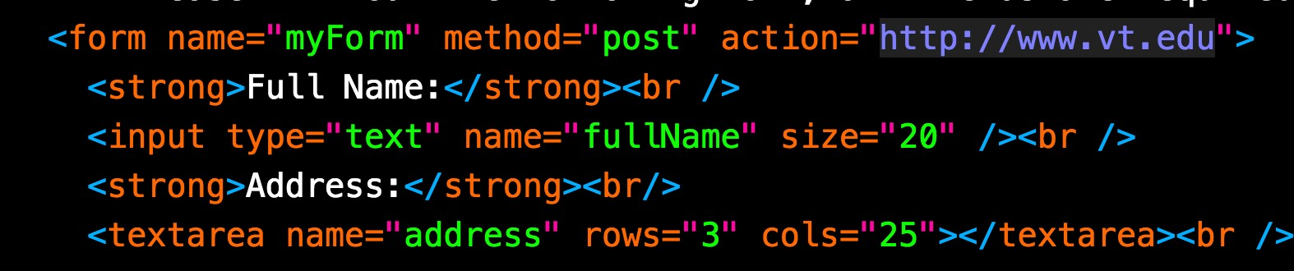
var x = document.getElementsByTagName("form")[0]
x.fullName x.address
//references the fullName text input
//refrences the address textarea input
©1992-2012 by Pearson Education, Inc. All Rights
Reserved.
5

Slide 9

parentNode
childNodes[nodenumber]
firstChild
lastChild
nextSibling
previousSibling
Note: A whitespace character is an empty space without any visual representation in
your page. A child/sibling node can be a whitespace.
©1992-2012 by Pearson Education, Inc. All Rights
Reserved.
5

Slide 10
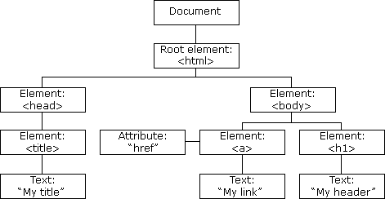
© w3schools.com.
10

Slide 11

document.getElementsByTagName("h1")[0].parentNode
//body element
document.getElementsByTagName("html")[0].firstChild
//head element document.getElementsByTagName("html")[0].lastChild
//body element
document.getElementsByTagName("h1")[0].previousSibling
//a element document.getElementsByTagName("a")[0].nextSibling
//h1 element
©1992-2012 by Pearson Education, Inc. All Rights
Reserved.
11

Slide 12
DOM has collections—groups of related objects on a page
DOM collections are links, images, forms, and anchors.
The document object has properties containing the images collection,
links collection, forms collection and anchors collection
Contain all the elements of the corresponding type on the page
The collection’s length property specifies the number of items in the collection
Example:
document.forms.length document.images[1]
//number of forms in the page
//the second image in the page
©1992-2012 by Pearson Education, Inc. All Rights
Reserved.
12

Slide 13
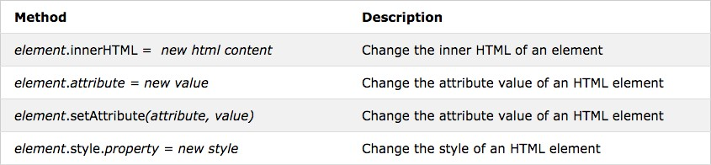
//the content of the element with id="p1" is updated to New text var x=document.getElementById("p1");
x.innerHTML = "New text";
x.style.visibility = "hidden"; //hide the p1 element
©1992-2012 by Pearson Education, Inc. All Rights
Reserved.

Slide 14
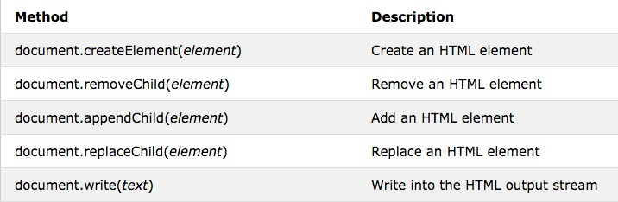
©1992-2012 by Pearson Education, Inc. All Rights
Reserved.

Slide 15

var newNode=document.createElement("p"); newNode.id="new";
var txt="I love Tech";
// attach text to the new paragraph node
newNode.appendChild(document.createTextNode(txt));
©1992-2012 by Pearson Education, Inc. All Rights
Reserved.

Slide 16
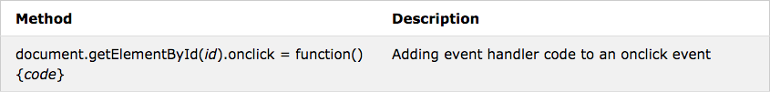
document.getElementById("p1").addEventListener("click", myFunction, false);
document.getElementById("p1").onclick = myFunction;
©1992-2012 by Pearson Education, Inc. All Rights
Reserved.

Slide 17
©1992-2012 by Pearson Education, Inc. All Rights
Reserved.

