Slide 1
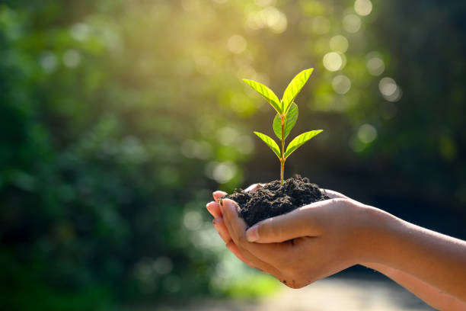
Environmental Pollution
Name: M.A.G.S.K. Wickramasingha.
Registration Number: 523598606

Slide 2
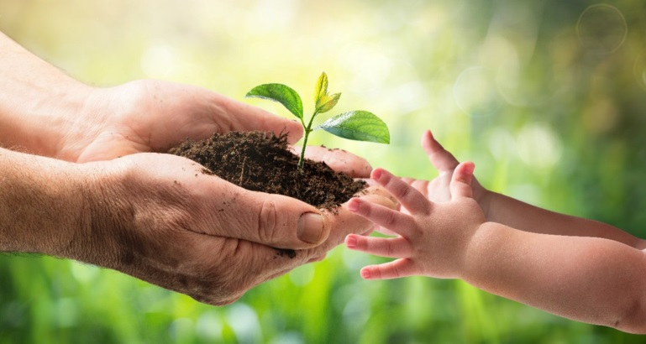
Understanding Pollution
Environmental pollution is a critical global issue that impacts the air we breathe, the water we drink, and the soil that supports our food. Understanding its sources, effects, and solutions is essential for protecting public health, preserving ecosystems, and ensuring a sustainable future. Raising awareness and advocating for effective policies can help mitigate pollution's harmful consequences and promote a cleaner, healthier environment for all

Slide 3
Key Points to Discuss
Types of Environmental Pollution
Causes of Environmental Pollution
Air Pollution
Water Pollution
Soil Pollution
Urbanization and Industrialization
Improper Waste Disposal
Population Growth and Urban Expansion
Effects of Environmental Pollution
Solutions and Measures
Health Issues
Impact on Biodiversity
Economic Impact
Regulations and Policies
Technological Innovations
Community Engagement

Slide 4
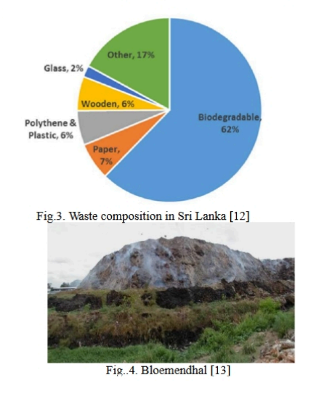
A Stark Reality
The pie chart of figure 3 shows the average waste composition generated in Sri Lanka. The MSW composition of Sri Lanka is 62 % biodegradable wastes, and the other 38 % consists of non-biodegradable materials. Currently, the reason for an increase in the generating of MSW is population growth and urbanization. The total amount of solid waste generated by Sri Lanka is around 7000MT daily. However, the municipal council collects only half of them for proper garbage disposal. Most of the waste generated in the Colombo Municipal area accounts for 0.8kg of solid waste per person
Asitha E. Soysa, Malki H. Perera, Navanjani Perera, Pamuditha Y. Pathirathna Faculty of Technology, University of Sri Jayewardenepur

Slide 5
Conclusion
Urgent action is needed to address environmental pollution in Sri Lanka to protect natural resources, improve public health, and ensure a sustainable future for generations to come.

