Slide 1
ArMADA - Arvind Made Analytical Digital Assistant
Anirban Das
Harsha Asetti
Runcy Oommen
Vaibhav Singhal

Slide 2
Arvind Brands: Digital Assistant
Context
Customer Identification, prioritization and Engagement are the key factors to increase Customer Experience and increasing the Customer Life-Time Value
In the age of e-commerce where e-retailers record every touch point of their customers and leverage that for personalized customer experience, stores lack behind in that area
With the advent of new technologies in hardware and software both, stores stand a chance to get a competitive advantage
Objectives
Analyze past purchasing behavior (in the store) and other activities outside the store ( Digital Presence) for identification and prioritization of the customers
Map the customer journey in the store for better customer service, marketing activities and operational efficiency
Analyze customer behavior within store by sentiment analysis, feedback etc. for improvement in conversion rates through better customer service
Proposed Solution
Hardware
Software
Tech Stack
Business Intelligence
Data
Analytics
Impact
Store Level Attributes: Transactions, Store Attributes
Us of sensors, cameras for touchpoint capturing
Store Kiosk Input
Sales Recommendation
Video Analytics
Wi-Fi Data Analytics
Increased Sales
Increased Customer Experience
Better Marketing Effectiveness
Better Operational Efficiency

Slide 3
Hackathon Solution Offering
What
Sales Recommendation
In-Store Customer Visit Analysis
Why
Personalized Customer Experience
Personalized Sales Recommendation
Targeted Sales
In-Store Footfall
Sales Conversion
Heat Map
Customer Tracking Dwell Time
For
Sales Planning
Sales Planning
Marketing
Sales Execution
Marketing

Slide 4
Sales Recommendation: Customer level personalized recommendation for the sales representative

Slide 5
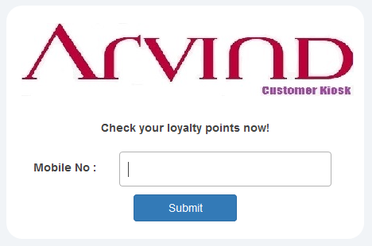
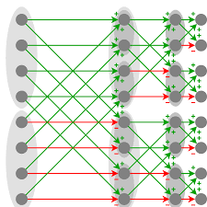
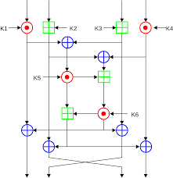
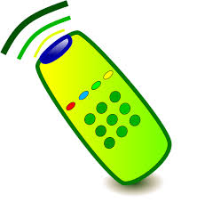
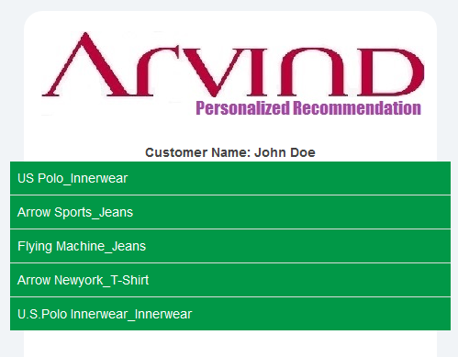
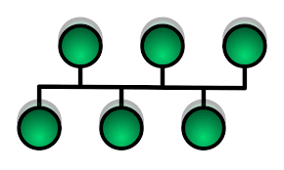



Sales Recommendation Pipeline
Data Transform layer to move raw data to the data model
Recommendation Data Model
built on a distributed, scalable NoSQL database
Recommendation Algorithm pipeline using Hadoop & Spark Clusters
Model Scoring engine using a delivery mechanism to score varied types of models
Business Rule Engine to define how business controls recommendations
Visiting Customer Recommendation
Customer Kiosk
Customer Identification Kiosk for triggering recommendation
Analytics Engine
Recommendations on Mobile App
Drive intelligent sales conversations, by recommending personalized products delivered to sales people on their devices

Slide 6
Customer Journey In-Store: Map customer path to get insightful customer behaviors

Slide 7
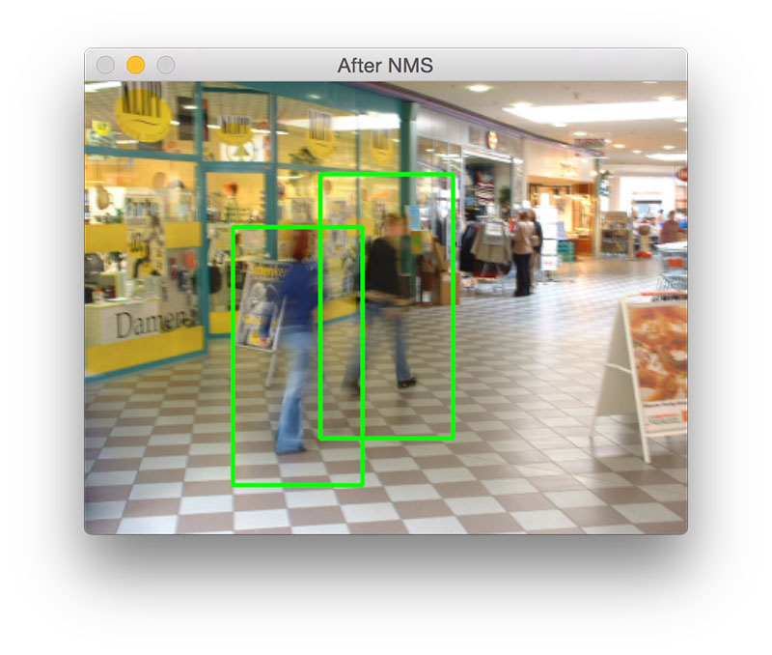
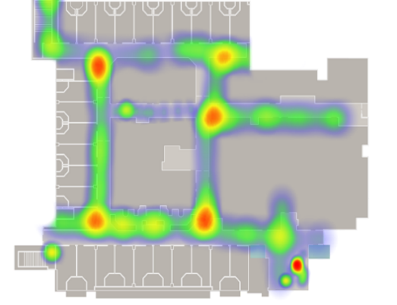
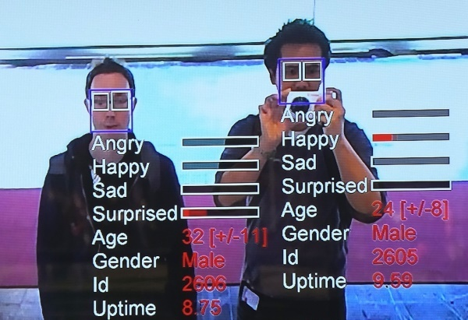
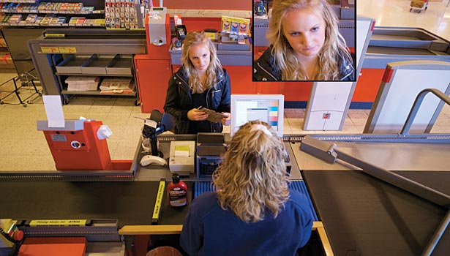
Impact of Capturing Customer Touchpoints
Touchpoints for video analytics
Store Entry
Moving in the store
At a counter/isle/dispenser
Point of sale
Video analytics
Outcome
Passer by to entry conversion
Path of customers, most busy zones
Age, Gender Tagging, Behavior Analysis
Identification of loyalty customers
Actionable Insights
Measures for increasing entry to store through ads, offers etc.
Use in store marketing for channelling people at desired zones (New Products, Offer Launches)
Customer behaviour at specific counters/zones
Automatic identification of loyal customers
Automated billing
Loyalty Customer Identification, Behaviour Analysis, Dwell Time at different counters

Slide 8
Representation of BI Dashboard
*Numbers are representative

Slide 9
Application Architecture

Slide 10





Sales Recommendation
AWS Lambda
REST APIs
PoS Transaction Data
Customer Kiosk
MySQL
Real-time
Sales
Recommendation
Consumption Layer
Data Storage

Slide 11


WiFi Data Analytics
On Premise Analytics and BI Server
Analytics
Kafka
MySQL
HTTPs
HTTPs
Repeat Customer Analysis
WiFi
Data Storage
High Data Velocity
BI Dashboard

Slide 12
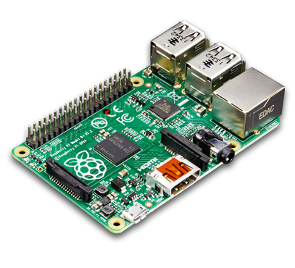
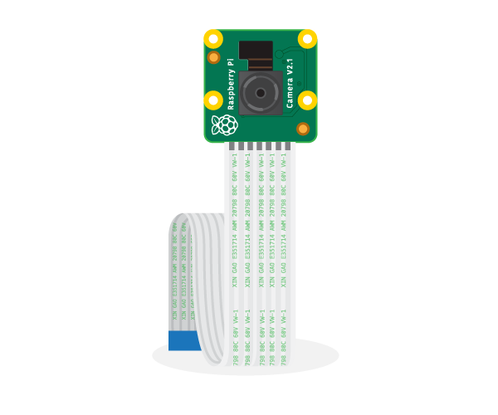

Image & Video Data Analytics
Kafka
AWS Lambda
Raspberry Pi
w/ Camera
HTTPs
REST APIs
Analytics
People counting
Face ID Mapping
Age, Gender Detection
Instore customer journey
Dwell time
* Ra-Pi Model B w/ 5 MP Camera
* Elementz USB Adapter/Charger
* SD Card (128 GB) – 160 mins
Data Buffer
Total Cost: $85
Consumption Layer
MySQL
Near Real-time
In-Store Activity Dashboard
Output Data Storage

Slide 13
Beyond The Hackathon: Identify & prioritize key customers entering store

Slide 14



Advanced Personalization using competitive information
Data Layer
Analytics Layer
Reporting Layer
Customer Profile
Transaction Data
Demographic Data
Lifestyle Preference
Persona Segmentation
Total Transactions Made
Average Order Amount
Mode of Payment
Order Returned/ Cancelled
Products Purchased
Persona Segmentation
Campaign Effectiveness
Campaign 1
Measuring campaign effectiveness in terms of
Store visits Frequency
Campaign contribution towards revenue
Sales Lift Analysis
Post campaign clickstream analysis
Recommendation System
Recommendation System
Total Impression provide
Impression Viewed/Clicked
Click through Conversion Rate
Types of campaigns Viewed/Clicked
In-Store Presence
Stores Visits Frequency
Time Spent within Store
Affinity towards product SKUs
Proximity from different Beacons
Path Followed
Zones Covered
Day Parting Details
Campaign 2
Promotion Content Design
App Usage
Campaign 3
Time spent in App
Browsing History
Pages Viewed Details
Time spent/page
Analysis to be done based on data collected across multiple brands/ stores
Note: In absence of mobile app the lifestyle prediction of consumers will be through hypothesis based on similarity in-store behavioural pattern of existing consumers

Slide 15
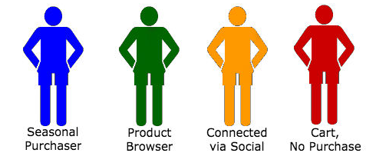
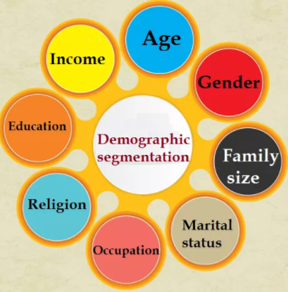
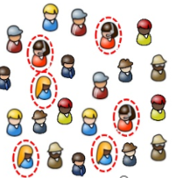
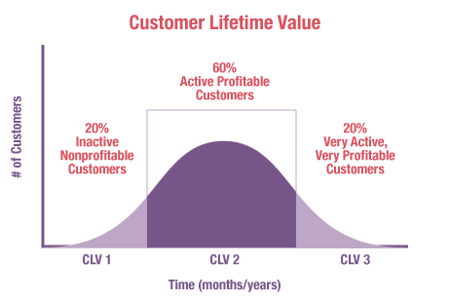
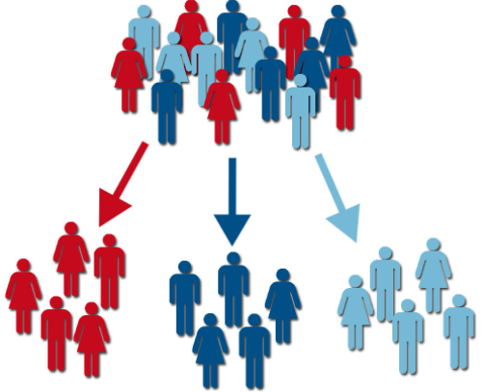
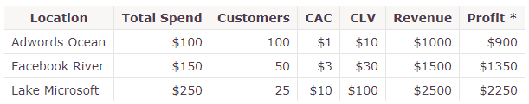



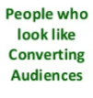

Acquiring customers with future potential through DMP
Identifying Potential Customers
from 1st Party Base
Understanding External Personas for
multiple segments
Identifying right target audience
based on personas identified
Estimating future potential customer using first party DMP data and adding monetary value to business through better engagement with them
Segmenting target customers and profiling them in homogeneous groups using 2nd and 3rd party data like product usage, demographics, behaviour etc..
Extrapolating identified persona information for targeted segment and mapping them with universal cookie base through look-alike models
Browsing Behaviour
Segments
Demographic Segments
-> Deal Hunters
-> Public Transport Users
-> Price sensitive
-> Holds Loyalty cards
-> Prefer offline Store
-> Food Lovers
-> Movie Goers
-> Youth Base
-> Rural Consumers
-> M Wallet users
-> Tech Enthusiast
-> White Collar Employ
-> Smart Phone Users
-> Urban Consumers
-> Credit Card Users
-> Brand Centric
-> International Traveller
-> Fleet Taxi Users
-> Jewellery Buyers
-> Deal Hunters
-> Public Transport Users
-> Price sensitive
-> Holds Loyalty cards
-> Prefer offline Store
-> Food Lovers
-> Movie Goers
-> Youth Base
-> Rural Consumers
-> M Wallet users
-> Tech Enthusiast
-> White Collar Employ
Understanding the right segment of customers bringing value to business with minimum acquisition cost.

