Slide 1

Auto-scalable & Low-cost Analytics Solution for Kirana Store
Rajani/Runcy/Kirti

Slide 2
Overview
Problem: Given the constraint on cost of investment and connectivity, the problem is to capture sales data from Kirana store: accurately and real-time, to understand consumer behaviour and automate inventory management.
Solution: The proposed solution is to have a Raspberry Pi system (with camera, barcode scanner and USB internet) for capturing the sell out information from the Kirana stores to manage the store operations in effective way. The analytics solution aims to create meaningful micro-segments based on stores activity captured through PoS data and Camera data. The data is then merged to give signals on Tableau/Spotfire around the stores operations efficiency in terms of inventory management.
Approach
Hardware
Software
Tech Stack
Business Intelligence
Low Cost Raspberry Pi System
Camera
USB internet
AWS Lambda (S3) with Object detection algorithm (Python
MySQL
Tableau/Spotfire
Architecture View
DB Schema
Analysis ready Data
Portfolio View
Micro Segment
Inventory Management

Slide 3
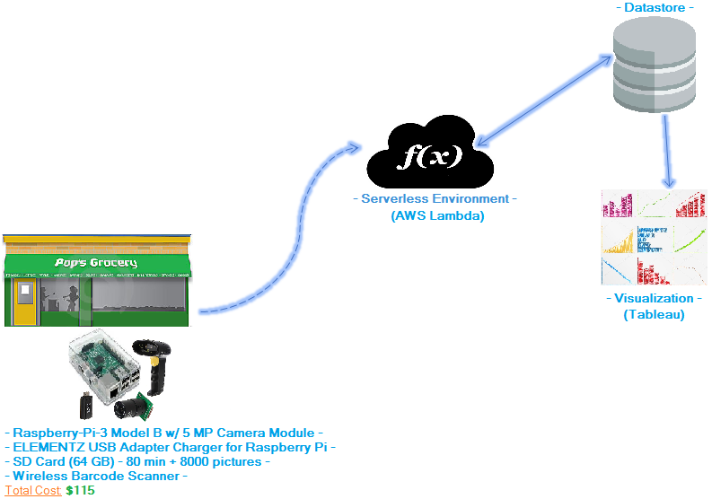
Solution Overview

Slide 4
Hardware & Software Overview
Barcode scanner to capture sell-out information (real-time or offline storage)
Each RaPi deployment to be dynamic/flexible based on factors like power, network, accessibility etc..
Barcode scanner data will be updated into DB via an API endpoint in a server-less manner
Camera data (pics) will be uploaded to cloud object storage for ML and DL processing with results stored into DB
Visualization/BI on the data with Tableau and Spotfire

Slide 5
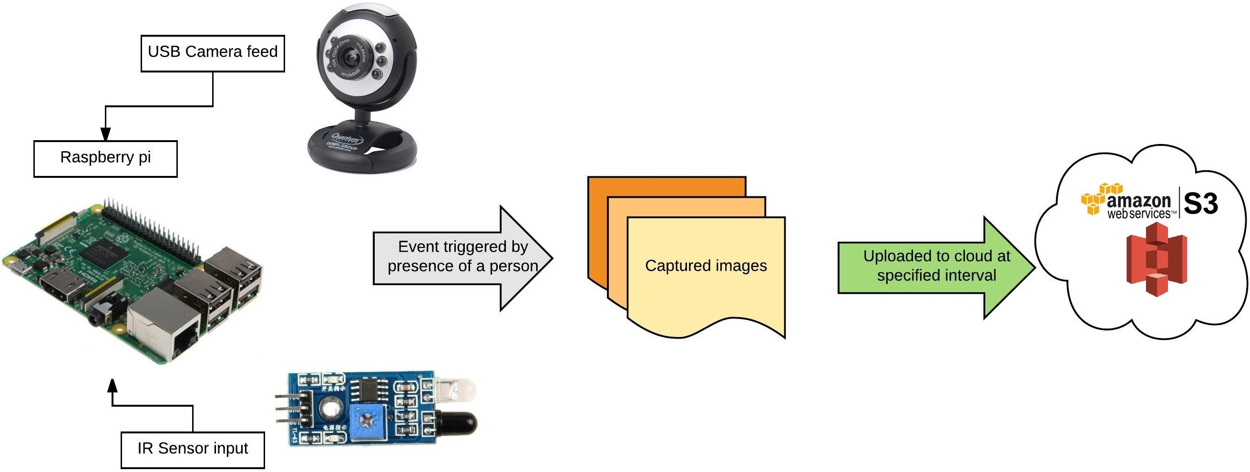
Hardware & Software Overview
High Level view of RaPi deployment at Kirana store

Slide 6
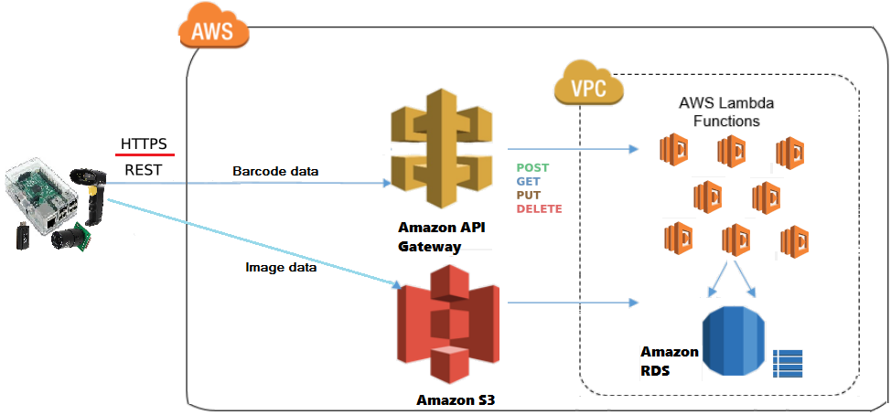
Tech Stack Overview: Server-less Architecture
AWS Lambda Functions coverts image and bar-code data which will be stored in DB for analytics consumption

Slide 7
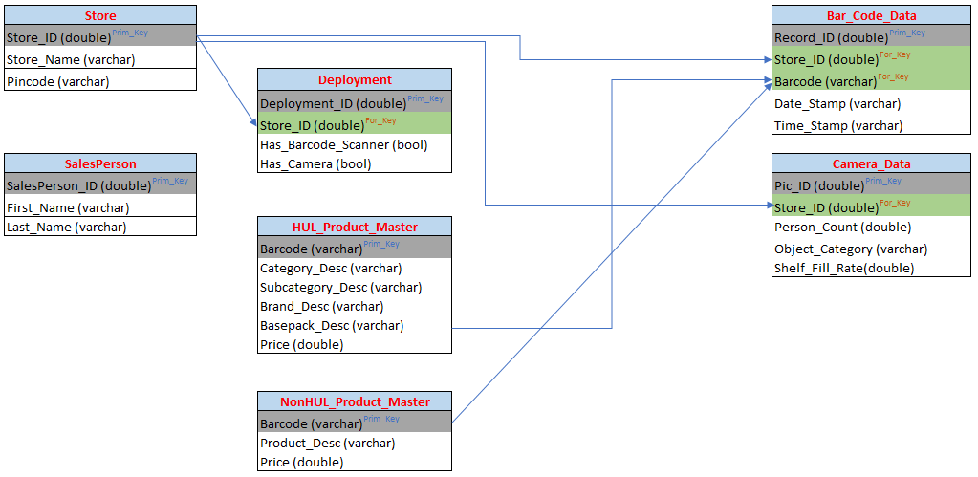
Tech Stack Overview: DB Schema

Slide 8
Business Intelligence
Tableau and Spotfire are used to create visualization around
Summary View
Micro Segmentation
Inventory
Management
Portfolio performance View: Performance of overall portfolio (Month on Month or Quarter on Quarter) which can also be viewed at Zipcode level and at a particular store level
Kirana Store Performance: Insights around the Kirana store’s performance is created using Revenue, average price and basket of the products
Inventory Flags: Signals are created to recommend a reordering point of each product category based on the fill rate and historical reordering point
Filters available
Time Span: WoW, MoM, QoQ
ZipCode
Stores

Slide 9
Business Intelligence: Analytics ready data preparation
Barcode Scanner Data
Camera Data
Product Master Data
Store ID
Barcode
Category
Subcategory
Brand
Base Pack No
Base Pack
Bill No
Created Stamp
Area Code
1) Store ID
2) Average Quantity on Shelf
3) Fill Rate
4) Shelf Number
5) Shelf Description
6) Shelf Occupancy%
7) Time Stamp
Barcode
Category
Subcategory
Brand
Base Pack
Price
Data streams across these sources is seamlessly stitched for the BI Consumption layer

Slide 10
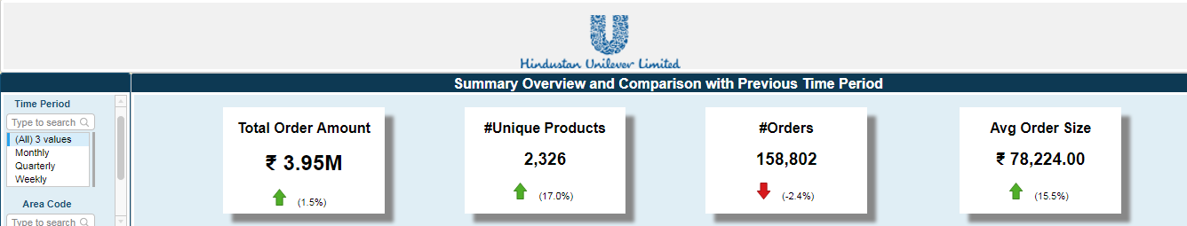
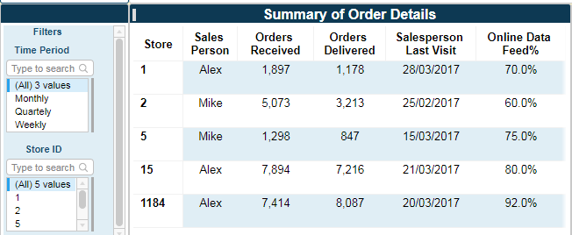
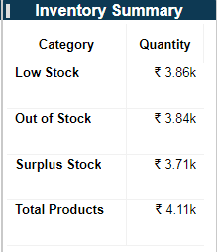
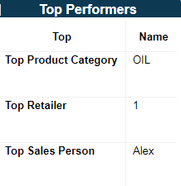
Business Intelligence: Portfolio View
State of Business – Compare against a prior period
User can choose a prior period – week , month, Quarter to compare change in order size and number of orders
Sales teams may further filter by Area code to compare sales order performance
Order Summary for current time period
This view gives the business a view of sales orders received and delivered
The visit of the sales person and the online connectivity serves as a reference point for the inventory lead or the sales lead to base judgement on the data feed of the week / month / Qtr.
State of Business – Compare against a prior period
The business user can also get a view at a store level of the status of the stock – surplus, out of stock etc
Serves as a trigger for the sales team to plan the route, the product to push and the sales plan of the sales agent

Slide 11
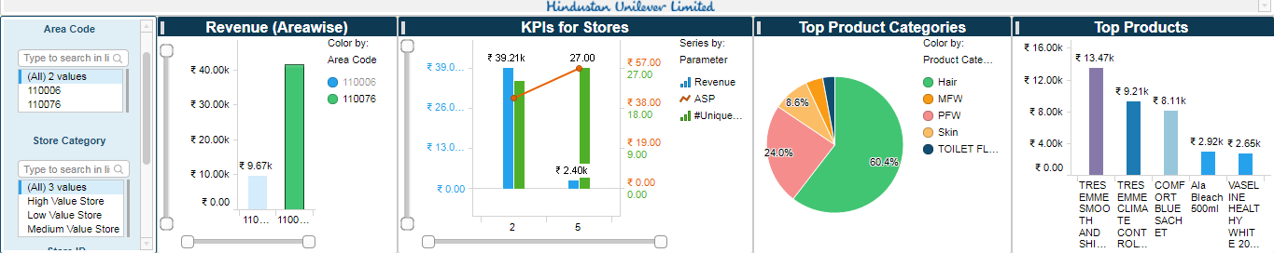
Business Intelligence: Store Micro Segmentation
Gives a detailed view for an Area sales manager and/ or Inventory manager
One can drill down by Area to a specific store to get a view of store performance by breadth of product categories sold and revenue parameters
To develop a product wise targeting strategy or recommend the next best product a look alike store to push, the view on the top selling product categories and top products will be helpful

Slide 12
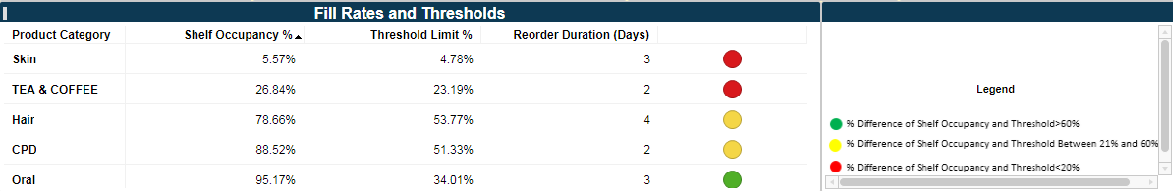
Business Intelligence: Inventory Management
This view gives the inventory team a view at a store level the pace at which products are moving off the shelves – The camera images of the shelf in the store will help capture the shelf occupancy rate.
One can also get a view of the average re-order cycle by store and product category basis historical data on product orders
The threshold indicated, gives the inventory /sales manager a view of how soon the order needs to be delivered and shelves replenished else would lead to dissatisfied customers

Slide 13
Vision

Slide 14
Hardware & Software: Vision
Multiple RaPi deployment per store:
Multiple cameras with Top as well as side view to capture transactional and inventory related information more accurately.
Current algorithm can only detect the objects and classify the objects into categories based on the side image captured by a camera. We can have a closer camera placed to detect each and every product including its Brand information with much more precision.
Automated Deployment:
Current architecture is a manual process when it comes to adding or changing the software and algorithms. The whole process can be automated using CI-CD techniques which can save a lot of manual effort.

Slide 15
Business Intelligence: Vision
Data Requirement
Sell in data from HUL to Kirana Store which includes following columns
Store Information
Product information including price
Channel information
Promotions
Camera data from Kirana Store with more camera set up near entrance and counters. Following information cane be captured and created through advance algorithms
Footfall activity
Gender information
Age information
Counter Actvity
Product information
Kirana Store Product Master data
Barcode
Product information
Price
GAP Analysis(Anomaly detection to identify Gaps)
Promotion Effectiveness
Sales Person’s performance
Product Recommendation
Demand Forecasting
Possible improvement of current Analysis/New Analysis based on new data

