Slide 1
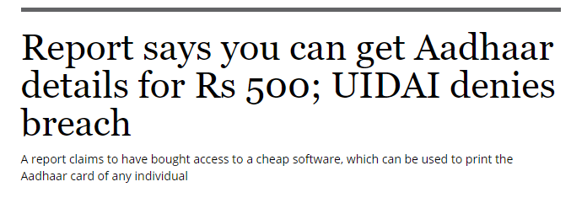
Problem Statement
1
Proposed Solution
A city like Jaipur has 1,98,000 street lights maintained by Jaipur Nagar Nigam (JNN), which runs on Samudra LED bulbs of 5W -112 W range.
The total energy consumption in Jaipur street light on account of the above, is ~30,000 MW annually which comes at a cost of ~₹ 1.13* lakh crores per year.
http://www.samudraled.com/index.php/component/k2/item/6-smc-samudra-awarded-the-contract-to-install-71-000-led-street-lights-in-jaipur
One challenge that will continue to concern the city is the rising demand for power.
The gap between demand and supply of power will determine the extent to which the government will be able to meet its development objective.
The key is to not just increase investment and enhance power generation, but
Invest in more efficient power distribution and optimize power consumption through use of efficient technology.
2
Proposed Solution
It’s difficult to find the sweet spot that balances national security and individual data privacy:
A distributed yet trustworthy source of truth of all Aadhaar access,
No central audit data to manipulate and every node in the blockchain network plays a custodian to each and every Aadhaar authentication.
http://www.business-standard.com/article/current-affairs/aadhaar-breach-how-rs-500-is-all-it-takes-to-pry-on-a-billion-indians-118010400169_1.html
*Assuming all 1,98,000 bulbs has been replaced by Samudra LED

Slide 2
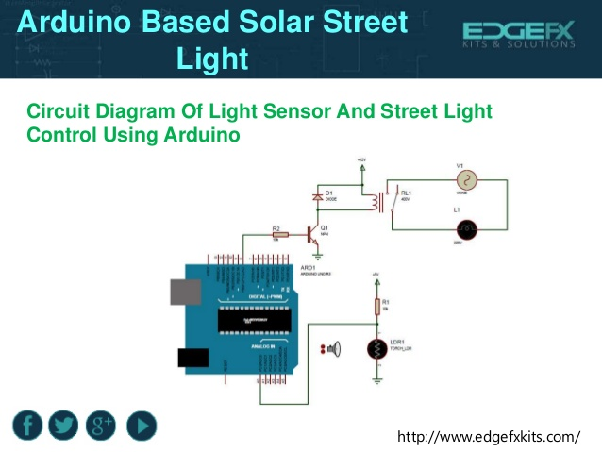
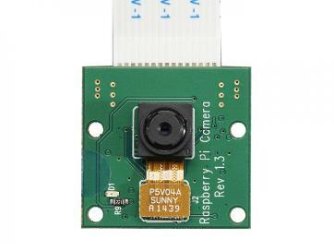

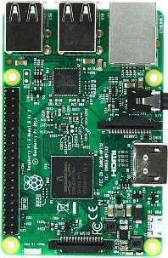
Solution 1: IoT based Street Light Surveillance System
Circuit Diagram for light control
Circuit Diagram for Surveillance
Camera
Public space
Arduino Processing System
Raspberry Pi Processing System
Controlled switching time can help in avoid day burners.
Programmable individual and group lamp brightens every regions.
Dynamic lighting based on traffic, sensors and weather.
Up to 50% of energy could be saved from street light.
Provides automatic failure detection and its predictive maintenance web applications helps crews in savng time and money.
Provides real time face recognition feature which is connected to Criminal Central Database for identification and location tracking.
Real time control module helps maintenance team check any situation on any streetlight, remotely.
Security for pedestrians and drivers are increased which provides the feeling of safety for citizens.
** Per unit cost of above integrated solution is ~₹5,000.

Slide 3

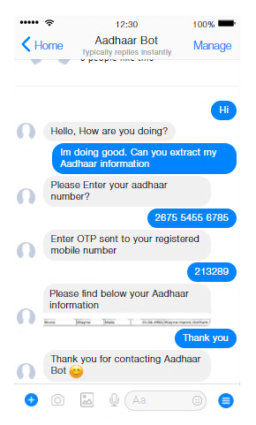
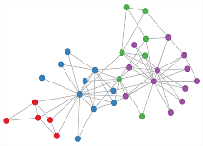


Solution 2: Blockchain Based Aadhar Authentication Audit Trail
On Demand Report
Different Nodes.
E.g - Admin node and Normal nodes
Sample report from Ledger
Governance Authority*
*Governance Authority can be any individual ,government/Private entity

