Slide 1
T.A.N.G.L.E
That’s A Nice Good Looking Encryption
Runcy Oommen
Arun Kumar S

Slide 2
Current scenario & threat landscape
Method used for encryption is primitive (in tech speak)
Data movement to cloud growing at an exponential rate
Edward Snowden revelations of mass govt. sponsored data snooping
Intentional weakening of algorithms and protocols by vendors
Backdoors to appliances and devices
NSA, China, N. Korea…

Slide 3
Existing Techniques – pros & cons
Symmetric Encryption
Pros: One key for encryption and decryption
Pros: Faster and efficient
Cons: Secure channel to exchange key
Asymmetric Encryption
Pros: Concept of private and public key
Pros: Convenient and allows non-repudiation
Cons: Slow process.

Slide 4
Introducing t.a.n.g.l.E
Time Dependent - the code used for any character differs depending on time (Linux Epoch).
Multi Alphabetic - the same character set at different locations of the plain-text are different.
Random number generation technique for code generation.
Symmetric key method and uses less complex mathematical operations.
Completely customizable by tweaking the algorithm ensuring uniqueness.

Slide 5
Encryption process
Get Linux epoch and generate a random 4 digit number
Multiply them together to get a product that will be exchanged b/w clients
Select random 8 digits or more from this product
Set appropriate buffer size for encoding, say 150
Generate the next 150 prime numbers with seed from step #3, modulo-d with 127*
Generate ASCII value series based on each of this modulo value as the start
Start substituting the plain-text characters from the series which we arrived at step #6 to form the encrypted text
*Up to 127 ASCII codes for demo

Slide 6
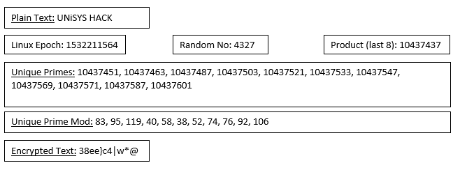
Sample encryption

Slide 7
decryption process
Based on the initial product exchanged, get the required key by following the same process as in encryption
Have the series generated accordingly based on the modulo value as the starting point
Perform a reverse lookup on the series with the encrypted value to get the real value

Slide 8
DEMO
http://alice.runcy.me

