Slide 1
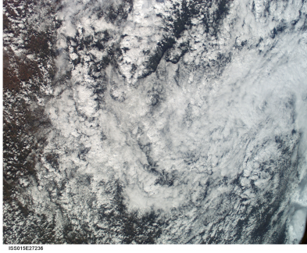
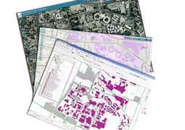
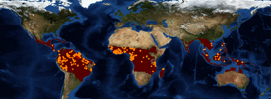
Questions of interest:
How to automate manual process?
How to keep track of data sources and analysis paths?
How to understand voluminous datasets used & generated?
Published
Web Services
Published
Web Services
NASA & others
Earth Data Analysis Center (EDAC)
Earth Science Data Provider
Lifemapper
Species Distribution Model Computational Experiments
Manual
Many
Datasets
IPCC & others
IPCC climate change & Others
Earth
Life

Slide 2
Questions of interest:
How to automate manual process? Semantic technologies
How to keep track of data sources and analysis paths?
How to understand voluminous datasets generated?
Cyber-ShARE
Reuse
CardioShARE
Knowledge Base
WORKING DEMO
Published 1
Web Service
Semantic Service Orchestration
Semantic Automated Discovery & Integration
(SADI) Services
Semantic annotation of Service inputs and outputs
Service “wrappers”
Published
Web Services
Published
Web Services
Earth Data Analysis Center (EDAC)
Lifemapper
Species Distribution Models
Earth
Semantic Web
Life

Slide 3
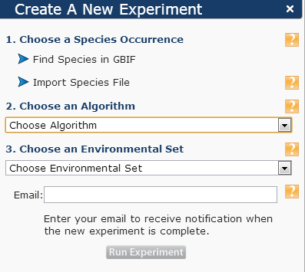
Knowledge Base
Experiment.owl
Dynamic ontologies that describe (constrain) experiments
Experiment.owl
Experiment.owl
imports
Client that generates experiment constraints and queries (in progress)
Lifemapper.owl
Static ontologies used to describe SADI services
Edac.owl
Query.rq
SPARQL query used to specify what experiment to use
Input to CardioSHARE
Earth
Semantic Web
Life

Slide 4
Questions of interest:
How to automate manual process? Semantic technologies
How to keep track of data sources and analysis paths?
How to understand voluminous datasets generated?
Cyber-ShARE
Reuse
CardioShARE
Knowledge Base
WORKING DEMO
Published 1
Web Service
Semantic Service Orchestration
Semantic Automated Discovery & Integration
(SADI) Services
Semantic annotation of Service inputs and outputs
Service “wrappers”
Published
Web Services
Published
Web Services
Earth Data Analysis Center (EDAC)
Lifemapper
Species Distribution Models
Earth
Semantic Web
Life

Slide 5
Questions of interest:
How to automate manual process? Semantic technologies
How to keep track of data sources and analysis paths? Provenance
How to understand voluminous datasets generated?
Cyber-ShARE
MOCKED UP DEMO
Reuse
CardioShARE
Knowledge Base
Overall provenance using
PROV Standard
+ Extensions in PML3
WebProbe
Provenance
Published 1
Web Service
Provenance
Provenance
Provenance
Published
Web Services
Published
Web Services
Earth Data Analysis Center (EDAC)
Lifemapper
Species Distribution Models
Earth
Semantic Web
Life

Slide 6
Questions of interest:
How to automate manual process? Semantic technologies
How to keep track of data sources and analysis paths? Provenance
How to understand voluminous datasets generated? Visual Analytics
Cyber-ShARE
Reuse
CardioShARE
Knowledge Base
Overall provenance using
PROV Standard
+ Extensions in PML3
WebProbe
Provenance
Published 1
Web Service
Semantic Service Orchestration
Published
Web Services
Published
Web Services
This proposal: Visualization
Next proposal: Visual Analytics
Earth Data Analysis Center (EDAC)
Lifemapper
Species Distribution Models
LM Output
VisKo
EDAC
Input
ELSeWeb

