Slide 1
Mitigating Disparities Between EDAC and Lifemapper Data Requirements using SADI
Nicholas Del Rio
Natalia Villanueva
Deana Pennington

Slide 2

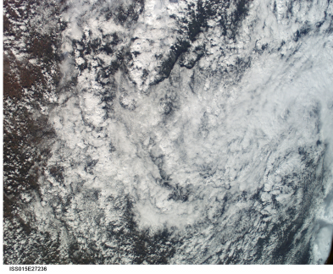

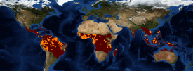
Mismatch between Lifemapper Data Requirements and EDAC WCS Data
Lifemapper Scenario Layer Requirements:
Order is respected
Must reside in TIFF format
Must be continuous and non-categorical
Limit 10 layers
Must all have same projection
Must all have intersecting region
Must all have same resolution?
We can’t directly serve EDAC Data into Lifemaper
EDAC WCS Data
Return WCS MIME Multipart Message format containing TIFF, JPEG, and PNG
Contains both continuous and categorical data services
1000’s of services
Various projection systems
Various bounding boxes or regions
Various resolutions

Slide 3
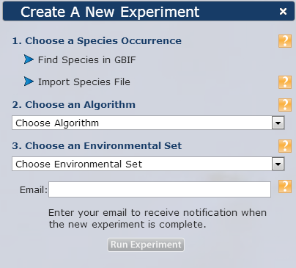
ELSeWeb Solution: Architecture
Over 6000 Coverage Services
EDAC WCS Metadata
imports
EDAC WCS Metadata
WCS Metadata To RDF
Coverage Set RDF
(part of KB)
ELSeWeb.owl
EDAC WCS Metadata
imports
SHARE Inference Model
SHARE Client
SADI Service Descriptions
(part of KB)
imports
Layer Criteria To OWL Rules
OWL + SWRL + SPARQL
(part of KB)
Static
Dynamic

Slide 4
More on the Layer Criteria Rules…
Users specify data requirements based on properties we currently encode in ELSeWeb.owl :
Measurement Type (e.g., Temperature, Snow Coverage, etc.)
Region
Source (e.g., MODIS sensor or PRISM modeling)
Time Duration
Resolution
Projection
WCSCoverage1:
Measurement: Temperature Data
Region: -110, -109, 33, 34
Source PRISM
Duration: 2009 and 2010
Resolution: DD
equivalentTo hasMeasurement some Temperature hasRegion some Region1
hasSource some PRISM
hasDuration some Duration1
hasResolution value DD
WCSCoverage2:
Measurement: Fractional Snow Data
Region: -110, -109, 33, 34
Source: MODIS
Duration: July 13, 2001 (instant)
Resolution: DD
equivalentTo hasMeasurement some Snow Cover hasRegion some Region2
hasSource some MODIS
hasDuration some Duration2
hasResolution value DD

Slide 5
The ELSeWeb Ontology (Partial of course)
WCSCoverage
hasWCSCoverage
Experiment
Stage1
hasWCSCoverageSet
WCSCoverage
Set
… (n)
…
WCSCoverage
hasWCSCoverage
subClassOf
WCSCoverage
1
hasWCSCoverageSet
hasWCSCoverage1
Experiment
Stage2
WCSCoverage
Sequence
…
…
WCSCoverage
10
subClassOf
hasWCSCoverage10
subClassOf
hasWCSPayload1
xsd:anyURI
Experiment
Stage3
hasWCSCoverageSet
WCSPayload
Sequence
…
…
hasWCSPayload10
xsd:anyURI
subClassOf
hasWCSCoverageSet
Experiment
Stage4
URL
Literal
Asserted
Derived
(Rules or SADI)
hasLifemapperModelURL

Slide 6
SHARE Client Service Orchestration Challenge
Experiment
Stage1
WCSCoverage
Set_Populated
WCSCoverage
AnExperiment
rdf:type
hasWCSCoverageSet
rdf:type
rdf:type
EDAC Coverage
Set
hasWCSCoverage
Fractional
Snow Cover
hasAlgorithm
Fractional
Snow Cover
BIOCLIM
Literal
…
hasOccurrenceSetID
Min Temperatures
4024107
Literal
AnExperiment
rdf:type
Experiment
Stage4
hasLifemapperModelURL
URL
Literal

Slide 7
Service 1: Extracts WCS TIFF Data from WCS Multipart MIME message
WCSCoverage
1
hasWCSCoverage1
WCSCoverage
Sequence
…
…
WCSCoverage
10
hasWCSCoverage10
WCSPayload
Extractor
hasWCSPayload1
xsd:anyURI
WCSPayload
Sequence
…
…
hasWCSPayload10
xsd:anyURI
SADI
Service
Data Type
OWL
Class

Slide 8
Service 2: Invokes Lifemapper Modeling Rest Service
hasWCSPayload1
xsd:anyURI
Experiment
Stage3
hasWCSCoverageSet
WCSPayload
Sequence
…
…
hasWCSPayload10
xsd:anyURI
hasAlgorithm
xsd:string
Lifemapper
hasOccurrenceSetID
xsd:string
Experiment
Stage4
xsd:string
hasLifemapperModelURL
SADI
Service
Data Type
OWL
Class

Slide 9
Experiment Lifecycle (Stage 1 to Stage 4)
Experiment
Stage1
(hasWCSCoverageSet some WCSCoverageSet)
and (hasModelingAlgorithm some ModelingAlgorithm)
and (hasOccurrenceSetID some Literal)
and (hasScenarioLayerUnits some Literal)
Rule: Dependent upon type of hasWCSCoverageSet value
Experiment
Stage2
(hasWCSCoverageSet some WCSCoverageSequence)
and (hasModelingAlgorithm some ModelingAlgorithm)
and (hasOccurrenceSetID some Literal)
and (hasScenarioLayerUnits some Literal)
Rule: Dependent upon type of hasWCSCoverageSet value
Experiment
Stage3
(hasWCSCoverageSet some WCSCoveragePayloadSequence)
and (hasModelingAlgorithm some ModelingAlgorithm)
and (hasOccurrenceSetID some Literal)
and (hasScenarioLayerUnits some Literal)
Lifemapper
(hasWCSCoverageSet some WCSCoverageSequence)
and (hasModelingAlgorithm some ModelingAlgorithm)
and (hasOccurrenceSetID some Literal)
and (hasScenarioLayerUnits some Literal)
and (hasLifemapperModelURL some URL)
Experiment
Stage4

Slide 10
Coverage Set Lifecycle (From a CoverageSet to a Payload Sequence)
WCSCoverage
Set_Populated
(hasWCSCoverage some WCSCoverage)
Rule: Dependent upon type of hasWCSCoverageSet value
(hasWCSCoverage1 some WCSCoverage1)
and (hasWCSCoverage2 some WCSCoverage2)
and (hasWCSCoverage3 some WCSCoverage3)
and (hasWCSCoverage4 some WCSCoverage4)
and (hasWCSCoverage5 some WCSCoverage5)
WCSCoverage
Sequence
Payload
Extractor
(hasWCSCoveragePayloadURL1 some anyURI)
and (hasWCSCoveragePayloadURL2 some anyURI)
and (hasWCSCoveragePayloadURL3 some anyURI)
and (hasWCSCoveragePayloadURL4 some anyURI)
and (hasWCSCoveragePayloadURL5 some anyURI)
WCSCoverage
PayloadSeq.
(hasDuration some Duration)
and (hasMeasurement some Measurement)
and (hasRegion some Region)
and (hasSource some Source)
and (hasFormat value MIXED)
and (hasRequestDateTime some dateTime)
and (hasWCSGetCoverageURL some anyURI)
WCSCoverage

