Slide 1
ELSEWeb, EDAC, and PROV-O
Nicholas Del Rio
Natalia Villanueva-Rosales
Deana Pennington

Slide 2
Goals
Catch up with current ELSEWeb scenario data model
Introduce PROV-O “starting point concepts”
Understand how PROV can be used to describe EDAC data publishing
Come to agreement on how/where UTEP can get access to PROV-O generated by EDAC

Slide 3
Outline
Background on OBOE, DCAT, and PROV-O
ELSEWeb Data Model and PROV-O Example
EDAC PROV-O Contribution
Data Publishing Process Revisited
Publishing Process Ontology
Publishing Process PROV-O Trace
EDAC PROV-O Hooks

Slide 4
Different Languages for Different Concerns
What is the data about?
OBOE: Observation Ontology
Where can I get the data?
DCAT: Data Catalog Vocabulary
How was the data generated?
Who was responsible for publishing?
When was it generated?
PROV-O: Provenance Ontology

Slide 5
OBOE: Observational Ontology
“The Extensible Observational Ontology was developed to describe scientific observations and measurements with particular emphasis on capturing observational context.”
https://semtools.ecoinformatics.org/oboe

Slide 6
OBOE: Example
Observation of a Tree in terms of its name and Height

Slide 7
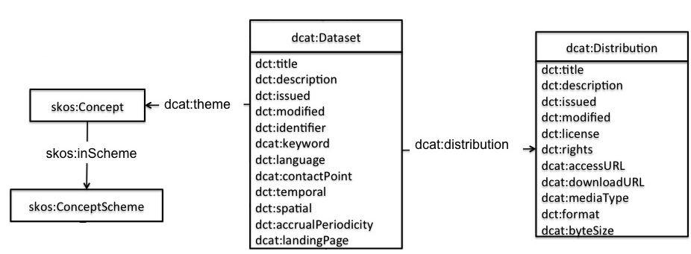
DCAT: Data Catalog
“DCAT is an RDF vocabulary designed to facilitate interoperability between data catalogs published on the Web.”
http://www.w3.org/TR/2013/WD-vocab-dcat-20130801/

Slide 8
PROV-Ontology (PROV-O)
The PROV Ontology (PROV-O) expresses the PROV Data Model using the OWL2 Web Ontology Language (OWL2).
PROV-O conforms to the OWL-RL profile and is lightweight so that it can be adopted in the widest range of applications
Where OWL 2 RL is a syntactic subset of OWL 2 DL.
PROV-O
provides a set of classes, properties, and restrictions
used to represent and interchange provenance information generated in different systems and under different contexts
can also be specialized to create new classes and properties to model provenance information specific to different domain applications
http://www.w3.org/TR/prov-o/

Slide 9
PROV-O Starting Point
Core classes for Starting Point includes
prov:Entity , prov:Activity and prov:Agent
prov:Entity -- is a physical, digital, conceptual, or other kind thing real or imaginary; an entity should have some fixed aspects in order to state some provenance information
prov:Activity -- is something that actually occurred over a period of time
prov:Agent– is something or someone which was responsible for or otherwise associated with what happened in an activity (takes on a role)

Slide 10
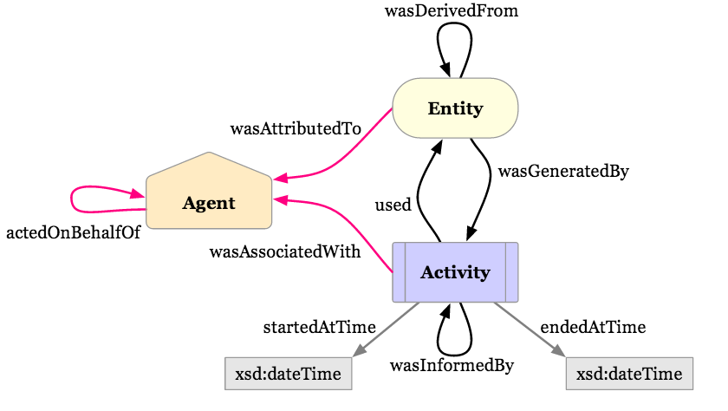
PROV-O Starting Point Depiction

Slide 11
PROV-O Example
We want to capture that a person named Guillermo was associated with a presentation that relied on a set of power point slides.
<prov:Person rdf:about="http://www.semanticweb.org#Guillermo">
<rdf:type rdf:resource="http://www.w3.org/2002/07/owl#NamedIndividual"/>
</prov:Person>
<prov:Entity rdf:about="http://www.semanticweb.org#Power_Point_Slides">
<rdf:type rdf:resource="http://www.w3.org/2002/07/owl#NamedIndividual"/>
<prov:wasAttributedTo rdf:resource="http://www.semanticweb.org#Guillermo"/>
</prov:Entity>

Slide 12
PROV-O Example Cont.
<prov:Activity rdf:about="http://www.semanticweb.org#Provenance_Presentation">
<rdf:type rdf:resource="&owl;NamedIndividual"/>
<prov:startedAtTime rdf:datatype="&xsd;dateTime">2012-07-18T02:00:00+01:00</prov:startedAtTime>
<prov:endedAtTime rdf:datatype="&xsd;dateTime">2012-07-18T02:10:00+01:00</prov:endedAtTime>
<prov:wasAssociatedWith rdf:resource="http://www.semanticweb.org#Guillermo"/>
<prov:used rdf:resource="http://www.semanticweb.org#Power_Point_Slides"/>
</prov:Activity>

Slide 13
PROV-O Generation
http://www.w3.org/TR/prov-implementations/
Currently, 65 implementations
Our experience: PROVoKing (Java)
Table 1: List of implementations reported to the PROV Working Group.
# Name Type PROV Encodings
1 StatJR eBook system Application PROV-O, PROV-JSON
2 PoN Application PROV-N
3 WingsProvenanceExport Application PROV-O
4 Taverna Application PROV-O
5 CollabMap Application PROV-JSON
6 WebLab-PROV Application PROV-O, PROV-N
7 ProvToolbox Framework /API PROV-O, PROV-N, PROV-XML, PROV-JSON

Slide 14
ELSEWeb Data Model
MUST support observation concerns (OBOE)
Example: MODIS measured the Celsius temperature of air in region X at time Y
MUST support acquisition concerns (DCAT)
Example: Dataset A can be downloaded at some URL
MUST support provenance concerns (PROV-O)
MUST be semantic

Slide 15
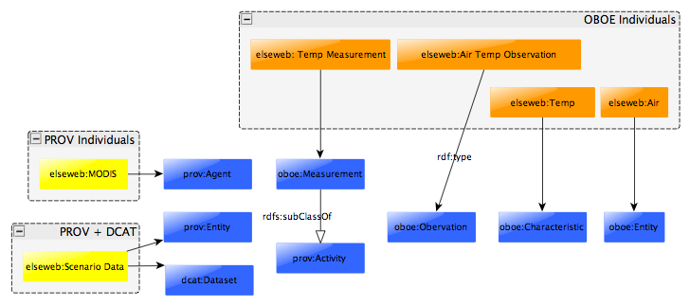
ELSEWeb Data Ontology
Comprised of OBOE, DCAT, and PROV

Slide 16
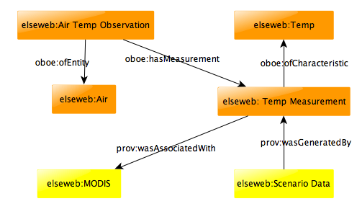
ELSEWeb Data Description Example
The data model provides context of Scenario Data for:
users when selecting input data
SADI when transforming data
Requires elaboration from EDAC side

Slide 17
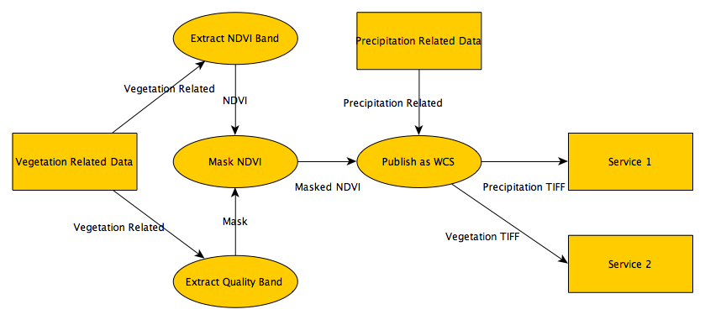
EDAC Data Publishing Data Flow

Slide 18
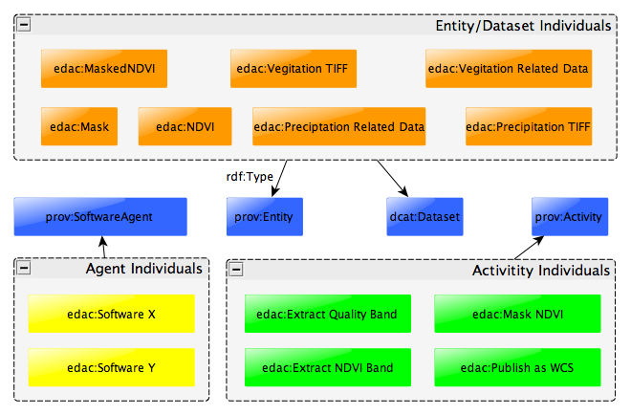
EDAC Data Publishing Ontology

Slide 19
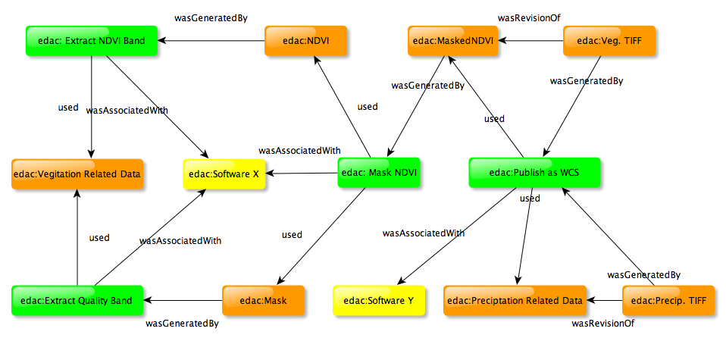
EDAC Data Publishing Trace

Slide 20
EDAC PROV-O Hooks
Where can we expect to get EDAC PROV-O
Is it static or dynamic (from perspective of retrieving data from WCS service)
If static:
FGDC?
getCapabilities?
If dynamic:
WCS payload metadata?
Alternative: leave in database and use DBOWLizer

Slide 21
Resources
Example EDAC PROV-O Trace:
https://raw.github.com/nicholasdelrio/ELSeWeb/master/documents/semantic-web/rdf/ontology/edac-prov.owl

