Slide 1
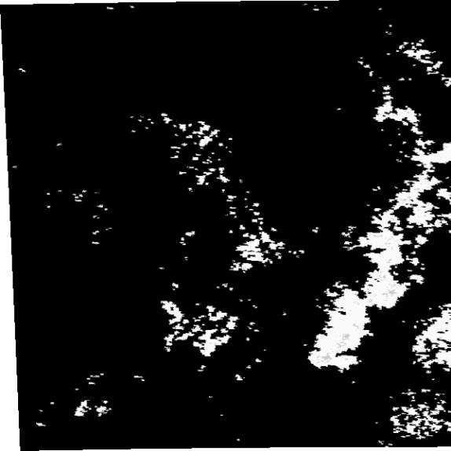
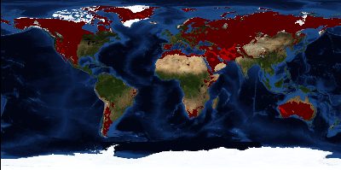



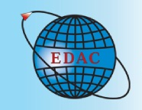


ELSeWeb
Streamlining the Integration of Data Access and Analysis Services
Deana Pennington ● Nicholas Del Rio
Karl Benedict
Paulo Pinheiro
University of Texas at El Paso CYBER-ShARE
ddpennington@utep.edu ndel2@miners.utep.edu
University of New Mexico Earth Data Analysis Center
kbene@edac.unm.edu
Pacific Northwest National Laboratories
Paulo.PinheiroDaSilva@pnnl.gov
Project Goal
Proposed Method
ELSEWEB aims to streamline the flow of highly heterogeneous
geographic, social, and geological data hosted at UNM’s Earth Data Analysis Center (EDAC) into LifeMapper that models potential future species distributions under scenarios of climate change.
The integrated system will provide climate change impact scientists streamlined mechanisms for:
discovering, accessing, understanding, and using Earth observation data, and
integrating those data into environmental models, particularly in the context of environmental impacts on human health and disease.
Develop a semantic layer between scientists and the EDAC/LifeMapper that will:
Convert EDAC OGC service metadata into RDF
Convert LifeMapper service metadata into RDF
Leverage RDF to build SADI EDAC and LifeMapper wrapper services
Translate user experiments requests into SPARQL queries that can be used by a SHARE client to orchestrate SADI service pipelines
Forward results along with provenance
1
2
3
RESULT: an environment where scientists can conduct more complex and realistic computational experiments (IF-THEN-ELSE models) that include multiple parameterizations of changing environments in addition to changing climates
4
5
EDAC
LifeMapper
EDAC hosts a large set of Open Geospatial Consortium (OGC) compliant services, providing a wide range of data for download including:
Environment
Climate
Geology
Land Use/Coverage
Forestry
Water Resources
Vegetation
Cities and Towns
Satellite Imagery
LifeMapper uses both online geospatial species occurrence data along with global climate, terrain, and land cover information to create distribution maps and predict where an individual species should exist.
MaxEnt
Goal 2
openModeller
getCapabilities.xml
service.wadl
experiment.xml
Results.html
Knowledge Base
1
getCapabilities2SADI
2
LifeMapperWADL2SADI
Prov Gen.
3
3
EDAC WCS URLs
5
Goal 1
scenario
SHARE client
EDAC WCS URLs
algorithm selection
parameters
specs2SPARQL
4
occurrence set ID
Develop EDAC/SADI Subsystem
Develop LifeMapper/SADI Subsystem
Develop Provenance Capturing Facilities
experiment-specs.rdf
Results + Provenance
If-Then-Else Analysis
Spring 2013
Summer 2013
Fall 2013
Mental Model Refinement
Experiment Specification Modification
Third Party Technologies
Challenges
OGC WCS Ontology: http://wsmls.googlecode.com/svn/trunk/application/OGC/WCS/0.1/WCS.html
Prov Ontology: http://www.w3.org/TR/prov-o/
SADI Services: http://sadiframework.org/content/getting-involved/what-is-a-sadi-service/
SHARE Service Orchestrator: http://biordf.net/cardioSHARE/
Associated with scenario layers:
Transforming scenario layers into common projection
Adjusting resolution of scenario layers to some common base resolution
Ensuring that scenario layers have common spatial and temporal coverage
Associated with Experiment Specifications:
Developing an interface that allows users to specify experiments
Translating experiment specifications into equivalent SPARQL queries that can be used by the SHARE client to orchestrate pipelines that perform experiment
LifeMapper Requirements
During Fall 2012, we tested manually piping data from EDAC WSC service responses into LifeMapper, which revealed a set of hidden LifeMapper data assumptions:
Data Continuity
Single Banded Data
Non-WCS Response Compliance
Requirement Implications
EDAC hosts a variety of data including discrete categorical data and continuous measurement data. Since LifeMapper can only ingest the latter, our SADI services must have the knowledge needed to discern between the two data types, and not allow the creation of layer sets that include non-compliant data.
Additionally, data from EDAC cannot be directly piped into LifeMapper because the WCS responses from EDAC are enveloped in multi-part MIME messages which LifeMapper cannot process. Therefore, in addition to transforming data into common projections and common resolutions, our system must also extract the TIFF payloads from these multi-part messages.
The material is based upon work supported by award Numbers:
HRD-0734825 (Cyber-ShARE)
HRD-1242122 (Cyber-ShARE)
NASA ACCESS-11-0018: Earth, Life, and Semantic Web (ELSeWeb)
Any opinions, findings, and conclusions or recommendations expressed in this material are those of the author(s) and do not necessarily reflect the views of the National Aeronautics and Space Administration
Notes:
Execution models
Graphics of different workflows
File and db access features
Actor prototyping
Execution environments
Domains
Graphical output features
Website and installer

