Slide 1
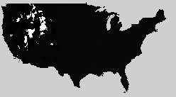
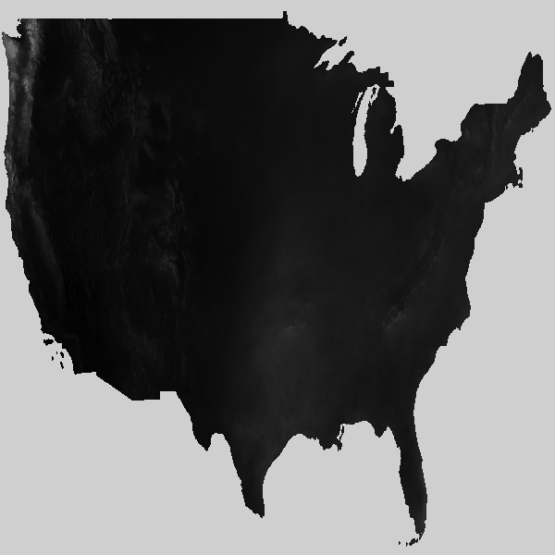
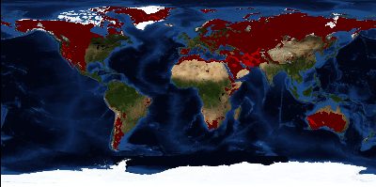




ELSEWeb: Earth Life and Semantic Web
Leveraging Semantic Web to Facilitate Data-to-Model Interactions
Deana Pennington ● Nicholas Del Rio
Karl Benedict
University of Texas at El Paso CYBER-ShARE
ddpennington@utep.edu ndel2@miners.utep.edu
University of New Mexico Earth Data Analysis Center
kbene@edac.unm.edu
Goal
Challenges
To streamline the flow of geographic, social, and geological data hosted at UNM’s Earth Data Analysis Center (EDAC) into LifeMapper, which models potential future species distributions under scenarios of climate change.
Discovery: EDAC houses thousands of datasets described using a family of metadata standards. Isolating target data can be time consuming for non experts
Impact: an environment where scientists can more easily conduct computational experiments (IF-THEN-ELSE models) that include multiple parameterizations of changing environments in addition to changing climates
Transformation: EDAC data must be transformed into Scenario Layer Sets before being ingested by Lifemapper
Provenance: The association of EDAC data with a resulting species prediction models must be persisted for sharing and comparison purposes
Semantic Model
Execution
Provenance
The ELSEWeb ontology extends classes for describing remote sensed data in terms of the Data Catalog Vocabulary (DCAT), Observation Ontology (OBOE) and Provenance Ontology (PROV-O)
EDAC XML metadata is transformed into ELSEWeb compliant RDF by a harvester
A sequence of SADI services is executed that transforms EDAC data to the required form
The SADI services are equipped to capture the input and output RDF using PROV-O. The input and output RDF are grouped into named graphs.
Catalog
dcat:dataset
Dataset
dcat:distribution
Distribution
WCS
FGDC
CF
ISO
rdfs:subClassOf
EDAC employs OGC, FGDC, CF, and ISO to describe data
EDAC Data
Store
PeriodOfTime
dc:temporal
WCSCoverage
dc:spatial
Location
Named Graph
oboe:ofCharacteristic
oboe:measurementFor
dcat:downloadURL
Distribution
Characteristic
Measurement
Observation
ELSEWeb RDF Data Registry
TargetWCS
Coverage
PROVO
rdfs:subClassOf
oboe:ofEntity
DCAT
Activity
Entity
Catalog
OBOE
Class: <experiment:TargetLocation>
EquivalentTo:
(<elseweb:hasLeftLongitude> some xsd:double[>= -126.0])
and (<elseweb.owl#hasLowerLatitude> some xsd:double[>= 23.0])
and (<elseweb.owl#hasRightLongitude> some xsd:double[<= -65.0])
and (<elseweb.owl#hasUpperLatitude> some xsd:double[<= 50.0])
provo:used
Sequence
Activity
Class: <experiment#TargetWCSCoverage>
EquivalentTo:
(<dc:spatial> some <experiment:TargetLocation>)
and (<dc:temporal> some <experiment:TargetPeriodofTime>)
and (<dcat:distribution> some <dcat:Distribution>)
and (<prov:wasGeneratedBy> some <experiment:TargetMeasurement>)
Experiment Descriptions
Sequencer
provo:wasGeneratedBy
TargetWCS
Coverage
Users target modeling input data by specifying OWL class extensions
WCSPayload
Extractor
WCSCoverage
Sequence
Catalog
Dataset
cardioSHARE + Pellet
provo:used
Extraction
Activity
rdfs:subClassOf
rdfs:subClassOf
cardioSHARE reasons with the RDF data to orchestrate service execution plans that satisfy user SPARQL queries
provo:wasGeneratedBy
WCSPayload
WCSCoverage
Sequence
elseweb:dataset 1
TargetWCS
Coverage
Lifemapper
Wrapper
ScenarioLayer
Sequence
rdfs:subClassOf
myGrid:inputParameter
elseweb:dataset n
rdfs:subClassOf
provo:wasDerivedFrom
WCSPayloadExtractor
SADI
ScenarioLayer
Sequence
SpeciesID
Experiment
SADI Service
Registry
myGrid:outputParameter
ELSEWeb
QualifiedExperiment
ScenarioLayer
Sequence
elseweb:payload 1
WCSPayload
provo:used
Lifemapper
Activity
elseweb:payload n
SADI Web services are described in terms of input and output OWL classes, which is used by the cardioSHARE client to automatically orchestrate service execution plans. Above is an example of a service that extracts the TIFF payload from WCS response messages and constructs ScenarioLayerSequences suitable for Lifemapper ingestion.
provo:wasDerivedFrom
Model
elseweb:hasModelURL
Completed
Experiment
Third Party Technologies
Output Lifemapper Model
OGC WCS Ontology: http://wsmls.googlecode.com/svn/trunk/application/OGC/WCS/0.1/WCS.html
Prov Ontology: http://www.w3.org/TR/prov-o/
SADI Services: http://sadiframework.org/content/getting-involved/what-is-a-sadi-service/
SHARE Service Orchestrator: http://biordf.net/cardioSHARE/
Results
During Fall 2012, we tested manually piping data from EDAC WSC service responses into LifeMapper, which revealed a set of hidden LifeMapper data assumptions:
Data Continuity
Single Banded Data
Non-WCS Response Compliance
The material is based upon work supported by award Numbers:
HRD-0734825 (Cyber-ShARE)
HRD-1242122 (Cyber-ShARE)
NASA ACCESS-11-0018: Earth, Life, and Semantic Web (ELSeWeb)
Any opinions, findings, and conclusions or recommendations expressed in this material are those of the author(s) and do not necessarily reflect the views of the National Aeronautics and Space Administration
Notes:
Execution models
Graphics of different workflows
File and db access features
Actor prototyping
Execution environments
Domains
Graphical output features
Website and installer

