Slide 1
Nicholas Del Rio
Natalia Villanueva-Rosales
Deana Pennington

Slide 2
Outline
Background
OBOE
PROV Data Model (Graphical + actual RDF from slides)
ELSEWeb Scenario Data Model
EDAC
Data publishing Process (extracted from SAW)
Describe publishing process in PROV (my interpretation)
PROV and Example RDF
Where can we expect to get EDAC prov (e.g., in FGDC, getCapabilities, WCS payload metadata?)
Alternative: leave in database and use dbowlizer.
How to generate it: Provo King

Slide 3
OBOE: Observational Ontology

Slide 4
DCAT: Data Catalog

Slide 5
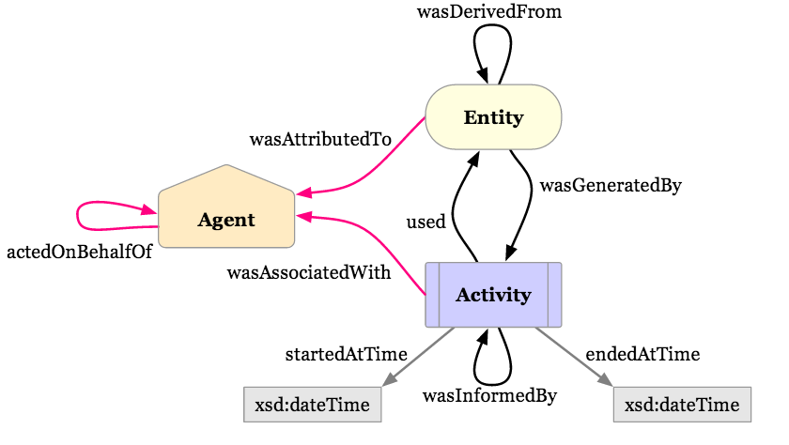
PROV Data Model

Slide 6
ELSEWeb Data Model
What is the data about?
OBOE: Observation Ontology
Where can I get the data?
DCAT: Data Catalog Vocabulary
How was the data generated?
Who was responsible for publishing?
When was it generated?
PROV-O: Provenance Ontology

Slide 7
ELSEWeb Data Model
oboe:Observation
oboe:Characteristic
oboe:ofEntity
oboe:hasMeasurement
oboe:ofCharacteristic
NOTE: add sources (e.g., MODIS)
oboe:Entity
oboe:Measurement
rdfs:subClassOf
prov:wasGeneratedBy
prov:Activity
dcat:Dataset
prov:wasAttributedWith
prov:Agent
EDAC Opportunity: Expand on how the dcat:Dataset (i.e., WCS Coverage Data) is really generated.

