Slide 1
ELSEWeb meets SADI

Slide 2
Outline
Model Generation on the Web
ELSEWeb Approach
Describing Data and Adaptor Services
Automated Discovery, Transformation, and Generation
Provenance

Slide 3
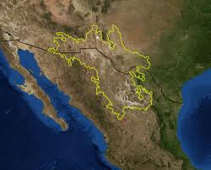
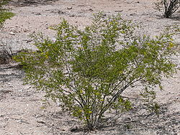
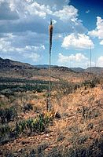
Chihuahuan Desert
Region: Northern Mexico, West Texas and Southern New Mexico
Terrain: Basins and Mountain Ranges
Climate: Mild Summer (35 – 40° C)
Flora:
Larrea Tridentata
Observation: Over the past 100 years, the Chihuahuan desert has encroached on existing grasslands, resulting in altered erosion patterns and thus an altered landscape.
Agave lechuguilla
Notes:
More informative title!!!! For example: the semantics of the scientific question

Slide 4
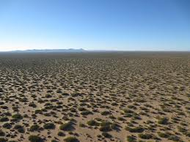
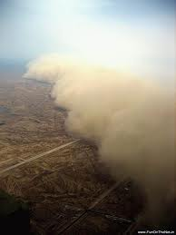
A Complex Chain of Events
Sparse vegetation of the Chihuahuan desert
Dust storms containing allergens such as fungus
Sparse vegetation of mesquite shrubs leads to altered erosion patterns, creating an environment suitable for dust storms.
Notes:
Get high resolution pics from Fransca from viz wall. Get them from Frank ☺ Possible video, test to see if works. Be sure to give credit

Slide 5
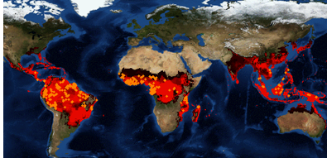

Scientific Inquiries
If we move to hotter climates with more variable precipitation, will we get further encroachment in the desert?
Will we get more erosion?
Will we get higher flood events?
Biodiversity Forecasting can provide insight:
“I want to model the transition from Chihuahua desert to biome X (probably steppe), during historic regions of drought”
Notes:
List all people at teams: lifemapper, edac, and UTEP. Include all people even non-authors. Introduce in the beginning with logos and picture of peoples.

Slide 6
Challenges: A Loaded Request
2
Denotes a duration of time encompassing a set of relevant environmental data (discovery)
Data Integration, transformation, and execution
1
3
The Chihuahuan desert is not defined solely by geographic coordinates; it is partially defined by its migrating flora (interpretation)
“I want to model the transition from Chihuahua desert to biome X (probably steppe), during historic periods of drought”
4
Drought denotes an event, that contextualizes a set of geospatial data within some space/time (interpretation)
Notes:
Identify the current and future work, perhaps by highlights. This is a work in progress, but we have some initial results for (1). This is achalleng that evolves but we are addressing the particular grant with was targeted with 1.

Slide 7

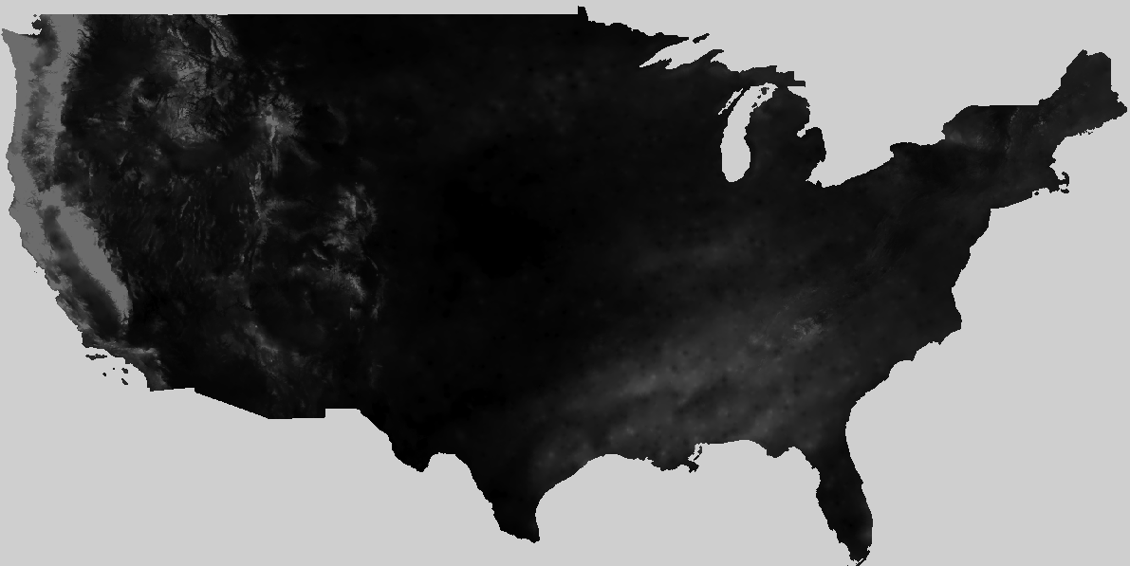
Challenges
Data Discovery:
Distributed throughout the Web
Non-uniform descriptions
Non-uniform formats
How can we aggregate and transform the data to fit Lifemapper Requirements
Where do we find relevant data?

Slide 8
Goal: ELSEWeb
The Earth, Life, and Semantic Web (ELSEWeb)
semantically-enabled service oriented environment
supporting Data-to-Model interactions
streamline the flow of heterogeneous geographic, social, and geological data into Lifemapper
Notes:
Show some semantic Web details: RDF, sparql, etc.

Slide 9
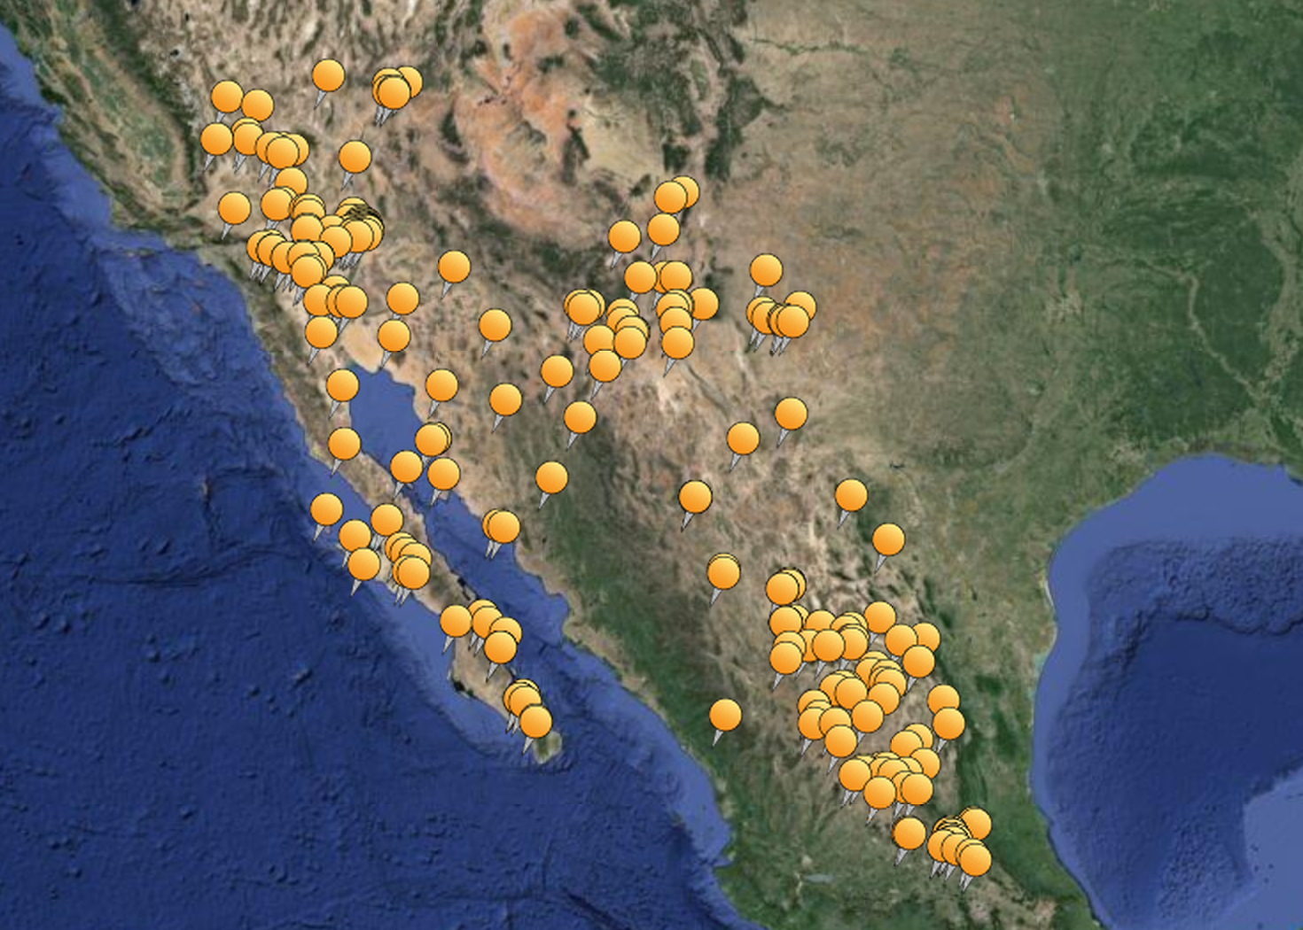
Lifemapper Model Generation

Slide 10
Earth Data Analysis Center

Slide 11
Lifemapper Data Requirements
Notes:
Visualization discussion and future work. Get from Paper and elaborate.

