Slide 1

Memory-R1: Enhancing Large Language Model Agents to Manage and Utilize Memories via Reinforcement Learning
——LLMs Forget. Memory-R1 Learns to Remember and Use! Presenter: Sikuan Yan
作者：Sikuan Yan, Xiufeng Yang, Zuchao Huang, Ercong Nie, Zifeng Ding, Zonggen Li, Xiaowen Ma, Kristian Kersting, Jeff Z. Pan, Hinrich Schütze, Volker Tresp, Yunpu Ma
机构：慕尼黑大学、慕尼黑机器学习中心、慕尼黑工业大学、剑桥大学、香港大学、 达姆施塔特工业大学、爱丁堡大学

Slide 2
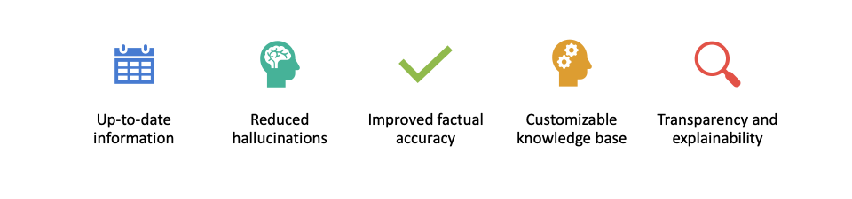
Why Do We Need Retrieval-Augmented Generation?
Limitations of vanilla LLMs (e.g. hallucination, lack of up-to-date info)
Need for grounding LLMs in external knowledge (LLM needs to know company confidential info during inference)
Explainability, flexibility & more

Slide 3
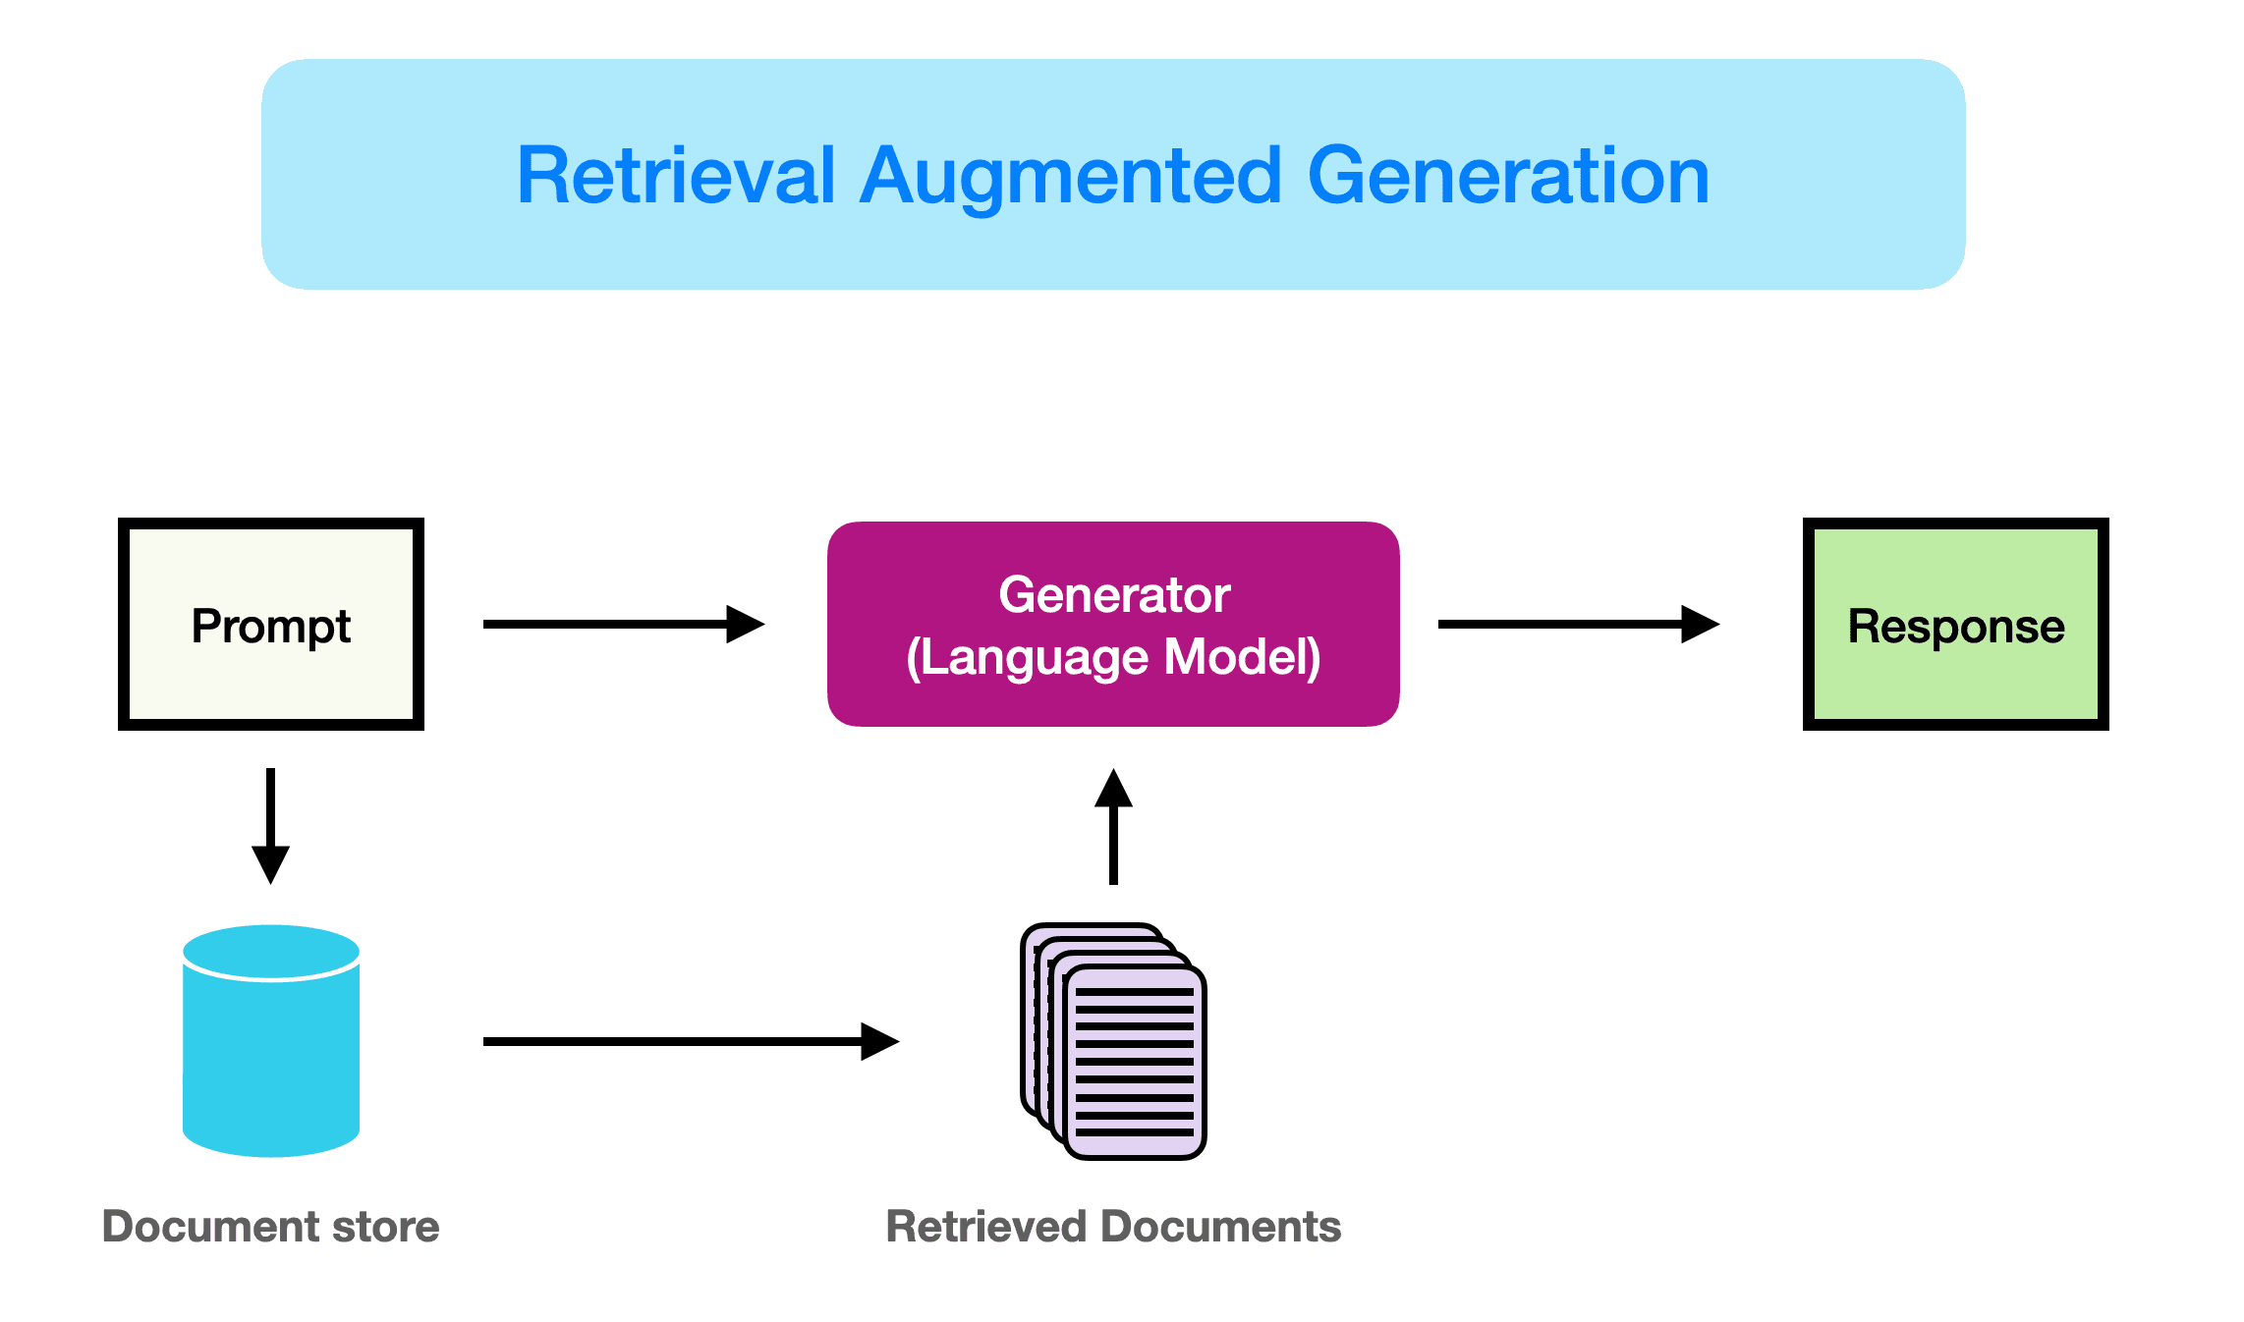
What is Retrieval-Augmented Generation (RAG)?
Short definition: "A hybrid approach that combines retrieval and generation"
RAG = Retrieval + Generation
Figure: Pipeline of RAG technique

Slide 4
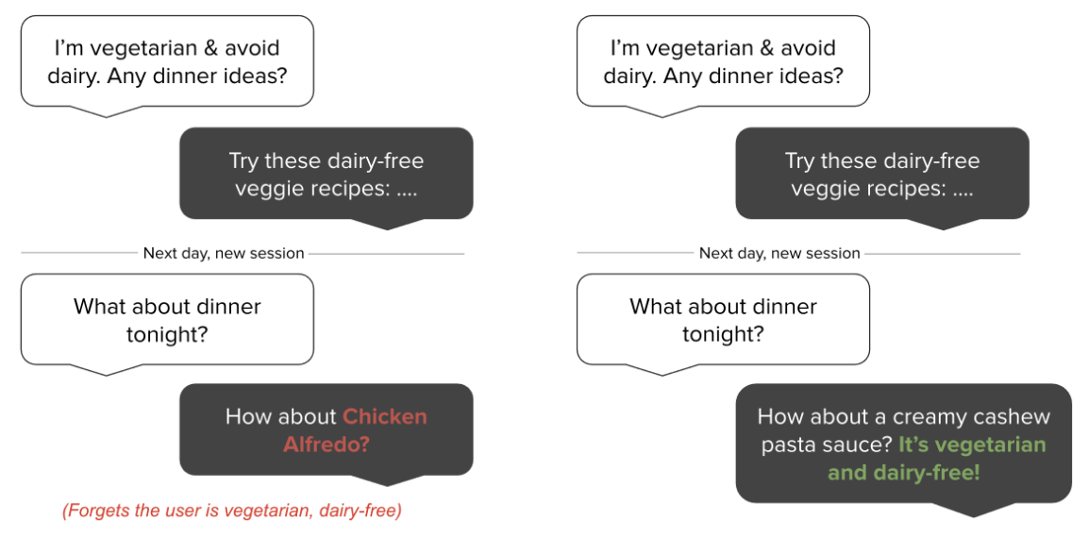
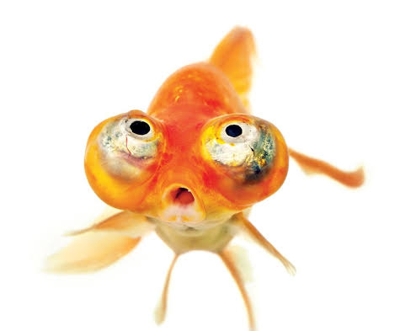
Beyond RAG: Toward Intelligent Memory Systems
Why memory matters?
Without Memory
  LLM/Agent is stateless
  Analogy to humans: Without memory, continuous learning, adaptation, and reasoning are impossible.
E.g., forgetting users, repeating answers, inability to handle multi-turn conversations
Figure: Comparison of Stateless LLM vs Memory-Augmented LLM in remembering user dietary needs

Slide 5
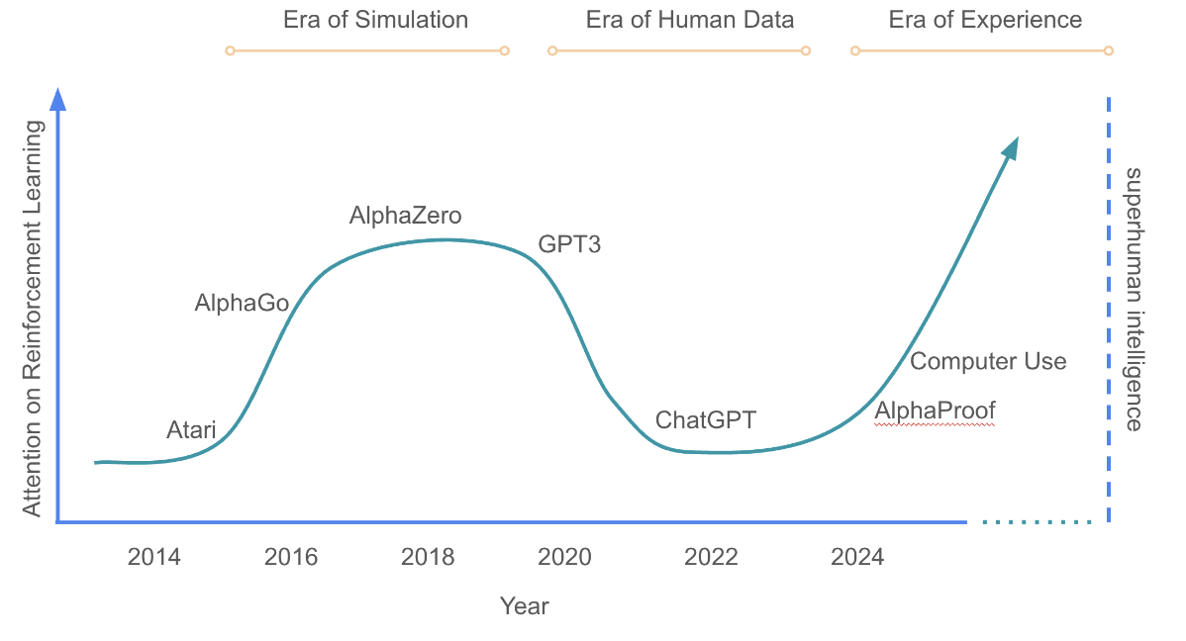
Why Memory Matters?
Humans
Learn from past problem-solving
Improve efficiency & accuracy over time
LLM Agents (today)
Do not retain experience
Restart from scratch every query
Era of Experience (Proposed by David Silver, Richard S. Sutton)
Beyond simulation & human data
Agents that remember, adapt, and improve with use
“The era of experience marks a pivotal moment in the evolution of AI. Building on today’s strong foundations but moving beyond the limitations of human-derived data, agents will increasingly learn from their own interactions with the world. Agents will autonomously interact with environments through rich observations and actions. They will continue to adapt over the course of lifelong streams of experience. Their goals will be directable towards any combination of grounded signals.”
Figure: Evolution of AI — from Simulation & Human Data to the Era of Experience

Slide 6
Beyond RAG: Toward Intelligent Memory Systems
RAG-Augmented LLMs | Memory-Augmented LLMs
Retrieve static external knowledge | Maintain dynamic, agent-specific memory
Stateless generation per query | Stateful reasoning across time
Query-based document recall | Experience-based task adaptation
Fixed retriever + generator pipeline | Learnable memory usage & update policies
Table: Comparison of RAG and Memory

Slide 7
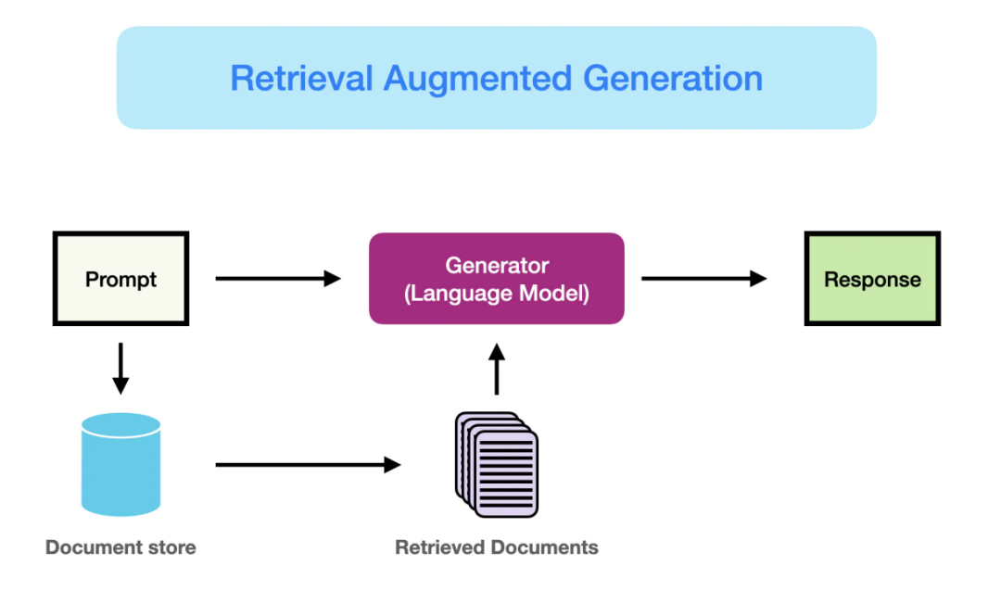
Mainstream Architectures (1): Vector Database-Based Information Retrieval & Generation
Principle
Retrieve external knowledge (docs, DBs) → generate with context
Combines information retrieval + language modelling
Workflow
User inputs query q
Embedding retriever finds similar docs D(q) (e.g., FAISS)
LM generates response using [q, D(q)]
Representative Systems
RAG (Facebook, 2020)
LoCoMo (Snap, 2024)
Emerging: DeepRetriever (2025) → better query–doc matching
Pros
Scalable
Knowledge easily updatable
Strong interpretability
Cons
Dependent on retrieval quality
No mechanism for long-term memory updates
retrieval encoder
reranker
retriever
Figure: Pipeline of RAG technique

Slide 8
Mainstream Memory Architectures (2): Memory-Augmented Interactive Agents
Principle
Manage memory lifecycle → give LLMs durable internal memory
Memory operations depend on model behaviour + context
Core Mechanisms
Long-term & short-term memory modules
Read/Write control
Rule-based or heuristic-driven Memory Controller
Representative Systems
MemGPT (2023)
Mem0 (2025)
A-Mem (2025)
Pros
Enables long-term memory with contextual consistency
Supports multi-turn dialogue & task tracking
Cons
Memory conflicts & redundancy
Forgetting risks
Working memory degrades if retrieval is poor
Figure: Pipeline of MemGPT

Slide 9
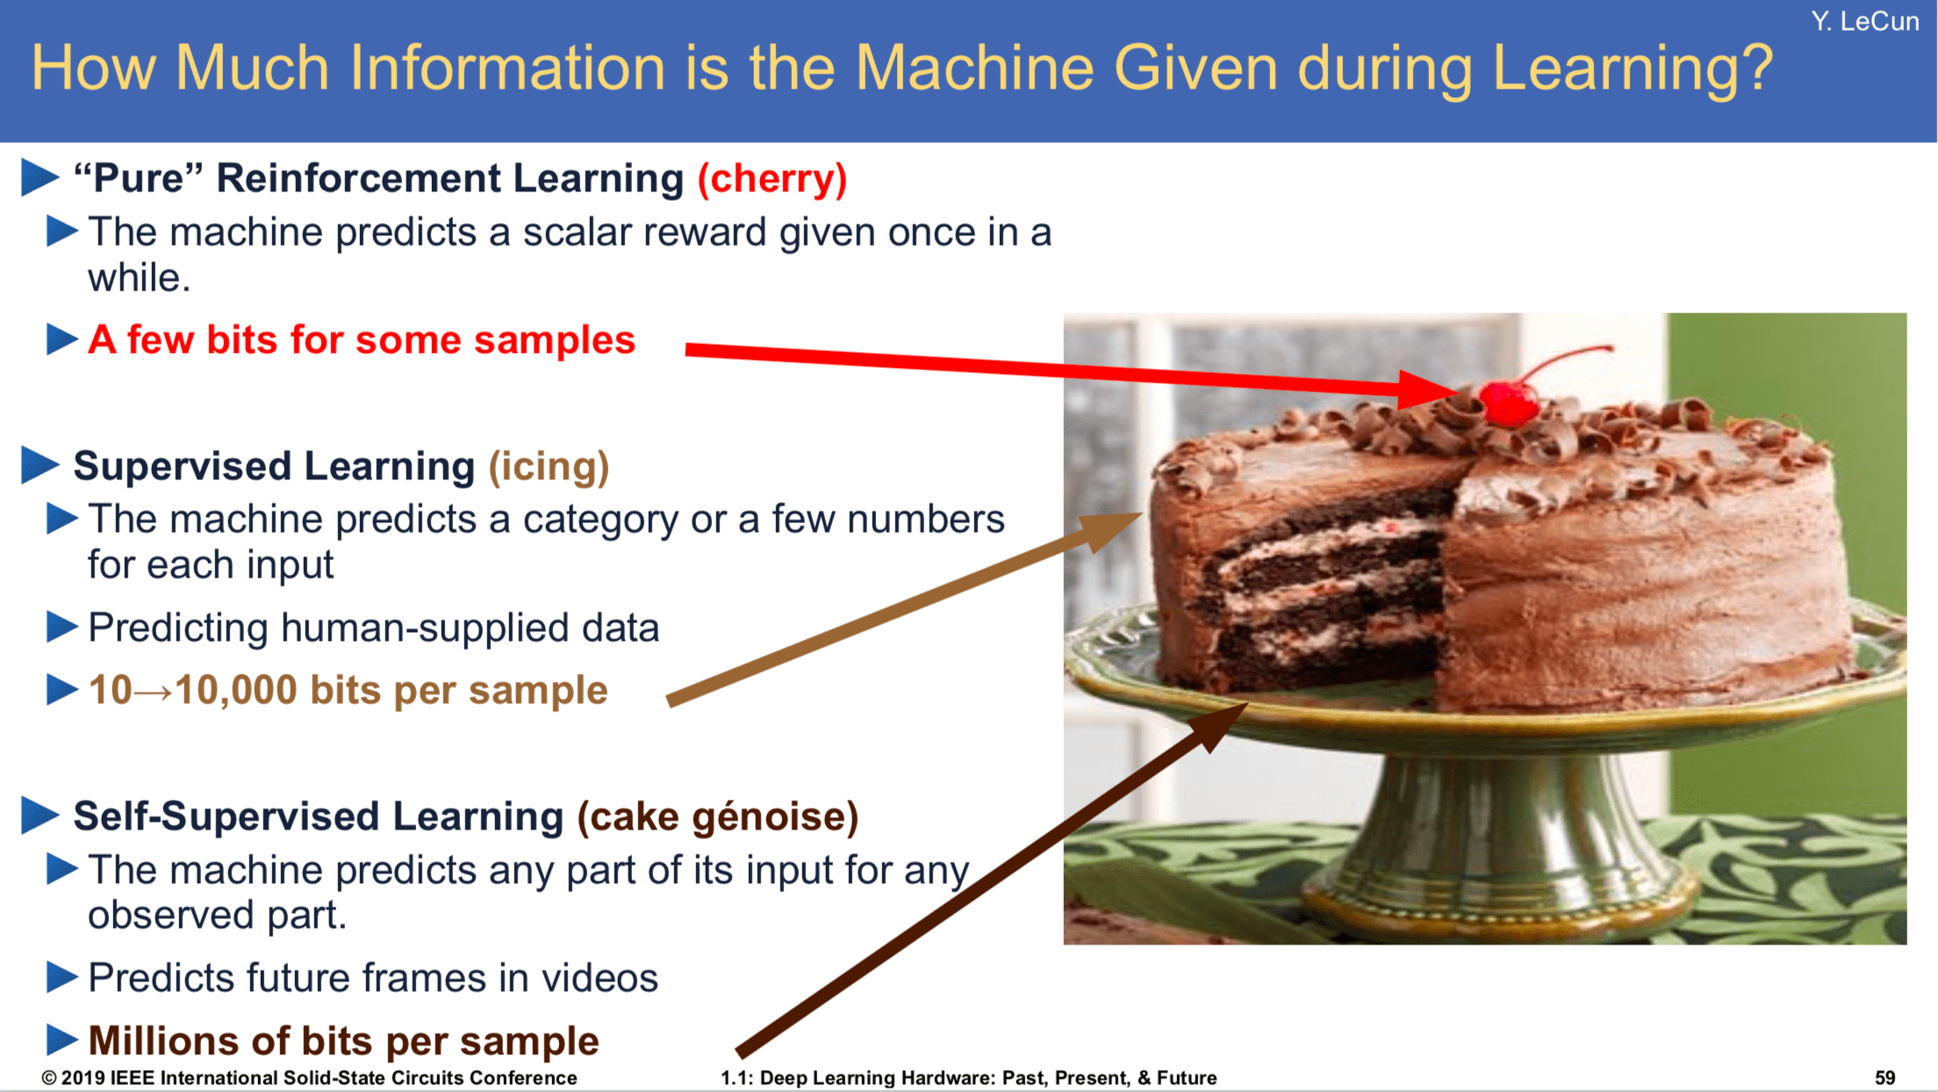
Reinforcement Learning as Cherry on Cake (by Yann LeCun)
Notes:
Think of today’s foundation models as a beautifully baked cake—rich pre-training on massive data gives you flavor and structure. But no matter how tasty the cake is, you still need that last flourish to make it shine: that’s exactly what reinforcement learning does. RL is the cherry on top—it lets your agent learn from its own trial-and-error, to fine-tune behaviors, recover from mistakes, and continuously improve in environments it’s never seen before. In a 6G world of billions of interacting agents, that ability to adapt on-the-fly from sparse rewards will be the true game-changer.

Slide 10
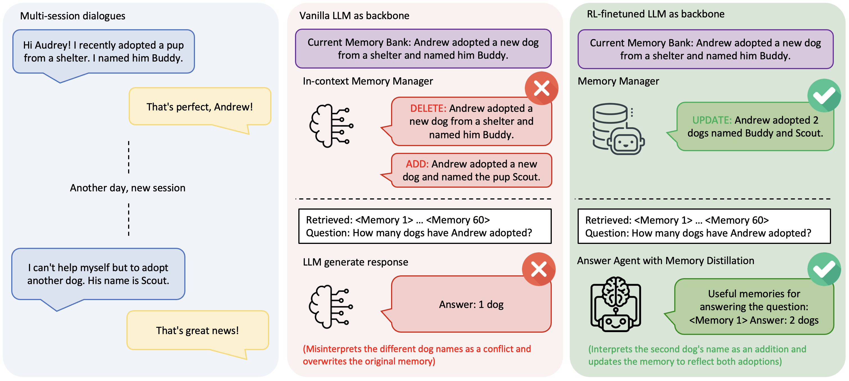
Motivation of Memory-R1
Challenges of current external memory system
Memory Manager
  Prompt LLM to make decisions on Memory
  Operations: {ADD, UPDATE, DELETE, NOOP}
  Rely on static, heuristic-driven approach
Answer Agent
  RAG relies on a fixed top-k retrieval strategy
  Small k -> risk of missing crucial information
  Large k -> context flooded with irrelevant
  information, leading to distraction and degradation
Training challenges
  No single “best” rule for memory operations
  Memory usefulness depends on context & downstream tasks
  Hard to handcraft optimal strategies
“External knowledge base”
“Reranker”
Figure: Comparison of vanilla LLM vs Memory-R1--heuristic approach fails, RL-enhanced approach correctly update memory
Solution: Using Reinforcement Learning (RL) to enable adaptive memory management and selective utilization

Slide 11
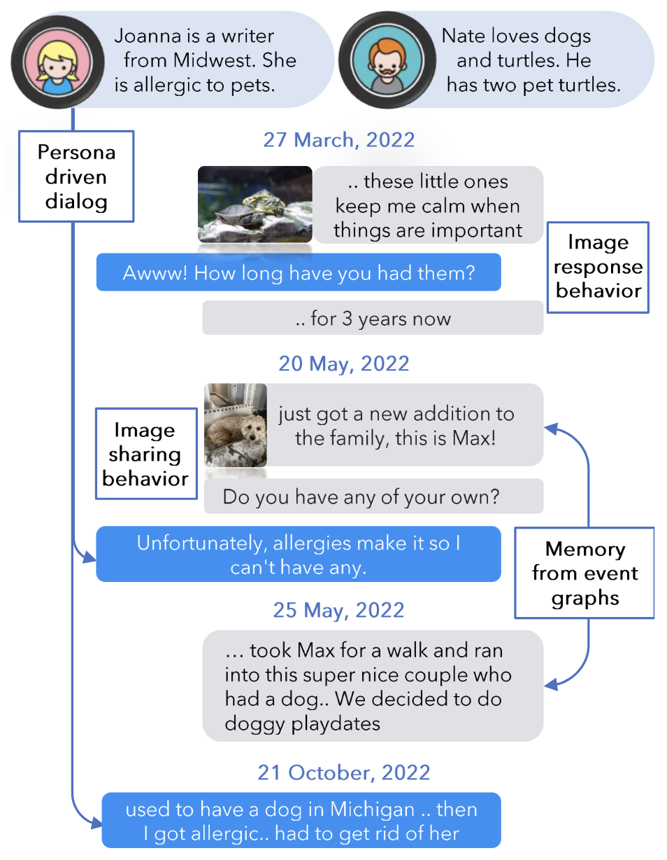
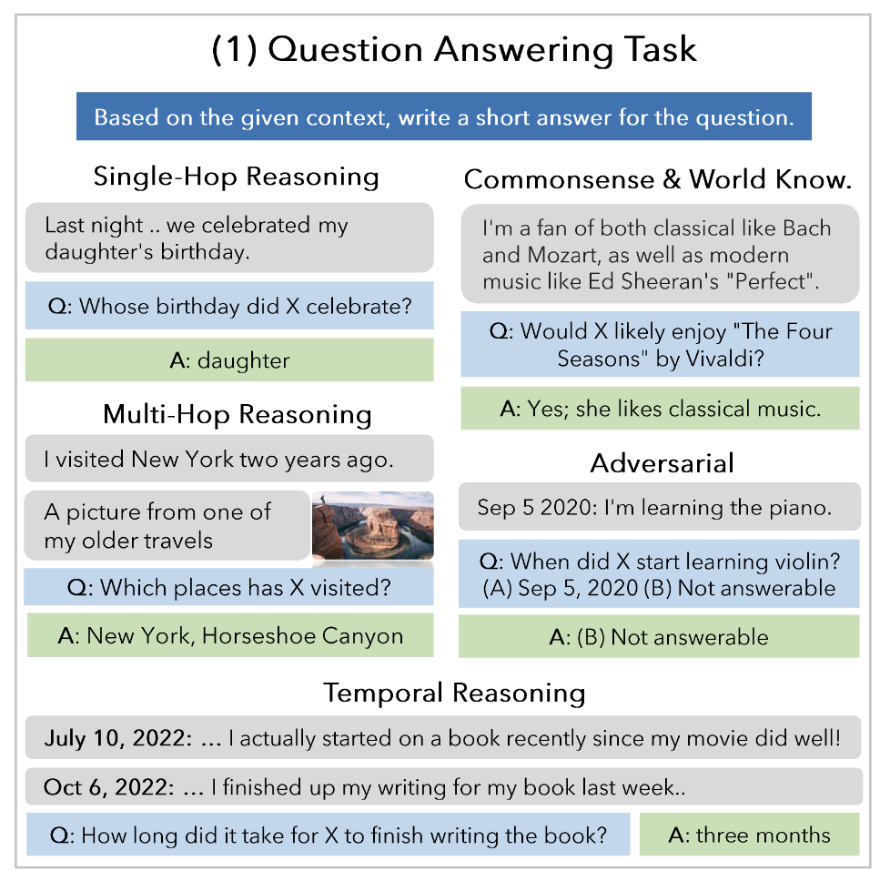
Problem Formulation
Figure: Example dialogues and questions from LoCoMo dataset
Setting:
Multi-session dialogues
Facts spread across distant turns
External memory needed for QA
Goal:
Adaptive memory management (Memory Manager)
Selective memory utilization (Answer Agent)
Core Challenge:
Go beyond heuristics & fixed top-k retrieval
RL to optimize memory ops & answer correctness
Questions can only be answered with information from the dialogues

Slide 12
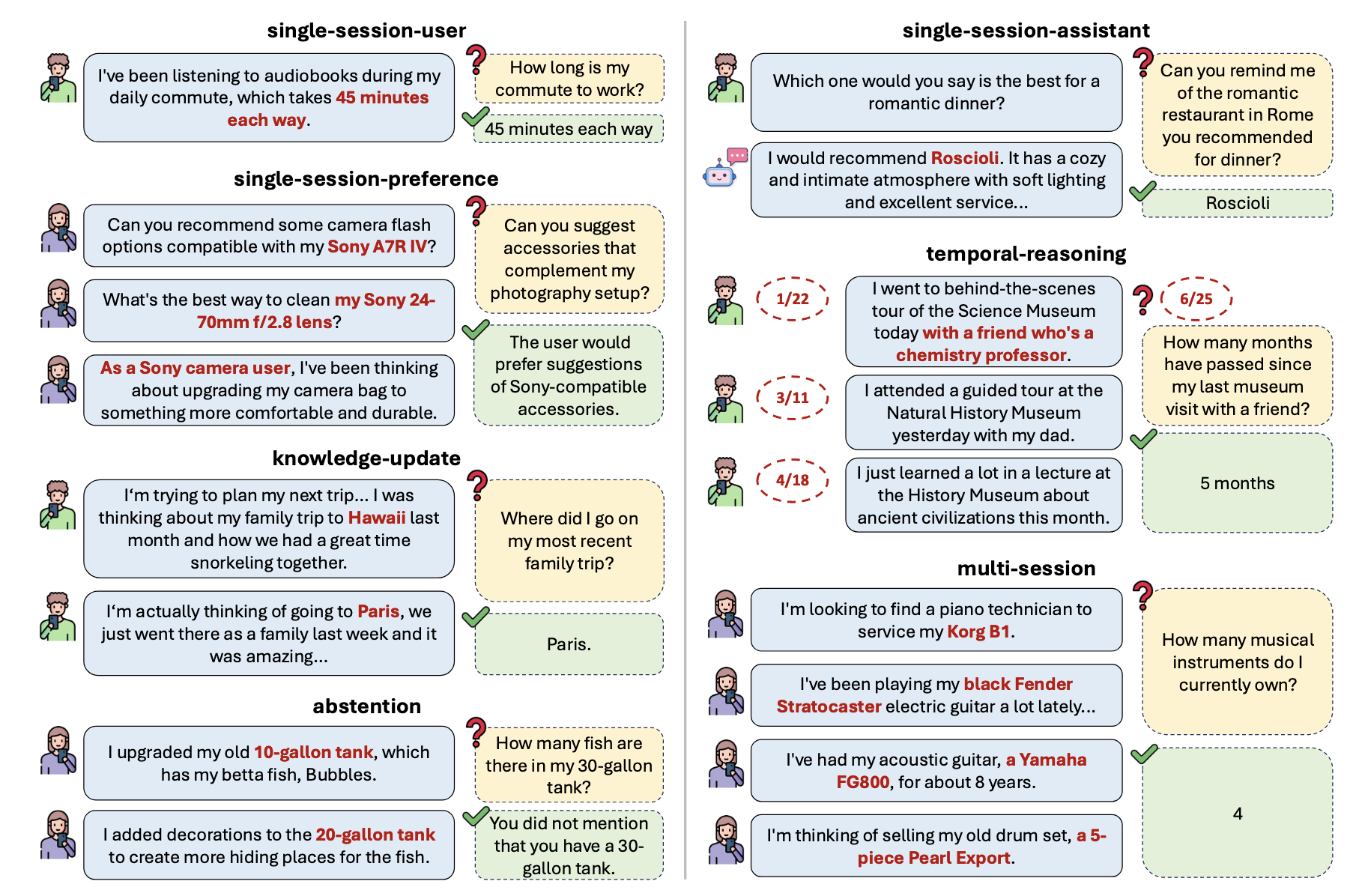
Dataset
LoCoMo:
Published by Snap
Types: Single-Hop Reasoning, Multi-Hop Reasoning,
Commonsense & World Know., Adversarial, Temporal Reasoning
10 dialogues + 1540 QA
MSC-self-instruct:
Published by MemGPT, derived from Multi-Session Chat (MSC) dataset.
Memory Retrieval QA – user asks about past details
(“What city did I visit last month?”).
500 dialogues + 500 QA
LongMemEval
Information Extraction (IE), Multi-Session Reasoning (MR),
Knowledge Updates (KU), Temporal Reasoning (TR), Abstention (ABS)
500 dialogues + 500 QA
Figure a: LoCoMo dataset
Figure b: MSC-self-instruct dataset
Figure c: LongMemEval dataset

Slide 13
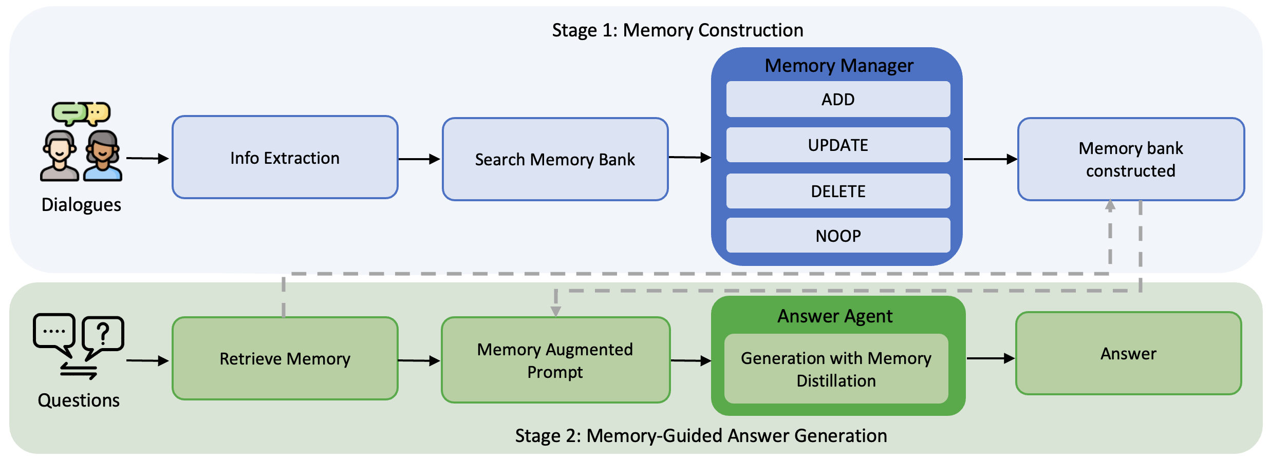
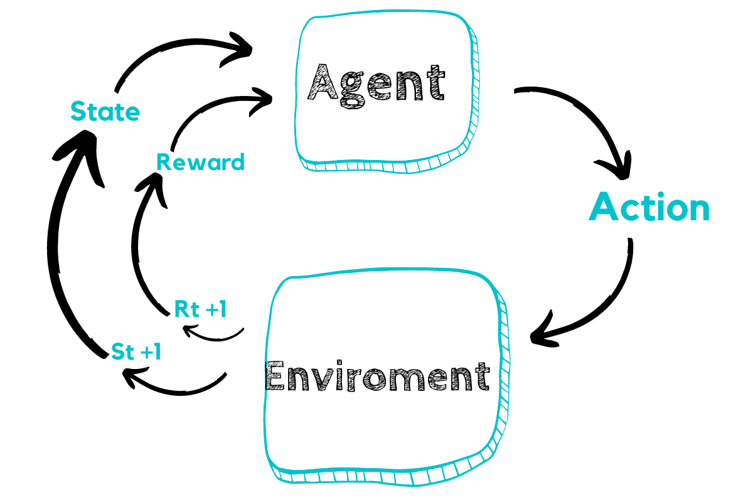
Pipeline
Stage 1: Memory Construction
Extract key info from dialogues
Memory Manager → {ADD, UPDATE, DELETE, NOOP}
Build & evolve memory bank
Stage 2: Memory-Guided Answer Generation
Retrieve candidate memories (30 from each candidate)
Answer Agent with Memory Distillation
Generate accurate answers
Figure: Overview of Memory-R1 framework
Formulate memory management & utilization into a Reinforcement Learning problem!

Slide 14

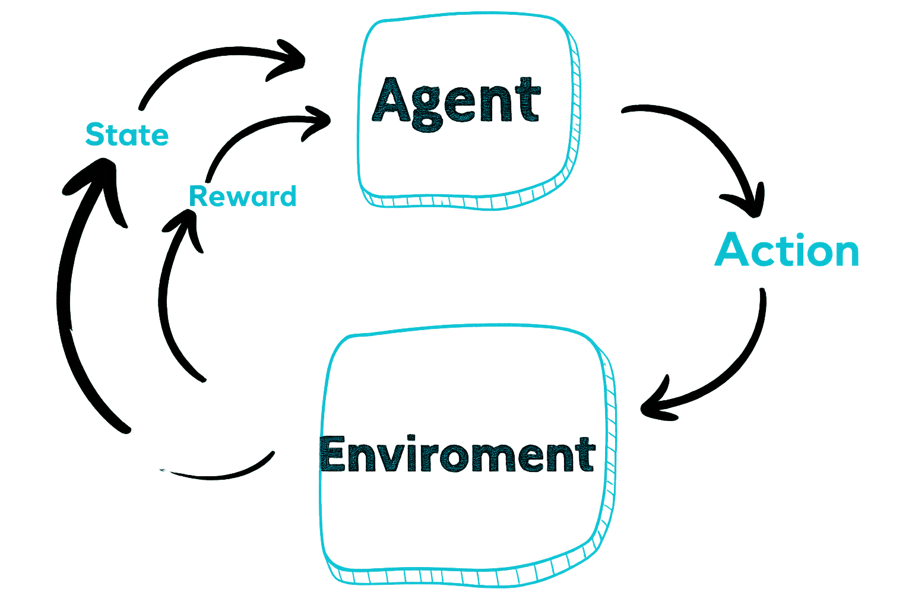

Memory-R1 Training Pipeline
Memory Manager
Memory bank
+ new fact
Answer correctness
Memory Manager
Input: dialogue turns + memory bank + QA pairs
Output: memory operation {ADD, UPDATE, DELETE, NOOP}
Training Signal: answer correctness after update
Reward: indirect (via Answer Agent’s success)
Optimization: PPO / GRPO
Answer Agent
Input: question + retrieved memories
Output: distilled memories → final answer
Training Signal: answer correctness vs ground truth
Reward: direct (exact match)
Optimization: PPO / GRPO
Memory operation
Memory system
Figure: Training pipeline of Memory Manager
Answer Agent
Retrieved memories + Question
Answer correctness
Memory distillation + answer
Memory system
Figure: Training pipeline of Answer Agent

Slide 15
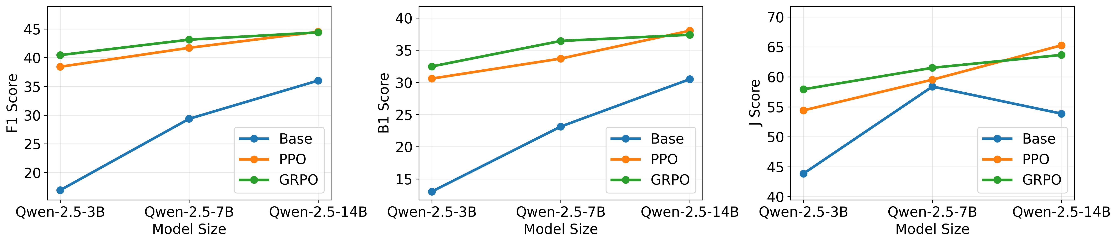
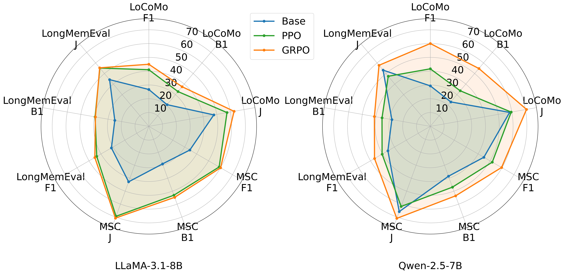
Experiments
Data-Efficient Training!
Benchmark
Dataset: LoCoMo
Split: 1 train (152 QA), 1 val (81 QA), 8 test (1,307 QA)
Backbones: LLaMA-3.1-8B-Instruct,
Qwen-2.5-3,7,14B-Instruct
Main Results (Table a)
Memory-R1 sets new SOTA across both backbones
Relative improvements on LLaMA:
  +69% F1, +48% BLEU-1, +37% LLM-as-Judge
Relative improvements on Qwen:
  +57% F1, +41% BLEU-1, +34% LLM-as-Judge
Scalability (Figure b)
Consistent Scaling: Memory-R1 shows consistent gains as model size.
Stable RL Performance \ Backbone-Independent:
Improvement trend holds across different backbones (Qwen-2.5 family).
Generalization (Figure c)
Zero-shot Generalization:
Trained only on LoCoMo, yet performs well on MSC & LongMemEval.
Cross-domain Robustness:
Maintains strong results across reasoning types (single-hop, temporal, etc.).
a) Overall benchmark
b) Scalability across different model sizes
c) Generalization analysis across LoCoMo, MSC, and LongMemEval

Slide 16
Experiments
Data-Efficient Training!
Benchmark
Dataset: LoCoMo
Split: 1 train (152 QA), 1 val (81 QA), 8 test (1,307 QA)
Backbones: LLaMA-3.1-8B-Instruct,
Qwen-2.5-3,7,14B-Instruct
Main Results (Table a)
Memory-R1 sets new SOTA across both backbones
Relative improvements on LLaMA:
  +69% F1, +48% BLEU-1, +37% LLM-as-Judge
Relative improvements on Qwen:
  +57% F1, +41% BLEU-1, +34% LLM-as-Judge
Outperforms BC-based SFT even when trained with
GPT-5 supervision
Figure: Overall benchmark

Slide 17
Experiments
Scalability (Figure b)
Consistent Scaling: Memory-R1 shows consistent gains as model size.
Stable RL Performance \ Backbone-Independent:
Improvement trend holds across different backbones (Qwen-2.5 family).
Generalization (Figure c)
Zero-shot Generalization:
Trained only on LoCoMo, yet performs well on MSC & LongMemEval.
Cross-domain Robustness:
Maintains strong results across reasoning types.
Figure a) Scalability across different model sizes
Figure b) Generalization analysis across LoCoMo, MSC, and LongMemEval

Slide 18
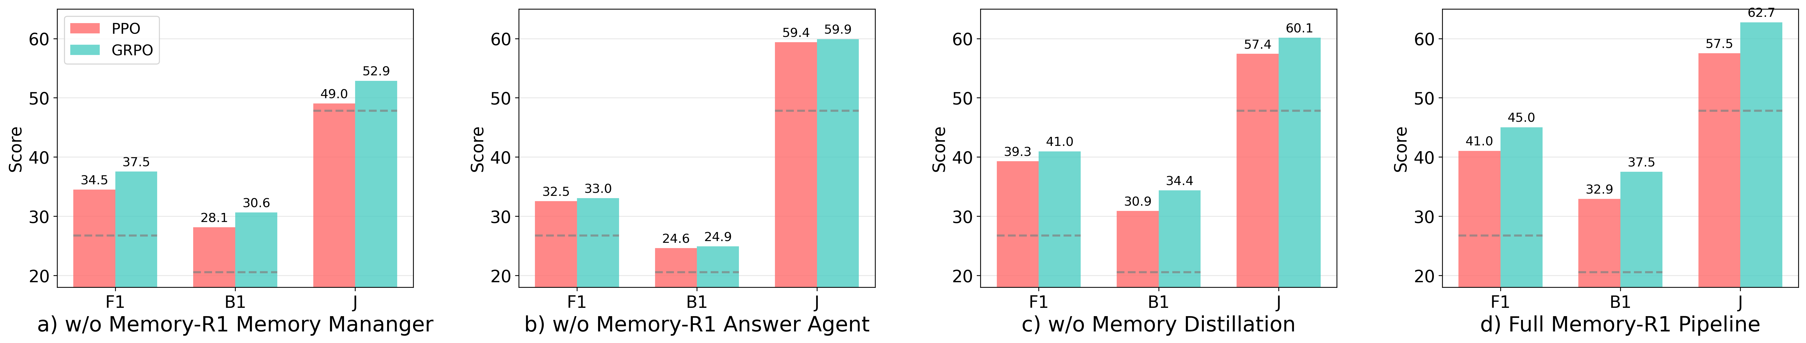
Ablation study
Each Component Helps!
Figure a: Memory Manager (RL > heuristic)
Figure b: Answer Agent (RL > baseline)
Figure c: Memory Distillation (fewer noisy memories → better QA)
Figure d: Full Pipeline

Slide 19
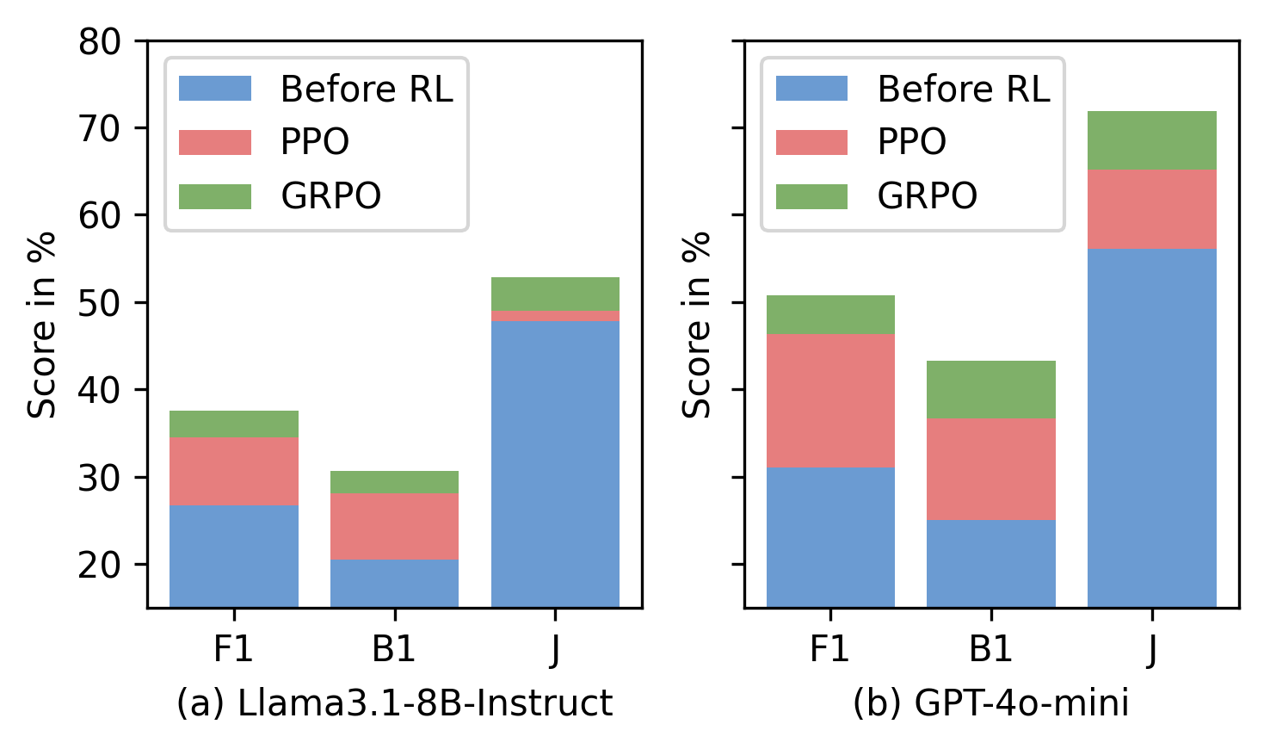
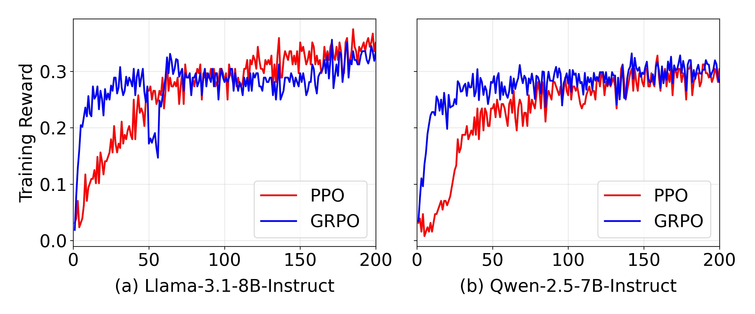
Discussion / Insights
Answer Agent Synergy:
Gains are larger when paired with a stronger Memory Manager
Reward Design Choice Comparison
LLM-as-Judge reward → higher J score but generates longer, verbose answers
Exact Match (EM) reward → more balanced across F1, BLEU-1, and J
Trade-off insight: choosing reward function impacts model behaviour
- optimizing for semantic richness vs precision and conciseness
RL Algorithm Comparison:
GRPO converges faster than PPO
Both PPO & GRPO outperform baseline
Adaptive Learning & Generalization:
Learns memory operations from experience, scales efficiently across model
sizes, and generalizes zero-shot to unseen datasets
RL Efficiency:
With only 152 QA pairs, Memory-R1 achieves large improvements
showing strong data-efficiency
Figure a: Answer Agent potential with more powerful Memory Manager
Figure b: Answer Agent potential with more powerful Memory Manager
Figure c: Training convergence comparison

Slide 20
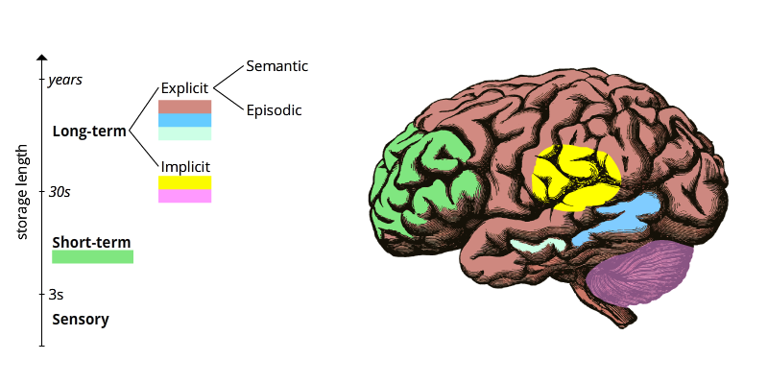
Limitations & Future work
Limitations
Benchmarks (e.g., LOCOMO) limited in scale & diversity
No dataset for evaluating memory ops {ADD, UPDATE, DELETE, NOOP}
System depends on QA supervision
Supports only one memory type (no separation of episodic, semantic, procedural, etc.)
Text only (no multimodal support yet)
Future Work
Build memory-centric datasets
Incorporate different memory types (episodic, semantic, procedural, and etc.)
Extend to multimodal memory (text + images + audio)
Apply to real-world domains

Slide 21
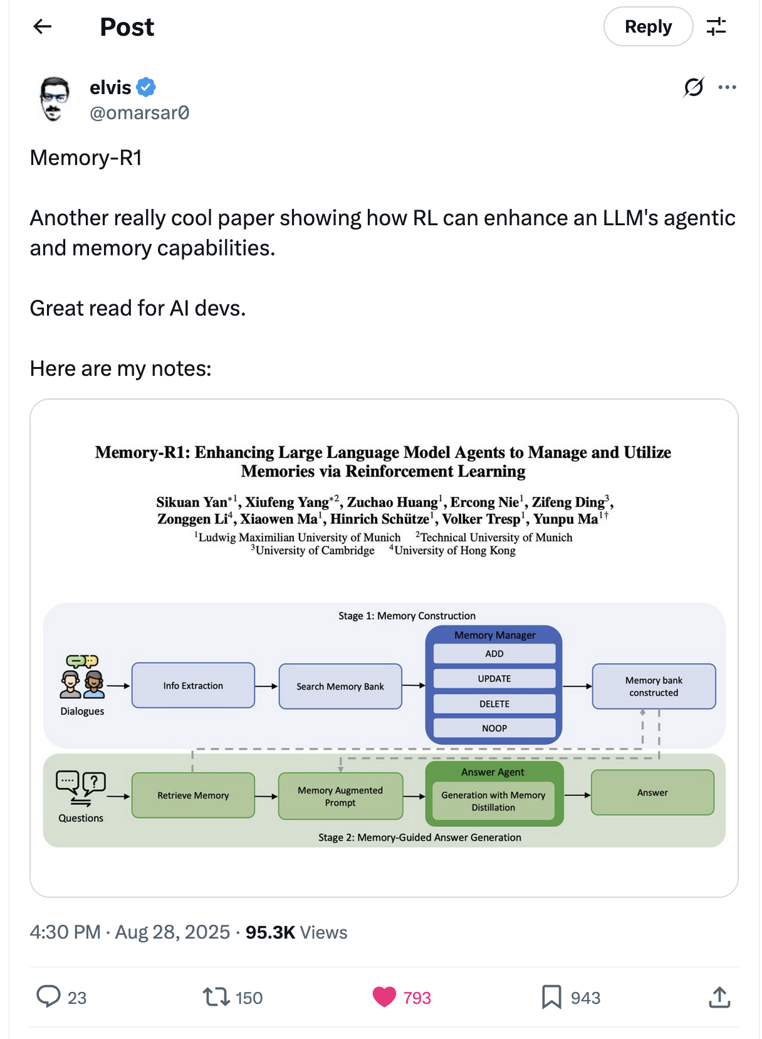

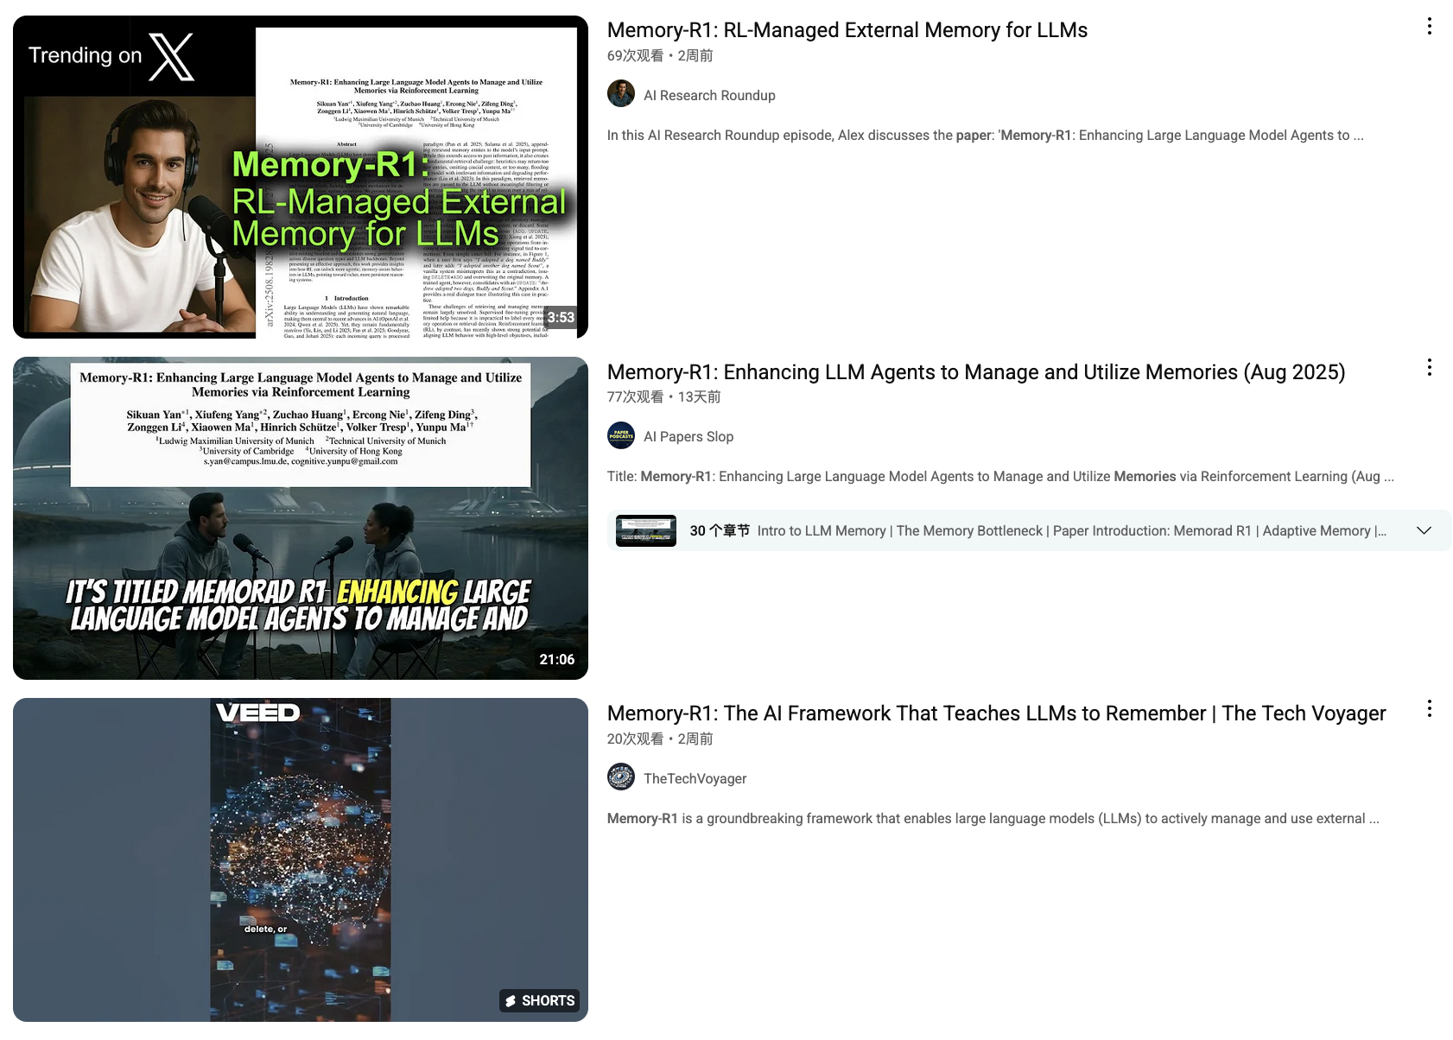
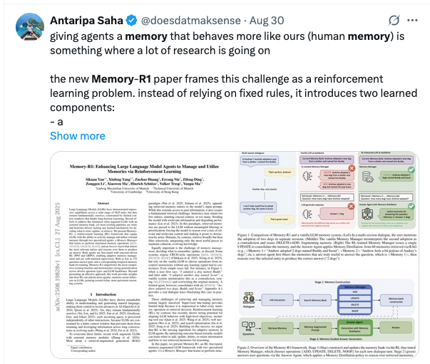
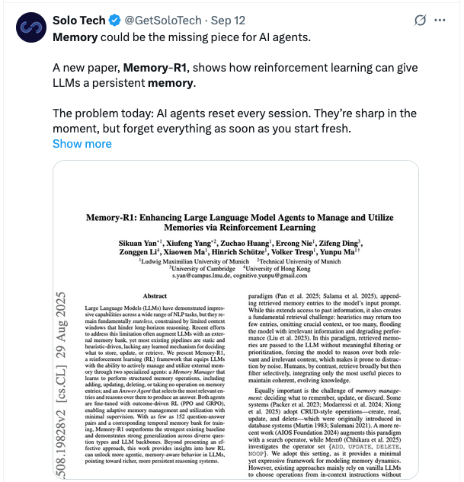
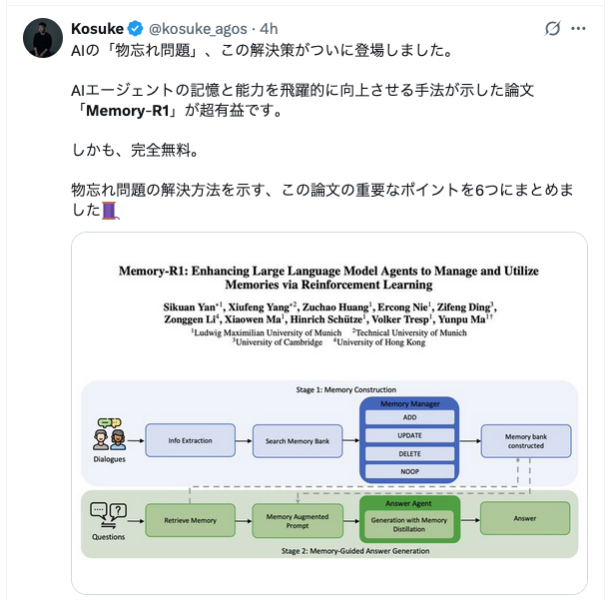
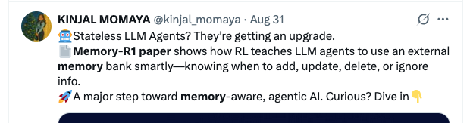
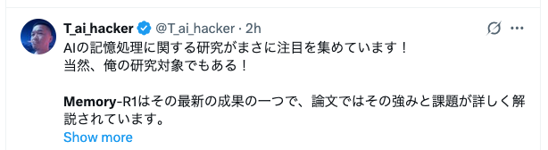
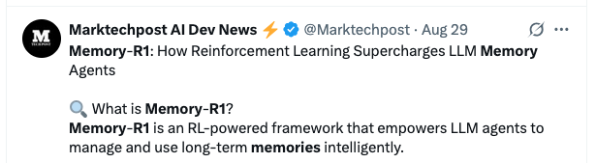
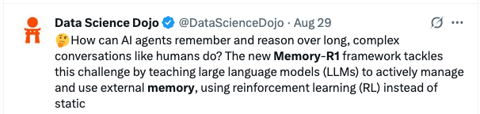
Impact
Over 500k views on X & LinkedIn
#1 Hottest paper of the day on AlphaXiv
Youtubers spontaneously made videos explaining the paper

Slide 22
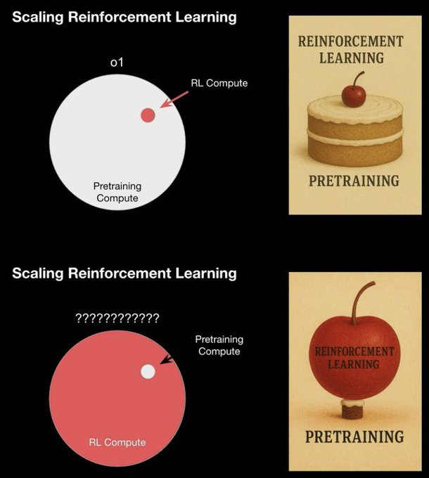
Scaling Reinforcement Learning (by Dan Roberts)
“OpenAI are attempting to flip the old cherry-on-top meme about Scaling RL”
Dan Roberts, AI Ascent, OpenAI, 2025
LLM-Based RL Agent
Notes:
https://www.51cto.com/article/815325.html
Left panel: the big grey circle is all the compute we pour into pre-training our foundation models. The tiny red dot at the edge? That’s the fraction reserved for reinforcement learning. Historically, RL has been just a small afterthought—what we call the ‘cherry on top.’
Right panel: here’s the meme itself: RL as the cherry decorating a cake of pre-training.
Bottom quote: Roberts points out that OpenAI is trying to flip this story—elevating reinforcement learning from a mere garnish to the main event. Their new LLM-based RL agents (highlighted in red) signal a shift toward RL-driven adaptation and decision-making as the core of next-generation AI.”

Slide 23
Scaling Reinforcement Learning (by Dan Roberts)
“OpenAI are attempting to flip the old cherry-on-top meme about Scaling RL”
Dan Roberts, AI Ascent, OpenAI, 2025
LLM-Based RL Agent

Slide 24
Thank you for your attention! Questions?

