Slide 1
GROUP MEETING · PAPER READING
T-POP
Test-Time Personalization
with Online Preference Feedback
Qu et al. · ICML 2026
Learning user preferences during interaction
Notes:
今天汇报 T-POP。这篇论文讨论如何通过交互中的偏好反馈，让回答更适合具体用户。
Today I will present T-POP. It learns from preference feedback during interaction to make answers fit each user.

Slide 2
T-POP · Test-Time Personalization with Online Preference Feedback · Qu et al., ICML 2026
Alignment for Personalization
General RLHF / DPO only for generic alignment.
Same question, different users: concise vs. detailed.
Prior direction | Features
User-specific fine-tuning | Update parameters
Memory / RAG / prompting | Collect enough user data (static)
Test-time Alignment (e.g., LA, AMULET) | A preference signal or objective (dynamic)
key point: align with a new user effectively.
T-POP §§1–2, 6 · Comparison summarizes the paper's motivation.
01 / 08
Notes:
今天讲 T-POP。它要解决的问题很直接：一个回答通常不错，不代表它适合每个用户。同一个问题，有人想看两句话，有人想看详细解释。RLHF 和 DPO 主要学习很多人的总体偏好。给每个用户单独微调，成本又比较高。用历史记录、RAG 或提示词，可以利用已有的用户信息。可是新用户没有这些记录。LA、AMULET 这类方法能在生成时引导冻结的模型，但还需要一个偏好信号。所以论文问的是：没有历史时，能不能通过几次比较，逐渐学会这个用户喜欢什么？
Today I will talk about T-POP. The problem is simple. A good answer may still be a poor fit for one user. One person wants two sentences. Another wants a detailed explanation. RLHF and DPO mainly learn preferences across many people. Fine-tuning for each user costs more. History, RAG, and prompts can use information we already have about someone. But a new user has no history. Methods like LA and AMULET can guide a frozen model during generation. They still need a preference signal. T-POP asks how we can learn that signal from a few comparisons.

Slide 3
MOTIVATION → PROBLEM FORMULATION
Problem formulation: personalizing from zero
A new user, no preference history.
The user's preferences are unknown; general helpfulness is not enough.
GIVEN
OBSERVED FEEDBACK
A frozen pretrained LLM.
A stream of user queries.
A binary preference between
two complete answers to a query.
GOAL AND CONSTRAINTS
Adapt answers to this user with few online comparisons.
T-POP §§1–3 · Task, available feedback, and constraints.
02 / 08
Notes:
先看任务条件。我们有一个冻结的 LLM，也会不断收到用户的新问题。一开始没有这个用户的偏好历史。我们不能直接知道他心里给回答打几分，能拿到的是一个选择：同一个问题的两个完整回答，他更喜欢哪一个。用户不用给每个 token 标注。目标是在尽量少的比较之后，让后面的回答更符合他的习惯。整个过程不改基础 LLM 的参数，也不希望用户花很多时间反馈。下一页看论文怎么测试这个任务。
We start with a frozen LLM and a new user. We receive their questions, but we have no preference history. We cannot directly observe how much they like an answer. We can ask them to choose between two complete answers. They do not label individual tokens. The goal is to improve later answers with few comparisons. The base LLM stays fixed. The user should not need to give a lot of feedback. Next, let us look at the test setting.

Slide 4
DATA AND EVALUATION SETTING
What is personalized, and how is it tested?
Question pool | Size
HelpSteer | 1,236
TruthfulQA | 811
UltraChat | 3,845
Personal Preference Eval | 548
ONLINE FEEDBACK
GPT-4o simulates the user.
EVALUATION
ArmoRM reward scores
GPT-4o win rate vs. Base
Frozen backbones: Mistral-7B · Qwen2-7B · Llama-3.1-8B
Baselines: Base · Preference Prompting · Beam Search (16) · LA · AMULET
T-POP §4.1; Appendix B · Sizes describe question pools, not observed preference-pair counts.
03 / 08
Notes:
论文从四个数据集中取问题，名字和数量在左边。原来的回答不用，所以这里的数量不是已经准备好的偏好对。两个新回答和对应标签，都是在交互中产生的。论文主要测试四种偏好：有创造性、详细、简短和鼓舞性。基础模型用了 Mistral、Qwen 和 Llama。实验里主要由 GPT-4o 模拟用户做选择。评估则看 ArmoRM 分数，以及 GPT-4o 判断的胜率。注意，ArmoRM 是外部评估器，和我们要训练的个人 RM 是两个模型。对比方法包括基础模型、偏好提示、束搜索、LA 和 AMULET。
The paper takes questions from four datasets. Their names and sizes are on the left. The original answers are removed. So these numbers are question counts, not ready-made preference pairs. New answers and labels are collected during interaction. The four targets are creative, verbose, concise, and uplifting. The backbones are Mistral, Qwen, and Llama. GPT-4o mainly acts as the user and chooses an answer. Evaluation uses ArmoRM scores and GPT-4o win rates against the base model. ArmoRM is an outside evaluator. It is not the personal RM being trained. The baselines include the base model, preference prompts, beam search, LA, and AMULET.

Slide 5



METHOD 1/3 · FOLLOWING ALGORITHM 1
Two loops: token generation and RM updates
RM UPDATE LOOP · t = 1, …, T
Start: θ₁, V₀ = λI, empty history
TOKEN LOOP · p = 1, …, M
RM parameters θₜ stay fixed
Receive qₜ
Initialize both
prefixes to y=[q]
Frozen LLM
Score each candidate
Choose v₁, then v₂
Shared RM: [y, v]
π + ωr → scoreⱼ
1: max score₁
candidate tokens
2: max (score₂+ bonus)
Update V · line 14
Update prefixes
Next
query
$$V←V+δδ^{⊤}$$
y $←$ [y, v]
t + 1
p < M: next token
p = M: complete answer pair
Carry V forward
Train RM on history Dₜ
Get user choice ℓₜ
Vₜ ← Vₜ₋₁
$$θ_{t+1}=\arg{\min_{θ}{ℒ_{t}\left(θ\right)}}$$
Save pair + label in Dₜ
Algorithm 1, lines 1–19 · δ is the selected gradient difference in line 14. V denotes the running matrix.
04 / 08
Notes:
方法可以分成两个循环。开始时有一个初始 RM，V 设为 lambda I，历史为空。外层每次接收一个问题，两条回答都从这个问题开始。然后进入内层，逐 token 生成。冻结 LLM 分别取两个前缀下概率最高的四十个 token，合并后最多八十个。每个候选接到各自前缀，交给同一个 RM 评分。把 LLM 概率和加权奖励相加，得到每条分支的分数。先选第一条的 token，再选第二条；第二条还加入探索奖励。选好后，各自接回前缀，再更新 V。这里加的是两个已选延续的奖励梯度差的外积。RM 参数在这个内层循环里不变。两个完整回答出来后，用户选一个，回答对和标签存入历史。再用这些历史训练 RM，把 V 继续保留，进入下一个问题。这就是内层生成、外层更新 RM。
There are two loops. We start with an initial RM, V equal to lambda I, and an empty history. The outer loop receives a question. Both answers start from that question. The inner loop generates tokens. The frozen LLM gives the top forty tokens for each prefix. Their union has at most eighty candidates. Each candidate is added to its own prefix and scored by the same RM. We add the LLM probability and the weighted reward. Then we select token one, followed by token two. The second choice also uses an exploration bonus. We append both tokens and update V. This adds an outer product of the selected reward-gradient difference. The RM parameters stay fixed inside this loop. Once both answers are complete, the user picks one. We save the pair and label in history. Then we train the RM on that history. We keep V and move to the next question.

Slide 6
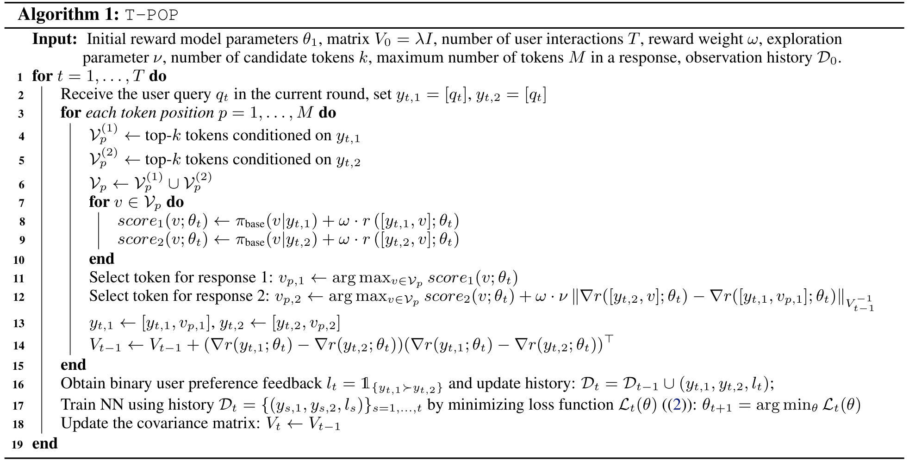
METHOD 2/3 · ORIGINAL PAPER PSEUDOCODE
Algorithm 1: T-POP
Source: T-POP.pdf, p. 4 · Original Algorithm 1 (unaltered).
05 / 08
Notes:
这就是论文原来的算法表。第一行是外层交互循环，第三行是内层 token 循环，和上一页对应。重点看两次更新。第十四行更新 V，记录这次已经比较过的方向。它没有改 RM 参数。第十六行才收集完整回答的偏好。第十七行用累计历史训练 RM，让用户选中的回答更容易得到高分。最后把 V 保留到下一轮。所以 V 的更新跟着 token 走，RM 的更新跟着用户反馈走。下面把两条回答怎么选 token 再展开一下。
This is the original algorithm table. Line one starts the outer loop. Line three starts the token loop. Focus on the two updates. Line fourteen updates V. It records the comparison made at this step. It does not change the RM parameters. Line sixteen collects feedback on the complete answers. Line seventeen trains the RM on the full history. The loss encourages the preferred answer to get a higher reward. V is kept for the next round. So V changes during token generation. The RM learns from user feedback.

Slide 7
METHOD 3/3 · ALGORITHM 1, LINES 8–12
Token selection: response 1, then response 2
Shared RM, separate prefixes · j = 1, 2
$${score}_{j}\left(v;θ_{t}\right)=π_{base}\left(v∣y_{t,j}\right)+ωr\left(\left[y_{t,j},v\right];θ_{t}\right)$$
1. RESPONSE 1 · HIGHEST CURRENT SCORE
$$v_{p,1}=\arg{\max_{v∈𝒱_{p}}{{score}_{1}\left(v;θ_{t}\right)}}$$
2. RESPONSE 2 · SCORE + COMPARISON UNCERTAINTY
$$v_{p,2}=\arg{\max_{v∈𝒱_{p}}\left[{score}_{2}\left(v;θ_{t}\right)+ων{\left\|g\left(v\right)\right\|}_{V_{t−1}^{−1}}\right]}$$
$$g\left(v\right)=∇_{θ}r\left(\left[y_{t,2},v\right];θ_{t}\right)−∇_{θ}r\left(\left[y_{t,1},v_{p,1}\right];θ_{t}\right)$$
Fixed reference: response 1 with its already selected token vₚ,₁.
Algorithm 1, lines 8–12 · g(v) abbreviates the gradient difference in line 12.
06 / 08
Notes:
这一页只看选词。上面的 score 就是 LLM 概率加上加权的 RM 奖励。两条回答用同一个 RM，但文本前缀各自保留。第一步很简单：第一条回答选 score 最大的候选。第二步再选第二条回答。它除了自己的 score，还看一个比较的不确定性。参照就是第一步已经选好的延续。下面的 g，是第二条候选延续和这个固定参照的奖励梯度之差，梯度都是对 RM 参数求的。用 V 的逆矩阵给这个差加权，就得到探索奖励。信息较少的比较方向，通常会有更大的奖励。所以第二条既看当前分数，也考虑这次比较能不能带来新信息。选完后回到上一页，接 token、更新 V，再继续。
This slide focuses on token choice. The score adds the LLM probability and the weighted RM reward. Both answers use the same RM, but each keeps its own prefix. First, response one picks the candidate with the highest score. Then we choose a token for response two. It uses its own score plus a comparison bonus. The reference is the continuation already selected for response one. Here, g is the difference between two reward gradients. Both gradients are taken with respect to the RM parameters. We weight this difference using the inverse of V. A less explored comparison direction can get a larger bonus. Response two therefore considers both the current score and what the comparison may teach us. We then append the tokens, update V, and repeat.

Slide 8
EXPERIMENTS · MAIN RESULT AND TWO CHECKS
Evidence: stronger alignment, uneven gains
Mean ArmoRM score across four preference attributes · Higher is better.
Backbone | Base | AMULET | T-POP
Mistral-7B | 0.3550 | 0.4150 | 0.4975
Qwen2-7B | 0.3575 | 0.4100 | 0.5250
Llama-3.1-8B | 0.3450 | 0.5325 | 0.5350
EARLY ADAPTATION
Fast gains in the first
20 interaction rounds.
Fig. 2 · concise · two datasets
EXPLORATION MATTERS
Beats entropy / Boltzmann.
Llama · Personal · concise
Qwen: +28.0% · Mistral: +19.9% vs. AMULET.
Llama is near a tie; gains are not uniform across attributes.
Table 1: means calculated from its four “Average” rows per model; Fig. 2; Table 8 (20-round ablation).
07 / 08
Notes:
实验保留这一页。左边是 ArmoRM 分数，不是胜率。我把论文表一中四个属性的平均结果又做了一次平均。和 AMULET 比，Qwen 提高了约百分之二十八，Mistral 提高了约百分之十九点九。Llama 基本持平，所以不能说每个模型、每个属性都明显提升。右边有两个补充结果。在两个简洁偏好设置下，前二十轮就有较快提升。另一个消融实验里，这种探索方式好于熵奖励和 Boltzmann 探索。它们支持少量交互就能学习偏好的思路，但效果也取决于模型和任务。
I keep the experiments on one slide. The table shows ArmoRM scores, not win rates. I averaged the four attribute averages in the paper's Table One. Compared with AMULET, Qwen improves by about twenty-eight percent. Mistral improves by about nineteen-point-nine percent. Llama is almost tied. So the gains are not the same for every model or attribute. There are two supporting results. Two concise-preference tests show fast gains in the first twenty rounds. One ablation also finds this exploration method better than entropy and Boltzmann alternatives. These results support learning from a small number of interactions.

Slide 9
DISCUSSION · TAKEAWAYS AND LIMITATIONS
Takeaways and limitations
Learn preferences. Keep the LLM frozen.
Choose useful comparisons as the RM improves.
User feedback
Mainly simulated users.
Training signal
Full-answer labels → prefix-level scores.
Query cost
23.26 s vs. 11.25 s (AMULET).
Future: richer feedback and changing preferences.
T-POP §7; Appendix B, C.3, C.6; Table 13 · Training-signal comparison follows the method.
08 / 08
Notes:
最后，这篇论文的关键是：一边学习用户喜欢什么，一边选择有用的回答对，基础 LLM 不用微调。局限这里留三点。第一，主要实验用的是模拟用户。第二，训练反馈来自完整回答，生成时却要给部分前缀评分。第三，计算成本不低。在论文报告的设置里，每个问题需要二十三点二六秒，AMULET 是十一点二五秒。论文提到的后续方向，是接收更丰富的反馈，以及适应用户偏好的长期变化。
The main idea is to learn what the user likes and choose useful comparisons. The base LLM stays frozen. There are three limits to keep in mind. First, the main experiments use simulated users. Second, training labels compare complete answers, while decoding scores partial prefixes. Third, the method adds computation. In the reported setting, one query takes 23.26 seconds. AMULET takes 11.25 seconds. The paper points to richer feedback and changes in user preferences as future work.

