Slide 1
Machine Learning
Applying MLP
Ruth Walters and Addison Wilson

Slide 2
Workflow
Load & preprocess dataset:
  Pandas DataFrame
  NULL/NA handling
  One hot encoding of categorical features
  Scaling numeric features
  Stratification to ensure
Notes:
RUTH – 1 MIN
The first step in any machine learning process is preprocessing the data
Import the data and structure it as a pandas DataFrame
Check for missing (in this case NULL and NA values); these would disrupt the processing
Prepare the inputs; for categorical variables this meant encoding them using the SciKitLearn’s LabelEncoder function
For numerical variables this means scaling them by their variance so that numerical features with very large/small numbers or wide ranges don’t impact the model
Finally we export as a CSV file so that it can be input

Slide 3
Workflow
Train & test multiple MLP candidates: different architectures, activations, learning rates
Evaluate models: accuracy, loss curves, confusion matrices
Select best model: based on validation performance
Predict validation inputs: output transformed to 1 / –1
Notes:
RUTH – 1 MIN
The first step in any machine learning process is preprocessing the data
Import the data and structure it as a pandas DataFrame
Check for missing (in this case NULL and NA values); these would disrupt the processing
Prepare the inputs; for categorical variables this meant encoding them using the SciKitLearn’s LabelEncoder function
For numerical variables this means scaling them by their variance so that numerical features with very large/small numbers or wide ranges don’t impact the model
Finally we export as a CSV file so that it can be input

Slide 4
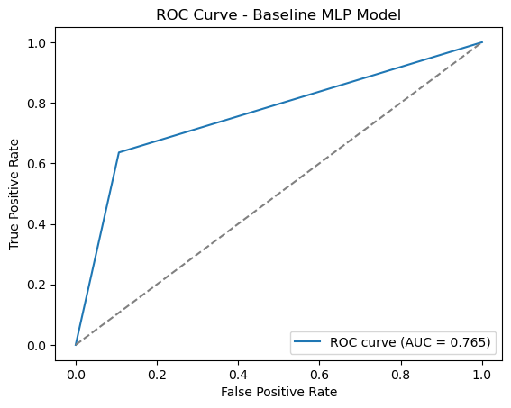
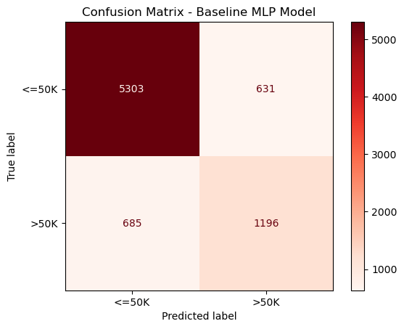
Model Development – Baseline Model
Test Accuracy: 83.16%
Notes:
RUTH

Slide 5
Model Development
Parameter Grid:
Parameter
Hidden Layer Size | (50,) | (100,) | (100,50)
Activation Function | ReLu | tanh
Solver | Adam | SGD | lbfgs
Regularization Strength | 0.0001 | 0.001 | 0.01
Initial Learning Rate | 0.0001 | 0.001 | 0.01
Notes:
RUTH

Slide 6
Model Development
Parameter Grid:
Parameter
Hidden Layer Size | (50,) | (100,) | (100,50)
Activation Function | ReLu | tanh
Solver | Adam | SGD | lbfgs
Regularization Strength | 0.0001 | 0.001 | 0.01
Initial Learning Rate | 0.0001 | 0.001 | 0.01
Some models with specific parameters consistently failed to converge, so those parameters were removed from the grid
Notes:
RUTH
- While 'lbfgs' is a commonly used solver, it preforms poorly for this dataset, and often fails to converge even with a high `max_iter`. This makes sense given that the dataset contains several one-hot-encoded categorical features (and therefore a high-dimensional feature space). 'sgd', which is better at handling this kind of data, was able to achieve much higher convergence rates
- Using a high learning rate often results in failure to converge, so we should keep learning rate at or below 0.01
- Higher regularization values seem to converege more often
This dataset generally seems to favor stochastic solvers, small learning rates, and stronger regularization for reliable convergence. This is consistent with what we understand about the dataset’s sparse, imbalanced, and mixed-type features.

Slide 7
Model Development – Best Model
Parameter Grid:
Parameter
Hidden Layer Size | (50,) | (100,) | (100,50)
Activation Function | ReLu | tanh
Solver | Adam | SGD | lbfgs
Regularization Strength | 0.0001 | 0.001 | 0.01
Initial Learning Rate | 0.0001 | 0.001 | 0.01
Notes:
RUTH

Slide 8
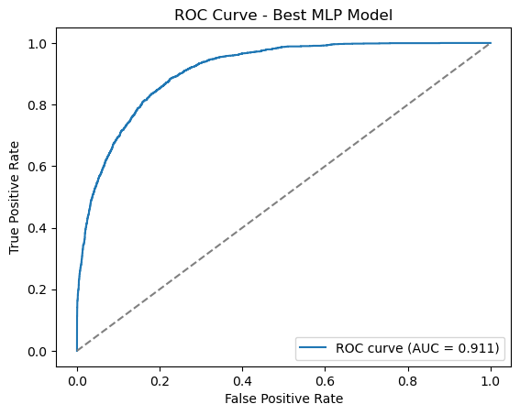
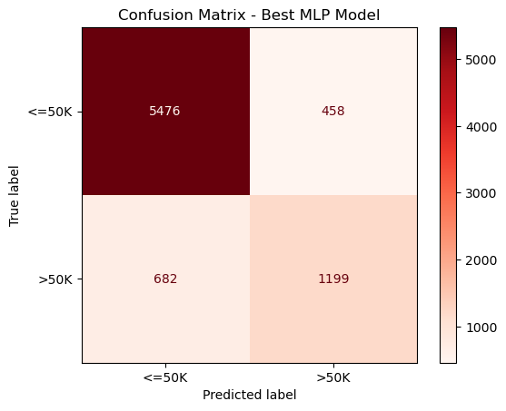
Model Development – Best Model
Test Accuracy: 85.41%
Notes:
RUTH

Slide 9
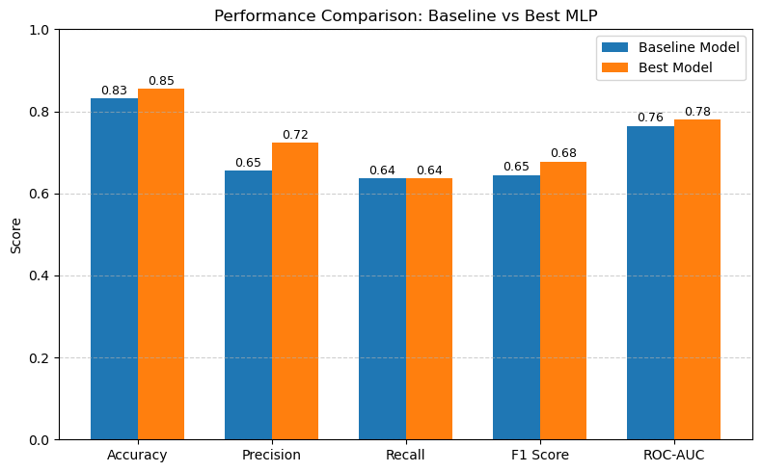
Notes:
RUTH

Slide 10
Reflection: Architecture Choice
Number of layers: Balanced depth to capture complexity without overfitting small dataset
Hidden units: Larger first layer to capture broad patterns, smaller later layers to refine features
Activation functions: ReLU for hidden layers (fast convergence, avoids vanishing gradient), sigmoid for output (binary classification)
Design rationale: Tabular dataset with mixed features benefits from moderate depth and non‑linear activations
Notes:
ADDIE

Slide 11
Reflection: Overfitting
Monitoring: Compared training vs. validation accuracy/loss curves
Mitigation techniques:
  L2 regularization to penalize large weights
Trade‑offs: Deeper models captured complexity but required stronger regularization
Notes:
ADDIE

Slide 12
Reflection: Ethical Concerns
Bias in dataset: Reflects historical inequalities (gender, race, occupation)
Risk of harm: Predictions may reinforce stereotypes or unfairly influence decisions
Fairness & accountability: Need to audit models for bias and explain decisions to stakeholders
Transparency: Communicate limitations clearly when deploying in real‑world settings
Notes:
ADDIE

Slide 13
Reflection: Activation Functions
Enable non‑linearity: Allow network to learn complex decision boundaries
Prevent collapse: Without activations, network reduces to linear regression
Examples:
  ReLU: efficient, avoids vanishing gradient, widely used in hidden layers
  Sigmoid: maps outputs to probability range [0,1], useful for binary classification
Impact: Activation choice directly affects training stability and model accuracy
Notes:
ADDIE

