Slide 1
V Semester B.Tech IT Principles of Operating Systems (Subject code: ICT 3122) [4 0 0 4]

Slide 2
Syllabus
Introduction
Operating system structure, Operating system operations, Distributed systems, Special purpose systems, Computing environments, Open source operating systems. [3 hours]
CPU Scheduling
Process concepts: Process states, Process control block, Scheduling queues, Schedulers, Context switch, Multi-threaded programming: Overview, Multithreading models, Threading issues, Process scheduling: Basic concepts, Scheduling criteria, scheduling algorithms. [7 hours]
Process Synchronization
Synchronization: The Critical section problem, Synchronization hardware, Semaphores, Classic problems of synchronization, monitors. [6 hours]
Deadlocks
Deadlock characterization, Methods for handling deadlocks, Deadlock prevention, Deadlock avoidance, Deadlock detection, Recovery from deadlock. [8 hours]

Slide 3
Syllabus
Memory management
Memory management strategies, Swapping, Contiguous memory allocation, Paging, Structure of the page table, Segmentation. [6 hours]
Virtual Memory
Demand paging, copy on write, page replacement, allocation of frames, thrashing. [7 hours]
Storage Management
File concept, Access methods, directory structure, file system structure, directory implementation, allocation methods, free space management, disk structure, and disk-scheduling [5 hours]
Case study on UNIX based Operating system
Design principles, Kernel modules, Process management, Memory management. [2 hours]
Real time systems: Characteristics of Real time operating systems, classification of real time systems, Micro kernels and RTOS, scheduling in RTOS, Rate monotonic scheduling, EDF, Priority inversion. [4 hours]

Slide 4
Course Objectives
To get familiarized with the basic functionality and the evolution of different types of operating systems.
To learn various algorithms related to CPU scheduling, deadlocks, memory management, and storage management.
To understand the basic aspects of real time operating systems

Slide 5
Course Outcomes
Illustrate the design principles and functionalities of different operating systems.
Demonstrate the working of various algorithms for CPU scheduling, synchronization and deadlocks.
Assess the memory management and storage management techniques and their suitability in different operating systems.
Apply the concepts of Real Time Operating Systems in application development.

Slide 6
References
Abraham Silberschatz, Peter Baer Galvin and Greg Gagne, Operating System Concepts, 9th edition, Wiley, 2012.
William Stallings, Operating Systems: Internals and Design Principles,9th edition, Pearson, 2017.
Phillip A Laplante, Seppo J Ovaska, Real time systems design and analysis, 4th edition, Wiley, 2013.
Rajib Mall, Real time systems: Theory and Practice, 2nd edition, Pearson, 2009.

Slide 7
Chapter 1: Introduction
Computer System Structure
Computer system can be divided into four components:
Hardware – provides basic computing resources
CPU, memory, I/O devices
Operating system
Controls and coordinates use of hardware among various applications and users
Application programs – define the ways in which the system resources are used to solve the computing problems of the users
Word processors, compilers, web browsers, database systems, video games
Users
People, machines, other computers

Slide 8
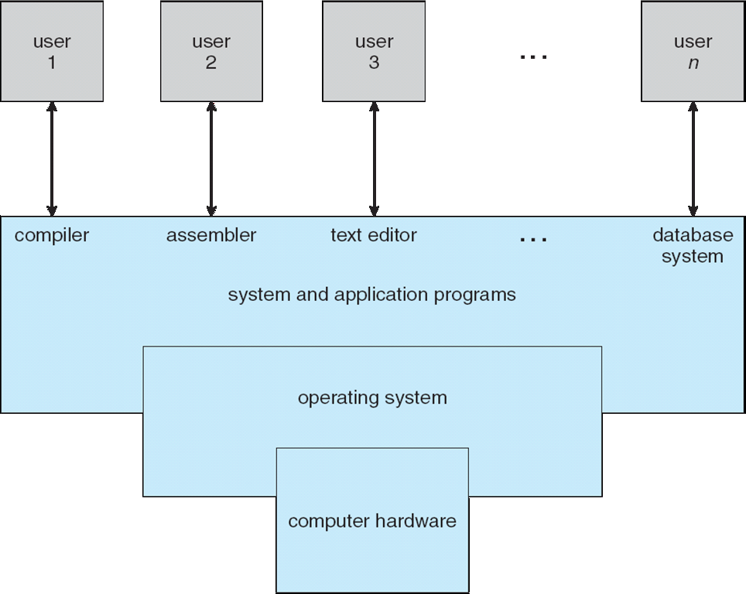
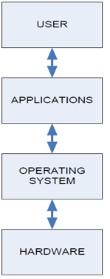
Computer System Structure
Four Components of a Computer System
operating system is large and complex, it must be created piece by piece.

Slide 9
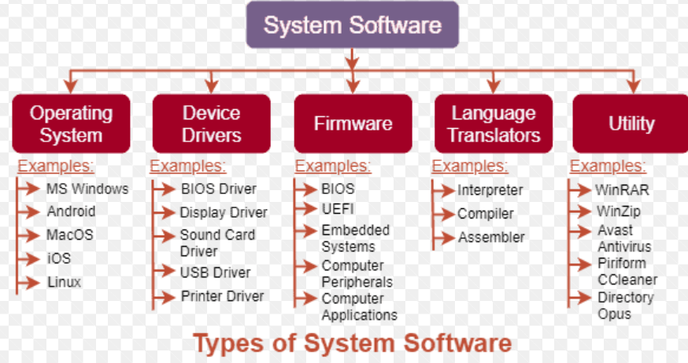

Slide 10
Operating System
It is a system software
A program that acts as an interface between user the computer hardware
Operating system goals:
Execute user programs and make solving user problems easier
Make the computer system convenient to use
Use the computer hardware in an efficient manner

Slide 11
Operating System
Functionalities
Resource Management
Process Management
Storage Management
Memory Management
Security and Privacy

Slide 12
Operating Systems
Types
Multiprogramming: they do not provide user interaction with the computer system
Multitasking: the switches occur so frequently that the users can interact with each program while it is running.
Real Time: operating system that is designed to meet hard deadlines and provide predictable and consistent performance. RTOSes are used in applications where real-time response is critical, such as avionics, robotics, industrial control, and medical equipment.

Slide 13
Distributed :
The major benefit of working with these types of the operating system is that it is always possible that one user can access the files or software which are not actually present on his system but some other system connected within this network i.e., remote access is enabled within the devices connected in that network.
Clustered:
The purpose of a clustered operating system is to provide high availability and scalability by distributing the workload across multiple nodes, so that if one node fails, the workload can be automatically redirected to another node, ensuring that the system remains operational.
Embedded: Embedded operating systems are designed for small, low-power devices, such as IoT devices, smartphones, medical devices, and industrial control systems.

Slide 14
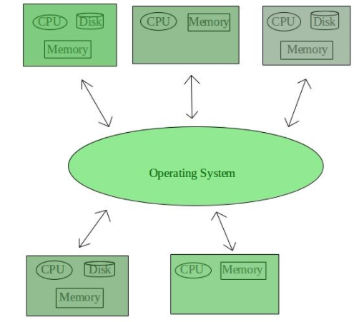
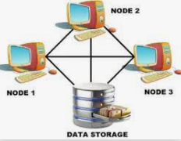
Clustered Operating System
Distributed Operating System

Slide 15
Operating System Definition
System View
OS is a resource allocator
Manages all resources
Decides between conflicting requests for efficient and fair resource use
OS is a control program
Controls execution of programs to prevent errors and improper use of the computer.

Slide 16
Operating System Definition (Cont.)
No universally accepted definition
“The one program running at all times on the computer” is the kernel.
Everything else is either,
a system program, or an application program.

Slide 17
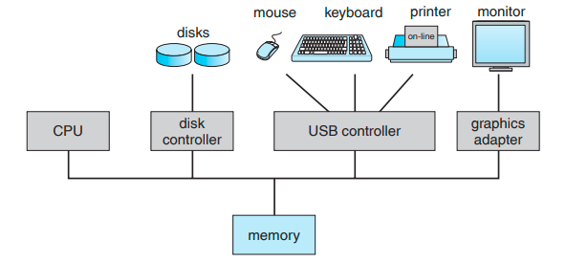
Computer-System Organization
A modern computer system.
One or more CPUs
Number of device controllers
Shared memory
Memory controller

Slide 18
Computer Startup
bootstrap program is loaded at power-up or reboot
Power-On or Reboot: When the computer is powered on or rebooted, the CPU starts executing the bootstrap program stored in the ROM/EPROM.
Initialization: The bootstrap program initializes hardware components and performs necessary checks.
Locate OS Kernel: It locates the OS kernel on the storage media.
Load OS Kernel: It loads the OS kernel into RAM.
Transfer Control: It transfers control to the OS kernel, which then continues with the system's startup process.

Slide 19
“Bootstrap is a term used to describe the process of loading an operating system into memory and starting it. BIOS, on the other hand, is a firmware that provides basic low-level services to the operating system, such as initializing hardware, testing memory, and providing a boot loader to load the operating system from a storage device.
An example of a Bootstrap program is the Master Boot Record (MBR) on a computer's hard drive. The MBR is a small piece of code stored in the first sector of the hard drive that is executed when the computer is powered on. It contains the boot loader, which loads the operating system into memory and starts it. This process is called bootstrapping, hence the name Bootstrap program.”

Slide 20
Common Functions of Interrupts
Interrupt transfers control to the interrupt service routine (ISR) generally, through the interrupt vector, which contains the addresses of all the service routines
Interrupt architecture must save the address of the interrupted instruction
A trap or exception is a software-generated interrupt caused either by an error or a user request
An operating system is interrupt driven

Slide 21
A key is pressed on the keyboard, generating a hardware interrupt.
The keyboard controller sends an interrupt signal to the CPU.
The CPU uses the interrupt vector to find the address of the ISR associated with the keyboard interrupt.
The CPU saves the address of the interrupted instruction and the current state of the CPU registers.
The CPU transfers control to the keyboard ISR, which processes the keypress (e.g., adding the character to a buffer).
After the ISR completes, the CPU restores the saved state and resumes execution of the interrupted program.

Slide 22
Storage Structure
Main Memory
RAM
Main memory is usually too small to store all needed programs and data permanently.
Main memory is a volatile storage device that loses its contents when power is turned off or otherwise lost
Read-only memory (ROM)
A typical instruction–execution cycle
Secondary storage
hold large quantities of data permanently
magnetic disk

Slide 23
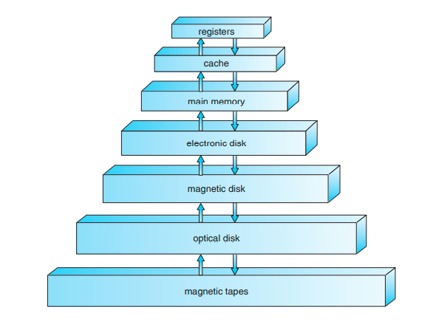
Storage-device hierarchy

Slide 24
Operating System Structure
Multiprogramming (Batch system) needed for efficiency
Single user cannot keep CPU and I/O devices busy at all times
Multiprogramming organizes jobs (code and data) so CPU always has one to execute
A subset of total jobs in system is kept in memory
One job selected and run via job scheduling(from job pool)
When it has to wait (for I/O for example), OS switches to another job
Timesharing (multitasking) is logical extension in which CPU switches jobs so frequently that users can interact with each job while it is running, creating interactive computing
Response time should be < 1 second
Each user has at least one program executing in memory process
If several jobs ready to run at the same time  CPU scheduling(picking jobs from memory)
If processes don’t fit in memory, swapping moves them in and out to run
Virtual memory allows execution of processes not completely in memory

Slide 25
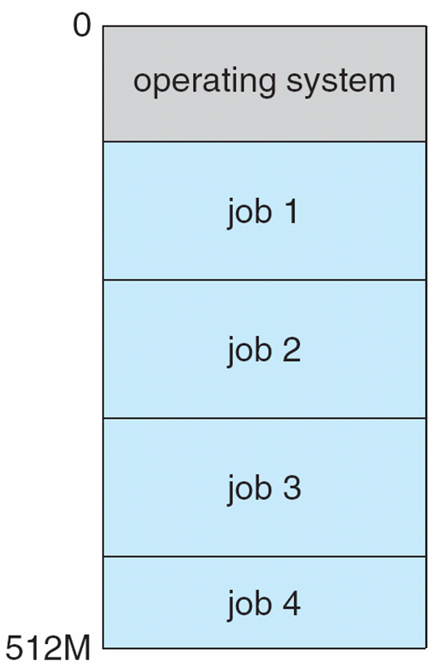
Memory Layout for Multiprogrammed System
job pool
job scheduling
CPU scheduling
Swapping
Virtual memory

Slide 26
Operating-System Operations
Modern OS are Interrupt driven (hardware and software)
Hardware interrupt by one of the devices: A signal created and sent to the CPU that is caused by some action taken by a hardware device. keystroke depressions and mouse movements cause hardware interrupts.
Software interrupt (exception or trap):
Software error (e.g., division by zero)
invalid memory access
Request from user program to access a specific operating system service
For each type of interrupt, separate segments of code in the operating system determine what action should be taken.
An interrupt service routine is provided that is responsible for dealing with the interrupt.
Other process problems include infinite loop, processes modifying each other or the operating system
Notes:
A properly designed operating system must ensure that an incorrect (or malicious) program cannot cause other programs to execute incorrectly.

Slide 27
Operating-System Operations (cont.)
Dual-mode operation allows OS to protect itself and other system components
User mode and kernel mode
Mode bit provided by hardware
Provides ability to distinguish when system is running user code or kernel code
Some instructions designated as privileged instructions(i/o instructions, turn of interrupts, set timer, clear memory etc), only executable in kernel mode
System call changes mode to kernel, return from call resets it to user

Slide 28
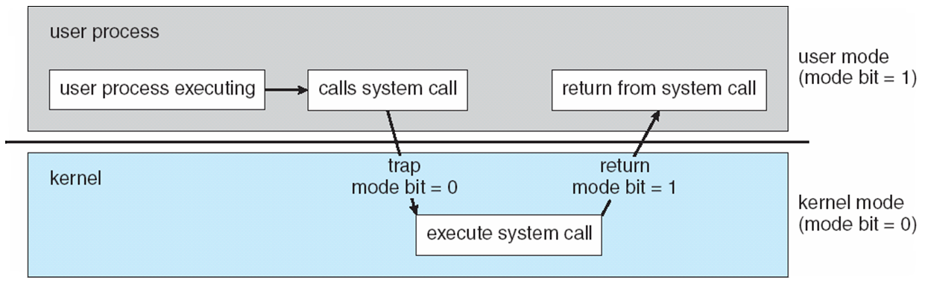
Transition from User to Kernel Mode
When the computer system is executing on behalf of a user application, the system is in user mode.
However, when a user application requests a service from the operating system (via a system call), it must transition from user to kernel mode to fulfill the request.

Slide 29
Transition from User to Kernel Mode
Timer to prevent infinite loop / process hogging resources
Timer is set to interrupt the computer after some period time
Keep a counter that is decremented by the physical clock.
Operating system set the counter (privileged instruction)
When counter zero generate an interrupt
Set up before scheduling process to regain control or terminate program that exceeds allotted time
A program with a 7-minute time limit, for example, would have its counter initialized to 420. Every second, the timer interrupts, and the counter is decremented by 1. As long as the counter is positive, control is returned to the user program. When the counter becomes negative, the operating system terminates the program for exceeding the assigned time limit.

Slide 30
Overview of OS functionalities Process Management
A process is a program in execution. It is a unit of work within the system. Program is a passive entity, process is an active entity.
Process needs resources to accomplish its task
CPU, memory, I/O, files
Initialization data
Process termination requires reclaim of any reusable resources
Single-threaded process has one program counter specifying location of next instruction to execute
Process executes instructions sequentially, one at a time, until completion
Multi-threaded process has one program counter per thread
Typically system has many processes, some user, some operating system running concurrently on one or more CPUs
Concurrency by multiplexing the CPUs among the processes / threads

Slide 31
Process Management Activities
The operating system is responsible for the following activities in connection with process management:
Creating and deleting both user and system processes
Suspending and resuming processes
Providing mechanisms for process synchronization
Providing mechanisms for process communication
Providing mechanisms for deadlock handling

Slide 32
Memory Management
To execute a program all (or part) of the instructions must be in memory
All (or part) of the data that is needed by the program must be in memory.
Memory management determines what is in memory
Optimizing CPU utilization and computer response to users
Memory management activities
Keeping track of which parts of memory are currently being used and by whom
Deciding which processes (or parts thereof) and data to move into and out of memory
Allocating and deallocating memory space as needed

Slide 33
Storage Management
OS provides uniform, logical view of information storage
Abstracts physical properties to logical storage unit - file
Each medium is controlled by device (i.e., disk drive, tape drive)
Varying properties include access speed, capacity, data-transfer rate, access method (sequential or random)
File-System management
Files usually organized into directories
Access control on most systems to determine who can access what
OS activities include
Creating and deleting files and directories
Primitives to manipulate files and directories
Mapping files onto secondary storage
Backup files onto stable (non-volatile) storage media

Slide 34
Mass-Storage Management
Usually disks used to store data that does not fit in main memory or data that must be kept for a “long” period of time
Proper management is of central importance
Entire speed of computer operation hinges on disk subsystem and its algorithms
OS activities
Free-space management
Storage allocation
Disk scheduling
Some storage need not be fast
Tertiary storage includes optical storage, magnetic tape
Still must be managed – by OS or applications
Varies between WORM (write-once, read-many-times) and RW (read-write)

Slide 35
Computing Environments - Traditional
Stand-alone general purpose machines
Portals provide web access to internal systems
Network computers (thin clients) are like Web terminals
Mobile computers interconnect via wireless networks
Networking becoming default– even home systems use firewalls to protect home computers from Internet attacks
Notes:
The current trend is toward providing more ways to access these computing environments(remote machines).
Stand-alone general purpose machines-more ways to access these computing environments.
Web technologies are stretching the boundaries of traditional computing.

Slide 36
Computing Environments – Distributed
Distributed computing
Collection of separate, possibly heterogeneous, systems networked together
Network is a communications path, TCP/IP most common
Local Area Network (LAN)
Wide Area Network (WAN)
Metropolitan Area Network (MAN)
Personal Area Network (PAN)
Network Operating System provides features between systems across network
Communication scheme allows systems to exchange messages
Illusion of a single system
Notes:
Access to a shared resource increases computation speed, functionality, data availability, and reliability.
TCP/IP is the most common network protocol

Slide 37
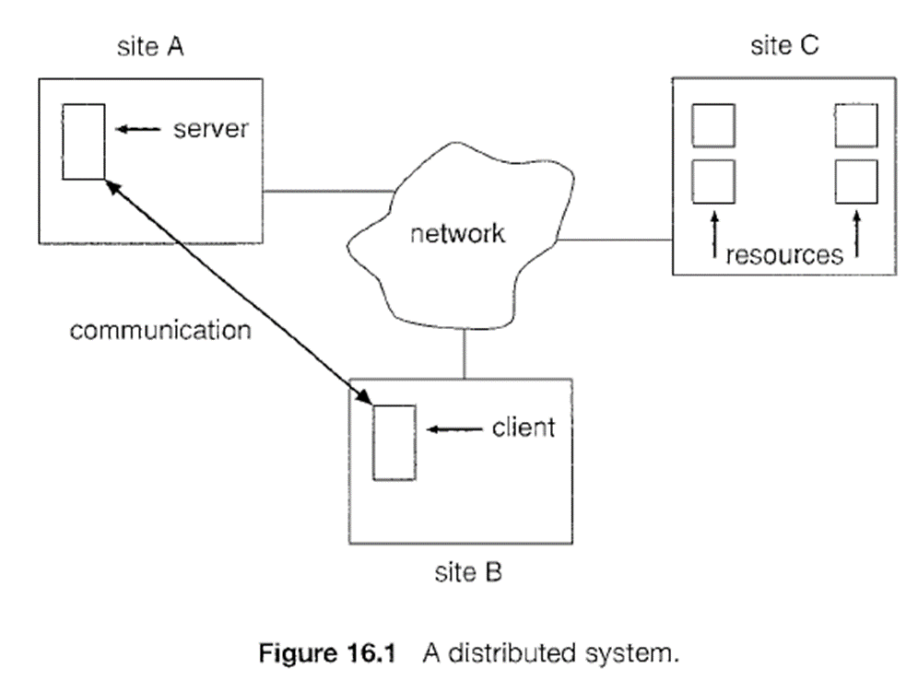

Slide 38
Computing Environments – Client-Server
Client-Server Computing
Many systems now servers, responding to requests generated by clients
Compute-server system provides an interface to client to request services
File-server system provides interface for clients to store and retrieve files
Notes:
Client server Vs Distributed sytems
Only one server at a time vs many sites simultaneously
Crash of server stops the system vs crash of a site does not stop the entire system
Less maintenance vs high maintance cost

Slide 39
Computing Environments - Peer-to-Peer
Another model of distributed system
P2P does not distinguish clients and servers
Instead all nodes are considered peers
May each act as client, server or both
Node must join P2P network
Registers its service with central lookup service on network, or
Broadcast request for service and respond to requests for service via discovery protocol
Notes:
In a client-server system, the server is a bottleneck; but in a peer-to-peer system, services can be provided by several nodes distributed
throughout the network. To participate in a peer-to-peer system, a node must first join the network of peers. Once a node has joined the network, it can begin providing services to—and requesting services from—other nodes in the network.

Slide 40
Computing Environments - Virtualization
virtualization refers to the act of creating a virtual version of something, including virtual computer hardware platforms, storage devices, and computer network resources.

Slide 41
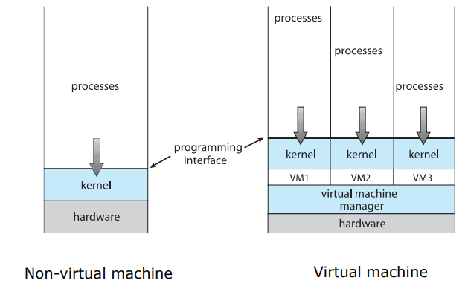
Computing Environments - Virtualization

Slide 42
Computing Environments – Cloud Computing
Delivers computing, storage, even apps as a service across a network
Many types
Public cloud – available via Internet to anyone willing to pay
Private cloud – run by a company for the company’s own use
Hybrid cloud – includes both public and private cloud components
Software as a Service (SaaS) – one or more applications available via the Internet (i.e., word processor)
Platform as a Service (PaaS) – software stack ready for application use via the Internet (i.e.,Google App Engine)
Infrastructure as a Service (IaaS) – servers or storage available over Internet (i.e., storage available for backup use)

Slide 43
Computing Environments – Cloud Computing

Slide 44
Computing Environments – Real-Time Embedded Systems
Real-time embedded systems most widespread form of computers
Vary considerable, special purpose, limited purpose OS, real-time OS
Many other special computing environments as well
Some have OSes, some perform tasks without an OS
Real-time OS has well-defined fixed time constraints
Processing must be done within constraint
Correct operation only if constraints met

Slide 45
Open-Source Operating Systems
Operating systems made available in source-code format rather than just binary closed-source(Windows)
Examples Open source include GNU/Linux and BSD UNIX
There are many benefits to open-source operating systems/ including a community of interested (and usually unpaid) programmers who contribute to the code by helping to debug it, analyze it, provide support, and suggest changes.

