Slide 1
Chapter 3: Processes

Slide 2
Chapter 3: Processes
Process Concept
Process Scheduling
Operations on Processes
Interprocess Communication
Examples of IPC Systems
Communication in Client-Server Systems

Slide 3
Objectives
To introduce the notion of a process -- a program in execution, which forms the basis of all computation
To describe the various features of processes, including scheduling, creation and termination, and communication
To describe communication in client-server systems

Slide 4
Process Concept
Textbook uses the terms job and process almost interchangeably
Process – a program in execution
A process includes:
  program counter
  stack
  data section
  Text
  heap

Slide 5
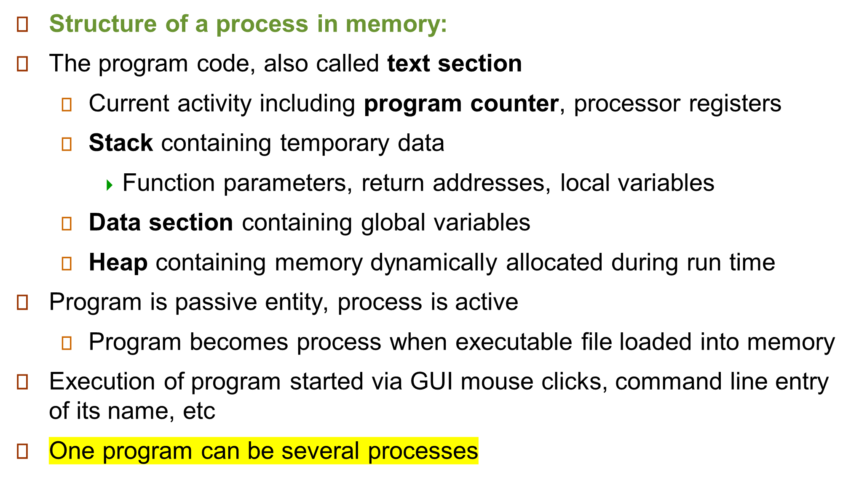
The Process

Slide 6

Process in Memory

Slide 7
Process State
As a process executes, it changes state
  new: The process is being created
  ready: The process is waiting to be assigned to a processor
  running: Instructions are being executed
  waiting: The process is waiting for some event to occur
  terminated: The process has finished execution

Slide 8

Diagram of Process State

Slide 9
Process Control Block (PCB)
Each process is represented in the OS by PCB
Information associated with each process
Process state
Program counter
CPU registers
CPU scheduling information (process priority, pointers to scheduling queues, and any other scheduling parameters)
Memory-management information (value of the base and limit registers, the page tables, or the segment tables)
Accounting information (amount of CPU and real time used, time limits, job or process numbers)
I/O status information (list of I/O devices allocated to the process, a list of open files)

Slide 10

Process Control Block (PCB)

Slide 11

CPU Switch From Process to Process

Slide 12
Process Scheduling
Maximize CPU use, quickly switch processes onto CPU for time sharing
Process scheduler selects among available processes for next execution on CPU
Maintains scheduling queues of processes
  Job queue – set of all processes in the system
  Ready queue – set of all processes residing in main memory, ready and waiting to execute
  Device queues – set of processes waiting for an I/O device
  Processes migrate among the various queues

Slide 13

Representation of Process Scheduling

Slide 14
Schedulers
Long-term scheduler (or job scheduler) – selects which processes should be brought into the ready queue
Short-term scheduler (or CPU scheduler) – selects which process should be executed next and allocates CPU
  Sometimes the only scheduler in a system
Medium term scheduler removes the process from memory-Swapping(whenever memory need to freed)

Slide 15
Schedulers (Cont.)
Short-term scheduler is invoked very frequently (milliseconds) ⇒ (must be fast)
Long-term scheduler is invoked very infrequently (seconds, minutes) ⇒ (may be slow)
The long-term scheduler controls the degree of multiprogramming (the maximum number of processes that a single-processor system can accommodate efficiently)
The long-term scheduler must select a good mix of CPU bound and I/O bound processes.
Processes can be described as either:
  I/O-bound process – spends more time doing I/O than computations, many short CPU bursts (STS will have little to do).
  CPU-bound process – spends more time doing computations; few very long CPU bursts(I/O queue goes empty)
The system with the best performance will thus have a combination of CPU-bound and I/O-bound processes

Slide 16

Addition of Medium Term Scheduling

Slide 17
Context Switch
When CPU switches to another process, the system must save the state of the old process and load the saved state for the new process via a context switch.
Context of a process represented in the PCB
Context-switch time is overhead; the system does no useful work while switching
  The more complex the OS and the PCB -> longer the context switch

Slide 18
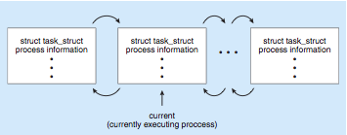
Process Representation in Linux
PCB of Linux OS is represented by the C structure task_struct
pid t pid; /* process identifier */
long state; /* state of the process */
unsigned int time slice /* scheduling information */ struct task struct *parent; /* this process’s parent */ struct list head children; /* this process’s children */ struct files struct *files; /* list of open files */ struct mm struct *mm; /* address space of this pro */

Slide 19
job queue
ready queue
device queue
This queue is generally stored as a linked list.
A ready-queue header contains pointers to the first and final PCBs in the list. Each PCB includes a pointer field that points to the next PCB in the ready queue.
The system also includes other queues. When a process is allocated the
CPU, it executes for a while and eventually quits, is interrupted, or
waits for the occurrence of a particular event, such as the completion
of an I/O request.
Each device has its own device queue

Slide 20

Ready Queue And Various
I/O Device Queues

Slide 21
Process Creation
Parent process create children processes, which, in turn create other processes, forming a tree of processes
Generally, process identified and managed via a process identifier (pid)
Resource sharing
  Parent and children share all resources
  Children share subset of parent’s resources
  Parent and child share no resources
Execution
  Parent and children execute concurrently
  Parent waits until children terminate

Slide 22
Process Creation (Cont.)
Address space
  Child duplicate of parent
  Child has a program loaded into it
UNIX examples
  fork system call creates new process
  exec system call used after a fork to replace the process’ memory space with a new program

Slide 23
When new process is created by the fork() system call, the new process consists of a copy of the address space of the original process. This mechanism allows the parent process to communicate easily with its child process.
Both processes (the parent and the child) continue execution at the instruction after the fork () , with one difference: the return code for the fork() is zero for the new (child) process, whereas the (nonzero) process identifier of the child is returned to the parent

Slide 24

Process Creation

Slide 25
C Program Forking Separate Process
#include <sys/types.h>
#include <studio.h>
#include <unistd.h>
int main()
{
pid_t pid;
/* fork another process */
pid = fork();
if (pid < 0) { /* error occurred */
fprintf(stderr, "Fork Failed");
return 1;
}
else if (pid == 0) { /* child process */
execlp("/bin/ls", "ls", NULL);
}
else { /* parent process */
/* parent will wait for the child */
wait (NULL);
printf ("Child Complete");
}
return 0;
}
#include <stdio.h>
#include <sys/types.h>
#include <unistd.h>
int main(void){
printf("Hello \n");
fork();
printf("bye\n");
return 0;
}
'l' indicates a list arrangement
'p' indicates the current PATH string should be used when the system searches for executable files.
type pid_t defined in sys/types
The header file <unistd.h> is where fork() is defined

Slide 26

A Tree of Processes in Linux

Slide 27
Process Termination
Process executes last statement and asks the operating system to delete it (exit)
  Process’ resources are deallocated by operating system
Parent may terminate execution of children processes (abort)
  Child has exceeded allocated resources
  Task assigned to child is no longer required
  If parent is exiting
    Some operating system do not allow child to continue if its parent terminates
      All children terminated - cascading termination

Slide 28
Interprocess Communication
Processes executing concurrently in the operating system may be either independent processes or cooperating processes.
A process is independent
  if it cannot affect or be affected by the other processes executing in the system.
  If it does not share data with any other processes
A process is cooperating
  if it can affect or be affected by the other processes executing in the system.
  If it shares data with other processes.

Slide 29
There are several reasons for providing an environment that allows process cooperation
Information sharing
Computation speedup
Modularity
Convenience
Cooperating processes require an inter-process communication (IPC)mechanism that will allow them to exchange data and information.
Two fundamental models of inter-process communication:
  (1) shared memory
  (2) message passing.

Slide 30
In the shared-memory model, a region of memory that is shared by cooperating processes is established. Processes can then exchange information by reading and writing data to the shared region.
  faster than message passing
  implemented using system calls and thus require kernel intervention.
  Once shared memory is established, all accesses are treated as routine memory accesses, and no assistance from the kernel is required.
a shared-memory region resides in the address space of the process creating the shared-memory segment
Other processes that wish to communicate using this shared-memory segment must attach it to their address space
Normally, the operating system tries to prevent one process from accessing another process’s memory.
Shared memory requires that two or more processes agree to remove this restriction.

Slide 31
“The form of the data and the location are determined by these processes and are not under the operating system’s control. The processes are also responsible for ensuring that they are not writing to the same location simultaneously.”
producer–consumer problem
A compiler may produce assembly code, which is consumed by an assembler. The assembler, in turn, may produce object modules, which are consumed by the loader.
Web server produces (that is, provides) HTML files and images, which are consumed (that is, read) by the client Web browser requesting the resource.

Slide 32
Message passing:
In the message passing model, communication takes place by means of messages exchanged between the cooperating processes.
  useful for exchanging smaller amounts of data
  easier to implement than shared memory
  useful in a distributed environment
A message-passing facility provides at least two operations: send(message) and receive(message). Messages sent by a process can be of either fixed or variable size.
There exists a logical link b/w sender and a receiver
  • Direct or indirect communication
  • Synchronous or asynchronous communication

Slide 33

Communications Models
(a) Message passing. (b) shared memory.

Slide 34
Direct communication: each process that wants to communicate must explicitly name the recipient or sender of the communication
symmetry in addressing-name (that is, both the sender process and the receiver process must name the other to communicate.)
send(P, message)—Send a message to process P.
receive(Q, message)—Receive a message from process Q.
asymmetry in addressing-ID
send(P, message)—Send a message to process P.
receive(id, message)//ID→ANY PROCESS
A communication link in this scheme has the following properties:
A link is established automatically between every pair of processes that want to communicate. The processes need to know only each other’s identity to communicate.
  • A link is associated with exactly two processes.
  • Between each pair of processes, there exists exactly one link.

Slide 35
Indirect communication: the messages are sent to and received from mailboxes(shared), or ports.
A mailbox can be viewed abstractly as an object into which messages can be placed by processes and from which messages can be removed.(mailbox is part of the address space of the process))
Two processes can communicate only if the processes have a shared mailbox
  • send(A, message)—Send a message to mailbox A.
  • receive(A, message)—Receive a message from mailbox A.
  A communication link has the following properties:
  A link is established between a pair of processes only if both members of the pair have a shared mailbox.
  A link may be associated with more than two processes.
  Between each pair of communicating processes, a number of different links may exist, with each link corresponding to one mailbox.

Slide 36
Example: Processes P1, P2, and P3 all share mailbox A. Process P1 sends a message to A, while both P2 and P3 execute a receive() from A. Which process will receive the message sent by P1?
  • Allow a link to be associated with two processes at most.
  • Allow at most one process at a time to execute a receive() operation.
  • Allow the system to select arbitrarily which process will receive the message.
A mailbox may be owned either by a process or by the operating system.
  When a process that owns a mailbox terminates, the mailbox disappears.”
OS can:
  • Create a new mailbox.
  • Send and receive messages through the mailbox.
  • Delete a mailbox.
“ownership and receiving privilege may be passed to other processes through appropriate system calls”

Slide 37
Message passing may be either blocking or non-blocking— also known as synchronous and asynchronous.
• Blocking send. The sending process is blocked until the message is received by the receiving process or by the mailbox.
• Non-blocking send. The sending process sends the message and resumes operation.
• Blocking receive. The receiver blocks until a message is available.
• Non-blocking receive. The receiver retrieves either a valid message or a null.

Slide 38
The messages exchanged by communicating processes reside in a temporary queue.
Zero capacity. The queue has a maximum length of zero; thus, the link cannot have any messages waiting in it. In this case, the sender must block until the recipient receives the message.
Bounded capacity. The queue has finite length n; thus, at most n messages can reside in it.
Unbounded capacity. The queue’s length is potentially infinite; thus, any number of messages can wait in it.

Slide 39
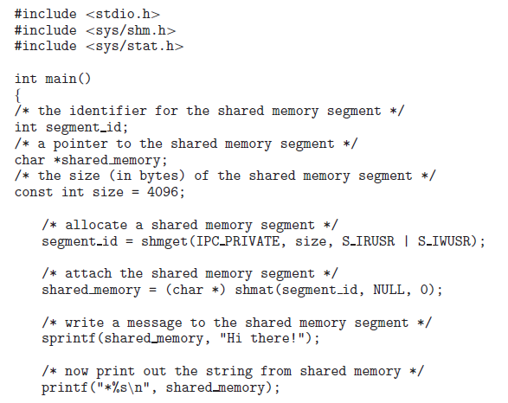

Slide 40
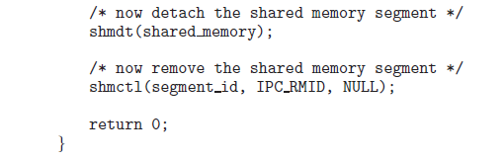
a process using an existing shared-memory segment first attaches
the shared-memory region to its address space and then accesses (and possibly updates) the region of shared memory.

Slide 41
Examples of IPC Systems - POSIX
POSIX Shared Memory
  Process first creates shared memory segment
  shm_fd = shm_open(name, O_CREAT | O_RDWR, 0666);
  Also used to open an existing segment to share it
  Set the size of the object
ftruncate(shm fd, 4096);
  Now the process could write to the shared memory
  sprintf(shared memory, "Writing to shared memory");

Slide 42

IPC POSIX Producer
void *mmap(void *addr, size_t length, int prot, int flags,int fd, off_t offset);

Slide 43

IPC POSIX Consumer

