Slide 1
Chapter 5: CPU Scheduling

Slide 2
Chapter 5: CPU Scheduling
Basic Concepts
Scheduling Criteria
Scheduling Algorithms
Thread Scheduling
Multiple-Processor Scheduling
Operating Systems Examples
Algorithm Evaluation

Slide 3
Objectives
To introduce CPU scheduling, which is the basis for multiprogrammed operating systems
To describe various CPU-scheduling algorithms
To discuss evaluation criteria for selecting a CPU-scheduling algorithm for a particular system

Slide 4
Component 1: CPU Scheduler
Selects from among the processes in memory that are ready to execute, and allocates the CPU to one of them
CPU scheduling decisions may take place when a process:
  1. Switches from running to waiting state
  2. Switches from running to ready state
  3. Switches from waiting to ready
  Terminates
Scheduling under 1 and 4 is non-preemptive
All other scheduling is preemptive

Slide 5
Component 2: Dispatcher
Dispatcher module gives control of the CPU to the process selected by the scheduler; this involves:
  switching context
  switching to user mode
  jumping to the proper location in the user program to restart that program
Dispatch latency – time it takes for the dispatcher to stop one process and start another running

Slide 6
Scheduling Criteria
CPU utilization – keep the CPU as busy as possible
Throughput – # of processes that complete their execution per time unit
Turnaround time – amount of time to execute a particular process
Waiting time – amount of time a process has been waiting in the ready queue
Response time – amount of time it takes from when a request was submitted until the first response is produced, not output

Slide 7
Scheduling Algorithm Optimization Criteria
Max CPU utilization
Max throughput
Min turnaround time
Min waiting time
Min response time

Slide 8
First-Come, First-Served (FCFS) Scheduling
Process Burst Time
P₁ 24
P₂ 3
P₃ 3
Suppose that the processes arrive in the order: P₁ , P₂ , P₃
The Gantt Chart for the schedule is:
Waiting time for P₁ = 0; P₂ = 24; P₃ = 27
Average waiting time: (0 + 24 + 27)/3 = 17
P₁
P₂
P₃
0
24
27
30

Slide 9
convoy effect:
I/0 processes end up waiting in the ready queue until the CPU-bound process is done; as all the other processes wait for the one big process to get off the CPU. This effect results in lower CPU and device utilization than might be possible if the shorter processes were allowed to go first.
The FCFS algorithm is thus particularly troublesome for time-sharing systems, where it is important that each user get a share of the CPU at regular intervals.

Slide 10
FCFS Scheduling (Cont.)
Suppose that the processes arrive in the order:
P₂ , P₃ , P₁
The Gantt chart for the schedule is:
Waiting time for P₁ = 6; P₂ = 0; P₃ = 3
Average waiting time: (6 + 0 + 3)/3 = 3
Much better than previous case
P₂
P₃
P₁
0
3
6
30

Slide 11
Shortest-Job-First (SJF) Scheduling
Associate with each process the length of its next CPU burst. Use these lengths to schedule the process with the shortest time.
If the next CPU bursts of two processes are the same, FCFS scheduling is used to break the tie.
SJF-preemptive
SJF-Non-preemptive
SJF is optimal – gives minimum average waiting time for a given set of processes
  The difficulty is knowing the length of the next CPU request.

Slide 12
Example of SJF
Process Arrival Time Burst Time
P₁ 0.0 6
P₂ 2.0 8
P₃ 4.0 7
P₄ 5.0 3
SJF scheduling chart
Average waiting time = (3 + 16 + 9 + 0) / 4 = 7
P₄
P₁
P₃
P₂
0
3
9
16
24

Slide 13
SJF scheduling is used frequently in long-term scheduling.
With short-term scheduling, there is no way to know the length of the next CPU burst.
One approach to this problem is to try to approximate SJF scheduling.
If we know the length of the next CPU burst, but we may be able to predict its value.
We expect that the next CPU burst will be similar in length to the previous ones.

Slide 14
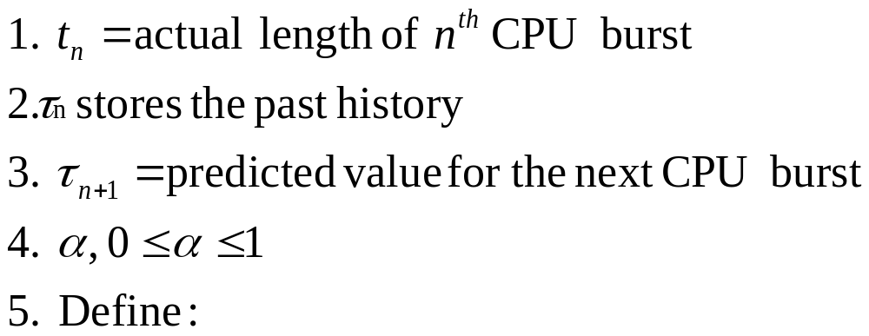
Determining Length of Next CPU Burst
Can be done by using the length of previous CPU bursts, using exponential averaging
τ _{n+1} = α t _{n} + (1- α) τ _{n}

Slide 15

Prediction of the Length of the
Next CPU Burst

Slide 16
Examples of Exponential Averaging
α =0
  τ_{n+1} = τ_{n}
  Recent CPU burst does not count; But past history counts.
α =1
  τ_{n+1} = α t_{n}
  Only the actual last CPU burst counts.

Slide 17
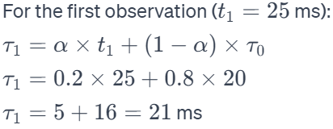
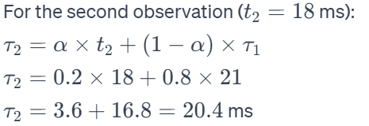
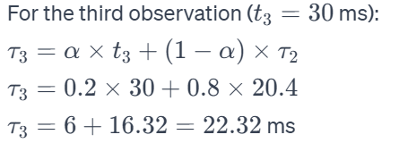
Assume an initial estimate (τ₀​) of 20 milliseconds, a smoothing factor (α) of 0.2, and a sequence of observed burst lengths as follows:
t₀=25 ms(assume this is the currunt CPU burst)
t₁=18 ms
t₂=30 ms
t₀
t₁
t₂

Slide 18
Priority Scheduling
A priority number (integer) is associated with each process
The CPU is allocated to the process with the highest priority (smallest integer ≡ highest priority)
  Preemptive
  Non-preemptive
Note that SJF is a priority scheduling where priority is the predicted next CPU burst time
Problem ≡ Starvation – low priority processes may never execute
Solution ≡ Aging – as time progresses increase the priority of the process

Slide 19
Round Robin (RR)
Each process gets a small unit of CPU time (time quantum), usually 10-100 milliseconds. After this time has elapsed, the process is preempted and added to the end of the ready queue.
Performance
  TS large ⇒ FIFO
  TS small ⇒ may hit the context switch wall, overhead is too high.

Slide 20
Example of RR with Time Quantum = 4
Process Burst Time
P₁ 24
P₂ 3
P₃ 3
The Gantt chart is:
P₁
P₂
P₃
P₁
P₁
P₁
P₁
P₁
0
4
7
10
14
18
22
26
30

Slide 21
Multilevel Queue
Ready queue is partitioned into separate queues:
  foreground (interactive)
  background (batch)
Each queue has its own scheduling algorithm:
  foreground – RR
  background – FCFS
Scheduling must be done between the queues:
  Fixed priority scheduling; (i.e., serve all from foreground then from background). Possibility of starvation.
  Time slice – each queue gets a certain amount of CPU time which it can schedule amongst its processes; i.e., 80% to foreground in RR, 20% to background in FCFS

Slide 22

Multilevel Queue Scheduling

Slide 23
Multilevel Feedback Queue
A process can move between the various queues; aging can be implemented this way.
Multilevel-feedback-queue scheduler defined by the following parameters:
  number of queues
  scheduling algorithms for each queue
  method used to determine when to upgrade a process
  method used to determine when to demote a process
  method used to determine which queue a process will enter when that process needs service

Slide 24
Example of Multilevel Feedback Queue
Three queues:
  Q₀ – RR with time quantum 8 milliseconds
  Q₁ – RR time quantum 16 milliseconds
  Q₂ – FCFS
Scheduling
  A new job enters queue Q₀ which is served RR. When it gains CPU, job receives 8 milliseconds. If it does not finish in 8 milliseconds, job is moved to queue Q₁.
  At Q₁ job is again served RR and receives 16 additional milliseconds. If it still does not complete, it is preempted and moved to queue Q₂.

Slide 25

Multilevel Feedback Queues

Slide 26
End of Chapter 5

