Slide 1
Chapter 6: Process Synchronization

Slide 2
Module 6: Process Synchronization
Background
The Critical-Section Problem
Peterson’s Solution
Synchronization Hardware
Semaphores
Classic Problems of Synchronization
Monitors
Synchronization Examples
Atomic Transactions

Slide 3
Objectives
To introduce the critical-section problem, whose solutions can be used to ensure the consistency of shared data
To present both software and hardware solutions of the critical-section problem
To introduce the concept of an atomic transaction and describe mechanisms to ensure atomicity

Slide 4
Background
Process Synchronization is a technique which is used to coordinate the process that use shared Data.
Independent Process –
The process that does not affect or is affected by the other process while its execution then the process is called Independent Process. Example The process that does not share any shared variable, database, files, etc.
Cooperating Process –
The process that affect or is affected by the other process while execution, is called a Cooperating Process. Example The process that share file, variable, database, etc are the Cooperating Process
Concurrent access to shared data may result in data inconsistency
Maintaining data consistency requires mechanisms to ensure the orderly execution of cooperating processes
Suppose that we wanted to provide a solution to the consumer-producer problem that fills the buffer. We can do so by having an integer count that keeps track of the number of elements in the buffer. Initially, count is set to 0. It is incremented by the producer after it produces a new item into the buffer and is decremented by the consumer after it consumes the item in the buffer.

Slide 5
Producer
while (true) {
/* produce an item and put in nextProduced */
while (counter == BUFFER_SIZE)
; // do nothing
buffer [in] = nextProduced;
in = (in + 1) % BUFFER_SIZE;
counter++;
}

Slide 6
Consumer
while (true) {
while (counter == 0)
; // do nothing
nextConsumed = buffer[out];
out = (out + 1) % BUFFER_SIZE;
counter--;
/* consume the item in nextConsumed
}

Slide 7
Race Condition
counter++ could be implemented as
register1 = counter
register1 = register1 + 1
counter = register1
counter-- could be implemented as
register2 = counter
register2 = register2 - 1
count = register2
Consider this execution interleaving with “count = 5” initially:
  S0: producer execute register1 = counter {register1 = 5}
  S1: producer execute register1 = register1 + 1 {register1 = 6}
  S2: consumer execute register2 = counter {register2 = 5}
  S3: consumer execute register2 = register2 - 1 {register2 = 4}
  S4: producer execute counter = register1 {count = 6 }
  S5: consumer execute counter = register2 {count = 4}

Slide 8
A situation like this, where several processes access and manipulate the same data concurrently and the outcome of the execution depends on the particular order in which the access takes place, is called a race condition.
ensure that only one process at a time can be manipulating
the variable counter
the problem with critical sections is called a race condition, where the outcome of the program depends on the order in which concurrent processes or threads execute
Race conditions can result in a wide range of issues, including data corruption, deadlocks, and resource starvation.

Slide 9
Critical Section Problem
Consider system of n processes {p₀, p₁, … p_{n-1}}
Each process has critical section segment of code
  Process may be changing common variables, updating table, writing file, etc
When one process is executing in its critical section, no other process is to be allowed to execute in critical section. That is, no two processes are executing in their critical sections at the same time. Critical section problem is to design protocol to solve this.
Each process must ask permission to enter critical section in entry section, may follow critical section with exit section, then remainder section
Especially challenging with preemptive kernels

Slide 10
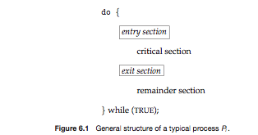
Critical Section
General structure of process p_{i} is

Slide 11
Solution to Critical-Section Problem
1. Mutual Exclusion - If process P_{i} is executing in its critical section, then no other processes can be executing in their critical sections.
2. Progress - If no process is executing in its critical section and some processes wish to enter their critical sections, then only those processes that are not executing in their remainder sections can participate in deciding which will enter its critical section next, and this selection cannot be postponed indefinitely.(decision must be taken within a finite time)
3. Bounded Waiting - A bound must exist on the number of times that other processes are allowed to enter their critical sections after a process has made a request to enter its critical section and before that request is granted.

Slide 12
First Version of Dekker’s Algorithm
Succeeds in enforcing the mutual exclusion.
The processor’s must enter and exit their critical sections in strict alteration (so inefficient).
Enforces lockstep synchronization problem.
program versionone;
var processnumber: integer;
procedure processone;
begin
while true do
begin
while processnumber=2 do;
critical_section_one;
processnumber:=2;
otherstuffone
end
end;
procedure procestwo;
begin
while true do
begin
while processnumber=1 do;
critical_section_two;
processnumber:=1;
otherstufftwo
end
end;
begin
processnumber:=1;
parbegin
processone;
processtwo;
parend
end;
It means each process depends on other to complete its execution. If one of the two processes completes its execution, then the second process runs.
Same process can’t enter CS continuously

Slide 13
Second Version of Dekker’s Alg
program versiontwo;
var p1inside, p2inside : boolean;
Lockstep synchronization is removed(but it creates new problem; both enters simultaneously into the CS). Lockstep synchronization is removed by using two flags to indicate its current status and updates them accordingly at the entry and exit section.
procedure processone;
begin
while true do
begin
while p2inside do;
p1inside:=true;
critical_section_one;
p1inside:=false;
otherstuffone
end
end;
procedure procestwo;
begin
while true do
begin
while p1inside do;
p2inside:=true;
critical_section_two;
p2inside:=false;
otherstufftwo
end
end;
begin
p1inside:=false;
p2inside:=false;
parbegin
processone;
processtwo;
parend
end;
statements are generally atomic, but series of statements are not
Mutual exclusion is not guaranteed

Slide 14
During flag update, if threads are preempted then both the threads enter into the critical section. Once the preempted thread is restarted, also the same can be observed at the start itself, when both the flags are false.

Slide 15
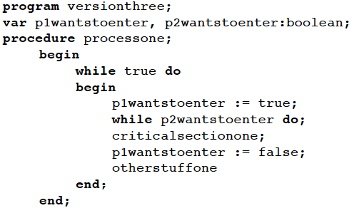



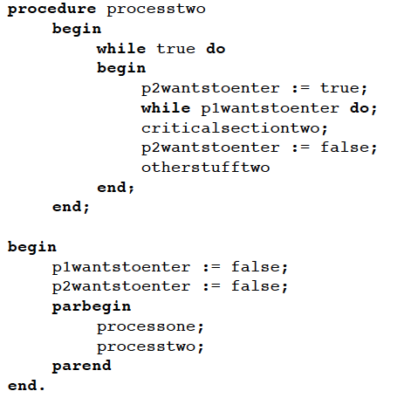
Mutual exclusion is guaranteed.
Introduces two-process deadlock.
Both threads could get flag simultaneously and they will wait for infinite time.
Both threads should not set the flag simultaneously, introduce randomness in the next version(4)
Version 3

Slide 16
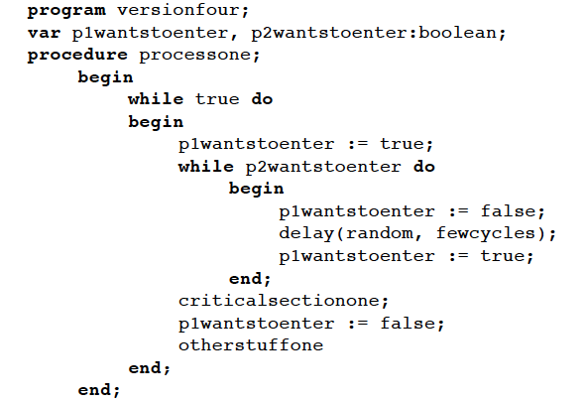

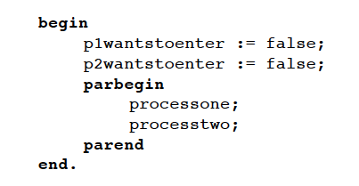

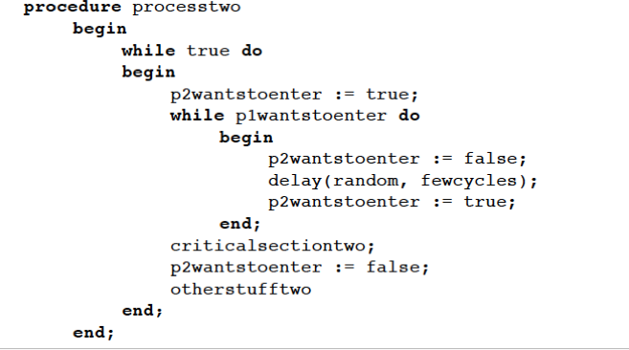
Mutual exclusion is guaranteed.
Deadlock cannot occur.
Indefinite postponement could occur.(random delay)
Version 4 is unacceptable.
Version 4

Slide 17
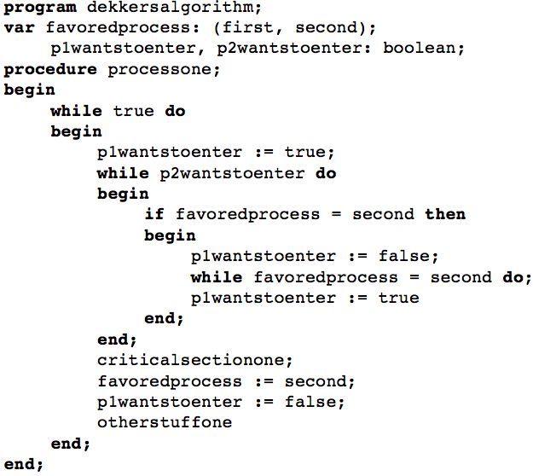
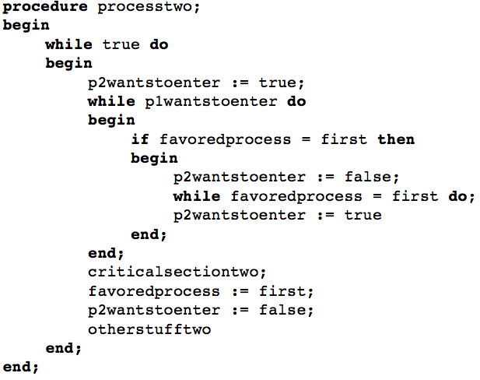
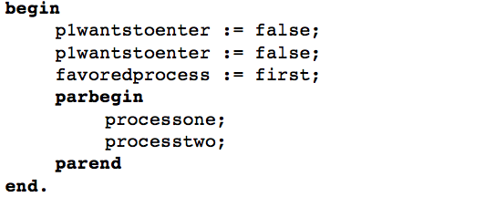
Dekker’s algorithm
Mutual exclusion guaranteed.
Lockstep Synchronization not enforced.
Deadlock is avoided.
Resolves possibility of indefinite postponement.

Slide 18
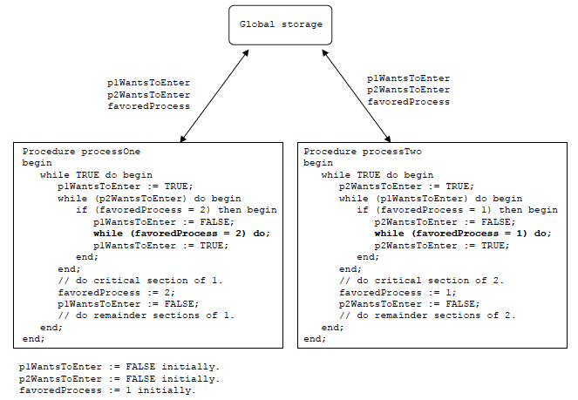
Dekker’s algorithm of ME Primitive
Mutual exclusion guaranteed.
Lockstep Synchronization not enforced.
Deadlock is avoided.
Resolves possibility of indefinite postponement.

Slide 19
Peterson’s Solution
Two process solution
The two processes share two variables:
  int turn;
  Boolean flag[2]
The variable turn indicates whose turn it is to enter the critical section
The flag array is used to indicate if a process is ready to enter the critical section. flag[i] = true implies that process P_{i} is ready!

Slide 20

Peterson’s Solution-Algorithm for Process P_{i}
Algorithm for Process P_{j}
do {
flag[j] = TRUE;
turn =i;
while (flag[i] && turn ==i);
critical section
flag[j] = FALSE;
remainder section
} while (TRUE);
do {
flag[i] = TRUE;
turn = j;
while (flag[j] && turn == j);
critical section
flag[i] = FALSE;
remainder section
} while (TRUE);
Provable that
Mutual exclusion is preserved
Progress requirement is satisfied
Bounded-waiting requirement is met
Disadv:
Holds good only for 2 processes

Slide 21
Synchronization Hardware
Many systems provide hardware support for critical section code
Uniprocessors – could disable interrupts
  Currently running code would execute without preemption
  Generally too inefficient on multiprocessor systems
    Operating systems using this not broadly scalable
Modern machines provide special atomic hardware instructions
    Atomic = non-interruptable
  Either test memory word and set value
  Or swap contents of two memory words

Slide 22
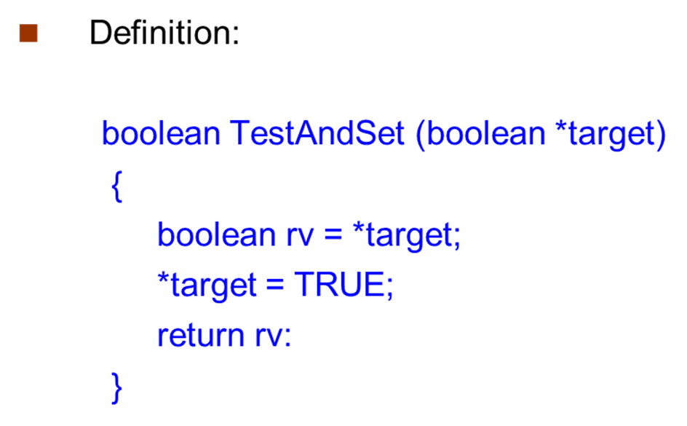
TestAndSet Instruction

Slide 23
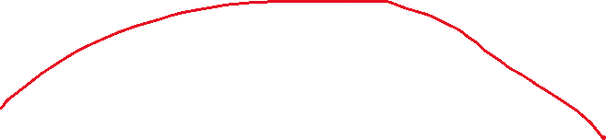
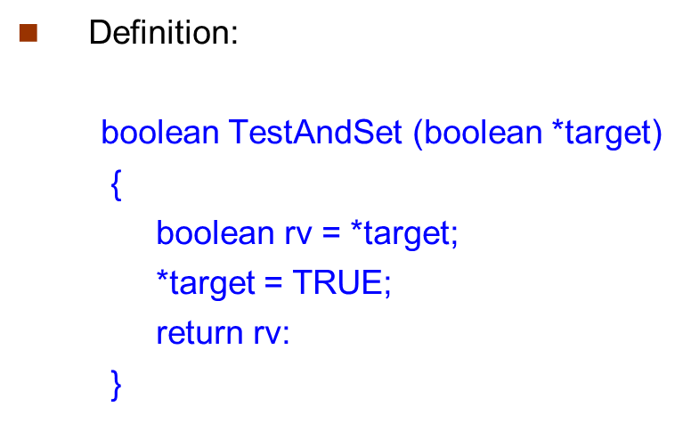
Solution using TestAndSet
Shared boolean variable lock, initialized to FALSE
Solution:
do {
while ( TestAndSet (&lock ))
; // do nothing
// critical section
lock = FALSE;
// remainder section
} while (TRUE);
The Test and Set solution does not satisfy bounded waiting. There is no inherent mechanism in the solution to limit the waiting time for a process trying to acquire the lock.

Slide 24
Swap Instruction
Definition:
void Swap (boolean *a, boolean *b)
{
boolean temp = *a;
*a = *b;
*b = temp:
}

Slide 25
Solution using Swap
Shared Boolean variable lock initialized to FALSE; Each process has a local Boolean variable key
Solution:
do {
key = TRUE;
while ( key == TRUE)
Swap (&lock, &key );
// critical section
lock = FALSE;
// remainder section
} while (TRUE);
void Swap (boolean *a, boolean *b)
{
boolean temp = *a;
*a = *b;
*b = temp:
}

Slide 26
Bounded-waiting Mutual Exclusion with TestandSet()
every process should get its turn eventually, and no process should be starved indefinitely.
do {
waiting[i] = TRUE;
key = TRUE;
while (waiting[i] && key)
key = TestAndSet(&lock);
waiting[i] = FALSE;
// critical section
j = (i + 1) % n;
while ((j != i) && !waiting[j])
j = (j + 1) % n;
if (j == i)
lock = FALSE;
else
waiting[j] = FALSE;
// remainder section
} while (TRUE);
do {
waiting[i] = TRUE;
key = TRUE;
while (waiting[i] && key)
key = TestAndSet(&lock);
waiting[i] = FALSE;
// critical section
j = (i + 1) % n;
while ((j != i) && !waiting[j])
j = (j + 1) % n;
if (j == i)
lock = FALSE;
else
waiting[j] = FALSE;
// remainder section
} while (TRUE);

Slide 27
Semaphores are versatile and can be used to control access to multiple resources, not just critical sections. This makes them suitable for scenarios where coordination and synchronization involve more than just protecting shared data.
Semaphores can be used as counting mechanisms, allowing multiple threads or processes to acquire/release multiple permits. This is useful in scenarios where more than one resource is available, and multiple processes can proceed concurrently.

Slide 28
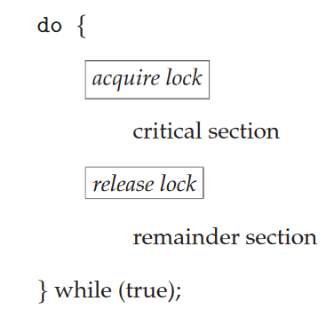
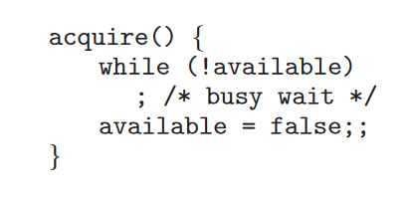
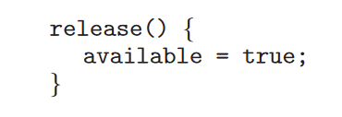
Mutex Locks
Problem: spinlock - process "spins" while waiting for the lock.

Slide 29
Semaphore
Semaphore S – integer variable
Two standard operations modify S: wait() and signal()
  Originally called P() →P (from the Dutch proberen, "to test");
  V()→ (from verhogen, "to increment").
Less complicated
Can only be accessed via two indivisible (atomic) operations
  wait (S) {
  while S <= 0
  ; // no-op
  S--;
  }
  signal (S) {
  S++;
  }
2 versions of semaphore exists, 1st version with busy waiting, 2nd version with blocking call

Slide 30
Semaphore as
General Synchronization Tool
Binary semaphore – integer value can range only between 0 and 1; can be simpler to implement
  Also known as mutex locks
Mutual-exclusion implementation with Binary semaphore
Semaphore mutex; // initialized to 1
  do {
  wait (mutex);
  // Critical Section
  signal (mutex);
  // remainder section
  } while (TRUE);

Slide 31
Use a binary semaphore when the goal is to protect a critical section. The binary semaphore ensures that only one thread or process can execute in the critical section at any given time.
Use a counting semaphore when you have a fixed number of resources that can be shared among multiple threads or processes, but the access to these resources does not constitute a critical section that requires mutual exclusion.
  Managing access to multiple resources. Counting semaphores allow multiple threads or processes to access shared resources concurrently, up to a specified limit. They are not typically used to enforce mutual exclusion in critical sections, as they allow more than one thread to proceed if the count is greater than 1.
  Eg: DB connections

Slide 32
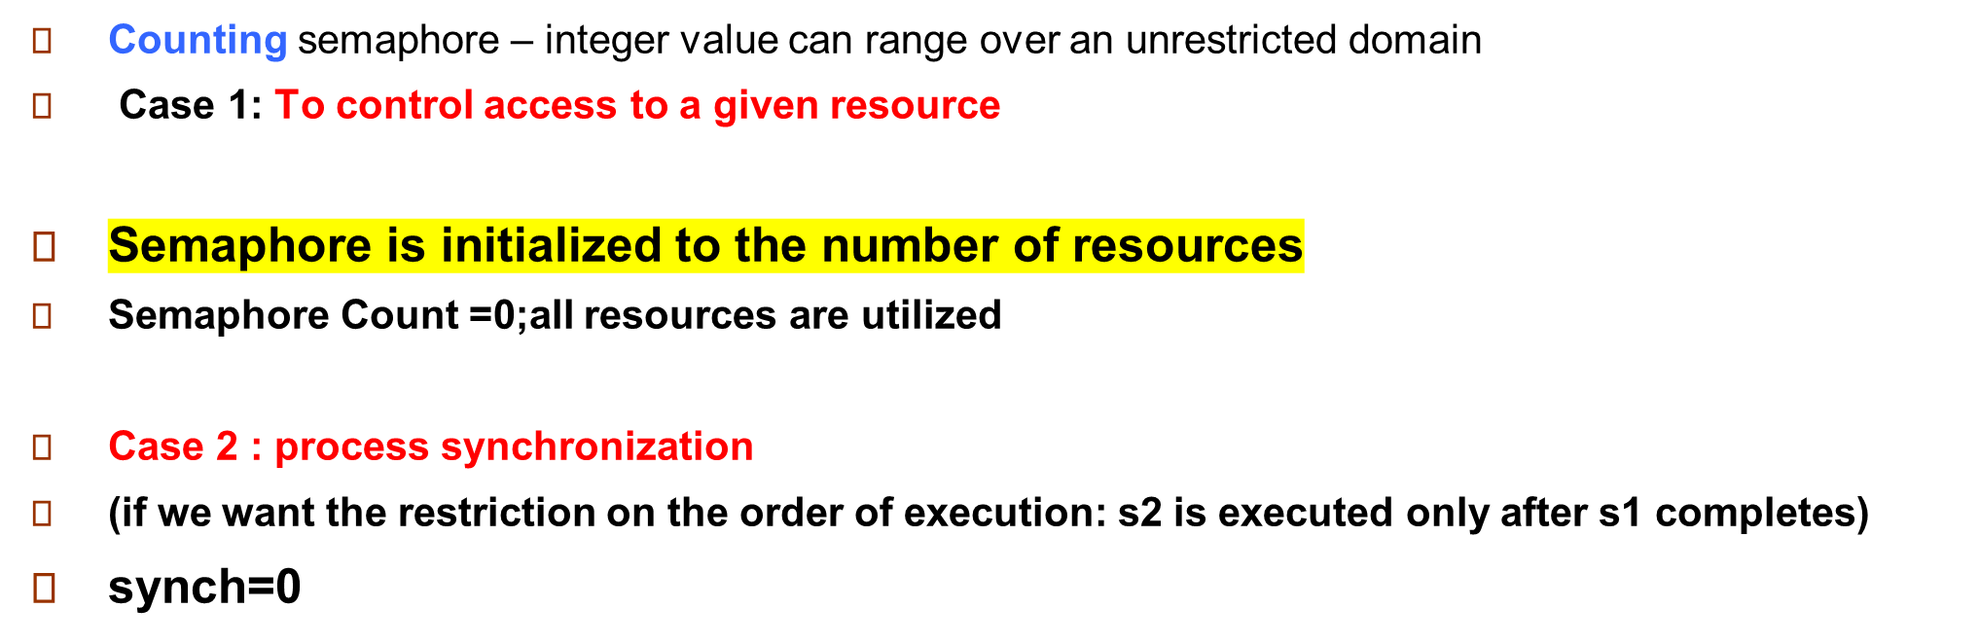


Disadvantage: Busy waiting thus wastes CPU cycles

Slide 33
While a process is in its critical section, any other process that tries to enter its critical section must loop continuously in the entry code.
This type of semaphore is also called spinlock a because the process "spins" while waiting for the lock.
Busy waiting wastes CPU cycles that some other process might be able to use productively.
To overcome the need for busy waiting, we can modify the definition of the wait() and signal() semaphore operations.
rather than engaging in busy waiting, the process can block itself. The block operation places a process into a waiting queue associated with the semaphore

Slide 34
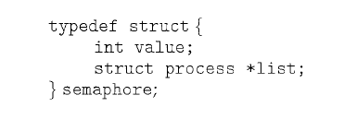
Semaphore Implementation with no Busy waiting
With each semaphore there is an associated waiting queue
Each entry in a waiting queue has two data items:
  value (of type integer)
  pointer to next record in the list
Two operations:
  block – place the process invoking the operation on the appropriate waiting queue
  wakeup – remove one of processes in the waiting queue and place it in the ready queue

Slide 35
Semaphore Implementation with no Busy waiting (Cont.)
Here, semaphore values may be negative, whereas semaphore values are never negative under the classical definition of semaphores with busy waiting.
Synchronization tool that does not require busy waiting
Implementation of wait:
wait(semaphore *S) {
S->value--;
if (S->value < 0) {
add this process to S->list;
block();
}
}
Implementation of signal:
signal(semaphore *S) {
S->value++;
if (S->value <= 0) {
remove a process P from S->list;
wakeup(P);
}
}
Semaphore value –ve indicates the processes waiting to acquire that semaphore
Entry
Put the processes from the blocked list to ready queue… not into CS
Exit

Slide 36
Deadlock and Starvation
Deadlock – two or more processes are waiting indefinitely for an event
Let S and Q be two semaphores initialized to 1
P₀ P₁
wait (S); wait (Q);
wait (Q); wait (S);
. .
. .
. .
signal (S); signal (Q);
signal (Q); signal (S);
Starvation – indefinite blocking
  occur if we remove processes from the list associated with a semaphore in LIFO order
S=0
Q=0
Q=-1
S=-1

Slide 37
Priority Inversion
Priority Inversion – Scheduling problem when lower-priority process holds a lock needed by higher-priority process
Solved via priority-inheritance protocol
L and H share/modify kernel data(CS)
Assume we have three processes, L, M, and H, whose priorities follow the order L < M < H. Assume that process H requires resource R, which is currently being accessed by process L. Ordinarily, process H would wait for L to finish using resource R.
M becomes runnable, thereby preempting process
a process with a lower priority—process M—has affected how long process H must wait for L to relinquish resource R.
This problem is known as priority inversion.
priority-inheritance protocol would allow process L to temporarily inherit the priority of process H, thereby preventing process M from preempting its execution. When process L had finished using resource R, it would relinquish its inherited priority from H and assume its original priority. Because resource R would now be available, process H—not M—would run next.
L and H(not M) share resource R

Slide 38
Classical Problems of Synchronization
Classical problems used to test newly-proposed synchronization schemes
  Bounded-Buffer Problem (When producer is producing an item the consumer must not consume the item)
  Readers and Writers Problem
  Dining-Philosophers Problem

Slide 39
Bounded-Buffer Problem
N buffers, each can hold one item
Semaphore mutex initialized to the value 1
Semaphore full initialized to the value 0
Semaphore empty initialized to the value N

Slide 40
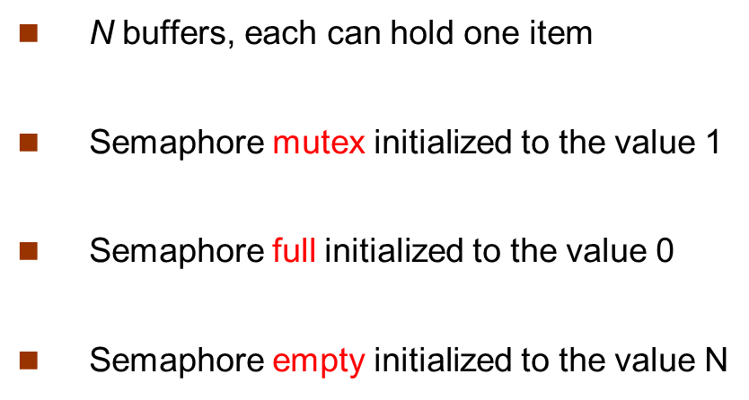
Bounded Buffer Problem (Cont.)
The structure of the producer process
do {
// produce an item in next_produced
wait (empty);
wait (mutex);
// add the item next_produced to the buffer
signal (mutex);
signal (full);
} while (TRUE);

Slide 41
Bounded Buffer Problem (Cont.)
The structure of the consumer process
do {
wait (full);
wait (mutex);
// remove an item from buffer to next_consumed
signal (mutex);
signal (empty);
// consume the item in next_consumed
} while (TRUE);

Slide 42
Readers-Writers Problem
A data set is shared among a number of concurrent processes
Problem – allow multiple readers to read at the same time
Only one single writer can access the shared data at the same time
Shared Data
  Semaphore mutex initialized to 1
  Semaphore wrt initialized to 1
  Integer readcount initialized to 0

Slide 43
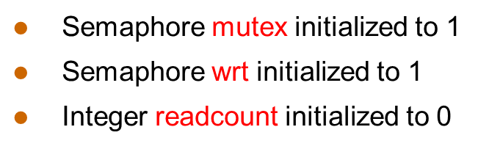
Readers-Writers Problem
semaphore wrt functions as a mutual-exclusion semaphore for the writers.
The structure of a writer process
do {
wait (wrt) ;
// writing is performed
signal (wrt) ;
} while (TRUE);

Slide 44
Readers-Writers Problem (Cont.)
The structure of a reader process
do {
wait (mutex) ;
readcount ++ ;
if (readcount == 1)
wait (wrt) ;
signal (mutex)
// reading is performed
wait (mutex) ;
readcount - - ;
if (readcount == 0)
signal (wrt) ;
signal (mutex) ;
} while (TRUE);

Slide 45
First reader process will lock the writer process
Last reader process will enable or allow the writer
process to proceed
Ensure the modification of readcount by only one process
do {
wait (mutex) ;
readcount ++ ;
if (readcount == 1)
wait (wrt) ;
signal (mutex)
// reading is performed
wait (mutex) ;
readcount - - ;
if (readcount == 0)
signal (wrt) ;
signal (mutex) ;
} while (TRUE);

Slide 46

Dining-Philosophers Problem
Philosophers spend their lives thinking and eating
Don’t interact with their neighbors, occasionally try to pick up 2 chopsticks (one at a time) to eat from bowl
  Need both to eat, then release both when done
In the case of 5 philosophers
  Shared data
    Bowl of rice (data set)
    Semaphore chopstick [5] initialized to 1

Slide 47
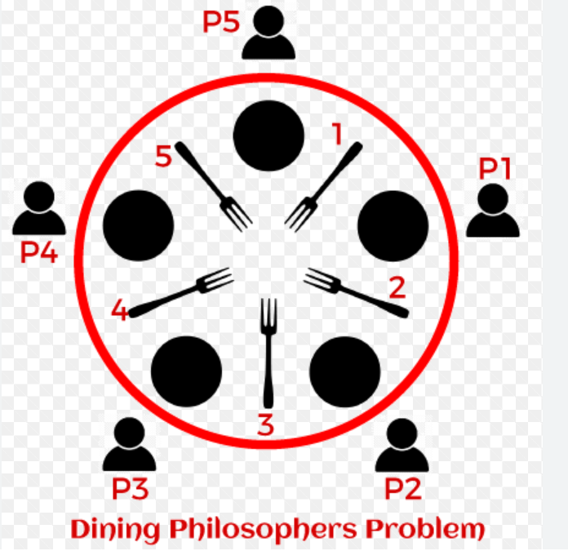
Dining-Philosophers Problem Algorithm
The structure of Philosopher i:
    do {
    wait ( chopstick[i] );
    wait ( chopStick[ (i + 1) % 5] );
    // eat
    signal ( chopstick[i] );
    signal (chopstick[ (i + 1) % 5] );
    // think
    } while (TRUE);
What is the problem with this algorithm?
If all five philosophers become hungry simultaneously and each grabs her left chopstick. All the elements of chopstick will now be equal to 0.When each philosopher tries to grab her right chopstick, she will be delayed forever.

Slide 48
Several possible remedies to the deadlock problem are listed next.
• Allow at most four philosophers to be sitting simultaneously at the table.
• Allow a philosopher to pick up her chopsticks only if both chopsticks are available .
• Allow odd philosopher picks up first her left chopstick and then her right chopstick, whereas an even philosopher picks up her right chopstick and then her left chopstick.

Slide 49
Monitors
A high-level abstraction that provides a convenient and effective mechanism for process synchronization
Abstract data type, internal variables only accessible by code within the procedure
Only one process may be active within the monitor at a time
    monitor monitor-name
    {
    // shared variable declarations
    procedure P1 (…) { …. }
    procedure Pn (…) {……}
    Initialization code (…) { … }
    }
    }

Slide 50

Schematic view of a Monitor

Slide 51
Condition Variables
condition x, y;
Two operations on a condition variable:
  x.wait () – a process that invokes the operation is suspended until x.signal ()
  x.signal () – resumes one of processes (if any) that invoked x.wait ()

Slide 52

Monitor with Condition Variables

Slide 53
Resource
Procedure 1
(Acquire the lock)
P1
Boolean: Busy
Condition: nonbusy
Procedure2
(Release the lock)
P2
if Busy then nonbusy.wait()
Else Busy=TRUE
Busy=FALSE
nonbusy.signal()

Slide 54
Condition Variables Choices
If process P invokes x.signal (), with Q in x.wait () state, what should happen next?
  If Q is resumed, then P must wait
Options include
  Signal and wait – P waits until Q leaves monitor or waits for another condition
  Signal and continue – Q waits until P leaves the monitor or waits for another condition
  Both have pros and cons – language implementer can decide
  Monitors implemented in Concurrent Pascal compromise
    P executing signal immediately leaves the monitor, Q is resumed
  Implemented in other languages including Mesa, C#, Java

Slide 55
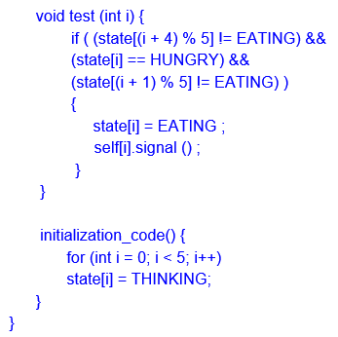
Solution to Dining Philosophers
P4
P0
P3
monitor DiningPhilosophers
{
enum { THINKING; HUNGRY, EATING} state [5] ;
condition self [5];
void pickup (int i) {
state[i] = HUNGRY;
test(i);
if (state[i] != EATING) self [i].wait;
}
void putdown (int i) {
state[i] = THINKING;
// test left and right neighbors
test((i + 4) % 5);
test((i + 1) % 5);
}
P2
P1

Slide 56
a philosopher moves to his/her eating state only if both neighbors are not in their eating states
if one of my neighbors is eating, and I’m hungry, ask them to signal() me when they’re done
“solution ensures that no two neighbors are eating simultaneously and that no deadlock will occur ”

Slide 57
End of Chapter 6

