Slide 1

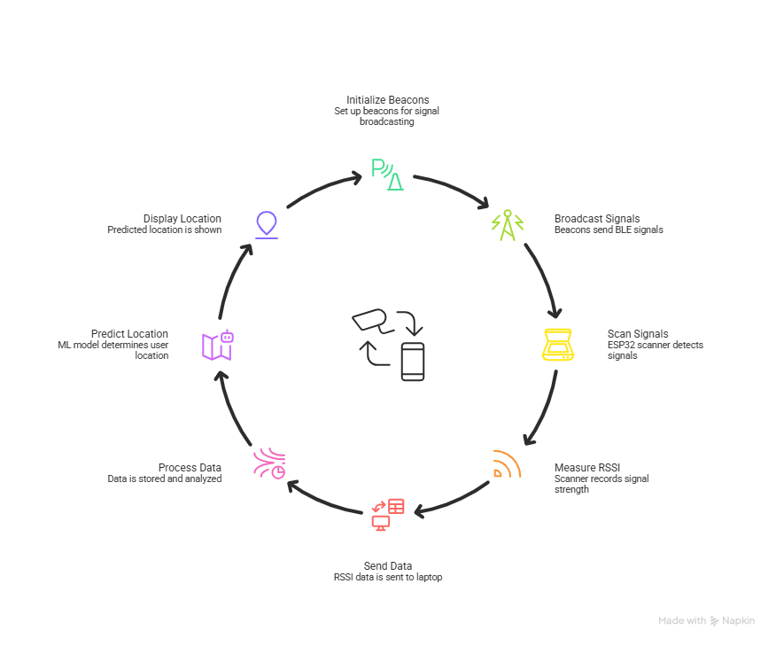
Title: Machine Learning Based Indoor Localization System Using Bluetooth RSSI Signals
Batch No: B8 SRNs: 02FE23BEC083,02FE23BEC112,02FE23BEC122,02FE23BEC123
Student Names: 1) Parth Jadhav Guide: Prof. Pavan Chavalagi
2) Md Danish Shamsher
3) Roopashree Pote
4) Keerti Mahantshetti
Context : Indoor navigation is difficult because GPS signals do not work well inside buildings. This project uses ESP32-based Bluetooth Low Energy (BLE) beacons to create an indoor localization system. A scanning device measures RSSI signal strength from multiple beacons, and machine learning analyze these signals to predict the user’s location inside the building. This provides a low-cost solution for indoor positioning.
Problem Statement : GPS provides accurate positioning outdoors but performs poorly indoors because signals are blocked by walls and other obstacles. As a result, determining the precise location of a person or device inside buildings becomes difficult, creating challenges for indoor navigation, tracking, and location-based services.
Deliverables : Development of a BLE-based indoor localization prototype using ESP32 devices
Collection and analysis of RSSI signal data from multiple beacons
Machine learning model for predicting indoor location
Real-time location prediction of the user/device inside a building
Demonstration of the system for indoor tracking and navigation applications
Training / Pre-Requisites: Basic understanding of Internet of Things (IoT) and ESP32 microcontrollers, Bluetooth Low Energy (BLE) communication, machine learning algorithms, and programming using Python/Arduino. Familiarity with data collection, signal analysis, and basic concepts of indoor positioning systems is also required.
Timeline:
Kick Off
< 1st Month >
Milestone 1
< 2nd Month >
Milestone 2
< 3rd & 4th Month >
Starter Reference Material:
[1] Baejah, Nur Ahmadi, Rahmat Mulyawan, and Trio Adiono, “Real-Time Indoor Localization System Based on Wearable Device, Bluetooth Low Energy (BLE) Beacons, and Machine Learning,” IEEE Access, vol. 12, 2024.
[2] R. M. M. R. Rathnayake, M. W. P. Maduranga, V. Tilwari, and M. B. Dissanayake, “RSSI and Machine Learning-Based Indoor Localization Systems for Smart Cities,” Eng, vol. 4, pp. 1468–1494, 2023.
[3] M. W. P. Maduranga, V. Tilwari, and R. Abeysekera, “Improved RSSI Indoor Localization in IoT Systems with Machine Learning Algorithms,” Signals, vol. 4, pp. 651–668, 2023.
Understanding indoor localization concepts and BLE technology
Studying ESP32 and RSSI signal measurement
Planning system architecture and project design
Setting up ESP32 beacons and scanner
Collecting RSSI signal data from different locations
Preparing dataset for machine learning
Training the machine learning model for location prediction
Testing and improving localization accuracy
Final system integration, documentation, and project demonstration

