Slide 1

International School of Engineering
Guide : Dr. Soumen Manna
2th AUGUST’ 19
CLASS IMBALANCE ANALYSIS
By : Roopa v

Slide 2
Research Statement
The objective is to investigate the best models through all possible imbalance situations for a multiclass dataset
I have done the experiment for all the models to get the results.

Slide 3
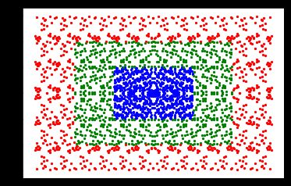
Problem Statement
Datasets are generated randomly within a rectangle pattern of 3 classes.
Total number of data are 3000.
Our task is to classify the observation into 3 classes.
Target: class 1, class 2, class 3 categorical level
Each classes contains 1000 data points totally 3000 data of all 3 classes in a dataset of pattern rectangle.

Slide 4
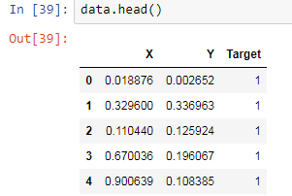

Data Description
Our data consists of 3 features including target attributes
i.e, x, y and target.

Slide 5
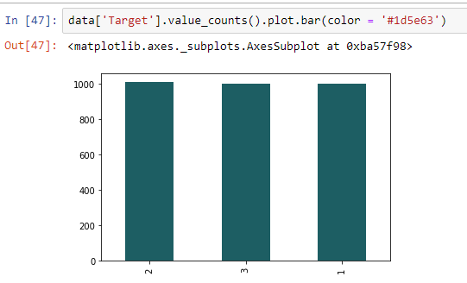
The target attribute has all 3 classes has balanced data.

Slide 6
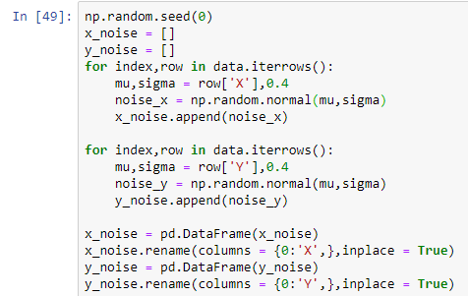
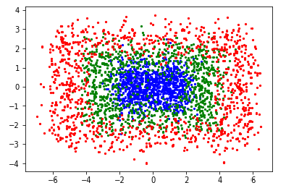
Adding impurities to the dataset.
Here we have added 0.4 % of impurities to the dataset

Slide 7
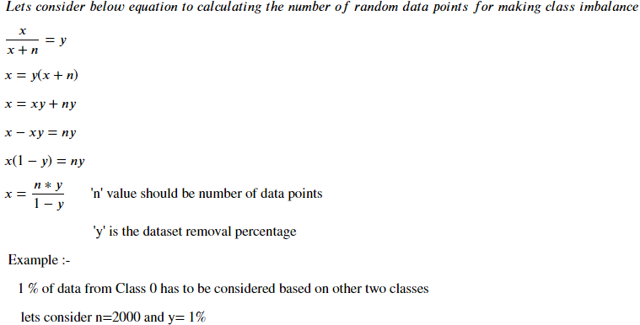
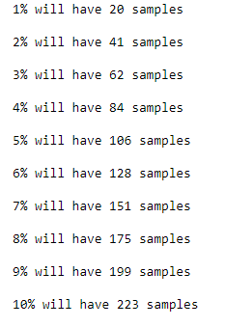
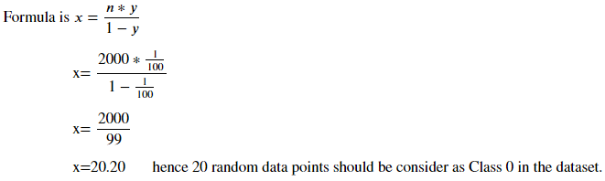
Creating class imbalance for Class - 0,1,2
Here we add impurities from 1% to 10% for each class with that many samples for every class.

Slide 8
Here we investigating the best models through all possible imbalance situation for a multiclass dataset.
So we are making class imbalance by keeping class 1 as a minority class and other 2 classes will remain same is called class imbalanced. In the same way remaining 2 classes will be done.

Slide 9
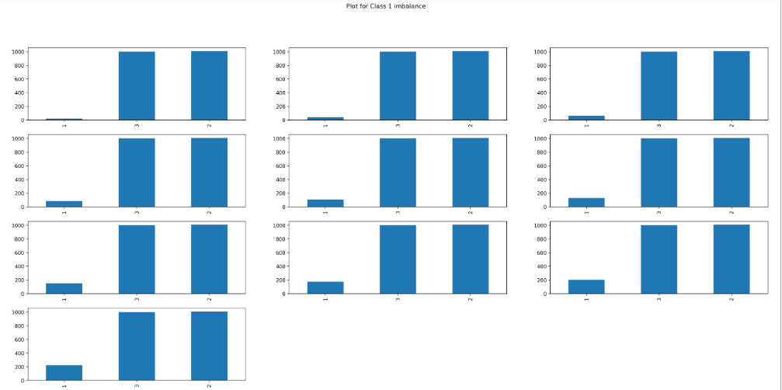

Slide 10
Building models
We have build models for various sampling proportions from 1% to 10%.
The models are :
Logistic regression
Naïve bayes
KNeighborsClassifier
Random forestClassifier
Decision treeClassifier
Svm
ADAboosting
Gradientboosting
Random forest classifier

Slide 11
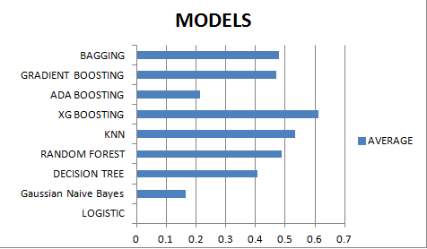
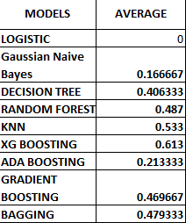
Result
Precision Report :

Slide 12
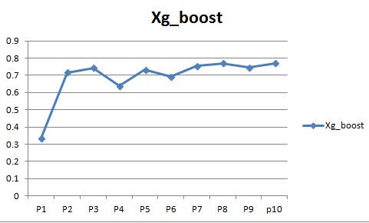
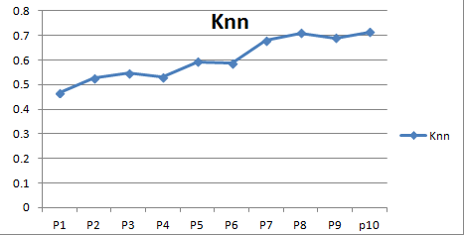
Precision Report
By observing above precision report we can say that compare to other model xgboosting model giving the best result.

Slide 13
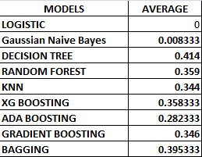
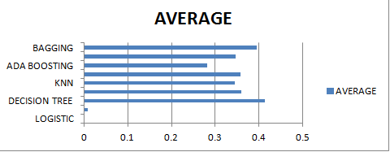
2. RecallReport
Overall average of all the classes r ecall report

Slide 14
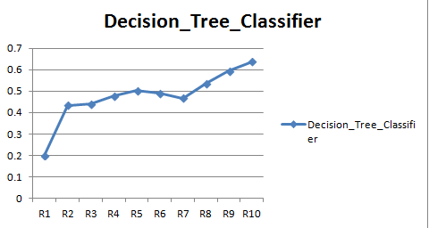
RecallReport
By observing above Recall report we can say that compare to other model Decision tree classifier giving the best result.

Slide 15
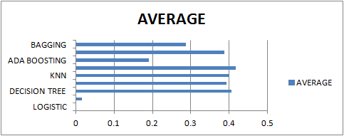
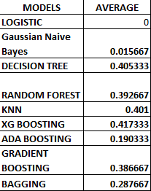
3. F1 sc0re Report
Overall average of all the classes F1 score report .

Slide 16
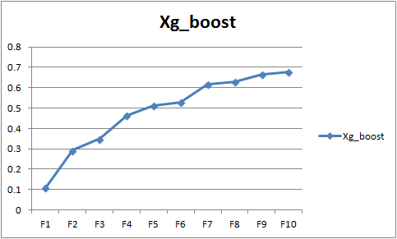
F1 sc0re Report
By observing above F1 score report we can say that compare to other model Xg boosting classifier giving the best result.

