Slide 1
Ethereum
Service Provider
SC_{A}
SC_{B}
1. Implement SC’s
2. Deploy SC’s
Bidder
3. Register Bidder
Manager
4. Get Aggregated
Nonce
5. Initialize Enclave

Slide 2
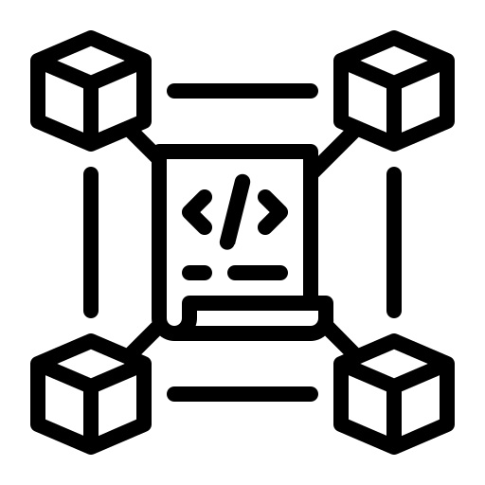
Service Provider
Blockchain
1. Implement and Deploy SC’s
Resource Consumer
2. Create Auction
Bidder
3. Register Bidder
Manager
4. Get Aggregated Nonce
5. Initialize Enclave

Slide 3
Manager
1. Implement and deploy SC’s
Ethereum
2. Deploy SC’s
Resource Consumer
3. Create Auction
4. Register Bidder
Bidder
5. Get Aggregated
Nonce
Manager
6. Initialize Enclave

Slide 4
Manager
Enclave
Bidder
Blockchain
1. Generate
Report
Remote Attestation
2. Verify Report
3. Encrypt and Submit Bid
4. Get Bids
5. Send Bids
6. Decrypt and Determine Winner
Winner Selection
7. Submit Tx

Slide 5
Manager
Enclave
Bidder
BC
Service Provider
Resource Consumer
1. Implement and deploy SC’s
Initialization
2. Create Auction
3. Register
4. Get Aggregated Nonce
5. Initialize Enclave
Remote Attestation
6. Generate
Report
7. Verify Report
8. Encrypt and Submit Bid
9. Get Bids
10. Send Bids
11. Decrypt and Determine Winner
Winner Selection
12. Submit Tx

Slide 6



Manager
Blockchain
Untrusted
Component
1
B_{i}
Bidders
RC
2
3
4
5
B_{i+1}
6
7
B_{i+2}
6.1
6.2
Enclave
.
.
.

Slide 7


Manager (M)
Blockchain
1
B_{i}
Bidders
RC
2
Untrusted
Component
3
B_{i+1}
4
5
6
B_{i+2}
8
7
B_{i+3}
Enclave (E)
  RC
  BIDDER
  MANAGER
.
.
.

Slide 8
dApp
Creator
Smart
Contract
Alice
Verifiers
1. Deploy
Bootstrap
2. Register
3. Generate TX details
4. Get VDF parameters
5. Sample random prime l
6. Compute VDF
7. Send proof
8. Verify and sign
9. Submit TX
10. Verify Signatures
.
.
.
.
.
.
.
.
.

Slide 9
dApp
Creator
Blockchain
Alice
Verifiers
1. Deploy SC
B_{i}
Bootstrap
2. Register
B_{i+1}
3. Generate TX details
4. Get VDF parameters
B_{i+2}
B_{i+3}
5. Sample random prime l
6. Compute VDF
B_{i+4}
7. Send proof
B_{i+5}
8. Verify and sign
9. Submit TX
B_{i+6}
B_{i+7}
.
.
.
10. Verify & Execute
.
.
.
.
.
.
.
.
.

Slide 10
Task
Requester
Manager
(Hosts Enclave)
Blockchain
Providers
1. Create Auction
Auction Initiation
B_{i+1}
2. Register
3. Retrieve Nonce
B_{i+2}
4. Initialize Enclave
5. Attestation Validation
Attestation & Bid Submission
6. Submit Bids
B_{i+3}
7. Retrieve Bids and Reputation State
8. Enclave Computes Winner
B_{i+4}
9. Set Winner On-chain
Winner Selection & Reputation Update
10. Execute Task; Update Reputation
B_{i+5}
.
.
.
.
.
.
.
.
.

Slide 11
dApp
Creator
Verifiers
Blockchain
1. Deploy SC
B_{i+1}
Bootstrap
2. Register
Alice
3. Set TX details
4. Get VDF challenge
B_{i+2}
5. Send prime l
B_{i+3}
6. Compute VDF
7. Send proof
VDF Compute
B_{i+4}
8. Verify & sign
9. Submit TX
Verify & Execute
B_{i+5}
.
.
.
.
.
.
.
.
.

