Slide 1


Profile-Based Customised Emails For Mass Mailing
Name : Mrs. Priya Gochide
Mr. Roopendra Salvi Mr. Vinayak Patil

Slide 2
Introduction
Organisations need personalised mass communication.
Traditional rule-based systems fail at scale.
Solution: AI-driven email generation using user profiles.
Incorporates RAG, MCP(agent to agent communication), and vector search via Pinecone.

Slide 3
Problem Statement
Generic bulk emails lead to low engagement.
Manual personised email writing is slow.
Lack of automated workflow for email response or CTA generation.

Slide 4
Objective
Build a context – aware personalised email engine.
Build profile embeddings and store them in Pinecone.
Use RAG to fetch relevant templates/content.
Use of knowledge base to provide external context to the LLM.
Delivers customised emails.
Intelligent understanding of user profile attributes

Slide 5
Proposed Solution
An AI-powered personalised emailing engine.
Uses Retrieval-Augmented Generation (RAG) for relevant content.
Pinecone for fast similarity search and profile embeddings.
Auto CTA generation and bulk dispatch.

Slide 6
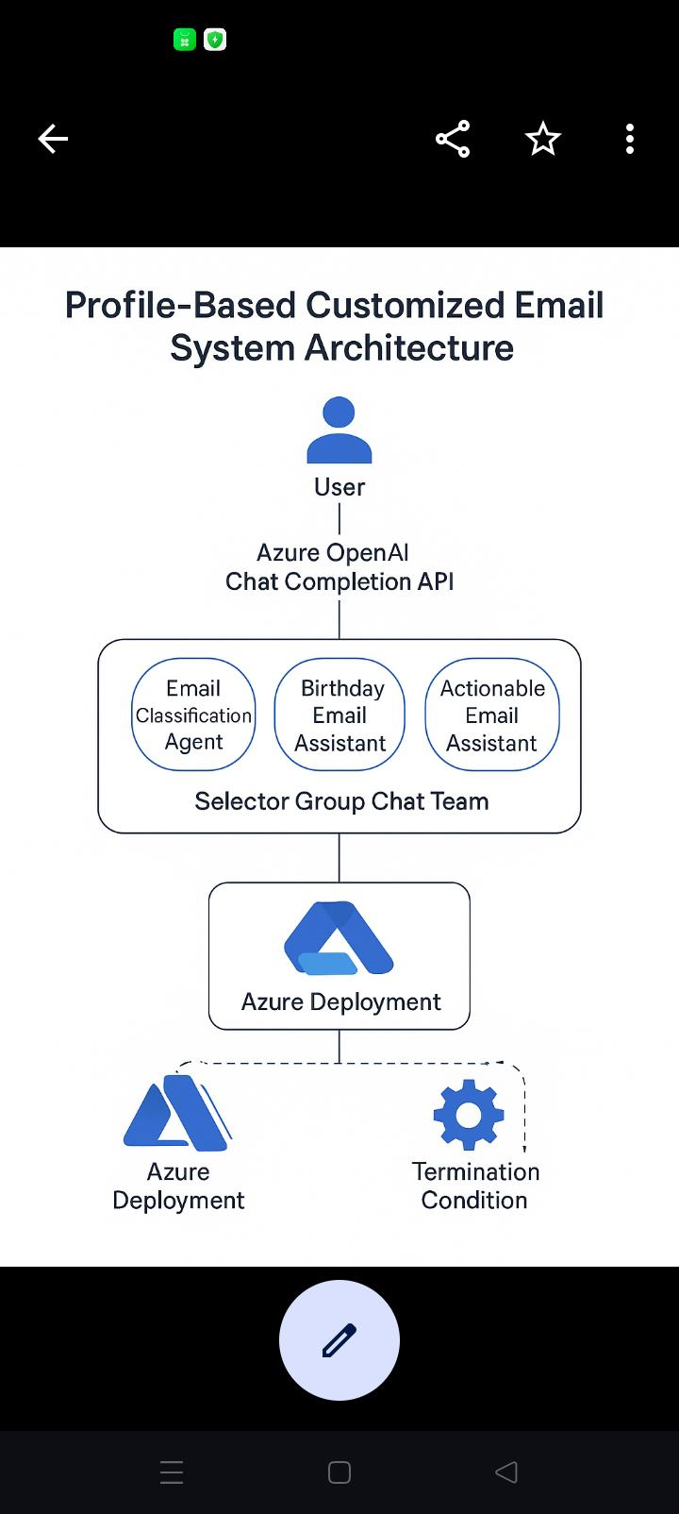
System Architecture

Slide 7
Description
This system describes how personalized emails-such as birthday, work anniversary under one category and in second category it provide actionable mails(leave, assets, meeting, Approval) i.e. classification of incoming mails, responses are generated using Azure Open AI and multiple intelligent agents.

Slide 8
Description
The user profile is converted into embeddings and stores in Pinecone. , RAG retrieves the best-matching template blocks.
LLM generates personalised email text.

Slide 9
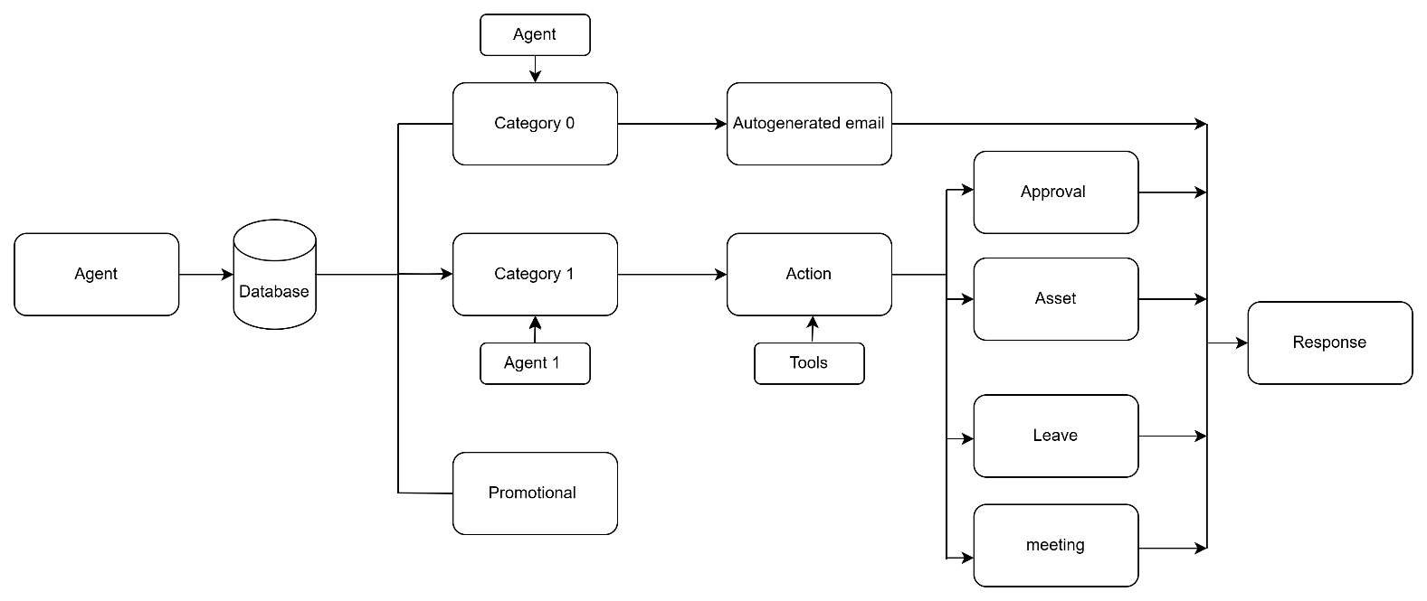
Workflow Overview

Slide 10
Role of MCP
(Model Context Protocol)
In this project MCP is basically used for agent to agent communication.
Also we have used Selector Group Chat, the model analyses the situation to decide who is best suited to respond next.

Slide 11
Role of Pinecone
Stores user profile embeddings.
Performs similarity search for
  Tone selection
  CTA prediction
  Best fit template retrieval.
Enables scalable vector search
Improves personalization accuracy.

Slide 12
Role of RAG
Retrieves relevant content blocks such as:
  Email Templates
  Greetings
  CTA variations
  Tone-specific fragments
Keeps output factual, contextual, and grounded
EnhanceLLM with external documents and templates.

Slide 13
Email Personalisation
Engine
Inputs: profile + retrieved templates + MCP context + LLM reasoning.
Injects personalised fields:
  Name
  Role
  Interests
  Domain/industry
  Behavioural history

Slide 14
Tech stack
FrontEnd: Streamlit
AI & Context layer
  LLM
  RAG
  MCP
  Embeddings Model(text- embedding-3-small)
Storage layer
- Pinecone vector DB
Backend
- Python+ FastAPI

Slide 15
Advantages
Personalisation at scale.
Faster communication cycles
Reduces manual workload.
Less hallucination due to RAG + MCP
High scalability with Pinecone.
Intelligent automated workflow

Slide 16
Use cases
Birthday/ Work Anniversary auto emails.
Asset, Meeting, Approval, Leave
HR workflow communication
Customer Engagement
Summary of the day

Slide 17
Future Enhancement
Behaviour-based content prediction
Real-time email reply summarization.
Predict best send time for each user for maximum open rates.
Track open, click, bounce, and unsubscribe metrics to refine strategy.

Slide 18
Conclusion
Modern AI-powered email system combining RAG +MCP +Pinecone
Enables accurate, personalised email generation at scale.
Ensures consistent, contextual communication.
Ideal for enterprise mass-mailing needs.

