Slide 1
Accident Prevention System at Blind Curves
Department of ECE
Presented by:
Avuthu Roopesh Reddy - 24EG504E01
Under the guidance of:
Dr. Rajesh Thumma
Associate Professor,
Dept. of ECE,
Anurag University
INDUSTRY ORIENTED MINI PROJECT(2026-2027), DEPARTMENT OF ECE - Anurag University

Slide 2
Contents
Abstract
Introduction
Problem Statement
Motivation
Study of Existing Methods
Existing Methodology
Objectives of the Project
Methodology of Proposed Work
Tools / Dataset
Block Diagram
Flow Diagram
References
INDUSTRY ORIENTED MINI PROJECT(2026-2027), DEPARTMENT OF ECE/ECM - Anurag University

Slide 3
Abstract
Blind curves in hilly and mountainous regions are major accident-prone areas due to limited visibility and the inability of drivers to detect approaching vehicles from the opposite direction. Conventional safety measures such as warning signboards, convex mirrors, and speed breakers provide only passive assistance and are often ineffective during adverse weather conditions.
This project presents a low-cost Accident Prevention System at Blind Curves that detects approaching vehicles on both sides of the curve using ultrasonic sensors and exchanges the information wirelessly through LoRa communication.
The system measures vehicle speed, estimates the time required to reach the curve, and classifies vehicles as light or heavy based on height. Using this information, the controller applies priority-based traffic management to determine which vehicle should proceed first and provides real-time alerts through LEDs, a buzzer, and an LCD display. The proposed system enhances driver awareness, reduces the possibility of head-on collisions, and offers a reliable, economical, and scalable solution for improving road safety in hilly and mountainous regions.
INDUSTRY ORIENTED MINI PROJECT(2026-2027), DEPARTMENT OF ECE /ECM - Anurag University

Slide 4
Introduction
Road safety is a major concern in hilly and mountainous regions where blind curves restrict the visibility of approaching vehicles. Drivers navigating such curves often face difficulty in predicting oncoming traffic, leading to accidents, especially when large vehicles are involved. Existing safety measures such as mirrors, signboards, and speed breakers are passive and rely heavily on driver awareness.
With advancements in embedded systems and wireless communication, it is possible to design intelligent systems that provide real-time alerts and predictive information to drivers. This project focuses on developing a smart accident prevention system that not only detects vehicles but also analyzes their speed, direction, and estimated arrival time to prevent collisions proactively.
INDUSTRY ORIENTED MINI PROJECT(2026-2027), DEPARTMENT OF ECE /ECM - Anurag University

Slide 5
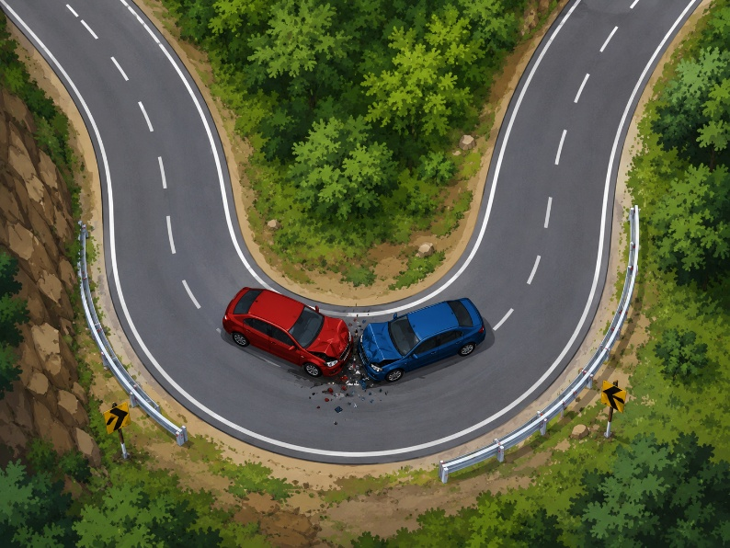
Problem Statement
Blind curves lack real-time communication between approaching vehicles, leading to:
High risk of head-on collisions
Poor visibility in fog, rain, and night
Difficulty for heavy vehicles to maneuver
Insufficient reaction time for drivers
Hence, there is a need for an intelligent, real-time,
and predictive accident prevention system
INDUSTRY ORIENTED MINI PROJECT(2026-2027), DEPARTMENT OF ECE /ECM - Anurag University

Slide 6
Motivation
Increasing accidents in hilly regions due to blind curves.
Lack of smart and dynamic traffic control systems.
Need for low-cost and scalable solutions.
Importance of protecting heavy vehicles and downhill traffic.
INDUSTRY ORIENTED MINI PROJECT(2026-2027), DEPARTMENT OF ECE/ECM - Anurag University

Slide 7
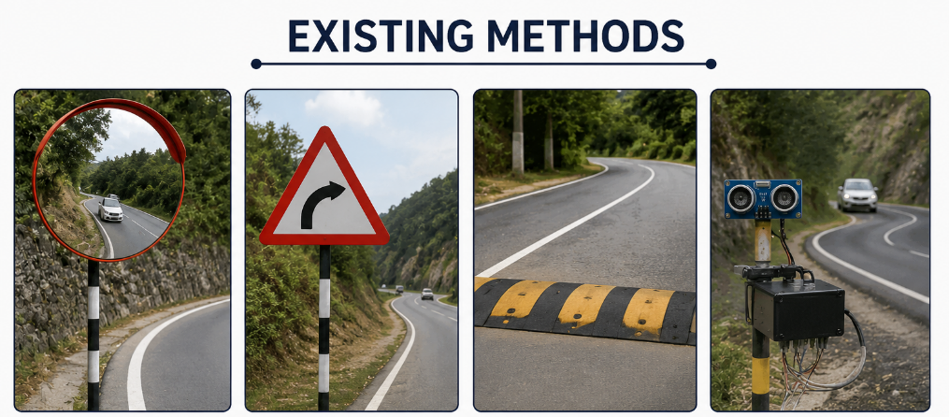
Study of Existing Methods
Existing methods include:
Convex mirrors
Warning signboards
Speed breakers
Basic ultrasonic detection systems
Limitations:
No real-time vehicle detection
No communication between both sides
Ineffective in bad weather
No predictive capability
INDUSTRY ORIENTED MINI PROJECT(2026-2027), DEPARTMENT OF ECE /ECM - Anurag University

Slide 8
Objectives
Detect vehicles in advance
Classify vehicles as light or heavy
Measure vehicle speed
Calculate time to reach the curve (ETA)
Implement priority-based traffic control
Provide real-time visual and audio alerts
Develop a low-cost and scalable system
INDUSTRY ORIENTED MINI PROJECT(2026-2027), DEPARTMENT OF ECE/ECM - Anurag University

Slide 9
Methodology of Proposed Work
Vehicles are detected using ultrasonic sensors
Speed is calculated using dual sensor method
Time-to-curve is estimated
Data is transmitted via LoRa to the main unit
Main controller processes:
Vehicle type
Speed
Direction
ETA
Priority logic applied:
Downhill vehicle priority
Heavy vehicle priority
Alerts generated:
LED signals
Buzzer alerts
LCD messages
INDUSTRY ORIENTED MINI PROJECT(2026-2027), DEPARTMENT OF ECE/ECM - Anurag University

Slide 10
Tools / Dataset
Hardware Tools
1. ESP32
2. NodeMCU
3. Arduino Nano
4. Ultrasonic Sensors (HC-SR04)
5. LoRa Modules
6. LCD Display
7. LEDs & Buzzer
Software Tools
1. Arduino IDE
Dataset
1. Real-time sensor data used
INDUSTRY ORIENTED MINI PROJECT(2026-2027), DEPARTMENT OF ECE /ECM - Anurag University

Slide 11
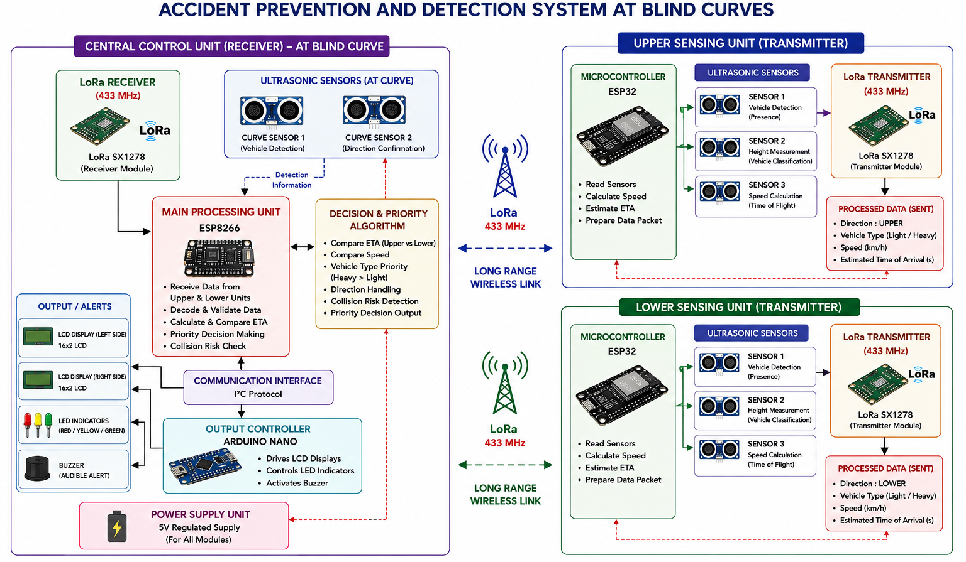
Block Diagram
INDUSTRY ORIENTED MINI PROJECT(2026-2027), DEPARTMENT OF ECE /ECM - Anurag University

Slide 12
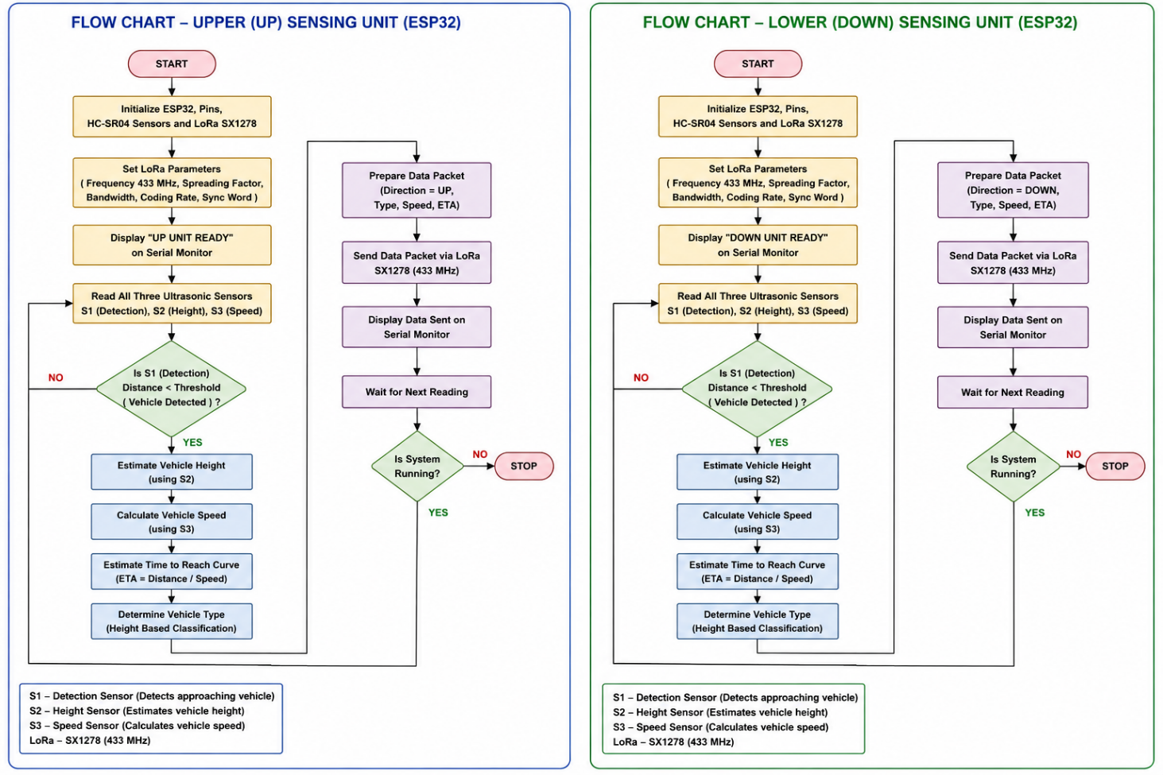
Flow Diagram
INDUSTRY ORIENTED MINI PROJECT(2026-2027), DEPARTMENT OF ECE /ECM - Anurag University

Slide 13
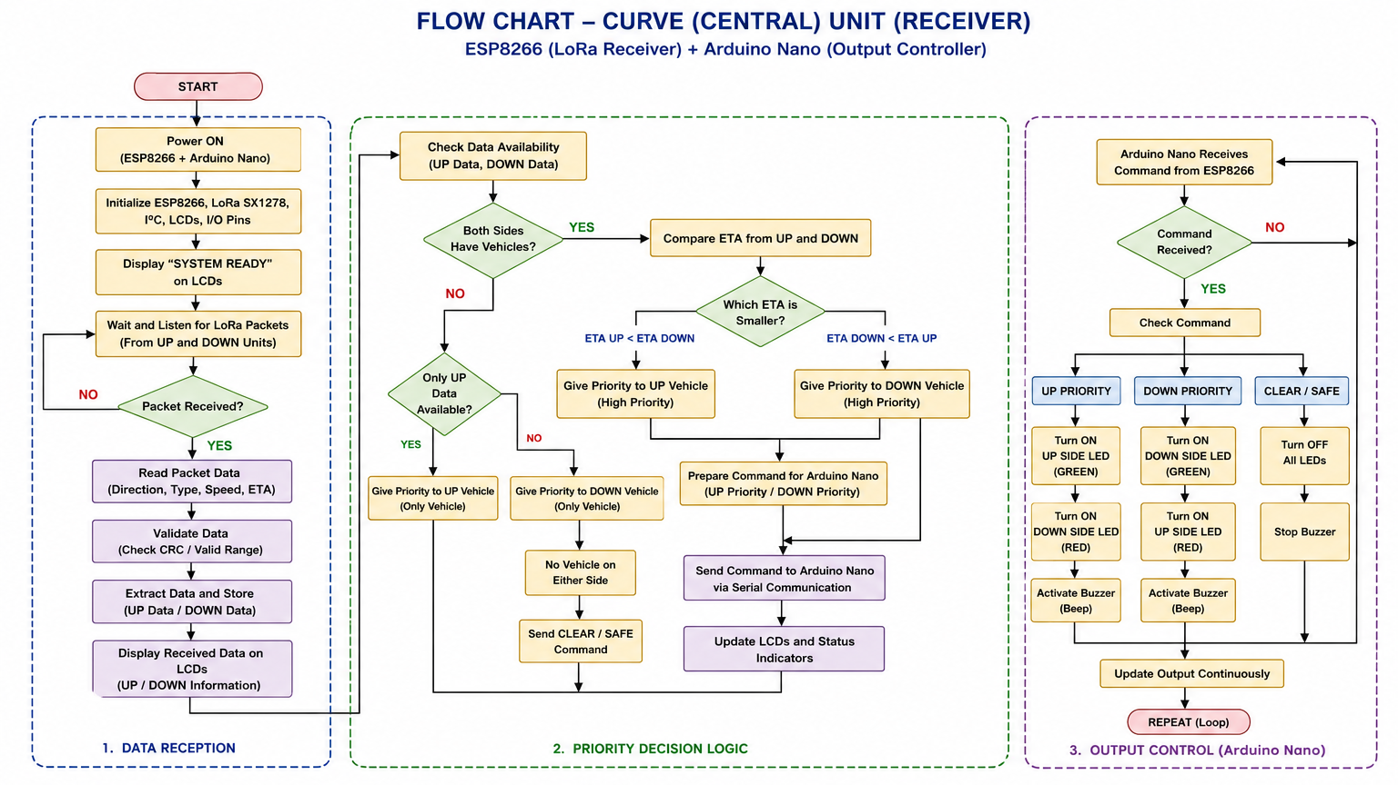
Flow Diagram
INDUSTRY ORIENTED MINI PROJECT(2026-2027), DEPARTMENT OF ECE /ECM - Anurag University

Slide 14
References
Kartik Venkata Mutya and Sandeep Rudra, “Smart Road Safety and Vehicle Accident Prevention System for Mountain Roads,” International Research Journal of Engineering and Technology (IRJET), vol. 7, no. 5, pp. 1–5, 2020, DOI: N/A,
P. Deepika, S. Sathya Priya, C. Priya, and M. Surya, “Smart Secure and Warning System in Hairpin Bends at Hill Stations Based on ZigBee Technology,” International Journal of Recent Technology and Engineering (IJRTE), vol. 8, no. 4, pp. 1–6, 2019, DOI: N/A.
Ranga Sreedhar Galla, “Diminishing Road Accidents on Sharp Curves Using Arduino,” International Journal of Recent Technology and Engineering (IJRTE), vol. 8, no. 4, pp. 1–4, 2019, DOI: N/A.
INDUSTRY ORIENTED MINI PROJECT(2026-2027), DEPARTMENT OF ECE /ECM - Anurag University

Slide 15
Thank you
INDUSTRY ORIENTED MINI PROJECT(2026-2027), DEPARTMENT OF ECE /ECM - Anurag University

