Slide 1
Query Processing

Slide 2
Query Processing
Overview
Measures of Query Cost
Selection Operation
Sorting
Join Operation
Other Operations
Evaluation of Expressions

Slide 3

Basic Steps in Query Processing
1. Parsing and translation
2. Optimization
3. Evaluation

Slide 4
Basic Steps in Query Processing (Cont.)
Parsing and translation
  translate the query into its internal form. This is then translated into relational algebra.
  Parser checks syntax, verifies relations
Evaluation
  The query-execution engine takes a query-evaluation plan, executes that plan, and returns the answers to the query.

Slide 5
Basic Steps in Query Processing : Optimization
A relational algebra expression may have many equivalent expressions
  E.g., σ_{salary<75000}(∏_{salary}(instructor)) is equivalent to
  ∏_{salary}(σ_{salary<75000}(instructor))
Each relational algebra operation can be evaluated using one of several different algorithms
  Correspondingly, a relational-algebra expression can be evaluated in many ways.
Annotated expression specifying detailed evaluation strategy is called an evaluation-plan.
  E.g., can use an index on salary to find instructors with salary < 75000,
  or can perform complete relation scan and discard instructors with salary ≥ 75000

Slide 6
Basic Steps: Optimization (Cont.)
Query Optimization: Amongst all equivalent evaluation plans choose the one with lowest cost.
  Cost is estimated using statistical information from the
  database catalog
    e.g. number of tuples in each relation, size of tuples, etc.
In this chapter we study
  How to measure query costs
  Algorithms for evaluating relational algebra operations
  How to combine algorithms for individual operations in order to evaluate a complete expression

Slide 7
Measures of Query Cost
Cost is generally measured as total elapsed time for answering query
  Many factors contribute to time cost
    disk accesses, CPU, or even network communication
Typically disk access is the predominant cost, and is also relatively easy to estimate. Measured by taking into account
  Number of seeks * average-seek-cost
  Number of blocks read * average-block-read-cost
  Number of blocks written * average-block-write-cost
    Cost to write a block is greater than cost to read a block
      data is read back after being written to ensure that the write was successful

Slide 8
Measures of Query Cost (Cont.)
For simplicity we just use the number of block transfers from disk and the number of seeks as the cost measures
  t_{T} – time to transfer one block
  t_{S} – time for one seek
  Cost for b block transfers plus S seeks
  b * t_{T} + S * t_{S}
We ignore CPU costs for simplicity
  Real systems do take CPU cost into account
We do not include cost to writing output to disk in our cost formulae

Slide 9
Measures of Query Cost (Cont.)
Several algorithms can reduce disk IO by using extra buffer space
  Amount of real memory available to buffer depends on other concurrent queries and OS processes, known only during execution
    We often use worst case estimates, assuming only the minimum amount of memory needed for the operation is available
Required data may be buffer resident already, avoiding disk I/O
  But hard to take into account for cost estimation

Slide 10
Selection Operation
File scan
Algorithm A1 (linear search). Scan each file block and test all records to see whether they satisfy the selection condition.
  Cost estimate = b_{r} block transfers + 1 seek
    b_{r} denotes number of blocks containing records from relation r
  If selection is on a key attribute, can stop on finding record
    cost = (b_{r} /2) block transfers + 1 seek
  Linear search can be applied regardless of
    selection condition or
    ordering of records in the file, or
    availability of indices
Note: binary search generally does not make sense since data is not stored consecutively
  except when there is an index available,
  and binary search requires more seeks than index search

Slide 11
Selections Using Indices
Index scan – search algorithms that use an index
  selection condition must be on search-key of index.
A2 (primary index, equality on key). Retrieve a single record that satisfies the corresponding equality condition
  Cost = (h_{i} + 1) * (t_{T} + t_{S})
A3 (primary index, equality on nonkey) Retrieve multiple records.
  Records will be on consecutive blocks
    Let b = number of blocks containing matching records
  Cost = h_{i} * (t_{T} + t_{S}) + t_{S} + t_{T} * b

Slide 12
Selections Using Indices
A4 (secondary index, equality on nonkey).
  Retrieve a single record if the search-key is a candidate key
    Cost = (h_{i} + 1) * (t_{T} + t_{S})
  Retrieve multiple records if search-key is not a candidate key
    each of n matching records may be on a different block
    Cost = (h_{i} + n) * (t_{T} + t_{S})
      Can be very expensive!

Slide 13
Selections Involving Comparisons
Can implement selections of the form σ_{A≤V} (r) or σ_{A ≥ V}(r) by using
  a linear file scan,
  or by using indices in the following ways:
A5 (primary index, comparison). (Relation is sorted on A)
    For σ_{A ≥ V}(r) use index to find first tuple ≥ v and scan relation sequentially from there
    For σ_{A≤V} (r) just scan relation sequentially till first tuple > v; do not use index
A6 (secondary index, comparison).
    For σ_{A ≥ V}(r) use index to find first index entry ≥ v and scan index sequentially from there, to find pointers to records.
    For σ_{A≤V} (r) just scan leaf pages of index finding pointers to records, till first entry > v
    In either case, retrieve records that are pointed to
      requires an I/O for each record
      Linear file scan may be cheaper

Slide 14
Implementation of Complex Selections
Conjunction: σ_{θ1}∧ _{θ2}∧. . . _{θn}(r)
A7 (conjunctive selection using one index).
  Select a combination of θ_{i} and algorithms A1 through A7 that results in the least cost for σ_{θi} (r).
  Test other conditions on tuple after fetching it into memory buffer.
A8 (conjunctive selection using composite index).
  Use appropriate composite (multiple-key) index if available.
A9 (conjunctive selection by intersection of identifiers).
  Requires indices with record pointers.
  Use corresponding index for each condition, and take intersection of all the obtained sets of record pointers.
  Then fetch records from file
  If some conditions do not have appropriate indices, apply test in memory.

Slide 15
Algorithms for Complex Selections
Disjunction:σ_{θ1}∨ _{θ2} ∨. . . _{θn} (r).
A10 (disjunctive selection by union of identifiers).
  Applicable if all conditions have available indices.
    Otherwise use linear scan.
  Use corresponding index for each condition, and take union of all the obtained sets of record pointers.
  Then fetch records from file
Negation: σ_{¬θ}(r)
  Use linear scan on file
  If very few records satisfy ¬θ, and an index is applicable to θ
    Find satisfying records using index and fetch from file

Slide 16
Sorting
We may build an index on the relation, and then use the index to read the relation in sorted order. May lead to one disk block access for each tuple.
For relations that fit in memory, techniques like quicksort can be used. For relations that don’t fit in memory, external
sort-merge is a good choice.

Slide 17
External Sort-Merge
Let M denote memory size (in pages).
Create sorted runs. Let i be 0 initially.
Repeatedly do the following till the end of the relation:
(a) Read M blocks of relation into memory
(b) Sort the in-memory blocks
(c) Write sorted data to run R_{i}; increment i.
Let the final value of i be N
Merge the runs (next slide)…..

Slide 18
External Sort-Merge (Cont.)
Merge the runs (N-way merge). We assume (for now) that N < M.
  Use N blocks of memory to buffer input runs, and 1 block to buffer output. Read the first block of each run into its buffer page
  repeat
    Select the first record (in sort order) among all buffer pages
    Write the record to the output buffer. If the output buffer is full write it to disk.
    Delete the record from its input buffer page.
    If the buffer page becomes empty then
    read the next block (if any) of the run into the buffer.
  until all input buffer pages are empty:

Slide 19
External Sort-Merge (Cont.)
If N ≥ M, several merge passes are required.
  In each pass, contiguous groups of M - 1 runs are merged.
  A pass reduces the number of runs by a factor of M -1, and creates runs longer by the same factor.
    E.g. If M=11, and there are 90 runs, one pass reduces the number of runs to 9, each 10 times the size of the initial runs
  Repeated passes are performed till all runs have been merged into one.

Slide 20

Example: External Sorting Using Sort-Merge

Slide 21
External Merge Sort (Cont.)
Cost analysis:
  1 block per run leads to too many seeks during merge
    Instead use b_{b} buffer blocks per run
      ➔ read/write b_{b} blocks at a time
    Can merge ⎣M/b_{b}⎦–1 runs in one pass
  Total number of merge passes required: ⎡log _{⎣M/bb⎦–1}(b_{r}/M)⎤.
  Block transfers for initial run creation as well as in each pass is 2b_{r}
    for final pass, we don’t count write cost
      we ignore final write cost for all operations since the output of an operation may be sent to the parent operation without being written to disk
    Thus total number of block transfers for external sorting:
    b_{r} ( 2 ⎡log _{⎣M/bb⎦–1} (b_{r} / M)⎤ + 1) ⎡
  Seeks: next slide

Slide 22
External Merge Sort (Cont.)
Cost of seeks
  During run generation: one seek to read each run and one seek to write each run
    2 ⎡b_{r} / M⎤
  During the merge phase
    Need 2 ⎡b_{r} / b_{b}⎤ seeks for each merge pass
      except the final one which does not require a write
    Total number of seeks:
    2 ⎡b_{r} / M⎤ + ⎡b_{r} / b_{b}⎤ (2 ⎡log_{⎣M/bb⎦–1}(b_{r} / M)⎤ -1)

Slide 23
Join Operation
Several different algorithms to implement joins
  Nested-loop join
  Block nested-loop join
  Indexed nested-loop join
  Merge-join
  Hash-join
Choice based on cost estimate
Examples use the following information
  Number of records of student: 5,000 takes: 10,000
  Number of blocks of student: 100 takes: 400

Slide 24
Nested-Loop Join
To compute the theta join r _{θ} s
for each tuple t_{r} in r do begin
for each tuple t_{s} in s do begin
test pair (t_{r},t_{s}) to see if they satisfy the join condition θ
if they do, add t_{r} • t_{s} to the result.
end
end
r is called the outer relation and s the inner relation of the join.
Requires no indices and can be used with any kind of join condition.
Expensive since it examines every pair of tuples in the two relations.

Slide 25
Nested-Loop Join (Cont.)
In the worst case, if there is enough memory only to hold one block of each relation, the estimated cost is
n_{r} ∗ b_{s} + b_{r} block transfers, plus
n_{r} + b_{r} seeks
If the smaller relation fits entirely in memory, use that as the inner relation.
  Reduces cost to b_{r} + b_{s} block transfers and 2 seeks
Assuming worst case memory availability cost estimate is
  with student as outer relation:
    5000 ∗ 400 + 100 = 2,000,100 block transfers,
    5000 + 100 = 5100 seeks
  with takes as the outer relation
    10000 ∗ 100 + 400 = 1,000,400 block transfers and 10,400 seeks
If smaller relation (student) fits entirely in memory, the cost estimate will be 500 block transfers.
Block nested-loops algorithm (next slide) is preferable.

Slide 26
Block Nested-Loop Join
Variant of nested-loop join in which every block of inner relation is paired with every block of outer relation.
for each block B_{r} of r do begin
for each block B_{s} of s do begin
for each tuple t_{r} in B_{r} do begin
for each tuple t_{s} in B_{s} do begin
Check if (t_{r},t_{s}) satisfy the join condition
if they do, add t_{r} • t_{s} to the result.
end
end
end
end

Slide 27
Block Nested-Loop Join (Cont.)
Worst case estimate: b_{r} ∗ b_{s} + b_{r} block transfers + 2 * b_{r} seeks
  Each block in the inner relation s is read once for each block in the outer relation
Best case: b_{r} + b_{s} block transfers + 2 seeks.
Improvements to nested loop and block nested loop algorithms:
  In block nested-loop, use M — 2 disk blocks as blocking unit for outer relations, where M = memory size in blocks; use remaining two blocks to buffer inner relation and output
    Cost = ⎡b_{r} / (M-2)⎤ ∗ b_{s} + b_{r} block transfers +
    2 ⎡b_{r} / (M-2)⎤ seeks
  If equi-join attribute forms a key or inner relation, stop inner loop on first match
  Scan inner loop forward and backward alternately, to make use of the blocks remaining in buffer (with LRU replacement)
  Use index on inner relation if available (next slide)

Slide 28
Indexed Nested-Loop Join
Index lookups can replace file scans if
  join is an equi-join or natural join and
  an index is available on the inner relation’s join attribute
    Can construct an index just to compute a join.
For each tuple t_{r} in the outer relation r, use the index to look up tuples in s that satisfy the join condition with tuple t_{r}.
Worst case: buffer has space for only one page of r, and, for each tuple in r, we perform an index lookup on s.
Cost of the join: b_{r} (t_{T} + t_{S}) + n_{r} ∗ c
  Where c is the cost of traversing index and fetching all matching s tuples for one tuple or r
  c can be estimated as cost of a single selection on s using the join condition.
If indices are available on join attributes of both r and s,
use the relation with fewer tuples as the outer relation.

Slide 29
Example of Nested-Loop Join Costs
Compute student takes, with student as the outer relation.
Let takes have a primary B⁺-tree index on the attribute ID, which contains 20 entries in each index node.
Since takes has 10,000 tuples, the height of the tree is 4, and one more access is needed to find the actual data
student has 5000 tuples
Cost of block nested loops join
  400*100 + 100 = 40,100 block transfers + 2 * 100 = 200 seeks
    assuming worst case memory
    may be significantly less with more memory
Cost of indexed nested loops join
  100 + 5000 * 5 = 25,100 block transfers and seeks.
  CPU cost likely to be less than that for block nested loops join

Slide 30

Merge-Join
Sort both relations on their join attribute (if not already sorted on the join attributes).
Merge the sorted relations to join them
  Join step is similar to the merge stage of the sort-merge algorithm.
  Main difference is handling of duplicate values in join attribute — every pair with same value on join attribute must be matched
  Detailed algorithm in book

Slide 31
Merge-Join (Cont.)
Can be used only for equi-joins and natural joins
Each block needs to be read only once (assuming all tuples for any given value of the join attributes fit in memory
Thus the cost of merge join is:
b_{r} + b_{s} block transfers + ⎡b_{r} / b_{b}⎤ + ⎡b_{s} / b_{b}⎤ seeks
  + the cost of sorting if relations are unsorted.
hybrid merge-join: If one relation is sorted, and the other has a secondary B⁺-tree index on the join attribute
  Merge the sorted relation with the leaf entries of the B⁺-tree .
  Sort the result on the addresses of the unsorted relation’s tuples
  Scan the unsorted relation in physical address order and merge with previous result, to replace addresses by the actual tuples
    Sequential scan more efficient than random lookup

Slide 32
Hash-Join
Applicable for equi-joins and natural joins.
A hash function h is used to partition tuples of both relations
h maps JoinAttrs values to {0, 1, ..., n}, where JoinAttrs denotes the common attributes of r and s used in the natural join.
  r₀, r₁, . . ., r_{n} denote partitions of r tuples
    Each tuple t_{r} ∈ r is put in partition r_{i} where i = h(t_{r} [JoinAttrs]).
  r₀,, r₁. . ., r_{n} denotes partitions of s tuples
    Each tuple t_{s} ∈s is put in partition s_{i}, where i = h(t_{s} [JoinAttrs]).
Note: In book, r_{i} is denoted as H_{ri,} s_{i} is denoted as H_{si} and
n is denoted as n_{h.}

Slide 33

Hash-Join (Cont.)

Slide 34
Hash-Join (Cont.)
r tuples in r_{i} need only to be compared with s tuples in s_{i} Need not be compared with s tuples in any other partition, since:
  an r tuple and an s tuple that satisfy the join condition will have the same value for the join attributes.
  If that value is hashed to some value i, the r tuple has to be in r_{i} and the s tuple in s_{i}.

Slide 35
Hash-Join Algorithm
The hash-join of r and s is computed as follows.
1. Partition the relation s using hashing function h. When partitioning a relation, one block of memory is reserved as the output buffer for each partition.
2. Partition r similarly.
3. For each i:
  (a) Load s_{i} into memory and build an in-memory hash index on it using the join attribute. This hash index uses a different hash function than the earlier one h.
  (b) Read the tuples in r_{i} from the disk one by one. For each tuple t_{r} locate each matching tuple t_{s} in s_{i} using the in-memory hash index. Output the concatenation of their attributes.
Relation s is called the build input and r is called the probe input.

Slide 36
Hash-Join algorithm (Cont.)
The value n and the hash function h is chosen such that each s_{i} should fit in memory.
  Typically n is chosen as ⎡b_{s}/M⎤ * f where f is a “fudge factor”, typically around 1.2
  The probe relation partitions s_{i} need not fit in memory
Recursive partitioning required if number of partitions n is greater than number of pages M of memory.
  instead of partitioning n ways, use M – 1 partitions for s
  Further partition the M – 1 partitions using a different hash function
  Use same partitioning method on r
  Rarely required: e.g., with block size of 4 KB, recursive partitioning not needed for relations of < 1GB with memory size of 2MB, or relations of < 36 GB with memory of 12 MB

Slide 37
Handling of Overflows
Partitioning is said to be skewed if some partitions have significantly more tuples than some others
Hash-table overflow occurs in partition s_{i} if s_{i} does not fit in memory. Reasons could be
  Many tuples in s with same value for join attributes
  Bad hash function
Overflow resolution can be done in build phase
  Partition s_{i} is further partitioned using different hash function.
  Partition r_{i} must be similarly partitioned.
Overflow avoidance performs partitioning carefully to avoid overflows during build phase
  E.g. partition build relation into many partitions, then combine them
Both approaches fail with large numbers of duplicates
  Fallback option: use block nested loops join on overflowed partitions

Slide 38
Cost of Hash-Join
If recursive partitioning is not required: cost of hash join is
3(b_{r} + b_{s}) +4 ∗ n_{h} block transfers +
2( ⎡b_{r} / b_{b}⎤ + ⎡b_{s} / b_{b}⎤) seeks
If recursive partitioning required:
  number of passes required for partitioning build relation s to less than M blocks per partition is ⎡log_{⎣M/bb⎦–1}(b_{s}/M)⎤
  best to choose the smaller relation as the build relation.
  Total cost estimate is:
  2(b_{r} + b_{s}) ⎡log_{⎣M/bb⎦–1}(b_{s}/M)⎤ + b_{r} + b_{s} block transfers +
  2(⎡b_{r} / b_{b}⎤ + ⎡b_{s} / b_{b}⎤) ⎡log_{⎣M/bb⎦–1}(b_{s}/M) ⎤ seeks
If the entire build input can be kept in main memory no partitioning is required
  Cost estimate goes down to b_{r} + b_{s}.

Slide 39
Example of Cost of Hash-Join
instructor teaches
Assume that memory size is 20 blocks
b_{instructor}= 100 and b_{teaches} = 400.
instructor is to be used as build input. Partition it into five partitions, each of size 20 blocks. This partitioning can be done in one pass.
Similarly, partition teaches into five partitions,each of size 80. This is also done in one pass.
Therefore total cost, ignoring cost of writing partially filled blocks:
  3(100 + 400) = 1500 block transfers +
  2( ⎡100/3⎤ + ⎡400/3⎤) = 336 seeks

Slide 40

Hybrid Hash–Join
Useful when memory sized are relatively large, and the build input is bigger than memory.
Main feature of hybrid hash join:
Keep the first partition of the build relation in memory.
E.g. With memory size of 25 blocks, instructor can be partitioned into five partitions, each of size 20 blocks.
  Division of memory:
    The first partition occupies 20 blocks of memory
    1 block is used for input, and 1 block each for buffering the other 4 partitions.
teaches is similarly partitioned into five partitions each of size 80
  the first is used right away for probing, instead of being written out
Cost of 3(80 + 320) + 20 +80 = 1300 block transfers for
hybrid hash join, instead of 1500 with plain hash-join.
Hybrid hash-join most useful if M >>

Slide 41
Complex Joins
Join with a conjunctive condition:
r _{θ1∧ θ 2∧... ∧ θ n} s
  Either use nested loops/block nested loops, or
  Compute the result of one of the simpler joins r _{θi} s
    final result comprises those tuples in the intermediate result that satisfy the remaining conditions
  θ₁ ∧ . . . ∧ θ_{i –1} ∧ θ_{i +1} ∧ . . . ∧ θ_{n}
Join with a disjunctive condition
  r _{θ1 ∨ θ2 ∨... ∨ θn} s
  Either use nested loops/block nested loops, or
  Compute as the union of the records in individual joins r _{θ i} s:
  (r _{θ1} s) ∪ (r _{θ2} s) ∪ . . . ∪ (r _{θn} s)

Slide 42
Other Operations
Duplicate elimination can be implemented via hashing or sorting.
  On sorting duplicates will come adjacent to each other, and all but one set of duplicates can be deleted.
  Optimization: duplicates can be deleted during run generation as well as at intermediate merge steps in external sort-merge.
  Hashing is similar – duplicates will come into the same bucket.
Projection:
  perform projection on each tuple
  followed by duplicate elimination.

Slide 43
Other Operations : Aggregation
Aggregation can be implemented in a manner similar to duplicate elimination.
  Sorting or hashing can be used to bring tuples in the same group together, and then the aggregate functions can be applied on each group.
  Optimization: combine tuples in the same group during run generation and intermediate merges, by computing partial aggregate values
    For count, min, max, sum: keep aggregate values on tuples found so far in the group.
      When combining partial aggregate for count, add up the aggregates
    For avg, keep sum and count, and divide sum by count at the end

Slide 44
Other Operations : Set Operations
Set operations (∪, ∩ and ⎯): can either use variant of merge-join after sorting, or variant of hash-join.
E.g., Set operations using hashing:
  Partition both relations using the same hash function
  Process each partition i as follows.
    Using a different hashing function, build an in-memory hash index on r_{i}.
    Process s_{i} as follows
      r ∪ s:
        Add tuples in s_{i} to the hash index if they are not already in it.
        At end of s_{i} add the tuples in the hash index to the result.

Slide 45
Other Operations : Set Operations
E.g., Set operations using hashing:
  as before partition r and s,
  as before, process each partition i as follows
    build a hash index on r_{i}
    Process s_{i} as follows
      r ∩ s:
        output tuples in s_{i} to the result if they are already there in the hash index
      r – s:
        for each tuple in s_{i}, if it is there in the hash index, delete it from the index.
        At end of s_{i} add remaining tuples in the hash index to the result.

Slide 46
Other Operations : Outer Join
Outer join can be computed either as
  A join followed by addition of null-padded non-participating tuples.
  by modifying the join algorithms.
Modifying merge join to compute r s
  In r s, non participating tuples are those in r – Π_{R}(r s)
  Modify merge-join to compute r s:
    During merging, for every tuple t_{r} from r that do not match any tuple in s, output t_{r} padded with nulls.
  Right outer-join and full outer-join can be computed similarly.

Slide 47
Other Operations : Outer Join
Modifying hash join to compute r s
  If r is probe relation, output non-matching r tuples padded with nulls
  If r is build relation, when probing keep track of which
  r tuples matched s tuples. At end of s_{i} output
  non-matched r tuples padded with nulls

Slide 48
Evaluation of Expressions
So far: we have seen algorithms for individual operations
Alternatives for evaluating an entire expression tree
  Materialization: generate results of an expression whose inputs are relations or are already computed, materialize (store) it on disk. Repeat.
  Pipelining: pass on tuples to parent operations even as an operation is being executed
We study above alternatives in more detail

Slide 49


Materialization
Materialized evaluation: evaluate one operation at a time, starting at the lowest-level. Use intermediate results materialized into temporary relations to evaluate next-level operations.
E.g., in figure below, compute and store
then compute the store its join with instructor, and finally compute the projection on name.

Slide 50
Materialization (Cont.)
Materialized evaluation is always applicable
Cost of writing results to disk and reading them back can be quite high
  Our cost formulas for operations ignore cost of writing results to disk, so
    Overall cost = Sum of costs of individual operations +
    cost of writing intermediate results to disk
Double buffering: use two output buffers for each operation, when one is full write it to disk while the other is getting filled
  Allows overlap of disk writes with computation and reduces execution time

Slide 51
Pipelining
Pipelined evaluation : evaluate several operations simultaneously, passing the results of one operation on to the next.
E.g., in previous expression tree, don’t store result of
  instead, pass tuples directly to the join.. Similarly, don’t store result of join, pass tuples directly to projection.
Much cheaper than materialization: no need to store a temporary relation to disk.
Pipelining may not always be possible – e.g., sort, hash-join.
For pipelining to be effective, use evaluation algorithms that generate output tuples even as tuples are received for inputs to the operation.
Pipelines can be executed in two ways: demand driven and producer driven

Slide 52
Pipelining (Cont.)
In demand driven or lazy evaluation
  system repeatedly requests next tuple from top level operation
  Each operation requests next tuple from children operations as required, in order to output its next tuple
  In between calls, operation has to maintain “state” so it knows what to return next
In producer-driven or eager pipelining
  Operators produce tuples eagerly and pass them up to their parents
    Buffer maintained between operators, child puts tuples in buffer, parent removes tuples from buffer
    if buffer is full, child waits till there is space in the buffer, and then generates more tuples
  System schedules operations that have space in output buffer and can process more input tuples
Alternative name: pull and push models of pipelining

Slide 53
Pipelining (Cont.)
Implementation of demand-driven pipelining
  Each operation is implemented as an iterator implementing the following operations
    open()
      E.g. file scan: initialize file scan
        state: pointer to beginning of file
      E.g.merge join: sort relations;
        state: pointers to beginning of sorted relations
    next()
      E.g. for file scan: Output next tuple, and advance and store file pointer
      E.g. for merge join: continue with merge from earlier state till
      next output tuple is found. Save pointers as iterator state.
    close()

Slide 54
Evaluation Algorithms for Pipelining
Some algorithms are not able to output results even as they get input tuples
  E.g. merge join, or hash join
  intermediate results written to disk and then read back
Algorithm variants to generate (at least some) results on the fly, as input tuples are read in
  E.g. hybrid hash join generates output tuples even as probe relation tuples in the in-memory partition (partition 0) are read in
  Double-pipelined join technique: Hybrid hash join, modified to buffer partition 0 tuples of both relations in-memory, reading them as they become available, and output results of any matches between partition 0 tuples
    When a new r₀ tuple is found, match it with existing s₀ tuples, output matches, and save it in r₀
    Symmetrically for s₀ tuples

Slide 55
End of Chapter

Slide 56

Figure 12.02

Slide 57
Selection Operation (Cont.)
Old-A2 (binary search). Applicable if selection is an equality comparison on the attribute on which file is ordered.
  Assume that the blocks of a relation are stored contiguously
  Cost estimate (number of disk blocks to be scanned):
    cost of locating the first tuple by a binary search on the blocks
      ⎡log₂(b_{r})⎤ * (t_{T} + t_{S})
    If there are multiple records satisfying selection
      Add transfer cost of the number of blocks containing records that satisfy selection condition
      Will see how to estimate this cost in Chapter 13

Slide 58
Query Optimization

Slide 59
Query Optimization
Introduction
Transformation of Relational Expressions
Catalog Information for Cost Estimation
Statistical Information for Cost Estimation
Cost-based optimization
Dynamic Programming for Choosing Evaluation Plans
Materialized views

Slide 60

Introduction
Alternative ways of evaluating a given query
  Equivalent expressions
  Different algorithms for each operation

Slide 61

Introduction (Cont.)
An evaluation plan defines exactly what algorithm is used for each operation, and how the execution of the operations is coordinated.
Find out how to view query execution plans on your favorite database

Slide 62
Introduction (Cont.)
Cost difference between evaluation plans for a query can be enormous
  E.g. seconds vs. days in some cases
Steps in cost-based query optimization
  Generate logically equivalent expressions using equivalence rules
  Annotate resultant expressions to get alternative query plans
  Choose the cheapest plan based on estimated cost
Estimation of plan cost based on:
  Statistical information about relations. Examples:
    number of tuples, number of distinct values for an attribute
  Statistics estimation for intermediate results
    to compute cost of complex expressions
  Cost formulae for algorithms, computed using statistics

Slide 63
Generating Equivalent Expressions

Slide 64
Transformation of Relational Expressions
Two relational algebra expressions are said to be equivalent if the two expressions generate the same set of tuples on every legal database instance
  Note: order of tuples is irrelevant
  we don’t care if they generate different results on databases that violate integrity constraints
In SQL, inputs and outputs are multisets of tuples
  Two expressions in the multiset version of the relational algebra are said to be equivalent if the two expressions generate the same multiset of tuples on every legal database instance.
An equivalence rule says that expressions of two forms are equivalent
  Can replace expression of first form by second, or vice versa

Slide 65



Equivalence Rules
1. Conjunctive selection operations can be deconstructed into a sequence of individual selections.
2. Selection operations are commutative.
3. Only the last in a sequence of projection operations is needed, the others can be omitted.
Selections can be combined with Cartesian products and theta joins.
  σ_{θ}(E₁ X E₂) = E₁ _{θ} E₂
  σ_{θ1}(E₁ _{θ2} E₂) = E₁ _{θ1∧ θ2} E₂

Slide 66
Equivalence Rules (Cont.)
5. Theta-join operations (and natural joins) are commutative.
E_{1 θ} E₂ = E₂ _{θ} E₁
6. (a) Natural join operations are associative:
(E₁ E₂) E₃ = E₁ (E₂ E₃)
(b) Theta joins are associative in the following manner:
(E_{1 θ1} E₂) _{θ2∧ θ3} E₃ = E_{1 θ1∧ θ3} (E₂ _{θ2} E₃)
where θ₂ involves attributes from only E₂ and E₃.

Slide 67

Pictorial Depiction of Equivalence Rules

Slide 68
Equivalence Rules (Cont.)
7. The selection operation distributes over the theta join operation under the following two conditions:
(a) When all the attributes in θ₀ involve only the attributes of one
of the expressions (E₁) being joined.
σ_{θ0}(E₁ _{θ} E₂) = (σ_{θ0}(E₁)) _{θ} E₂
(b) When θ ₁ involves only the attributes of E₁ and θ₂ involves
only the attributes of E₂.
σ_{θ1}∧_{θ2} (E₁ _{θ} E₂) = (σ_{θ1}(E₁)) _{θ} (σ_{θ2} (E₂))

Slide 69
Equivalence Rules (Cont.)
8. The projection operation distributes over the theta join operation as follows:
(a) if θ involves only attributes from L₁ ∪ L₂:
(b) Consider a join E_{1 θ} E₂.
  Let L₁ and L₂ be sets of attributes from E₁ and E₂, respectively.
  Let L₃ be attributes of E₁ that are involved in join condition θ, but are not in L₁ ∪ L₂, and
  let L₄ be attributes of E₂ that are involved in join condition θ, but are not in L₁ ∪ L₂.
∏
(
E
E
)
=
(
∏
(
E
))
(
∏
(
E
))
L
1
∪
L
2
1
θ
2
L
1
1
θ
L
2
2
∏
(
E
E
)
=
∏
((
∏
(
E
))
(
∏
(
E
)))
L
1
∪
L
2
1
θ
2
L
1
∪
L
2
L
1
∪
L
3
1
θ
L
2
∪
L
4
2

Slide 70
Equivalence Rules (Cont.)
The set operations union and intersection are commutative
E₁ ∪ E₂ = E₂ ∪ E₁
E₁ ∩ E₂ = E₂ ∩ E₁
  (set difference is not commutative).
Set union and intersection are associative.
(E₁ ∪ E₂) ∪ E₃ = E₁ ∪ (E₂ ∪ E₃)
(E₁ ∩ E₂) ∩ E₃ = E₁ ∩ (E₂ ∩ E₃)
The selection operation distributes over ∪, ∩ and –.
σ_{θ} (E₁ – E₂) = σ_{θ} (E₁) – σ_{θ}(E₂)
and similarly for ∪ and ∩ in place of –
Also: σ_{θ} (E₁ – E₂) = σ_{θ}(E₁) – E₂
and similarly for ∩ in place of –, but not for ∪
12. The projection operation distributes over union
Π_{L}(E₁ ∪ E₂) = (Π_{L}(E₁)) ∪ (Π_{L}(E₂))

Slide 71
Exercise
Create equivalence rules involving
  The group by/aggregation operation
  Left outer join operation

Slide 72
Transformation Example: Pushing Selections
Query: Find the names of all instructors in the Music department, along with the titles of the courses that they teach
  Π_{name, title}(σ_{dept_name= “Music”}
  (instructor (teaches Π_{course_id, title} (course))))
Transformation using rule 7a.
  Π_{name, title}((σ_{dept_name= “Music”}(instructor))
  (teaches Π_{course_id, title} (course)))
Performing the selection as early as possible reduces the size of the relation to be joined.

Slide 73
Example with Multiple Transformations
Query: Find the names of all instructors in the Music department who have taught a course in 2009, along with the titles of the courses that they taught
  Π_{name, title}(σ_{dept_name= “Music”∧year = 2009}
  (instructor (teaches Π_{course_id, title} (course))))
Transformation using join associatively (Rule 6a):
  Π_{name, title}(σ_{dept_name= “Music”∧gear = 2009}
  ((instructor teaches) Π_{course_id, title} (course)))
Second form provides an opportunity to apply the “perform selections early” rule, resulting in the subexpression
σ_{dept_name = “Music”} (instructor) σ _{year = 2009} (teaches)

Slide 74

Multiple Transformations (Cont.)

Slide 75
Transformation Example: Pushing Projections
Consider: Π_{name, title}(σ_{dept_name= “Music”} (instructor) teaches)
Π_{course_id, title} (course))))
When we compute
(σ_{dept_name = “Music”} (instructor teaches)
we obtain a relation whose schema is:
(ID, name, dept_name, salary, course_id, sec_id, semester, year)
Push projections using equivalence rules 8a and 8b; eliminate unneeded attributes from intermediate results to get:
Π_{name, title}(Π_{name, course_id} (
σ_{dept_name= “Music”} (instructor) teaches))
Π_{course_id, title} (course))))
Performing the projection as early as possible reduces the size of the relation to be joined.

Slide 76
Join Ordering Example
For all relations r_{1,} r_{2,} and r₃,
(r₁ r₂) r₃ = r₁ (r₂ r₃ )
(Join Associativity)
If r₂ r₃ is quite large and r₁ r₂ is small, we choose
(r₁ r₂) r₃
so that we compute and store a smaller temporary relation.

Slide 77
Join Ordering Example (Cont.)
Consider the expression
Π_{name, title}(σ_{dept_name= “Music”} (instructor) teaches)
Π_{course_id, title} (course))))
Could compute teaches Π_{course_id, title} (course) first, and join result with
σ_{dept_name= “Music”} (instructor)
but the result of the first join is likely to be a large relation.
Only a small fraction of the university’s instructors are likely to be from the Music department
  it is better to compute
σ_{dept_name= “Music”} (instructor) teaches
first.

Slide 78
Enumeration of Equivalent Expressions
Query optimizers use equivalence rules to systematically generate expressions equivalent to the given expression
Can generate all equivalent expressions as follows:
  Repeat
    apply all applicable equivalence rules on every subexpression of every equivalent expression found so far
    add newly generated expressions to the set of equivalent expressions
    Until no new equivalent expressions are generated above
The above approach is very expensive in space and time
  Two approaches
    Optimized plan generation based on transformation rules
    Special case approach for queries with only selections, projections and joins

Slide 79
Implementing Transformation Based Optimization
Space requirements reduced by sharing common sub-expressions:
  when E1 is generated from E2 by an equivalence rule, usually only the top level of the two are different, subtrees below are the same and can be shared using pointers
    E.g. when applying join commutativity
  Same sub-expression may get generated multiple times
    Detect duplicate sub-expressions and share one copy
Time requirements are reduced by not generating all expressions
  Dynamic programming
    We will study only the special case of dynamic programming for join order optimization
E1
E2

Slide 80
Cost Estimation
Cost of each operator computed as described in Chapter 12
  Need statistics of input relations
    E.g. number of tuples, sizes of tuples
Inputs can be results of sub-expressions
  Need to estimate statistics of expression results
  To do so, we require additional statistics
    E.g. number of distinct values for an attribute
More on cost estimation later

Slide 81
Choice of Evaluation Plans
Must consider the interaction of evaluation techniques when choosing evaluation plans
  choosing the cheapest algorithm for each operation independently may not yield best overall algorithm. E.g.
    merge-join may be costlier than hash-join, but may provide a sorted output which reduces the cost for an outer level aggregation.
    nested-loop join may provide opportunity for pipelining
Practical query optimizers incorporate elements of the following two broad approaches:
  1. Search all the plans and choose the best plan in a
  cost-based fashion.
  2. Uses heuristics to choose a plan.

Slide 82
Cost-Based Optimization
Consider finding the best join-order for r₁ r₂ . . . r_{n}.
There are (2(n – 1))!/(n – 1)! different join orders for above expression. With n = 7, the number is 665280, with n = 10, the number is greater than 176 billion!
No need to generate all the join orders. Using dynamic programming, the least-cost join order for any subset of
{r₁, r₂, . . . r_{n}} is computed only once and stored for future use.

Slide 83
Dynamic Programming in Optimization
To find best join tree for a set of n relations:
  To find best plan for a set S of n relations, consider all possible plans of the form: S₁ (S – S₁) where S₁ is any non-empty subset of S.
  Recursively compute costs for joining subsets of S to find the cost of each plan. Choose the cheapest of the 2^{n} – 2 alternatives.
  Base case for recursion: single relation access plan
    Apply all selections on R_{i} using best choice of indices on R_{i}
  When plan for any subset is computed, store it and reuse it when it is required again, instead of recomputing it
    Dynamic programming

Slide 84
Join Order Optimization Algorithm
procedure findbestplan(S)
if (bestplan[S].cost ≠ ∞)
return bestplan[S]
// else bestplan[S] has not been computed earlier, compute it now
if (S contains only 1 relation)
set bestplan[S].plan and bestplan[S].cost based on the best way
of accessing S /* Using selections on S and indices on S */
else for each non-empty subset S1 of S such that S1 ≠ S
P1= findbestplan(S1)
P2= findbestplan(S - S1)
A = best algorithm for joining results of P1 and P2
cost = P1.cost + P2.cost + cost of A
if cost < bestplan[S].cost
bestplan[S].cost = cost
bestplan[S].plan = “execute P1.plan; execute P2.plan;
join results of P1 and P2 using A”
return bestplan[S]
* Some modifications to allow indexed nested loops joins on relations that have
selections (see book)

Slide 85

Left Deep Join Trees
In left-deep join trees, the right-hand-side input for each join is a relation, not the result of an intermediate join.

Slide 86
Cost of Optimization
With dynamic programming time complexity of optimization with bushy trees is O(3^{n}).
  With n = 10, this number is 59000 instead of 176 billion!
Space complexity is O(2^{n})
To find best left-deep join tree for a set of n relations:
  Consider n alternatives with one relation as right-hand side input and the other relations as left-hand side input.
  Modify optimization algorithm:
    Replace “for each non-empty subset S1 of S such that S1 ≠ S”
    By: for each relation r in S
    let S1 = S – r .
If only left-deep trees are considered, time complexity of finding best join order is O(n 2^{n})
  Space complexity remains at O(2^{n})
Cost-based optimization is expensive, but worthwhile for queries on large datasets (typical queries have small n, generally < 10)

Slide 87
Interesting Sort Orders
Consider the expression (r₁ r₂) r₃ (with A as common attribute)
An interesting sort order is a particular sort order of tuples that could be useful for a later operation
  Using merge-join to compute r₁ r₂ may be costlier than hash join but generates result sorted on A
  Which in turn may make merge-join with r₃ cheaper, which may reduce cost of join with r₃ and minimizing overall cost
  Sort order may also be useful for order by and for grouping
Not sufficient to find the best join order for each subset of the set of n given relations
  must find the best join order for each subset, for each interesting sort order
  Simple extension of earlier dynamic programming algorithms
  Usually, number of interesting orders is quite small and doesn’t affect time/space complexity significantly

Slide 88
Cost Based Optimization with Equivalence Rules
Physical equivalence rules allow logical query plan to be converted to physical query plan specifying what algorithms are used for each operation.
Efficient optimizer based on equivalent rules depends on
  A space efficient representation of expressions which avoids making multiple copies of subexpressions
  Efficient techniques for detecting duplicate derivations of expressions
  A form of dynamic programming based on memoization, which stores the best plan for a subexpression the first time it is optimized, and reuses in on repeated optimization calls on same subexpression
  Cost-based pruning techniques that avoid generating all plans
Pioneered by the Volcano project and implemented in the SQL Server optimizer

Slide 89
Heuristic Optimization
Cost-based optimization is expensive, even with dynamic programming.
Systems may use heuristics to reduce the number of choices that must be made in a cost-based fashion.
Heuristic optimization transforms the query-tree by using a set of rules that typically (but not in all cases) improve execution performance:
  Perform selection early (reduces the number of tuples)
  Perform projection early (reduces the number of attributes)
  Perform most restrictive selection and join operations (i.e. with smallest result size) before other similar operations.
  Some systems use only heuristics, others combine heuristics with partial cost-based optimization.

Slide 90
Structure of Query Optimizers
Many optimizers considers only left-deep join orders.
  Plus heuristics to push selections and projections down the query tree
  Reduces optimization complexity and generates plans amenable to pipelined evaluation.
Heuristic optimization used in some versions of Oracle:
  Repeatedly pick “best” relation to join next
    Starting from each of n starting points. Pick best among these
Intricacies of SQL complicate query optimization
  E.g. nested subqueries

Slide 91
Structure of Query Optimizers (Cont.)
Some query optimizers integrate heuristic selection and the generation of alternative access plans.
  Frequently used approach
    heuristic rewriting of nested block structure and aggregation
    followed by cost-based join-order optimization for each block
  Some optimizers (e.g. SQL Server) apply transformations to entire query and do not depend on block structure
  Optimization cost budget to stop optimization early (if cost of plan is less than cost of optimization)
  Plan caching to reuse previously computed plan if query is resubmitted
    Even with different constants in query
Even with the use of heuristics, cost-based query optimization imposes a substantial overhead.
  But is worth it for expensive queries
  Optimizers often use simple heuristics for very cheap queries, and perform exhaustive enumeration for more expensive queries

Slide 92
Statistics for Cost Estimation

Slide 93

Statistical Information for Cost Estimation
n_{r}: number of tuples in a relation r.
b_{r}: number of blocks containing tuples of r.
l_{r}: size of a tuple of r.
f_{r}: blocking factor of r — i.e., the number of tuples of r that fit into one block.
V(A, r): number of distinct values that appear in r for attribute A; same as the size of ∏_{A}(r).
If tuples of r are stored together physically in a file, then:

Slide 94

Histograms
Histogram on attribute age of relation person
Equi-width histograms
Equi-depth histograms

Slide 95
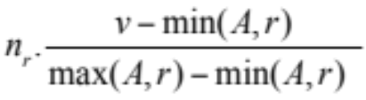
Selection Size Estimation
σ_{A=v}(r)
    n_{r} / V(A,r) : number of records that will satisfy the selection
    Equality condition on a key attribute: size estimate = 1
σ_{A≤V}(r) (case of σ_{A ≥ V}(r) is symmetric)
  Let c denote the estimated number of tuples satisfying the condition.
  If min(A,r) and max(A,r) are available in catalog
    c = 0 if v < min(A,r)
    c =
  If histograms available, can refine above estimate
  In absence of statistical information c is assumed to be n_{r} / 2.

Slide 96


Size Estimation of Complex Selections
The selectivity of a condition θ_{i} is the probability that a tuple in the relation r satisfies θ_{i} .
  If s_{i} is the number of satisfying tuples in r, the selectivity of θ_{i} is given by s_{i} /n_{r}.
Conjunction: σ_{θ1∧ θ2∧. . . ∧ θn} (r). Assuming indepdence, estimate of
tuples in the result is:
Disjunction:σ_{θ1∨} _{θ2 ∨. . . ∨} _{θn} (r). Estimated number of tuples:
Negation: σ_{¬θ}(r). Estimated number of tuples:
n_{r} – size(σ_{θ}(r))

Slide 97
Join Operation: Running Example
Running example:
student takes
Catalog information for join examples:
n_{student} = 5,000.
f_{student} = 50, which implies that
b_{student} =5000/50 = 100.
n_{takes} = 10000.
f_{takes} = 25, which implies that
b_{takes} = 10000/25 = 400.
V(ID, takes) = 2500, which implies that on average, each student who has taken a course has taken 4 courses.
  Attribute ID in takes is a foreign key referencing student.
  V(ID, student) = 5000 (primary key!)

Slide 98
Estimation of the Size of Joins
The Cartesian product r x s contains n_{r} .n_{s} tuples; each tuple occupies s_{r} + s_{s} bytes.
If R ∩ S = ∅, then r s is the same as r x s.
If R ∩ S is a key for R, then a tuple of s will join with at most one tuple from r
  therefore, the number of tuples in r s is no greater than the number of tuples in s.
If R ∩ S in S is a foreign key in S referencing R, then the number of tuples in r s is exactly the same as the number of tuples in s.
    The case for R ∩ S being a foreign key referencing S is symmetric.
In the example query student takes, ID in takes is a foreign key referencing student
  hence, the result has exactly n_{takes} tuples, which is 10000

Slide 99


Estimation of the Size of Joins (Cont.)
If R ∩ S = {A} is not a key for R or S.
If we assume that every tuple t in R produces tuples in R S, the number of tuples in R S is estimated to be:
If the reverse is true, the estimate obtained will be:
The lower of these two estimates is probably the more accurate one.
Can improve on above if histograms are available
  Use formula similar to above, for each cell of histograms on the two relations

Slide 100
Estimation of the Size of Joins (Cont.)
Compute the size estimates for depositor customer without using information about foreign keys:
  V(ID, takes) = 2500, and
  V(ID, student) = 5000
  The two estimates are 5000 * 10000/2500 = 20,000 and 5000 * 10000/5000 = 10000
  We choose the lower estimate, which in this case, is the same as our earlier computation using foreign keys.

Slide 101
Size Estimation for Other Operations
Projection: estimated size of ∏_{A}(r) = V(A,r)
Aggregation : estimated size of _{A}g_{F}(r) = V(A,r)
Set operations
  For unions/intersections of selections on the same relation: rewrite and use size estimate for selections
    E.g. σ_{θ1} (r) ∪ σ_{θ2} (r) can be rewritten as σ_{θ1 ˅ θ2} (r)
  For operations on different relations:
    estimated size of r ∪ s = size of r + size of s.
    estimated size of r ∩ s = minimum size of r and size of s.
    estimated size of r – s = r.
    All the three estimates may be quite inaccurate, but provide upper bounds on the sizes.

Slide 102
Size Estimation (Cont.)
Outer join:
  Estimated size of r s = size of r s + size of r
    Case of right outer join is symmetric
  Estimated size of r s = size of r s + size of r + size of s

Slide 103
Estimation of Number of Distinct Values
Selections: σ_{θ} (r)
If θ forces A to take a specified value: V(A,σ_{θ} (r)) = 1.
    e.g., A = 3
If θ forces A to take on one of a specified set of values:
V(A,σ_{θ} (r)) = number of specified values.
    (e.g., (A = 1 V A = 3 V A = 4 )),
If the selection condition θ is of the form A op r
estimated V(A,σ_{θ} (r)) = V(A.r) * s
    where s is the selectivity of the selection.
In all the other cases: use approximate estimate of
min(V(A,r), n_{σθ (r)} )
  More accurate estimate can be got using probability theory, but this one works fine generally

Slide 104
Estimation of Distinct Values (Cont.)
Joins: r s
If all attributes in A are from r
estimated V(A, r s) = min (V(A,r), n _{r s})
If A contains attributes A1 from r and A2 from s, then estimated
V(A,r s) =
min(V(A1,r)*V(A2 – A1,s), V(A1 – A2,r)*V(A2,s), n_{r s})
  More accurate estimate can be got using probability theory, but this one works fine generally

Slide 105
Estimation of Distinct Values (Cont.)
Estimation of distinct values are straightforward for projections.
  They are the same in ∏_{A (r)} as in r.
The same holds for grouping attributes of aggregation.
For aggregated values
  For min(A) and max(A), the number of distinct values can be estimated as min(V(A,r), V(G,r)) where G denotes grouping attributes
  For other aggregates, assume all values are distinct, and use V(G,r)

Slide 106
Additional Optimization Techniques
Nested Subqueries
Materialized Views

Slide 107
Optimizing Nested Subqueries**
Nested query example:
select name
from instructor
where exists (select *
from teaches
where instructor.ID = teaches.ID and teaches.year = 2007)
SQL conceptually treats nested subqueries in the where clause as functions that take parameters and return a single value or set of values
  Parameters are variables from outer level query that are used in the nested subquery; such variables are called correlation variables
Conceptually, nested subquery is executed once for each tuple in the cross-product generated by the outer level from clause
  Such evaluation is called correlated evaluation
  Note: other conditions in where clause may be used to compute a join (instead of a cross-product) before executing the nested subquery

Slide 108
Optimizing Nested Subqueries (Cont.)
Correlated evaluation may be quite inefficient since
  a large number of calls may be made to the nested query
  there may be unnecessary random I/O as a result
SQL optimizers attempt to transform nested subqueries to joins where possible, enabling use of efficient join techniques
E.g.: earlier nested query can be rewritten as
select name
from instructor, teaches
where instructor.ID = teaches.ID and teaches.year = 2007
  Note: the two queries generate different numbers of duplicates (why?)
    teaches can have duplicate IDs
    Can be modified to handle duplicates correctly as we will see
In general, it is not possible/straightforward to move the entire nested subquery from clause into the outer level query from clause
  A temporary relation is created instead, and used in body of outer level query

Slide 109
Optimizing Nested Subqueries (Cont.)
In general, SQL queries of the form below can be rewritten as shown
Rewrite: select …
from L₁
where P₁ and exists (select *
from L₂
where P₂)
To: create table t₁ as
select distinct V
from L₂
where P₂¹
select …
from L₁, t₁
where P₁ and P₂²
  P₂¹ contains predicates in P₂ that do not involve any correlation variables
  P₂² reintroduces predicates involving correlation variables, with
  relations renamed appropriately
  V contains all attributes used in predicates with correlation variables

Slide 110
Optimizing Nested Subqueries (Cont.)
In our example, the original nested query would be transformed to
create table t₁ as
select distinct ID
from teaches
where year = 2007
select name
from instructor, t₁
where t₁.ID = instructor.ID
The process of replacing a nested query by a query with a join (possibly with a temporary relation) is called decorrelation.
Decorrelation is more complicated when
  the nested subquery uses aggregation, or
  when the result of the nested subquery is used to test for equality, or
  when the condition linking the nested subquery to the other
  query is not exists,
  and so on.

Slide 111
Materialized Views**
A materialized view is a view whose contents are computed and stored.
Consider the view
create view department_total_salary(dept_name, total_salary) as
select dept_name, sum(salary)
from instructor
group by dept_name
Materializing the above view would be very useful if the total salary by department is required frequently
  Saves the effort of finding multiple tuples and adding up their amounts

Slide 112
Materialized View Maintenance
The task of keeping a materialized view up-to-date with the underlying data is known as materialized view maintenance
Materialized views can be maintained by recomputation on every update
A better option is to use incremental view maintenance
  Changes to database relations are used to compute changes to the materialized view, which is then updated
View maintenance can be done by
  Manually defining triggers on insert, delete, and update of each relation in the view definition
  Manually written code to update the view whenever database relations are updated
  Periodic recomputation (e.g. nightly)
  Above methods are directly supported by many database systems
    Avoids manual effort/correctness issues

Slide 113
Incremental View Maintenance
The changes (inserts and deletes) to a relation or expressions are referred to as its differential
  Set of tuples inserted to and deleted from r are denoted i_{r} and d_{r}
To simplify our description, we only consider inserts and deletes
  We replace updates to a tuple by deletion of the tuple followed by insertion of the update tuple
We describe how to compute the change to the result of each relational operation, given changes to its inputs
We then outline how to handle relational algebra expressions

Slide 114
Join Operation
Consider the materialized view v = r s and an update to r
Let r^{old} and r^{new} denote the old and new states of relation r
Consider the case of an insert to r:
  We can write r^{new} s as (r^{old} ∪ i_{r}) s
  And rewrite the above to (r^{old} s) ∪ (i_{r} s)
  But (r^{old} s) is simply the old value of the materialized view, so the incremental change to the view is just i_{r} s
Thus, for inserts v^{new} = v^{old} ∪(i_{r} s)
Similarly for deletes v^{new} = v^{old} – (d_{r} s)
A, 1
B, 2
1, p
2, r
2, s
A, 1, p
B, 2, r
B, 2, s
C,2
C, 2, r
C, 2, s

Slide 115
Selection and Projection Operations
Selection: Consider a view v = σ_{θ}(r).
  v^{new} = v^{old} ∪σ_{θ}(i_{r})
  v^{new} = v^{old} - σ_{θ}(d_{r})
Projection is a more difficult operation
  R = (A,B), and r(R) = { (a,2), (a,3)}
  ∏_{A}(r) has a single tuple (a).
  If we delete the tuple (a,2) from r, we should not delete the tuple (a) from ∏_{A}(r), but if we then delete (a,3) as well, we should delete the tuple
For each tuple in a projection ∏_{A}(r) , we will keep a count of how many times it was derived
  On insert of a tuple to r, if the resultant tuple is already in ∏_{A}(r) we increment its count, else we add a new tuple with count = 1
  On delete of a tuple from r, we decrement the count of the corresponding tuple in ∏_{A}(r)
    if the count becomes 0, we delete the tuple from ∏_{A}(r)

Slide 116
Aggregation Operations
count : v = _{A}g_{count(B)}^{(r)}.
  When a set of tuples i_{r} is inserted
    For each tuple r in i_{r}, if the corresponding group is already present in v, we increment its count, else we add a new tuple with count = 1
  When a set of tuples d_{r} is deleted
    for each tuple t in i_{r.}we look for the group t.A in v, and subtract 1 from the count for the group.
      If the count becomes 0, we delete from v the tuple for the group t.A
sum: v = _{A}g_{sum (B)}^{(r)}
  We maintain the sum in a manner similar to count, except we add/subtract the B value instead of adding/subtracting 1 for the count
  Additionally we maintain the count in order to detect groups with no tuples. Such groups are deleted from v
    Cannot simply test for sum = 0 (why?)
To handle the case of avg, we maintain the sum and count
aggregate values separately, and divide at the end

Slide 117
Aggregate Operations (Cont.)
min, max: v = _{A}g_{min (B)} (r).
  Handling insertions on r is straightforward.
  Maintaining the aggregate values min and max on deletions may be more expensive. We have to look at the other tuples of r that are in the same group to find the new minimum

Slide 118
Other Operations
Set intersection: v = r ∩ s
  when a tuple is inserted in r we check if it is present in s, and if so we add it to v.
  If the tuple is deleted from r, we delete it from the intersection if it is present.
  Updates to s are symmetric
  The other set operations, union and set difference are handled in a similar fashion.
Outer joins are handled in much the same way as joins but with some extra work
  we leave details to you.

Slide 119
Handling Expressions
To handle an entire expression, we derive expressions for computing the incremental change to the result of each sub-expressions, starting from the smallest sub-expressions.
E.g. consider E₁ E₂ where each of E₁ and E₂ may be a complex expression
  Suppose the set of tuples to be inserted into E₁ is given by D₁
    Computed earlier, since smaller sub-expressions are handled first
  Then the set of tuples to be inserted into E₁ E₂ is given by
  D₁ E₂
    This is just the usual way of maintaining joins

Slide 120
Query Optimization and Materialized Views
Rewriting queries to use materialized views:
  A materialized view v = r s is available
  A user submits a query r s t
  We can rewrite the query as v t
    Whether to do so depends on cost estimates for the two alternative
Replacing a use of a materialized view by the view definition:
  A materialized view v = r s is available, but without any index on it
  User submits a query σ_{A=10}(v).
  Suppose also that s has an index on the common attribute B, and r has an index on attribute A.
  The best plan for this query may be to replace v by r s, which can lead to the query plan σ_{A=10}(r) s
Query optimizer should be extended to consider all above
alternatives and choose the best overall plan

Slide 121
Materialized View Selection
Materialized view selection: “What is the best set of views to materialize?”.
Index selection: “what is the best set of indices to create”
  closely related, to materialized view selection
    but simpler
Materialized view selection and index selection based on typical system workload (queries and updates)
  Typical goal: minimize time to execute workload , subject to constraints on space and time taken for some critical queries/updates
  One of the steps in database tuning
    more on tuning in later chapters
Commercial database systems provide tools (called “tuning assistants” or “wizards”) to help the database administrator choose what indices and materialized views to create

Slide 122
Additional Optimization Techniques

Slide 123
Top-K Queries
Top-K queries
  select *
  from r, s
  where r.B = s.B
  order by r.A ascending
  limit 10
  Alternative 1: Indexed nested loops join with r as outer
  Alternative 2: estimate highest r.A value in result and add selection (and r.A <= H) to where clause
    If < 10 results, retry with larger H

Slide 124
Optimization of Updates
Halloween problem
  update R set A = 5 * A
  where A > 10
  If index on A is used to find tuples satisfying A > 10, and tuples updated immediately, same tuple may be found (and updated) multiple times
  Solution 1: Always defer updates
    collect the updates (old and new values of tuples) and update relation and indices in second pass
    Drawback: extra overhead even if e.g. update is only on R.B, not on attributes in selection condition
  Solution 2: Defer only if required
    Perform immediate update if update does not affect attributes in where clause, and deferred updates otherwise.

Slide 125
Join Minimization
Join minimization
  select r.A, r.B
  from r, s
  where r.B = s.B
Check if join with s is redundant, drop it
  E.g. join condition is on foreign key from r to s, r.B is declared as not null, and no selection on s
  Other sufficient conditions possible
  select r.A, s2.B
  from r, s as s1, s as s2
  where r.B=s1.B and r.B = s2.B and s1.A < 20 and s2.A < 10
    join with s1 is redundant and can be dropped (along with selection on s1)
  Lots of research in this area since 70s/80s!

Slide 126
Multiquery Optimization
Example
Q1: select * from (r natural join t) natural join s
Q2: select * from (r natural join u) natural join s
  Both queries share common subexpression (r natural join s)
  May be useful to compute (r natural join s) once and use it in both queries
    But this may be more expensive in some situations
      e.g. (r natural join s) may be expensive, plans as shown in queries may be cheaper
Multiquery optimization: find best overall plan for a set of queries, expoiting sharing of common subexpressions between queries where it is useful

Slide 127
Multiquery Optimization (Cont.)
Simple heuristic used in some database systems:
  optimize each query separately
  detect and exploiting common subexpressions in the individual optimal query plans
    May not always give best plan, but is cheap to implement
  Shared scans: widely used special case of multiquery optimization
Set of materialized views may share common subexpressions
  As a result, view maintenance plans may share subexpressions
  Multiquery optimization can be useful in such situations

Slide 128
Parametric Query Optimization
Example
select *
from r natural join s
where r.a < $1
  value of parameter $1 not known at compile time
    known only at run time
  different plans may be optimal for different values of $1
Solution 1: optimize at run time, each time query is submitted
    can be expensive
Solution 2: Parametric Query Optimization:
  optimizer generates a set of plans, optimal for different values of $1
    Set of optimal plans usually small for 1 to 3 parameters
    Key issue: how to do find set of optimal plans efficiently
  best one from this set is chosen at run time when $1 is known
Solution 3: Query Plan Caching
  If optimizer decides that same plan is likely to be optimal for all parameter values, it caches plan and reuses it, else reoptimize each time
  Implemented in many database systems

Slide 129
Extra Slides
(Not in 6th Edition book)

Slide 130
Plan Stability Across Optimizer Changes
What if 95% of plans are faster on database/optimizer version N+1 than on N, but 5% are slower?
  Why should plans be slower on new improved optimizer?
    Answer: Two wrongs can make a right, fixing one wrong can make things worse!
Approaches:
  Allow hints for tuning queries
    Not practical for migrating large systems with no access to source code
  Set optimization level, default to version N (Oracle)
    And migrate one query at a time after testing both plans on new optimizer
  Save plan from version N, and give it to optimizer version N+1
    Sybase, XML representation of plans (SQL Server)

Slide 131
End of Chapter

Slide 132
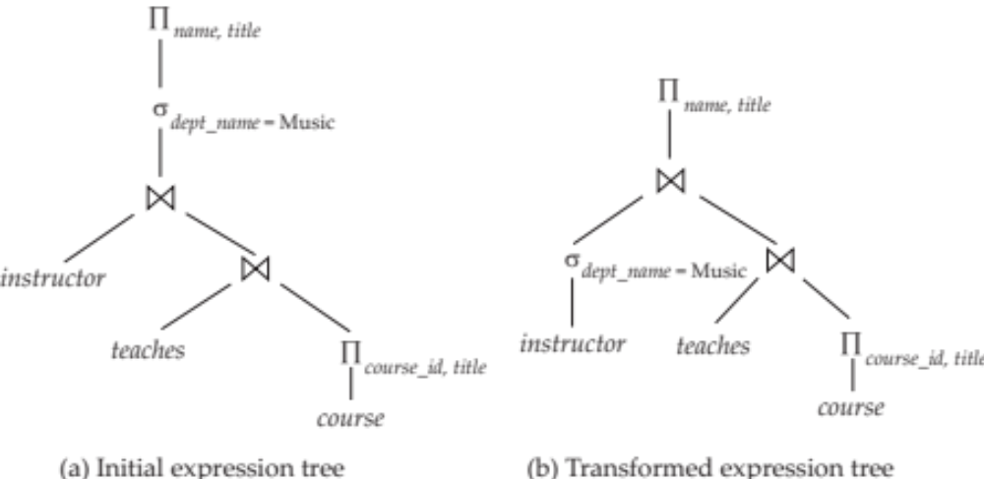
Figure 13.01

Slide 133
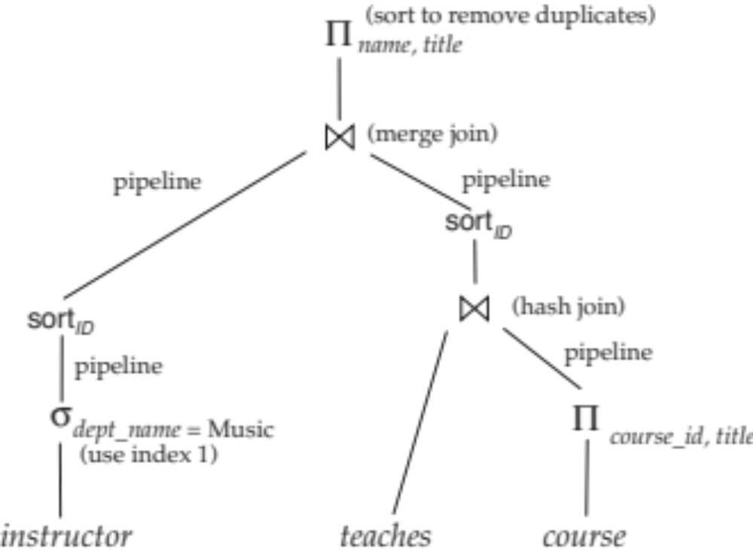
Figure 13.02

Slide 134
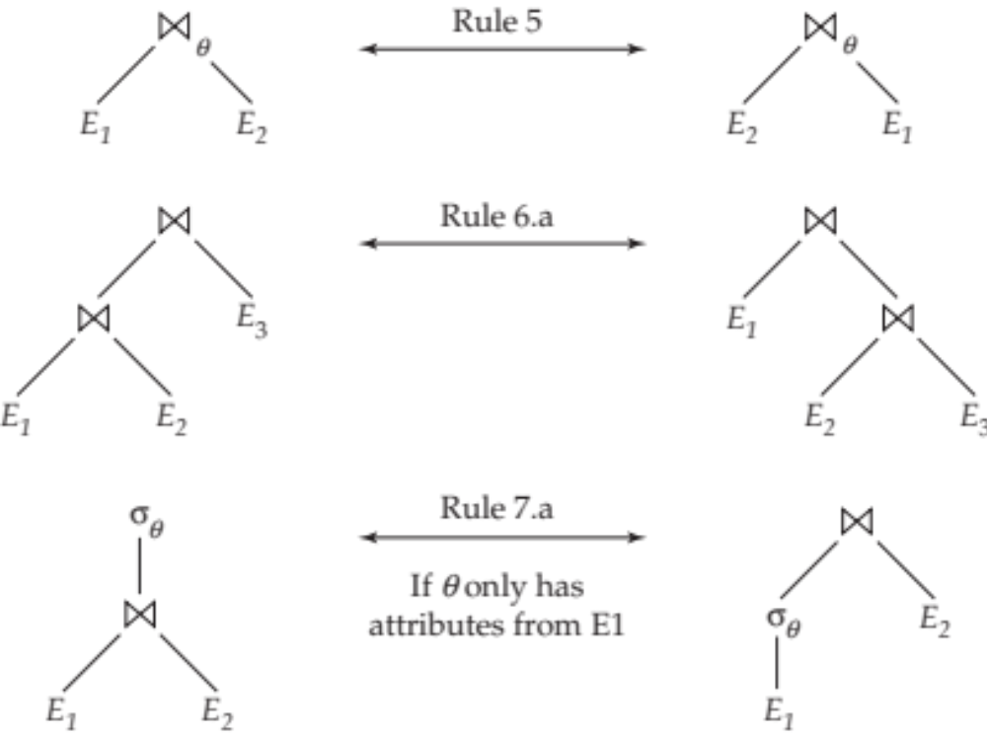
Figure 13.03

Slide 135
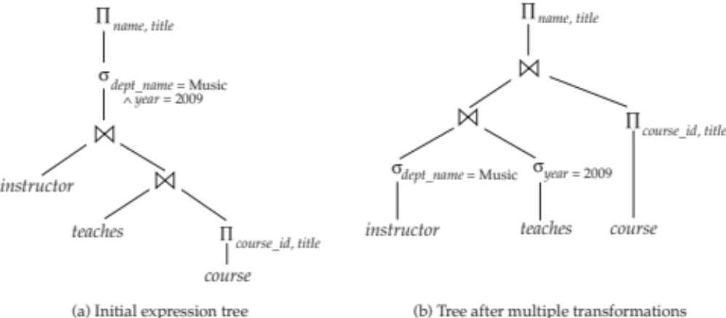
Figure 13.04

Slide 136

Figure 13.06

Slide 137
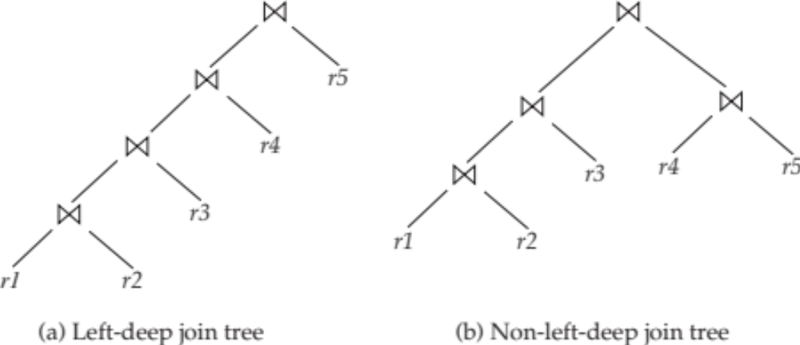
Figure 13.08

