Slide 1

Slide 25- <number>

Slide 2
Chapter 4
Distributed Databases and
Client-Server Architectures
Copyright © 2007 Ramez Elmasri and Shamkant B. Navathe

Slide 3
Chapter 4 Outline
Distributed Database Concepts
Data Fragmentation, Replication and Allocation
Types of Distributed Database Systems
Query Processing
Concurrency Control and Recovery
3-Tier Client-Server Architecture
Slide 25- <number>

Slide 4
Distributed Database Concepts
A transaction can be executed by multiple networked computers in a unified manner.
A distributed database (DDB) processes Unit of execution (a transaction) in a distributed manner. A distributed database (DDB) can be defined as
  A distributed database (DDB) is a collection of multiple logically related database distributed over a computer network, and a distributed database management system as a software system that manages a distributed database while making the distribution transparent to the user.
Slide 25- <number>

Slide 5
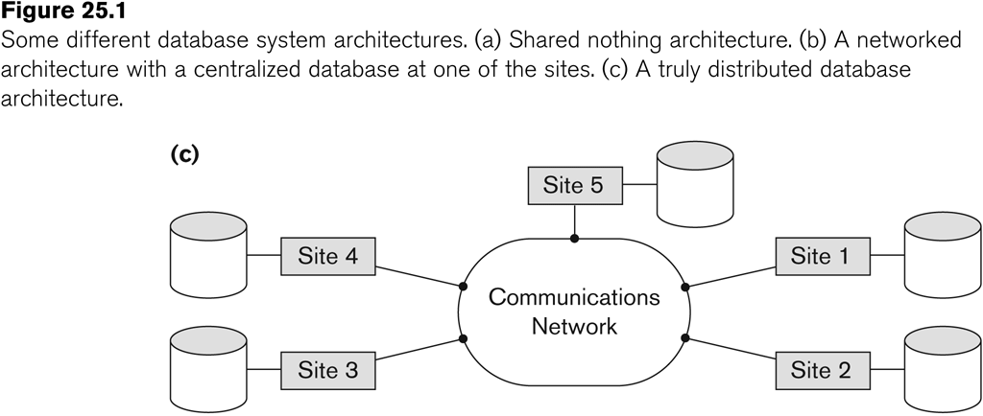
Distributed Database System
Advantages
  Management of distributed data with different levels of transparency:
    This refers to the physical placement of data (files, relations, etc.) which is not known to the user (distribution transparency).
Slide 25- <number>

Slide 6
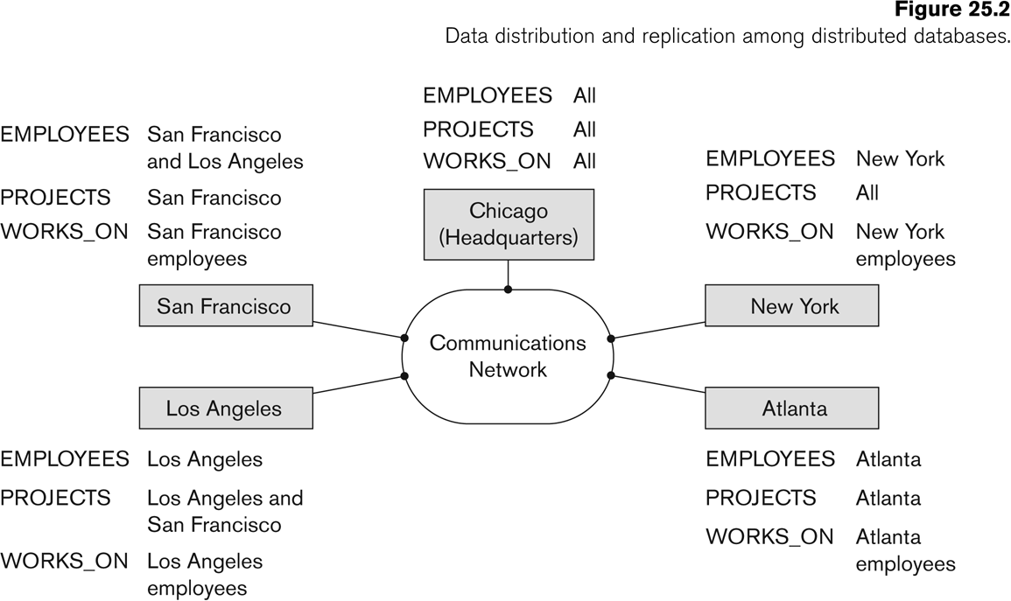
Distributed Database System
Advantages (transparency, contd.)
  The EMPLOYEE, PROJECT, and WORKS_ON tables may be fragmented horizontally and stored with possible replication as shown below.
Slide 25- <number>

Slide 7
Distributed Database System
Advantages (transparency, contd.)
  Distribution and Network transparency:
    Users do not have to worry about operational details of the network.
      There is Location transparency, which refers to freedom of issuing command from any location without affecting its working.
      Then there is Naming transparency, which allows access to any names object (files, relations, etc.) from any location.
Slide 25- <number>

Slide 8
Distributed Database System
Advantages (transparency, contd.)
  Replication transparency:
    It allows to store copies of a data at multiple sites as shown in the above diagram.
    This is done to minimize access time to the required data.
  Fragmentation transparency:
    Allows to fragment a relation horizontally (create a subset of tuples of a relation) or vertically (create a subset of columns of a relation).
Slide 25- <number>

Slide 9
Distributed Database System
Other Advantages
  Increased reliability and availability:
    Reliability refers to system live time, that is, system is running efficiently most of the time. Availability is the probability that the system is continuously available (usable or accessible) during a time interval.
    A distributed database system has multiple nodes (computers) and if one fails then others are available to do the job.
Slide 25- <number>

Slide 10
Distributed Database System
Other Advantages (contd.)
  Improved performance:
    A distributed DBMS fragments the database to keep data closer to where it is needed most.
    This reduces data management (access and modification) time significantly.
  Easier expansion (scalability):
    Allows new nodes (computers) to be added anytime without chaining the entire configuration.
Slide 25- <number>

Slide 11
Data Fragmentation, Replication and Allocation
Data Fragmentation
  Split a relation into logically related and correct parts. A relation can be fragmented in two ways:
    Horizontal Fragmentation
    Vertical Fragmentation
Slide 25- <number>

Slide 12
Data Fragmentation, Replication and Allocation
Horizontal fragmentation
  It is a horizontal subset of a relation which contain those of tuples which satisfy selection conditions.
  Consider the Employee relation with selection condition (DNO = 5). All tuples satisfy this condition will create a subset which will be a horizontal fragment of Employee relation.
  A selection condition may be composed of several conditions connected by AND or OR.
  Derived horizontal fragmentation: It is the partitioning of a primary relation to other secondary relations which are related with Foreign keys.
Slide 25- <number>

Slide 13
Data Fragmentation, Replication and Allocation
Vertical fragmentation
  It is a subset of a relation which is created by a subset of columns. Thus a vertical fragment of a relation will contain values of selected columns. There is no selection condition used in vertical fragmentation.
  Consider the Employee relation. A vertical fragment of can be created by keeping the values of Name, Bdate, Sex, and Address.
  Because there is no condition for creating a vertical fragment, each fragment must include the primary key attribute of the parent relation Employee. In this way all vertical fragments of a relation are connected.
Slide 25- <number>

Slide 14
Data Fragmentation, Replication and Allocation
Representation
  Horizontal fragmentation
    Each horizontal fragment on a relation can be specified by a σ_{Ci} (R) operation in the relational algebra.
    Complete horizontal fragmentation
    A set of horizontal fragments whose conditions C1, C2, …, Cn include all the tuples in R- that is, every tuple in R satisfies (C1 OR C2 OR … OR Cn).
    Disjoint complete horizontal fragmentation: No tuple in R satisfies (Ci AND Cj) where i ≠ j.
    To reconstruct R from horizontal fragments a UNION is applied.
Slide 25- <number>

Slide 15
Data Fragmentation, Replication and Allocation
Representation
  Vertical fragmentation
    A vertical fragment on a relation can be specified by a Π_{Li}(R) operation in the relational algebra.
    Complete vertical fragmentation
    A set of vertical fragments whose projection lists L1, L2, …, Ln include all the attributes in R but share only the primary key of R. In this case the projection lists satisfy the following two conditions:
    L1 ∪ L2 ∪ ... ∪ Ln = ATTRS (R)
    Li ∩ Lj = PK(R) for any i j, where ATTRS (R) is the set of attributes of R and PK(R) is the primary key of R.
    To reconstruct R from complete vertical fragments a OUTER UNION is applied.
Slide 25- <number>

Slide 16
Data Fragmentation, Replication and Allocation
Representation
  Mixed (Hybrid) fragmentation
    A combination of Vertical fragmentation and Horizontal fragmentation.
    This is achieved by SELECT-PROJECT operations which is represented by Π_{Li}(σ_{Ci} (R)).
    If C = True (Select all tuples) and L ≠ ATTRS(R), we get a vertical fragment, and if C ≠ True and L ≠ ATTRS(R), we get a mixed fragment.
    If C = True and L = ATTRS(R), then R can be considered a fragment.
Slide 25- <number>

Slide 17
Data Fragmentation, Replication and Allocation
Fragmentation schema
  A definition of a set of fragments (horizontal or vertical or horizontal and vertical) that includes all attributes and tuples in the database that satisfies the condition that the whole database can be reconstructed from the fragments by applying some sequence of UNION (or OUTER JOIN) and UNION operations.
Allocation schema
  It describes the distribution of fragments to sites of distributed databases. It can be fully or partially replicated or can be partitioned.
Slide 25- <number>

Slide 18
Data Fragmentation, Replication and Allocation
Data Replication
  Database is replicated to all sites.
  In full replication the entire database is replicated and in partial replication some selected part is replicated to some of the sites.
  Data replication is achieved through a replication schema.
Data Distribution (Data Allocation)
  This is relevant only in the case of partial replication or partition.
  The selected portion of the database is distributed to the database sites.
Slide 25- <number>

Slide 19
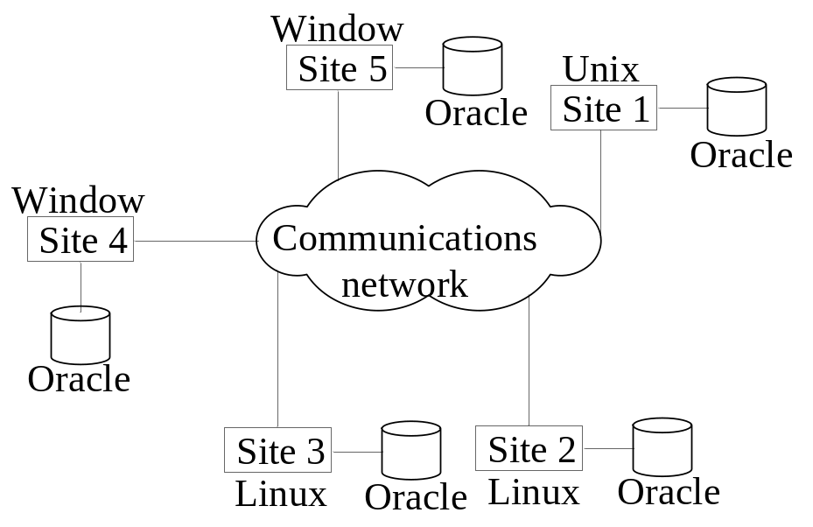
Types of Distributed Database Systems
Homogeneous
  All sites of the database system have identical setup, i.e., same database system software.
  The underlying operating system may be different.
    For example, all sites run Oracle or DB2, or Sybase or some other database system.
  The underlying operating systems can be a mixture of Linux, Window, Unix, etc.
Slide 25- <number>

Slide 20
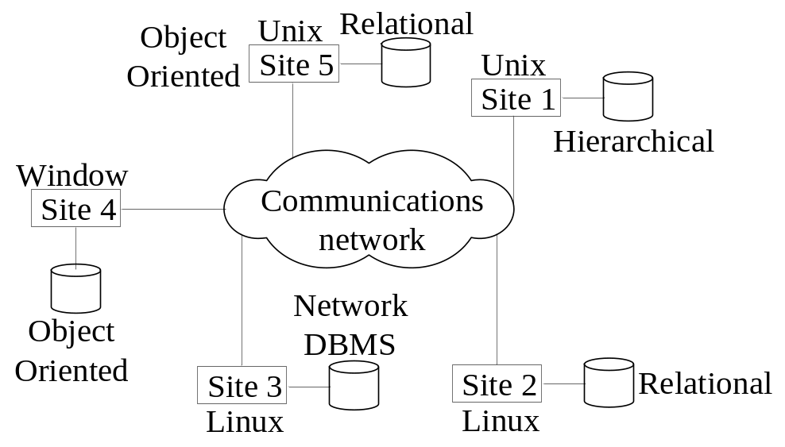
Types of Distributed Database Systems
Heterogeneous
  Federated: Each site may run different database system but the data access is managed through a single conceptual schema.
    This implies that the degree of local autonomy is minimum. Each site must adhere to a centralized access policy. There may be a global schema.
  Multidatabase: There is no one conceptual global schema. For data access a schema is constructed dynamically as needed by the application software.
Slide 25- <number>

Slide 21
Types of Distributed Database Systems
Federated Database Management Systems Issues
  Differences in data models:
    Relational, Objected oriented, hierarchical, network, etc.
  Differences in constraints:
    Each site may have their own data accessing and processing constraints.
  Differences in query language:
    Some site may use SQL, some may use SQL-89, some may use SQL-92, and so on.
Slide 25- <number>

Slide 22

Query Processing in Distributed Databases
Issues
  Cost of transferring data (files and results) over the network.
    This cost is usually high so some optimization is necessary.
    Example relations: Employee at site 1 and Department at Site 2
      Employee at site 1. 10,000 rows. Row size = 100 bytes. Table size = 10⁶ bytes.
      Department at Site 2. 100 rows. Row size = 35 bytes. Table size = 3,500 bytes.
    Q: For each employee, retrieve employee name and department name Where the employee works.
    Q: Π_{Fname,Lname,Dname} (Employee _{Dno = Dnumber} Department)
Fname | Minit | Lname | SSN | Bdate | Address | Sex | Salary | Superssn | Dno
Dname | Dnumber | Mgrssn | Mgrstartdate
Slide 25- <number>

Slide 23
Query Processing in Distributed Databases
Result
  The result of this query will have 10,000 tuples, assuming that every employee is related to a department.
  Suppose each result tuple is 40 bytes long. The query is submitted at site 3 and the result is sent to this site.
  Problem: Employee and Department relations are not present at site 3.
Slide 25- <number>

Slide 24
Query Processing in Distributed Databases
Strategies:
  Transfer Employee and Department to site 3.
    Total transfer bytes = 1,000,000 + 3500 = 1,003,500 bytes.
  Transfer Employee to site 2, execute join at site 2 and send the result to site 3.
    Query result size = 40 * 10,000 = 400,000 bytes. Total transfer size = 400,000 + 1,000,000 = 1,400,000 bytes.
  Transfer Department relation to site 1, execute the join at site 1, and send the result to site 3.
    Total bytes transferred = 400,000 + 3500 = 403,500 bytes.
Optimization criteria: minimizing data transfer.
Slide 25- <number>

Slide 25
Query Processing in Distributed Databases
Strategies:
  Transfer Employee and Department to site 3.
    Total transfer bytes = 1,000,000 + 3500 = 1,003,500 bytes.
  Transfer Employee to site 2, execute join at site 2 and send the result to site 3.
    Query result size = 40 * 10,000 = 400,000 bytes. Total transfer size = 400,000 + 1,000,000 = 1,400,000 bytes.
  Transfer Department relation to site 1, execute the join at site 1, and send the result to site 3.
    Total bytes transferred = 400,000 + 3500 = 403,500 bytes.
Optimization criteria: minimizing data transfer.
  Preferred approach: strategy 3.
Slide 25- <number>

Slide 26
Query Processing in Distributed Databases
Consider the query
  Q’: For each department, retrieve the department name and the name of the department manager
Relational Algebra expression:
  Π_{Fname,Lname,Dname} (Employee _{Mgrssn = SSN} Department)
Slide 25- <number>

Slide 27
Query Processing in Distributed Databases
The result of this query will have 100 tuples, assuming that every department has a manager, the execution strategies are:
  Transfer Employee and Department to the result site and perform the join at site 3.
    Total bytes transferred = 1,000,000 + 3500 = 1,003,500 bytes.
  Transfer Employee to site 2, execute join at site 2 and send the result to site 3. Query result size = 40 * 100 = 4000 bytes.
    Total transfer size = 4000 + 1,000,000 = 1,004,000 bytes.
  Transfer Department relation to site 1, execute join at site 1 and send the result to site 3.
    Total transfer size = 4000 + 3500 = 7500 bytes.
Slide 25- <number>

Slide 28
Query Processing in Distributed Databases
The result of this query will have 100 tuples, assuming that every department has a manager, the execution strategies are:
  Transfer Employee and Department to the result site and perform the join at site 3.
    Total bytes transferred = 1,000,000 + 3500 = 1,003,500 bytes.
  Transfer Employee to site 2, execute join at site 2 and send the result to site 3. Query result size = 40 * 100 = 4000 bytes.
    Total transfer size = 4000 + 1,000,000 = 1,004,000 bytes.
  Transfer Department relation to site 1, execute join at site 1 and send the result to site 3.
    Total transfer size = 4000 + 3500 = 7500 bytes.
Preferred strategy: Choose strategy 3.
Slide 25- <number>

Slide 29
Query Processing in Distributed Databases
Now suppose the result site is 2. Possible strategies :
  Transfer Employee relation to site 2, execute the query and present the result to the user at site 2.
    Total transfer size = 1,000,000 bytes for both queries Q and Q’.
  Transfer Department relation to site 1, execute join at site 1 and send the result back to site 2.
    Total transfer size for Q = 400,000 + 3500 = 403,500 bytes and for Q’ = 4000 + 3500 = 7500 bytes.
Slide 25- <number>

Slide 30
Query Processing in Distributed Databases
Semijoin:
  Objective is to reduce the number of tuples in a relation before transferring it to another site.
Example execution of Q or Q’:
  Project the join attributes of Department at site 2, and transfer them to site 1. For Q, 4 * 100 = 400 bytes are transferred and for Q’, 9 * 100 = 900 bytes are transferred.
  Join the transferred file with the Employee relation at site 1, and transfer the required attributes from the resulting file to site 2. For Q, 34 * 10,000 = 340,000 bytes are transferred and for Q’, 39 * 100 = 3900 bytes are transferred.
  Execute the query by joining the transferred file with Department and present the result to the user at site 2.
Slide 25- <number>

Slide 31
Concurrency Control and Recovery
Distributed Databases encounter a number of concurrency control and recovery problems which are not present in centralized databases. Some of them are listed below.
  Dealing with multiple copies of data items
  Failure of individual sites
  Communication link failure
  Distributed commit
  Distributed deadlock
Slide 25- <number>

Slide 32
Concurrency Control and Recovery
Details
  Dealing with multiple copies of data items:
    The concurrency control must maintain global consistency. Likewise the recovery mechanism must recover all copies and maintain consistency after recovery.
  Failure of individual sites:
    Database availability must not be affected due to the failure of one or two sites and the recovery scheme must recover them before they are available for use.
Slide 25- <number>

Slide 33
Concurrency Control and Recovery
Details (contd.)
  Communication link failure:
    This failure may create network partition which would affect database availability even though all database sites may be running.
  Distributed commit:
    A transaction may be fragmented and they may be executed by a number of sites. This require a two or three-phase commit approach for transaction commit.
  Distributed deadlock:
    Since transactions are processed at multiple sites, two or more sites may get involved in deadlock. This must be resolved in a distributed manner.
Slide 25- <number>

Slide 34
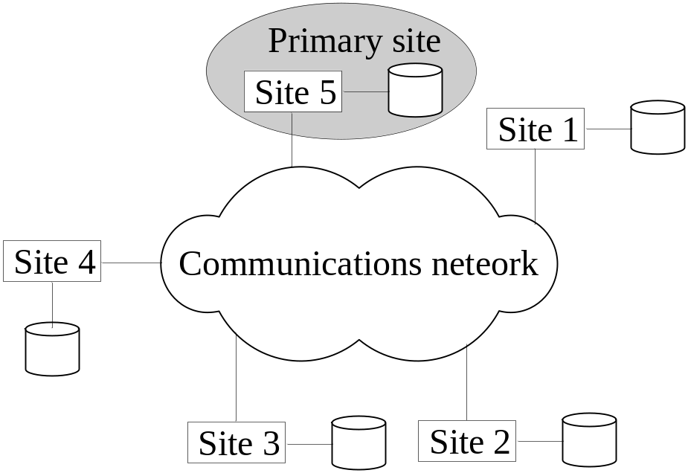
Concurrency Control and Recovery
Distributed Concurrency control based on a distributed copy of a data item
  Primary site technique: A single site is designated as a primary site which serves as a coordinator for transaction management.
Slide 25- <number>

Slide 35
Concurrency Control and Recovery
Transaction management:
  Concurrency control and commit are managed by this site.
  In two phase locking, this site manages locking and releasing data items. If all transactions follow two-phase policy at all sites, then serializability is guaranteed.
Slide 25- <number>

Slide 36
Concurrency Control and Recovery
Transaction Management
  Advantages:
    An extension to the centralized two phase locking so implementation and management is simple.
    Data items are locked only at one site but they can be accessed at any site.
  Disadvantages:
    All transaction management activities go to primary site which is likely to overload the site.
    If the primary site fails, the entire system is inaccessible.
  To aid recovery a backup site is designated which behaves as a shadow of primary site. In case of primary site failure, backup site can act as primary site.
Slide 25- <number>

Slide 37
Concurrency Control and Recovery
Primary Copy Technique:
  In this approach, instead of a site, a data item partition is designated as primary copy. To lock a data item just the primary copy of the data item is locked.
Advantages:
  Since primary copies are distributed at various sites, a single site is not overloaded with locking and unlocking requests.
Disadvantages:
  Identification of a primary copy is complex. A distributed directory must be maintained, possibly at all sites.
Slide 25- <number>

Slide 38
Concurrency Control and Recovery
Recovery from a coordinator failure
  In both approaches a coordinator site or copy may become unavailable. This will require the selection of a new coordinator.
Primary site approach with no backup site:
  Aborts and restarts all active transactions at all sites. Elects a new coordinator and initiates transaction processing.
Primary site approach with backup site:
  Suspends all active transactions, designates the backup site as the primary site and identifies a new back up site. Primary site receives all transaction management information to resume processing.
Primary and backup sites fail or no backup site:
  Use election process to select a new coordinator site.
Slide 25- <number>

Slide 39
Concurrency Control and Recovery
Concurrency control based on voting:
  There is no primary copy of coordinator.
  Send lock request to sites that have data item.
  If majority of sites grant lock then the requesting transaction gets the data item.
  Locking information (grant or denied) is sent to all these sites.
  To avoid unacceptably long wait, a time-out period is defined. If the requesting transaction does not get any vote information then the transaction is aborted.
Slide 25- <number>

Slide 40
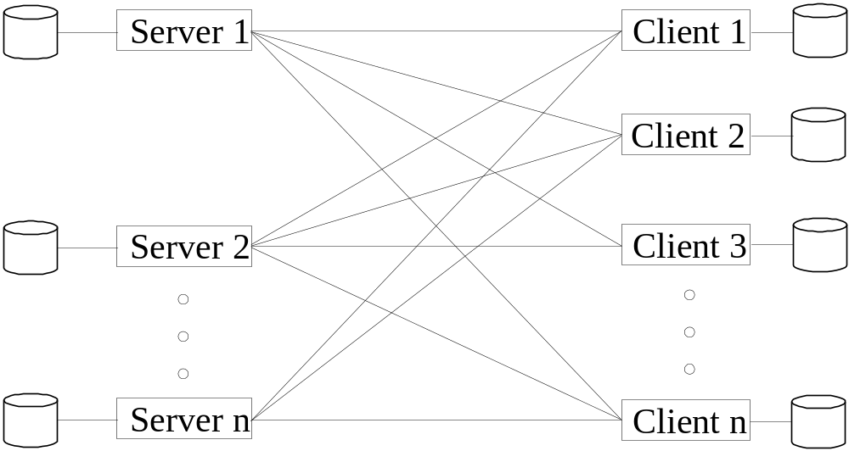
Client-Server Database Architecture
It consists of clients running client software, a set of servers which provide all database functionalities and a reliable communication infrastructure.
Slide 25- <number>

Slide 41
Client-Server Database Architecture
Clients reach server for desired service, but server does reach clients.
The server software is responsible for local data management at a site, much like centralized DBMS software.
The client software is responsible for most of the distribution function.
The communication software manages communication among clients and servers.
Slide 25- <number>

Slide 42
Client-Server Database Architecture
The processing of a SQL queries goes as follows:
  Client parses a user query and decomposes it into a number of independent sub-queries. Each subquery is sent to appropriate site for execution.
  Each server processes its query and sends the result to the client.
  The client combines the results of subqueries and produces the final result.
Slide 25- <number>

Slide 43
Recap
Distributed Database Concepts
Data Fragmentation, Replication and Allocation
Types of Distributed Database Systems
Query Processing
Concurrency Control and Recovery
3-Tier Client-Server Architecture
Slide 25- <number>

Slide 44
Slide 25- <number>

Slide 45
CAP Theorem

Slide 46
CAP Theorem
Consistency:
  All nodes should see the same data at the same time
Availability:
  Node failures do not prevent survivors from continuing to operate
Partition-tolerance:
  The system continues to operate despite network partitions
A distributed system can satisfy any two of these guarantees at the same time but not all three

Slide 47
CAP Theorem
C
A
P

Slide 48

CAP Theorem
A simple example:
Hotel Booking: are we double-booking the same room?
Bob
Dong

Slide 49
CAP Theorem
A simple example:
Hotel Booking: are we double-booking the same room?
Bob
Dong

Slide 50

CAP Theorem
A simple example:
Hotel Booking: are we double-booking the same room?
Bob
Dong

Slide 51
CAP Theorem: Proof
A simple proof using two nodes:
A
B

Slide 52
CAP Theorem: Proof
A simple proof using two nodes:
Not Consistent!
A
B
Respond to client

Slide 53

CAP Theorem: Proof
A simple proof using two nodes:
Not Available!
A
B
Wait to be updated

Slide 54
CAP Theorem: Proof
A simple proof using two nodes:
Not Partition Tolerant!
A
B
A gets updated from B

Slide 55
Why this is important?
The future of databases is distributed (Big Data Trend, etc.)
CAP theorem describes the trade-offs involved in distributed systems
A proper understanding of CAP theorem is essential to making decisions about the future of distributed database design
Misunderstanding can lead to erroneous or inappropriate design choices

Slide 56
Problem for Relational Database to Scale
The Relational Database is built on the principle of ACID (Atomicity, Consistency, Isolation, Durability)
It implies that a truly distributed relational database should have availability, consistency and partition tolerance.
Which unfortunately is impossible …

Slide 57
Revisit CAP Theorem
Of the following three guarantees potentially offered a by distributed systems:
  Consistency
  Availability
  Partition tolerance
Pick two
This suggests there are three kinds of distributed systems:
  CP
  AP
  CA
C
A
P
Any problems?

Slide 58
A popular misconception: 2 out 3
How about CA?
Can a distributed system (with unreliable network) really be not tolerant of partitions?
C
A

Slide 59
Consistency or Availability
Consistency and Availability is not “binary” decision
AP systems relax consistency in favor of availability – but are not inconsistent
CP systems sacrifice availability for consistency- but are not unavailable
This suggests both AP and CP systems can offer a degree of consistency, and availability, as well as partition tolerance
C
A
P

Slide 60
AP: Best Effort Consistency
Example:
  Web Caching
  DNS
Trait:
  Optimistic
  Expiration/Time-to-live
  Conflict resolution

Slide 61
CP: Best Effort Availability
Example:
  Majority protocols
  Distributed Locking (Google Chubby Lock service)
Trait:
  Pessimistic locking
  Make minority partition unavailable

Slide 62
Types of Consistency
Strong Consistency
  After the update completes, any subsequent access will return the same updated value.
Weak Consistency
  It is not guaranteed that subsequent accesses will return the updated value.
Eventual Consistency
  Specific form of weak consistency
  It is guaranteed that if no new updates are made to object, eventually all accesses will return the last updated value (e.g., propagate updates to replicas in a lazy fashion)

Slide 63
Eventual Consistency Variations
Causal consistency
  Processes that have causal relationship will see consistent data
Read-your-write consistency
  A process always accesses the data item after it’s update operation and never sees an older value
Session consistency
  As long as session exists, system guarantees read-your-write consistency
  Guarantees do not overlap sessions

Slide 64
Eventual Consistency Variations
Monotonic read consistency
  If a process has seen a particular value of data item, any subsequent processes will never return any previous values
Monotonic write consistency
  The system guarantees to serialize the writes by the same process
In practice
  A number of these properties can be combined
  Monotonic reads and read-your-writes are most desirable

Slide 65
Lecture 6- NoSQL

Slide 66
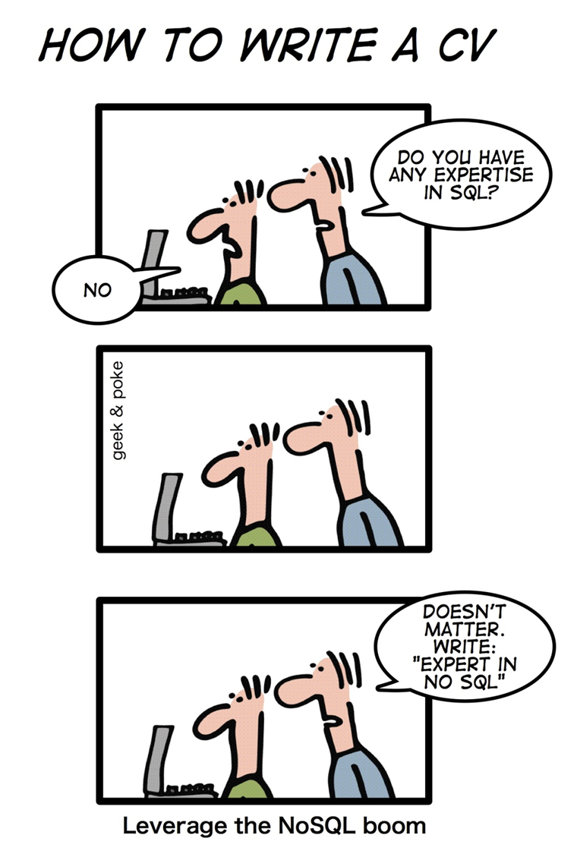
NoSQL!
NoSQL databases are currently a hot topic in some parts of computing, with over a hundred
different NoSQL databases.

Slide 67
RDBMS Characteristics
Data stored in columns and tables
Relationships represented by data
Data Manipulation Language
Data Definition Language
Transactions
Abstraction from physical layer
Applications specify what, not how
Physical layer can change without modifying applications
  Create indexes to support queries
  In Memory databases

Slide 68
Transactions – ACID Properties
Atomic – All of the work in a transaction completes (commit) or none of it completes
  a transaction to transfer funds from one account to another involves making a withdrawal operation from the first account and a deposit operation on the second. If the deposit operation failed, you don’t want the withdrawal operation to happen either.
Consistent – A transaction transforms the database from one consistent state to another consistent state. Consistency is defined in terms of constraints.
  a database tracking a checking account may only allow unique check numbers to exist for each transaction
Isolated – The results of any changes made during a transaction are not visible until the transaction has committed.
  a teller looking up a balance must be isolated from a concurrent transaction involving a withdrawal from the same account. Only when the withdrawal transaction commits successfully and the teller looks at the balance again will the new balance be reported.
Durable – The results of a committed transaction survive failures
  A system crash or any other failure must not be allowed to lose the results of a transaction or the contents of the database. Durability is often achieved through separate transaction logs that can "re-create" all transactions from some picked point in time (like a backup).

Slide 69
No SQL?
NoSQL stands for:
  No Relational
  No RDBMS
  Not Only SQL
NoSQL is an umbrella term for all databases and data stores that don’t follow the RDBMS principles
  A class of products
  A collection of several (related) concepts about data storage and manipulation
  Often related to large data sets

Slide 70
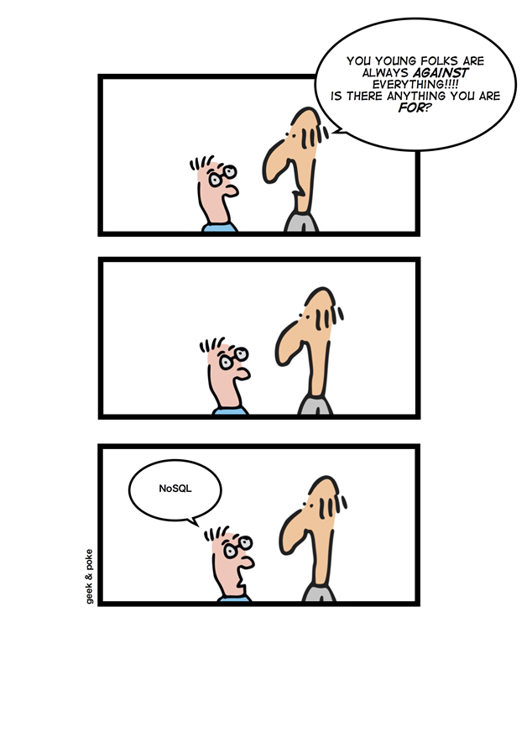
NoSQL Definition
  Next Generation Databases mostly addressing some of the points: being non-relational, distributed, open-source and horizontal scalable. The original intention has been modern web-scale databases. The movement began early 2009 and is growing rapidly. Often more characteristics apply as: schema-free, easy replication support, simple API, eventually consistent / BASE (not ACID), a huge data amount, and more.

Slide 71
Where does NoSQL come from?
Non-relational DBMSs are not new
But NoSQL represents a new incarnation
  Due to massively scalable Internet applications
  Based on distributed and parallel computing
Development
  Starts with Google
  First research paper published in 2003
  Continues also thanks to Lucene's developers/Apache (Hadoop) and Amazon (Dynamo)
  Then a lot of products and interests came from Facebook, Netfix, Yahoo, eBay, Hulu, IBM, and many more

Slide 72
Dynamo and BigTable
Three major papers were the seeds of the NoSQL movement
  BigTable (Google)
  Dynamo (Amazon)
    Distributed key-value data store
    Eventual consistency
  CAP Theorem (discuss in a sec ..)
Notes:
-> BigTable: http://labs.google.com/papers/bigtable.html
-> Dynamo: http://www.allthingsdistributed.com/2007/10/amazons_dynamo.html and http://www.allthingsdistributed.com/files/amazon-dynamo-sosp2007.pdf
-> Amazon and consistency
* http://www.allthingsdistributed.com/2010/02
* http://www.allthingsdistributed.com/2008/12

Slide 73
NoSQL and Big Data
NoSQL comes from Internet, thus it is often related to the “big data” concept
How much big are “big data”?
  Over few terabytes Enough to start spanning multiple storage units
Challenges
  Efficiently storing and accessing large amounts of data is difficult, even more considering fault tolerance and backups
  Manipulating large data sets involves running immensely parallel processes
  Managing continuously evolving schema and metadata for semi-structured and un-structured data is difficult

Slide 74
How did we get here?
Explosion of social media sites (Facebook, Twitter) with large data needs
Rise of cloud-based solutions such as Amazon S3 (simple storage solution)
Just as moving to dynamically-typed languages (Python, Ruby, Groovy), a shift to dynamically-typed data with frequent schema changes
Open-source community

Slide 75
Why are RDBMS not suitable for Big Data
The context is Internet
RDBMSs assume that data are
  Dense
  Largely uniform (structured data)
Data coming from Internet are
  Massive and sparse
  Semi-structured or unstructured
With massive sparse data sets, the typical storage mechanisms and access methods get stretched

Slide 76
NoSQL Distinguishing Characteristics
Large data volumes
  Google’s “big data”
Scalable replication and distribution
  Potentially thousands of machines
  Potentially distributed around the world
Queries need to return answers quickly
Mostly query, few updates
Asynchronous Inserts & Updates
Schema-less
ACID transaction properties are not needed – BASE
CAP Theorem
Open source development

Slide 77
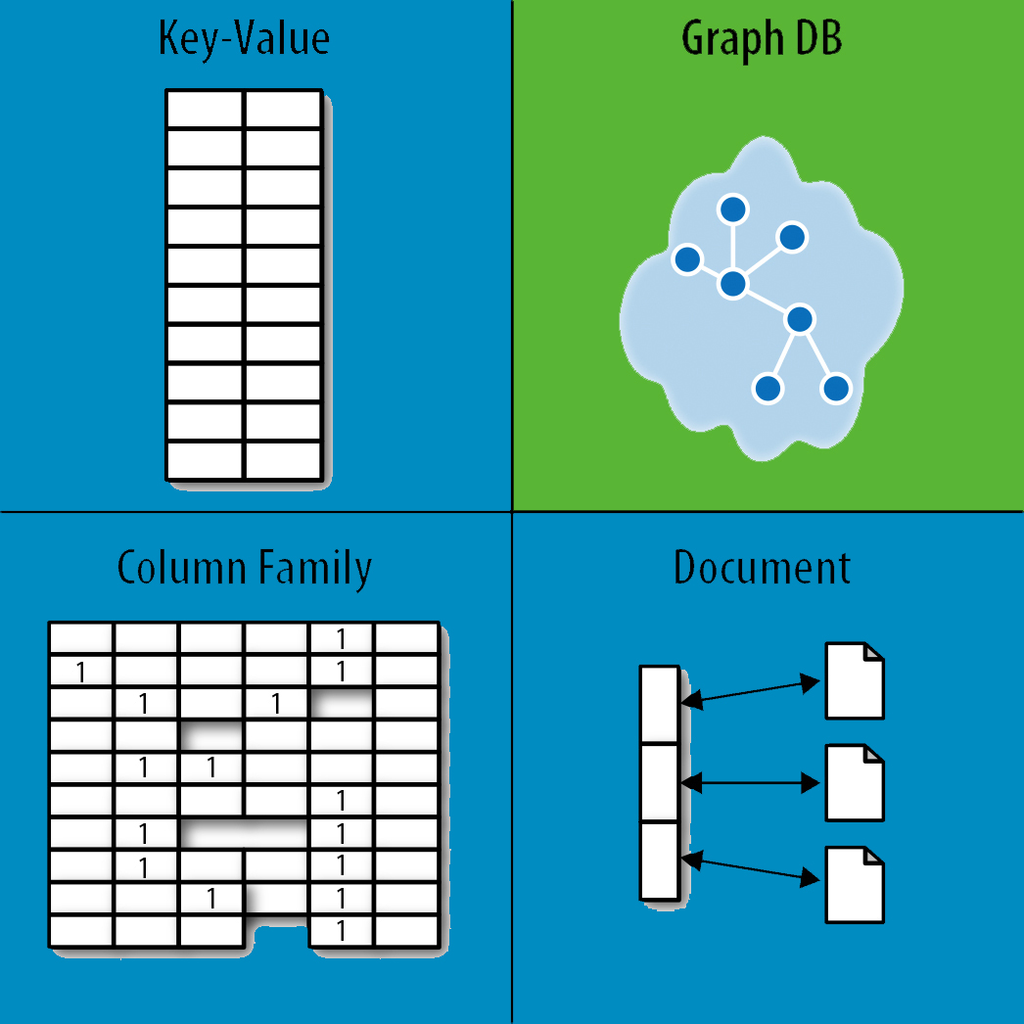
NoSQL Database Types
Discussing NoSQL databases is complicated
because there are a variety of types:
Sorted ordered Column Store
  Optimized for queries over large datasets, and store
  columns of data together, instead of rows
Document databases:
  pair each key with a complex data structure known as a document.
Key-Value Store :
  are the simplest NoSQL databases. Every single item in the database is stored as an attribute name (or 'key'), together with its value.
Graph Databases :
  are used to store information about networks of data, such as social connections.

Slide 78
Document Databases (Document Store)
Documents
  Loosely structured sets of key/value pairs in documents, e.g., XML, JSON, BSON
  Encapsulate and encode data in some standard formats or encodings
  Are addressed in the database via a unique key
  Documents are treated as a whole, avoiding splitting a document into its constituent name/value pairs
Allow documents retrieving by keys or contents
Notable for:
  MongoDB (used in FourSquare, Github, and more)
  CouchDB (used in Apple, BBC, Canonical, Cern, and more)

Slide 79
Document Databases (Document Store)
The central concept is the notion of a "document“ which corresponds to a row in RDBMS.
A document comes in some standard formats like JSON (BSON).
Documents are addressed in the database via a unique key that represents that document.
The database offers an API or query language that retrieves documents based on their contents.
Documents are schema free, i.e., different documents can have structures and schema that differ from one another. (An RDBMS requires that each row contain the same columns.)

Slide 80
Document Databases, JSON
{
_id: ObjectId("51156a1e056d6f966f268f81"),
type: "Article",
author: "Derick Rethans",
title: "Introduction to Document Databases with MongoDB",
date: ISODate("2013-04-24T16:26:31.911Z"),
body: "This arti…"
},
{
_id: ObjectId("51156a1e056d6f966f268f82"),
type: "Book",
author: "Derick Rethans",
title: "php|architect's Guide to Date and Time Programming with PHP",
isbn: "978-0-9738621-5-7"
}

Slide 81
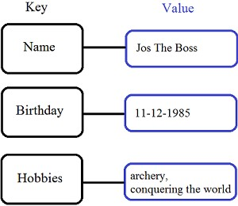
Key/Value stores
Store data in a schema-less way
Store data as maps
  HashMaps or associative arrays
  Provide a very efficient average running
  time algorithm for accessing data
Notable for:
  Couchbase (Zynga, Vimeo, NAVTEQ, ...)
  Redis (Craiglist, Instagram, StackOverfow,
  flickr, ...)
  Amazon Dynamo (Amazon, Elsevier,
  IMDb, ...)
  Apache Cassandra (Facebook, Digg,
  Reddit, Twitter,...)
  Voldemort (LinkedIn, eBay, …)
  Riak (Github, Comcast, Mochi, ...)

Slide 82
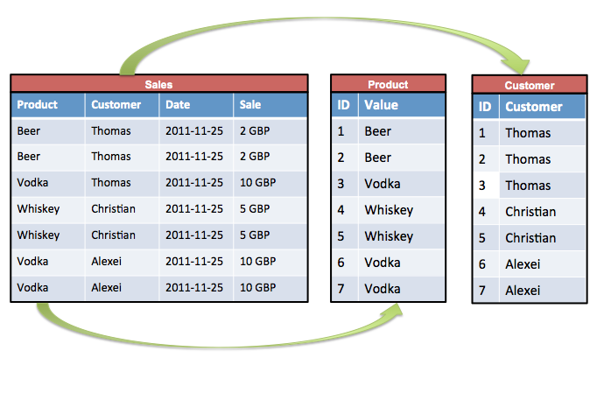
Sorted Ordered Column-Oriented Stores
Data are stored in a column-oriented way
  Data efficiently stored
  Avoids consuming space for storing nulls
  Columns are grouped in column-families
  Data isn’t stored as a single table but is stored by column families
  Unit of data is a set of key/value pairs
    Identified by “row-key”
    Ordered and sorted based on row-key
Notable for:
  Google's Bigtable (used in all
  Google's services)
  HBase (Facebook, StumbleUpon,
  Hulu, Yahoo!, ...)

Slide 83
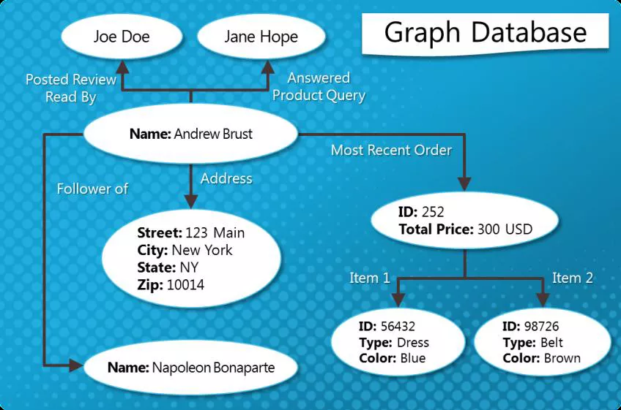
Graph Databases
Graph-oriented
Everything is stored as an edge, a node or an attribute.
Each node and edge can have any number of attributes.
Both the nodes and edges can be labelled.
Labels can be used to narrow searches.

Slide 84
Dealing with Big Data and Scalability
Issues with scaling up when the dataset is just too big
RDBMS were not designed to be distributed
Traditional DBMSs are best designed to run well on a “single” machine
  Larger volumes of data/operations requires to upgrade the server with faster CPUs or more memory known as ‘scaling up’ or ‘Vertical scaling’
NoSQL solutions are designed to run on clusters or multi-node database solutions
  Larger volumes of data/operations requires to add more machines to the cluster, Known as ‘scaling out’ or ‘horizontal scaling’
  Different approaches include:
    Master-slave
    Sharding (partitioning)

Slide 85
Scaling RDBMS
Master-Slave
  All writes are written to the master. All reads performed against the replicated slave databases
  Critical reads may be incorrect as writes may not have been propagated down
  Large data sets can pose problems as master needs to duplicate data to
Sharding
  Any DB distributed across multiple machines needs to know in what machine a piece of data is stored or must be stored
  A sharding system makes this decision for each row, using its key

Slide 86
NoSQL, No ACID
RDBMSs are based on ACID (Atomicity, Consistency, Isolation, and Durability) properties
NoSQL
  Does not give importance to ACID properties
  In some cases completely ignores them
In distributed parallel systems it is difficult/impossible to ensure ACID properties
  Long-running transactions don't work because keeping resources blocked for a long time is not practical

Slide 87
BASE Transactions
Acronym contrived to be the opposite of ACID
  Basically Available,
  Soft state,
  Eventually Consistent
Characteristics
  Weak consistency – stale data OK
  Availability first
  Best effort
  Approximate answers OK
  Aggressive (optimistic)
  Simpler and faster

Slide 88
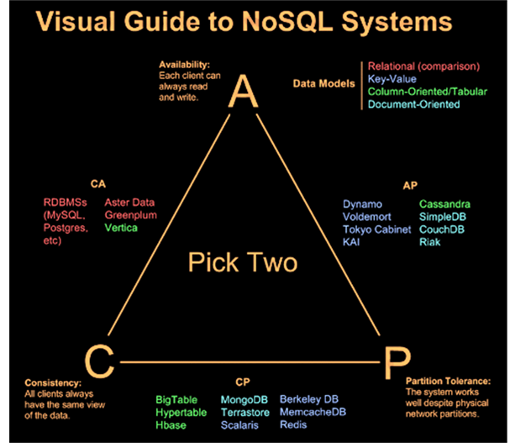
CAP Theorem
A congruent and logical way for assessing the problems involved in assuring ACID-like guarantees in distributed systems is provided by the CAP theorem
At most two of the following three can be maximized at one time
Consistency
  Each client has the same view of the
  data
Availability
  Each client can always read and write
Partition tolerance
  System works well across distributed
  physical networks

Slide 89
CAP Theorem: Two out of Three
CAP theorem – At most two properties on three can be addressed
The choices could be as follows:
Availability is compromised but consistency and partition tolerance are preferred over it
The system has little or no partition tolerance. Consistency and availability are preferred
Consistency is compromised but systems are always available and can work when parts of it are partitioned

Slide 90
Consistency or Availability
Consistency and Availability is not “binary” decision
AP systems relax consistency in favor of availability – but are not inconsistent
CP systems sacrifice availability for consistency- but are not unavailable
This suggests both AP and CP systems can offer a degree of consistency, and availability, as well as partition tolerance
C
A
P

Slide 91
Performance
There is no perfect NoSQL database
Every database has its advantages and disadvantages
  Depending on the type of tasks (and preferences) to accomplish
NoSQL is a set of concepts, ideas, technologies, and software dealing with
  Big data
  Sparse un/semi-structured data
  High horizontal scalability
  Massive parallel processing
Different applications, goals, targets, approaches need different NoSQL solutions

Slide 92
Where would I use it?
Where would I use a NoSQL database?
Do you have somewhere a large set of uncontrolled, unstructured, data that you are trying to fit into a RDBMS?
  Log Analysis
  Social Networking Feeds (many firms hooked in through Facebook or Twitter)
  External feeds from partners
  Data that is not easily analyzed in a RDBMS such as time-based data
  Large data feeds that need to be massaged before entry into an RDBMS

Slide 93
Don’t forget about the DBA
It does not matter if the data is deployed on a NoSQL platform instead of an RDBMS.
Still need to address:
  Backups & recovery
  Capacity planning
  Performance monitoring
  Data integration
  Tuning & optimization
What happens when things don’t work as expected and nodes are out of sync or you have a data corruption occurring at 2am?
Who you gonna call?
  DBA and SysAdmin need to be on board

Slide 94
The Perfect Storm
Large datasets, acceptance of alternatives, and dynamically-typed data has come together in a perfect storm
Not a backlash/rebellion against RDBMS
SQL is a rich query language that cannot be rivaled by the current list of NoSQL offerings
  So you have reached a point where a read-only cache and write-based RDBMS isn’t delivering the throughput necessary to support a particular application.
  You need to examine alternatives and what alternatives are out there.
  The NoSQL databases are a pragmatic response to growing scale of databases and the falling prices of commodity hardware.

Slide 95
Summary
Most likely, 10 years from now, the majority of data is still stored in RDBMS.
Leading users of NoSQL datastores are social networking sites such as Twitter, Facebook, LinkedIn, and Digg.
Not every problem is a nail and not every solution is a hammer.
NoSQL has taken a field that was "dead" (database development) and suddenly brought it back to life.

Slide 96
What is Big Data?
Big data is a collection of large datasets that cannot be processed using traditional computing techniques. It is not a single technique or a tool, rather it has become a complete subject, which involves various tools, technqiues and frameworks.
Slide 25- <number>

Slide 97
What Comes Under Big Data?
Big data involves the data produced by different devices and applications. Given below are some of the fields that come under the umbrella of Big Data.
Black Box Data − It is a component of helicopter, airplanes, and jets, etc. It captures voices of the flight crew, recordings of microphones and earphones, and the performance information of the aircraft.
Social Media Data − Social media such as Facebook and Twitter hold information and the views posted by millions of people across the globe.
Stock Exchange Data − The stock exchange data holds information about the ‘buy’ and ‘sell’ decisions made on a share of different companies made by the customers.
Power Grid Data − The power grid data holds information consumed by a particular node with respect to a base station.
Transport Data − Transport data includes model, capacity, distance and availability of a vehicle.
Search Engine Data − Search engines retrieve lots of data from different databases.
Slide 25- <number>

Slide 98
Benefits of Big Data
Using the information kept in the social network like Facebook, the marketing agencies are learning about the response for their campaigns, promotions, and other advertising mediums.
Using the information in the social media like preferences and product perception of their consumers, product companies and retail organizations are planning their production.
Using the data regarding the previous medical history of patients, hospitals are providing better and quick service.
Slide 25- <number>

Slide 99
Big Data Challenges
The major challenges associated with big data are as follows −
Capturing data
Curation
Storage
Searching
Sharing
Transfer
Analysis
Presentation
Slide 25- <number>

Slide 100
What is Hadoop?
Apache Hadoop is an open source framework that is used to efficiently store and process large datasets ranging in size from gigabytes to petabytes of data. Instead of using one large computer to store and process the data, Hadoop allows clustering multiple computers to analyze massive datasets in parallel more quickly.
Hadoop consists of four main modules:
Hadoop Distributed File System (HDFS) – A distributed file system that runs on standard or low-end hardware. HDFS provides better data throughput than traditional file systems, in addition to high fault tolerance and native support of large datasets.
Yet Another Resource Negotiator (YARN) – Manages and monitors cluster nodes and resource usage. It schedules jobs and tasks.
MapReduce – A framework that helps programs do the parallel computation on data. The map task takes input data and converts it into a dataset that can be computed in key value pairs. The output of the map task is consumed by reduce tasks to aggregate output and provide the desired result.
Hadoop Common – Provides common Java libraries that can be used across all modules.
Slide 25- <number>

Slide 101
Slide 25- <number>

