Slide 1
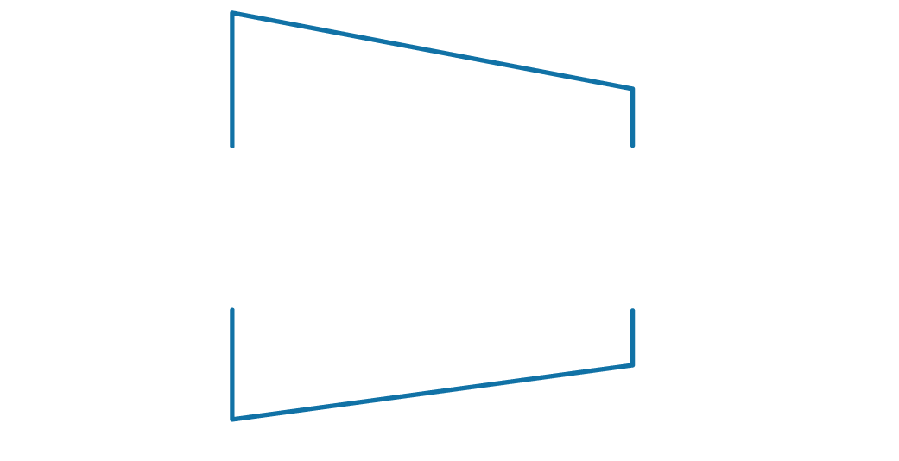
Bluescape
Battle Card
The Opportunity
Mobile devices and dispersed teams have changed the way people work. It’s a challenge for organizations to effectively communicate across time, geography and technology.
Customer Pain Points | Bluescape can help…
Difficult to collaborate across time zones, geographies, and technologies | Reduce Travel: Multiple teams can simultaneously collaborate across time and space in a persistent workspace
Challenging and time consuming to find context when information is scattered | Central Repository: Quickly evolve and ideate complex concepts - workflows and artifacts are stored in one place – forever
Waste resources trying to track and capture IP and original marks | Persistent Workspace: Capture intellectual property in an always available and secure environment
Risk losing competitive advantage because of slow and stifled innovation | Increase Strategic Speed: Full transparency of the best ideas to enable faster innovation and go-to-market
Idea validation and evolution costs are high – mistakes and iterations are expensive | Dynamic Innovation: Uncover and visualize the best ideas through diversified participation from top talent and teams in an interactive workspace
Inability to predict organizational outcomes due to a lack of visibility | Drive Better Decision Making: See the big picture to gain insights and optimize existing resources
Tough to have effective meetings, align and motivate teams to focus on the right priorities | Plug-and-play ready: Easy to use, save time without having to hook up hardware or move from room-to-room
Key Messages
Bluescape is a platform for real time collaboration, making it easy for individuals and teams to create, interact with and share content.
Connects existing resources
Enables deeper insights
Meaningful innovation
Simultaneous collaboration across time zones
Elevator Pitch
Bluescape™ provides cloud-based visual collaborative workspaces for individuals, teams and multisite enterprises.
See further, faster
Ignite breakthrough ideas
Connect across teams and time zones

Slide 2
Bluescape Battle Card
How would you use Bluescape?
Strategic planning
Conceptualizing/visualization
Working sessions
Project management
Prototyping
Design review
Customer presentations
Content & data management
Storyboarding
Qualification Questions:
Does your organization utilize public cloud-based solutions?
Is it challenging to collaborate with multisite teams?
Does your organization do a lot of ‘re-work’ because information is stored in different camps?
What do you currently use for IP tracking?
Do you have management challenges with your virtual environments?
How do you collaborate today?
What business challenges are you facing?
How are your teams distributed geographically?
What applications are you using for collaboration today?
What are the limitations to the current technologies you’re using today?
Do you collaborate with clients or third parties?
Is there budget for this sort of initiative?
Differentiators
Real time visual collaboration
Cloud-based solution
Easy to deploy and adopt (people actually use it!)
Persistent, always-on information availability
Central repository
Plug-and-play ready
End-to-end solution for mobile workforce

Slide 3
BluescapeBattle Card
Objection Handling
Differentiation in Market
Easiest to deploy and use
Broadest out-of-the-box cloud based collaboration platform
Connect across teams and time zones
Retain organizational knowledge
Parallel versus serial activity
Objection | Response
We already have collaboration technology | Bluescape protects existing technology investments by pulling preferred tools and applications into a centralized workspace. We make it easier to use your digital tools in a non-linear way that delivers simultaneous touch and stylus in a cloud-based platform – so it travels where you do.
We use video conferencing to collaborate with remote teams | Bluescape brings existing video conferencing solutions into the workspace, allowing you to see your content and team members. Our service transforms the way our clients work and virtually meet by consolidating people, content and applications across time and space in a persistent workspace with limitless, simultaneous collaboration.
We’ve been looking at other collaboration tools that are half the cost, with more features. | Bluescape is a new technology and we have many features in the project roadmap. We’re working with our early customers to create an even more robust solution.
How do we organize our information in Bluescape efficiently? | We have location markers to help you navigate and organize the workspace. We’re working on other features in the roadmap to make it even easier for you in the future.

Slide 4
Bluescape Battle Card
The Competition
Comparison | Smart | Oblong | Microsoft | Prysm (Anacore merged)
 |  |  | (Perceptive Pixel)
Solution Pricing | $7,000 | $150k-300k | $7,500 | $200k-$1M+
Solution Overview | 55" panel & annotation software | Wand, (3) 55" panels, cameras | 55" panel display | Wall options that tend to be custom
Software MSRP | $13,000 (500 users for Bridget Video Conferencing) | N/A | N/A | N/A
Strengths | Brand name recognition | MIT innovation & backing, Minority Report PR | Owned by Microsoft | Customizable, high-quality screens
Weaknesses | Associated with education market, struggling to gain foothold in enterprise. | Limited to presentation functionality. Static content that is linear. Requires dedicated room space. | Brand confusion over product naming; customers primarily in news/broadcasting; limited to Windows 8; little attention from MS. | Display-only functionality
Concurrent users at a wall using the touch panel at the same time | 2 | Users use wand, not wall -- only 2 users at a time can use a wand. | 10 | 12
Native Interoperability (bring software into your environment) | No | No | No | No
User experience | Touch/Stylus | Wand | Touch/Stylus | Display/Touch
Cloud Native | No | No | No | No
Partnerships | Microsoft Lync, Google for Education, Epson, Cisco | AdTech, Carahsoft, CDG, AVI-SPL | AccuWeather | Cisco, Crestron
Top Customers | Audi, Microsoft, various universities/schools | IBM, GE, Boeing, Beats Music, SAP | CNN, Lockheed Martin, Pixar, CBS News | GE, CNBC

Slide 5
Bluescape Battle Card
Customer ROI
Why Bluescape
Reduce business travel
More efficient meetings
Streamline communication across teams
Resources
/ Tools
-Overview
-Pricing sheets
-Case Studies
-Tech support/guides
-Quick Start Guide
-Spec sheets
-Competitor Matrix
-Showroom Locations
-FAQ
Use Cases | Before Bluescape | With Bluescape | ROI
Collaboration | Version control issues Multiple time zones and mobile teams | Better faster decision-making & execution Increase transparency | Cost savings of $1.4M (for one team with 15 team members over 6 months)
Workflow Redundancy | Too many meetings Multiple revisions Taxing travel time | Information centrally available Streamline meetings | $1.3M in project dev. savings
Project Management | Lack of clarity for decision-making roles Duplication of effort, confusion, & inefﬁciency | Better faster decision-making & execution Increase transparency | Cost savings of $290K (for one team with 7 team members over 16 weeks)
Customer Engagements
• Reebok • GE • Johnson & Johnson • Genentech • Mazda • Toyota • Sony Mobile • Shell Autodesk • HP • Marriott • Gensler • HOK • Stanford • BTS • LucasFilm • Haworth • San Mateo County Sheriff
Sales Contact
Loni Miller: 650-567-4528 loni.miller@bluescape.com
Marketing
Liz Carlston 650-567-4529 liz.carlston@bluescape.com
Videos
Bluescape YouTube Channel

