Slide 1
GROUP 6
PACKCHECK
Portable EV Battery
Diagnostic & Charging Tool
Entrepreneurship Development
Noyal K N • Prabhath C S • Pranav Praveen
Roopesh O R • Roshna Palatty Santhosh
PROJECT FEASIBILITY

Slide 2
Product Concept
Problem
Solution
Target customers
Repair shops need quick way to find weak cells, battery-pack condition and fix them.
A handheld tool for cell-voltage checks, health estimation, balancing and charging.
EV repair shops, battery service technicians.
Proposed selling price
₹8,000 per unit
Similar products are in the ₹10,000–₹16,000 range
02

Slide 3
Technical Feasibility & Business Model
Materials
All components are commercial-off-the-shelf, proctured from distributers like DigiKey
Manufacturing
Outsource: PCB fabrication
in-house: assembly, firmware flashing and testing.
Revenue & sales
Sell units directly to repair shops and service centres
Support services may add revenue in future.
03

Slide 4
Cost Structure, Land & Investment
Unit cost component | Cost
Electronics | ₹3,600
Packaging | ₹200
Variable cost | 5%
Total variable cost | ₹4,000
Initial investment item | Cost
Building | ₹4,65,000
Equipment | ₹67,000
Clearance charges | ₹52,000
Total initial investment | ₹5,84,000
Monthly operational cost item | Cost
Electricity | ₹13,000
Water | ₹1,000
Insurance | ₹4,000
Maintenance | ₹1,000
Total monthly operational cost | ₹18,000
Location: Kothamangalam, Ernakulam
Funding plan: Partner Investment, and utilizing land of one of partners
PACKCHECK | ENTREPRENEURSHIP DEVELOPMENT
04

Slide 5
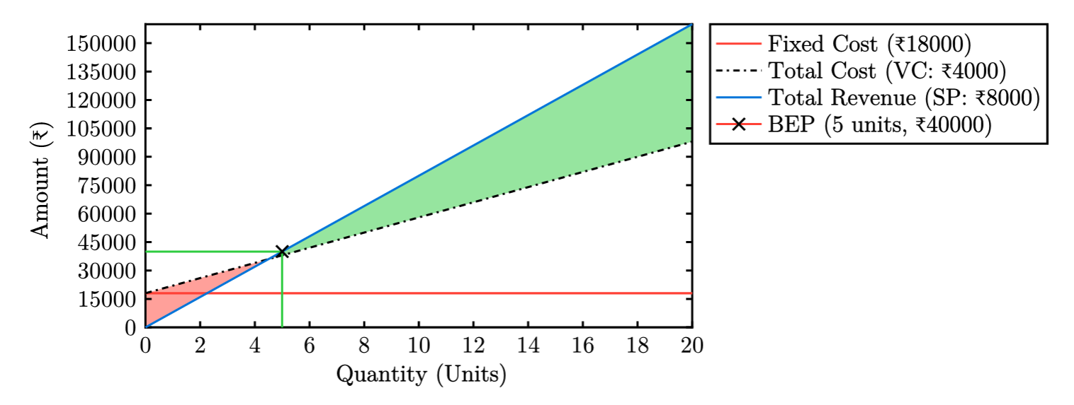
Break-Even Point (BEP) & Repay
Monthly fixed operating cost: ₹18,000
Selling Price of: ₹8000/unit.
Target Sale: 20 units/month
Contribution per unit: ₹8000 − ₹4000 = ₹4000/unit
BEP (units) = Fixed cost / Contribution per unit ≈ 5 units/month [Achieved in 1 week]
Investment recovered in ₹5,84,000 / (₹4000 * (20-5) units/month) ≈ 10 months
05

Slide 6
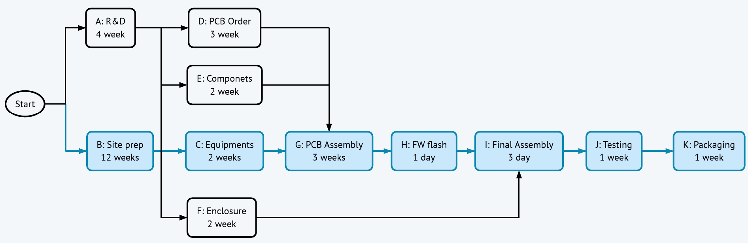
PERT: Project Scheduling
PERT expected time = (O + 4M + P) / 6
O = optimistic, M = most likely, P = pessimistic duration. The synopsis does not provide activity-level duration estimates, so this network is illustrative.
Reported overall project duration: 4.5 months (from synopsis).
07

Slide 7
CPM: Critical Path
B
C
G
H
I
J
K
Requirements
Circuit design
Prototype
Testing
Firmware
Pilot production
Launch
Total project duration: 4.5 months
The critical path is the longest sequence of dependent activities. A delay in any critical activity can delay the overall project. Activity durations were not supplied, so the 4.5-month result is presented as reported.
PACKCHECK | ENTREPRENEURSHIP DEVELOPMENT
08

Slide 8
Risks, Mitigation & Implementation Plan
Conditions to address before commercial launch
Technical risk
Market risk
Financial risk
Unsafe charging/balancing or inaccurate readings. Validate protection circuits, calibration and thermal behaviour.
Customer demand and price acceptance are unverified. Conduct interviews, demonstrations and pilot sales.
High upfront capital and uncertain sales. Confirm supplier quotes and use conservative forecasts.
Implementation roadmap
Customer discovery and requirements confirmation
Prototype design, assembly and bench testing
Safety validation and calibration
Pilot deployment, feedback and launch decision
PACKCHECK | ENTREPRENEURSHIP DEVELOPMENT
09

Slide 9
THANK YOU

