Slide 1
OpenFDA Food, Dietary Supplement, and Cosmetic Adverse Events API
The openFDA food, dietary supplements, and cosmetic adverse event API returns data from the Center for Food Safety and Applied Nutrition Adverse Event Reporting System (CAERS), a database that contains information on adverse event and product complaint reports submitted to FDA for foods, dietary supplements, and cosmetics.
Time period covered in this API: 2004 to present
Limit of 1000 records for search query API call.
FDA receives some adverse event reports directly from healthcare professionals (such as physicians, pharmacists, nurses and others) and consumers (such as patients, family members, lawyers and others). Healthcare professionals and consumers may also report adverse events to the products’ manufacturers. If a manufacturer receives an adverse event report, it is normally required to send the report to FDA.

Slide 3
Each report received regarding an individual that experiences an adverse event is assigned a unique report number.
A report may list several products, as well as several reactions and outcomes that the consumer experienced.
Adverse event reports submitted to FDA do not undergo extensive validation or verification. While a suspected relationship may exist, it is not medically validated and should not be the sole source of information for clinical decision making
CAERS data does have limitations. There is no certainty that the reported event was actually due to the product. FDA does not require that a causal relationship between a product and event be proven, and reports do not always contain enough detail to properly evaluate an event.
The plots used in this presentation are for study and project purpose only.

Slide 4
Understanding the API Results
For search queries (such as: https://api.fda.gov/food/event.json?search=outcomes:"medically+important"), the results section includes matching adverse event reports returned by the API. Each adverse event report consists of these major sections:
Header:General information about the adverse event
(report_number, date_started,date_created)
Consumer:Information about the individual who experienced the adverse event
(consumer_age,consumer_age_unit,consumer_gender).
Not all records have consumer information. Sometimes gender, age or age_unit is missing.
Consumer_age is reported in units like day(s),month(s),year(s),decade(s)
Products:Information about the products involved in the adverse event report
(role,name_brand,industry_code,industry_name). Sometimes name_brand, industry_name is missing
Reactions:Information on the reactions or symptoms experienced by the individual involved
Outcomes:Information on known outcomes or consequences of the adverse event
For count queries (such as: https://api.fda.gov/food/event.json?count=reactions.exact), the results section will look something like the following:
Term - term can be reaction, industry, brand_name for which the count is needed
Count – count for term

Slide 5
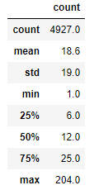
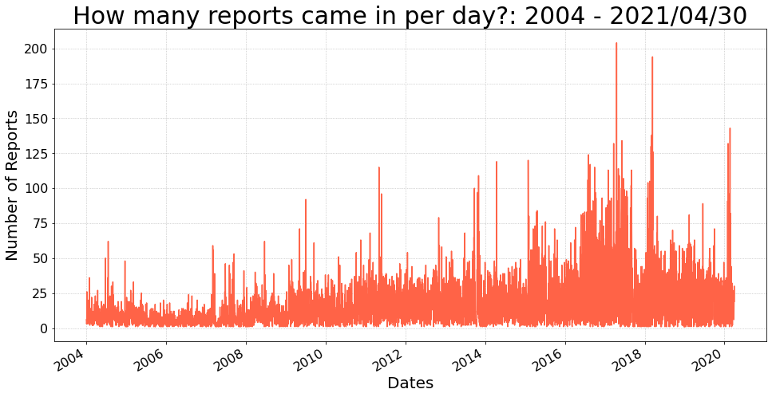

Slide 6
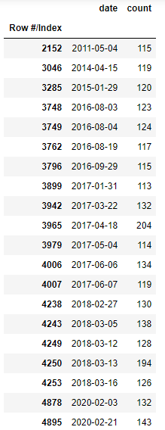
Top 20 Report Dates
2011-05-04
103 of 115 were Hydroxycut weightloss suppliments - 05/01/2009 FDA had issued a warning to stop using the product due to health problems, liver damage, and one death
https://api.fda.gov/food/event.json?search=date_created:[20110504+TO+20110504]&limit=205
2017-04-18
171 were reports with predated date-started for Quorn Products - Feb 15,2017 report - Class action lawsuit
204 repts against Quorn Food Products saying it mislead consumers into thinking that the food was mushroom based protein, when it was really made from fermented mold. Class action lawsuit was for consumers who had purchased Quorn products between Jan 26,2012, and Dec 14, 2016 - Suit started Feb 3 of 2017, ended Sept 1, 2017
Case # CV 16-1346-DMG (AJWx) Birbrower v Quorn Foods, Inc. Claimants had to file a claim by June 1, 2017
https://api.fda.gov/food/event.json?search=date_created:[20170418+TO+20170418]&limit=205
2018-03-13
165 were reports with predated date-started of OVARIAN CANCER - ALL WERE EXEMPTION 4 - August 21, 2017
194 repts Johnson & Johnson ordered to pay $417 million in talcum powder lawsuit - asbestos in the talcum powder
As of Oct 13, 2020 - there are 20,000 lawsuits against Johnson and Johnson - Baby Powder and Shower-to-Shower
https://api.fda.gov/food/event.json?search=date_created:[20180313+TO+20180313]&limit=205
2020-02-21
260 vitamin products

Slide 7
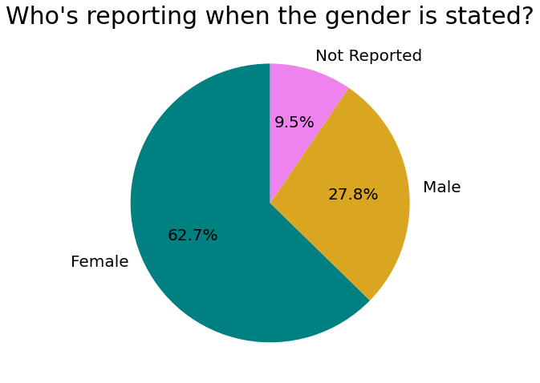
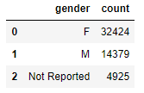

Slide 8
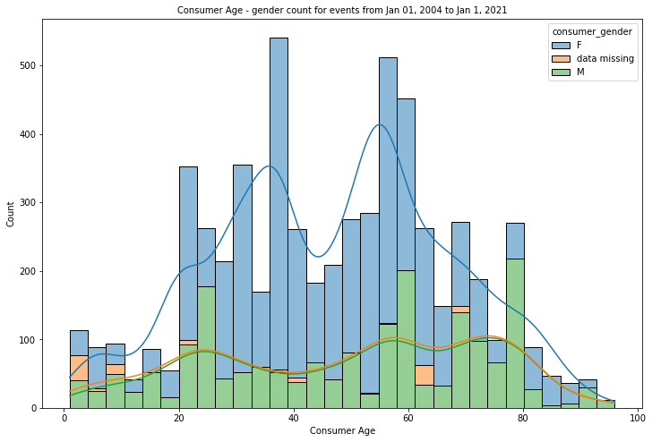
Median Age : 48 years

Slide 9
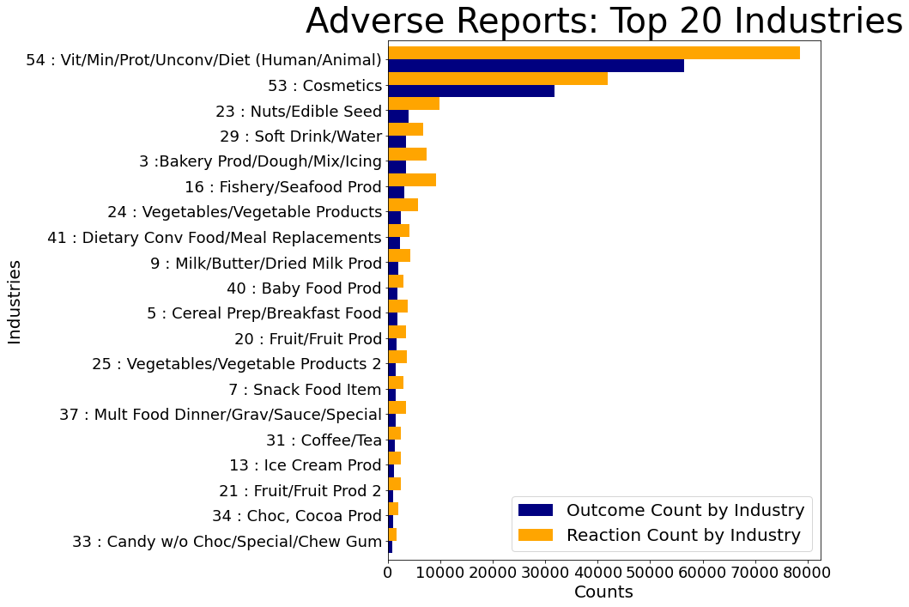
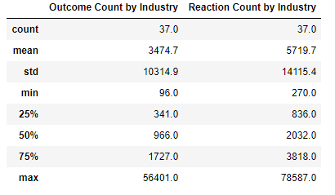

Slide 10
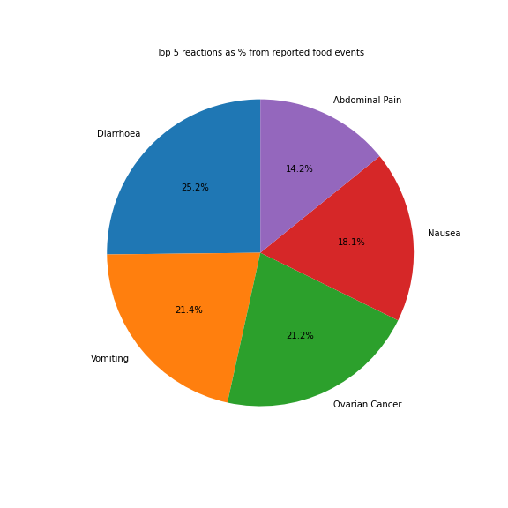
What is most reported reaction? - Diarrhoea (25.2 %)

Slide 11
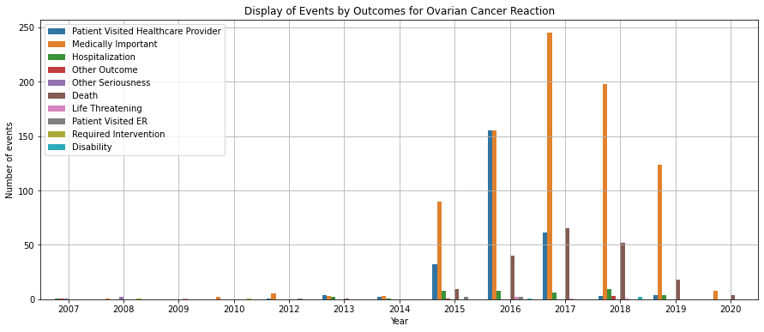
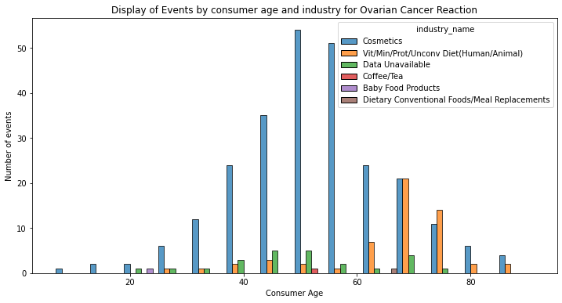
Ovarian Cancer reaction - greatest outcome: "Medically Important"
Ovarian Cancer reaction - median age 55 yrs.
- products observed from the "Cosmetics" industry

Slide 12
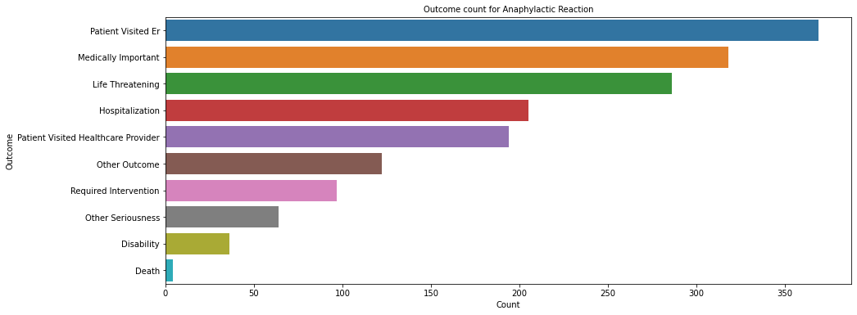
What was the most outcome for Anaphylactic reactions reports ?
- greatest outcome "Patients Visited E.R." - 369 events reported

Slide 13
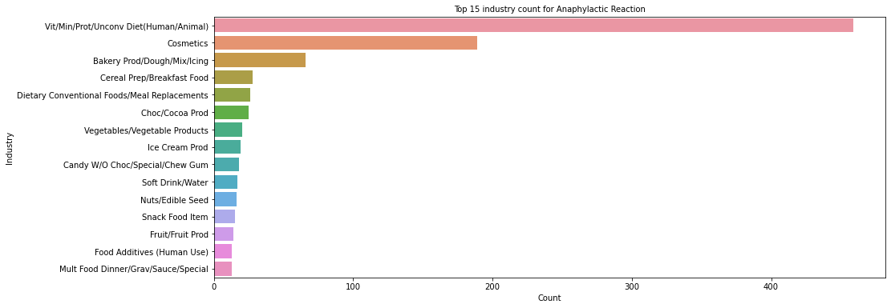
Which industry products gave the most Anaphylactic reaction?
-products from "Vit/Min/Prot/Unconv Diet(Human/Animal)" industry gave the reaction (459)

Slide 14
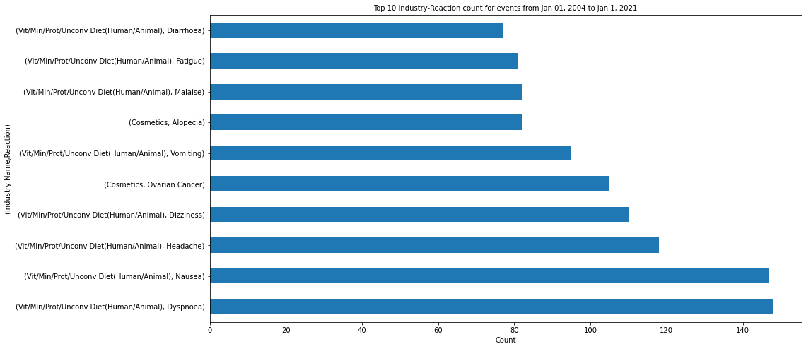
What industry caused what reaction the most? - "Vit/Min/Prot/Unconv Diet(Human/Animal) -Dyspnoea" with 148 events reported

