Slide 1

Lending Club Data Analysis
Minimising credit risk in
peer to peer lending

Slide 2
1. Data :
1.1 Variable Types:
Data source:
Lending Club “accepted loans” dataset from data world.
42538 records
115 columns
Measurement types:
Ordinal Values:
grade
emp_length
term
Nominal Values:
home_ownership
verification_status
purpose
addr_state
application_type
initial_list_status
Independent variables with discrete type:
Term
home_ownership
Independent variables with continuous type:
loan_amnt
annual_inc
rev_utli
rev_bal

Slide 3
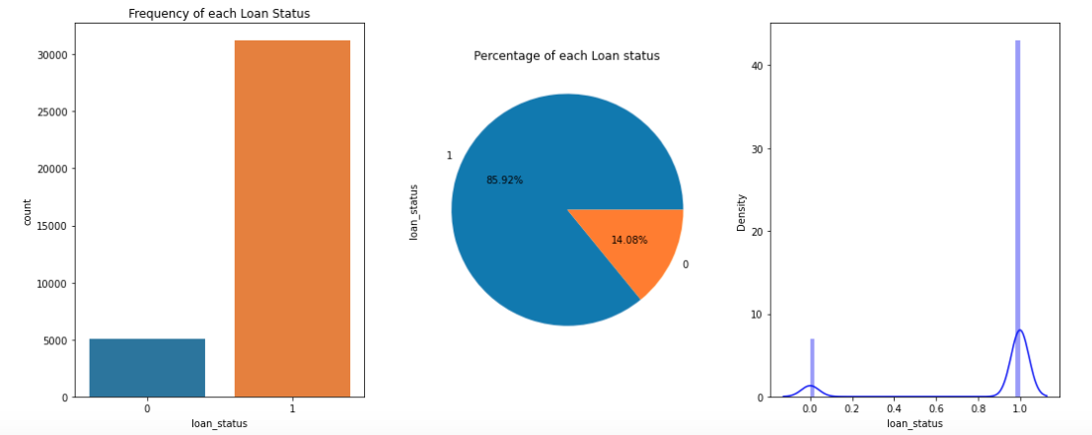
1.Target Variable:
loan_status:
Target Variable: loan_status column which is discrete in nature.
Fully Paid (“1”) - Repaid loans at the end of the term.
Charged off (“0”) - Failed to repay even after 120 days of due date.

Slide 4
2. Preprocessing:
Conducted basic statistics on the data.
Loan amount varies in the range of 500 to 35000 and median is at 9600.
Borrowers annual income is varies largely as there are borrowers who earn around 4000 and goes up to 262000.
delinq_2yrs, which means borrowers that failed to pay dues for more than 30 days varies between 0 to 11.
IQR3 for delinq_2yris zero which signifies that borrowers that pay loan in full are more when compared to charged off.
fico range varies from 632 to 827 with a mean of 716. Which implies that borrower who have score above 716 has more chances of getting the loan approved.
Removed columns with nulls.
Dropped the columns that are out of scope.
Performed feature engineering and created new columns.
One hot encoded nominal categorical columns.
Label encoded ordinal categorical columns.
Outliers removed using z-score and threshold of 3.

Slide 5
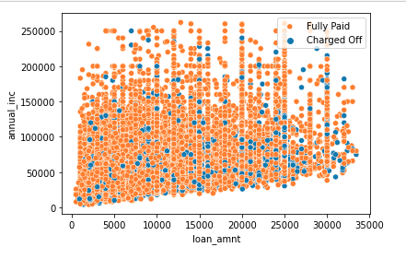
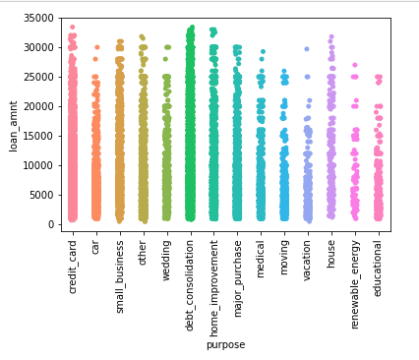
3.1. Bivariate analysis

Slide 6
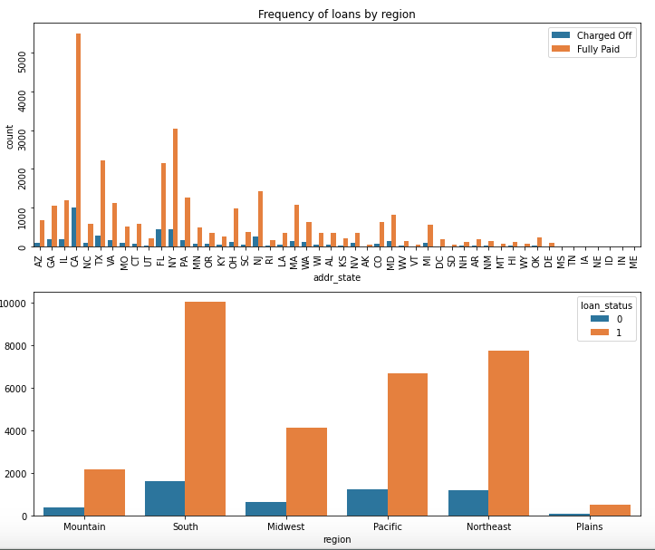
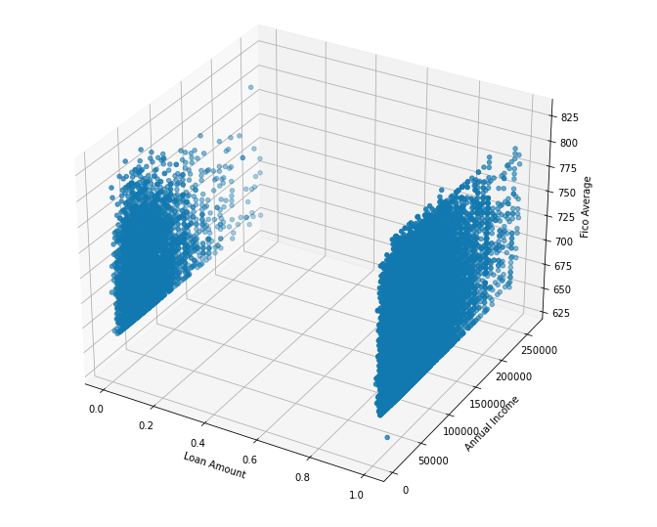
3.1. Bivariate analysis contd...

Slide 7
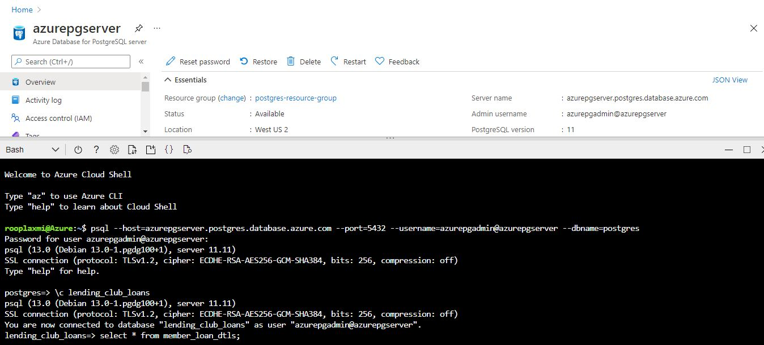
5. ETL - with Azure Postgres

Slide 8
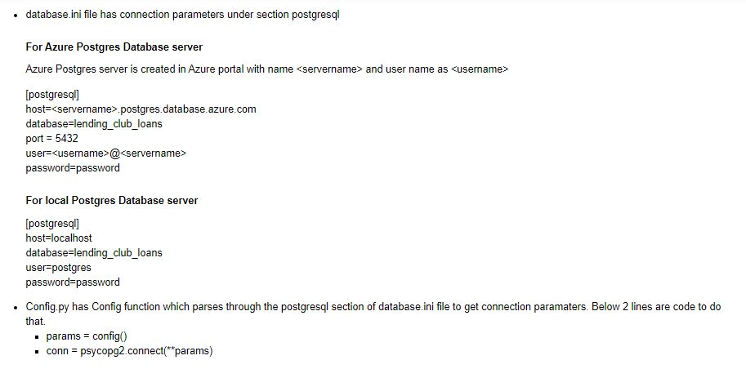
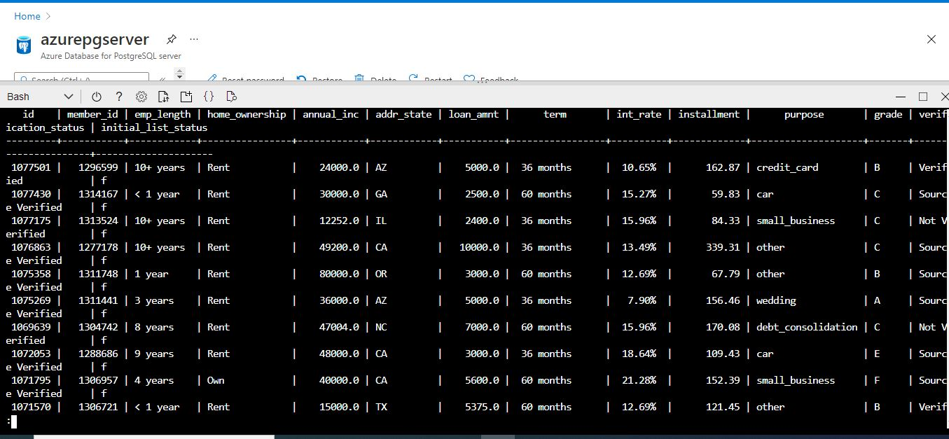
5. ETL - with Azure Postgres

Slide 9
5. ETL - with Azure Postgres and local postgres server

Slide 10
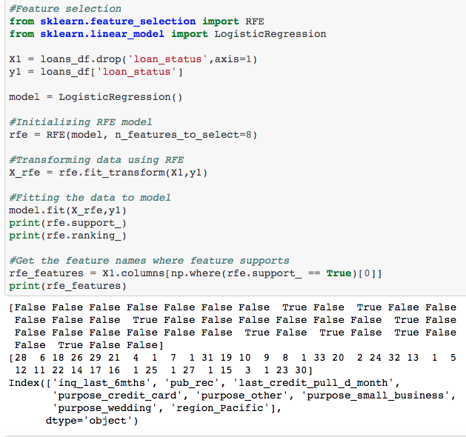
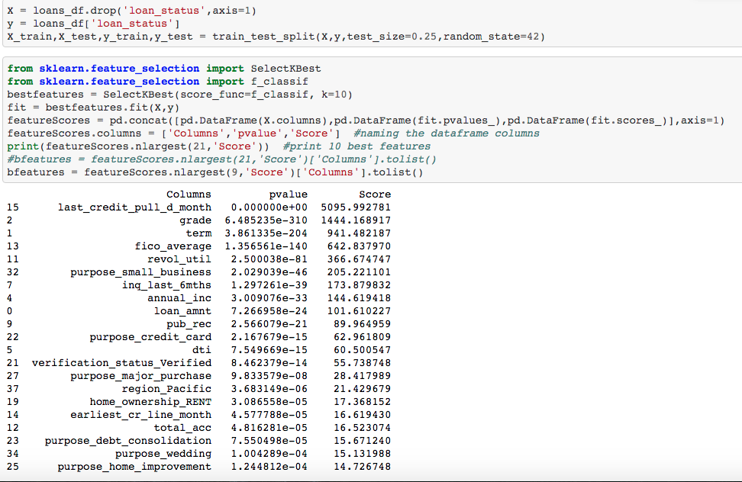
6.1. Feature selection

Slide 11
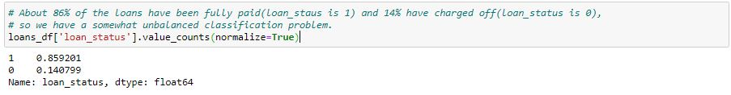
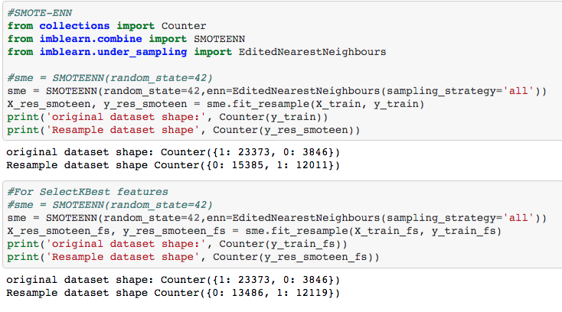
6.2. Resampling Methods:

Slide 12
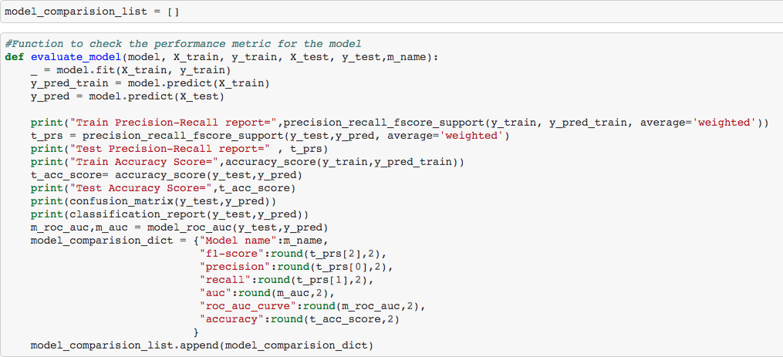
7. Helper functions

Slide 13
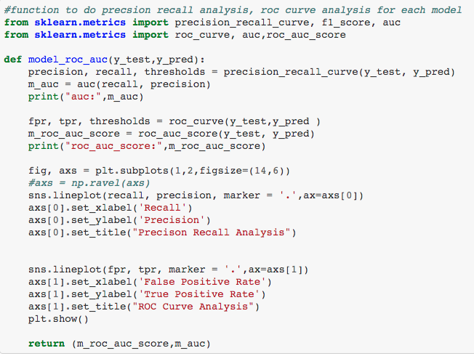
7.Helper functions contd...

Slide 14
8. Model Performance Measures:
Confusion Matrix | Predicted Charged off (0) | Predicted Fully Paid(1)
Actual Charged off (0) | True Negative | False Positive
Actual Fully Paid (1) | False Negative | True Positive
True Negative - actual is “0” and model predicted as “0”
False Positive - actual if “0” model predicted it as “1”
False Negative - actual is “1” model predicted it as “0”
True Positive - actual is “1” model predicted as “1”
We don’t want Charged Off to be predicted as Fully Paid so we are looking for less False Positives.

Slide 15
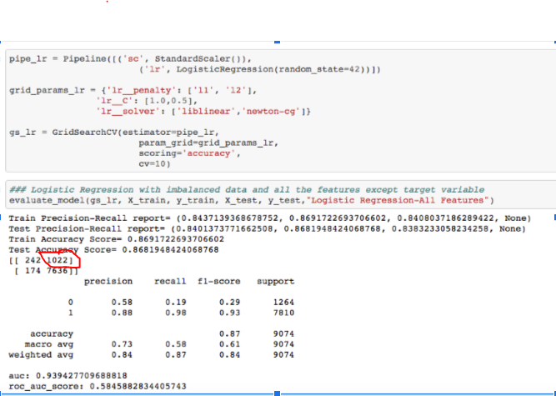
8.1.Logistic Regression:

Slide 16
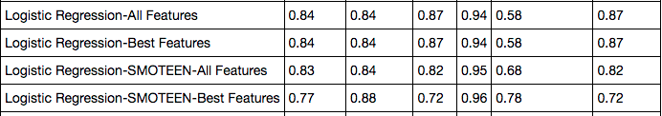
8.1.Logistic Regression cont...

Slide 17
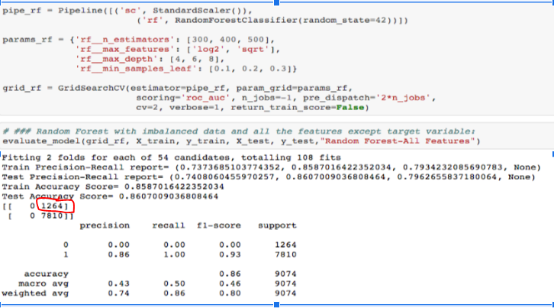
8.2.Random Forest:

Slide 18
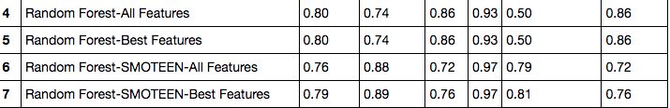
8.2.Random Forest contd….

Slide 19
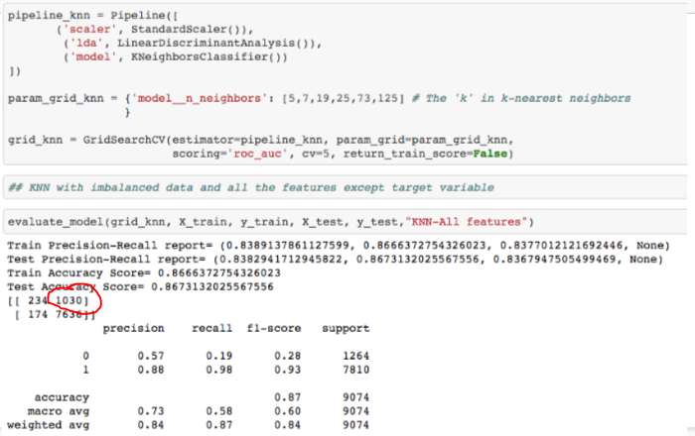
8.3.K-Nearest Neighbors (KNN):

Slide 20
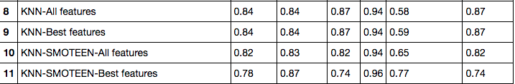
8.3.KNN contd….

Slide 21
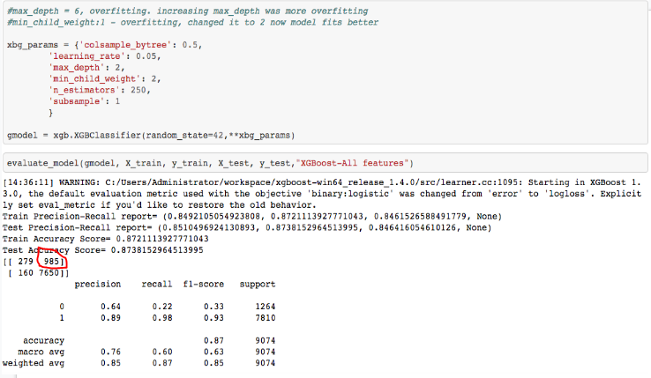
8.4.XG Boost:

Slide 22
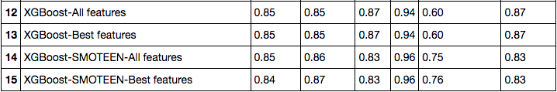
8.4.XgBoost contd….

Slide 23
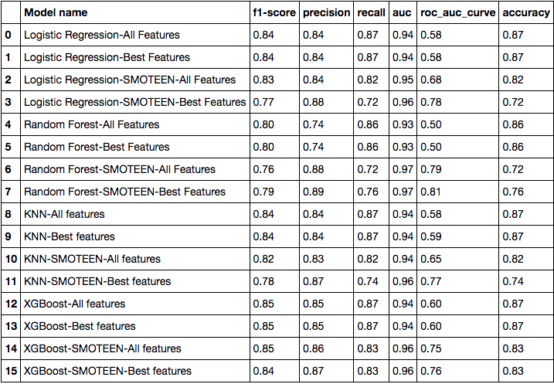
9.Model Scores Comparisons:

Slide 24
10.Results:
Based on Accuracy :
XGBoost - Training Score (0.87) - Testing Score(0.87)
KNN - Training Score(0.87) and Testing Score(0.87)
Based on F1 Score
XGBoost - Training Score(0.85) - Testing Score(0.85)
Logistic Regression - Training Score(0.84) and Testing Score(0.84)
XGBoost model performed better in both cases and model doesn’t look overfitted or under fitted.

Slide 25
11.Future Enhancements:
Run unsupervised learning models.
Analysis of lending club “rejected loans” dataset and evaluate current findings.

Slide 26

Thank You

