Slide 1
Order of Operations & Outputs
Retrieve SNAP data from U.S. Department of Agriculture website
Data Cleaning
Machine Learning Modeling
Exploratory Data Analysis
Histograms
Correlation matrix
Correlation heatmap
Boxplot
Pair plot
Logistic Regression
Random Forest
Neural network
SQL database
.csv

Slide 2
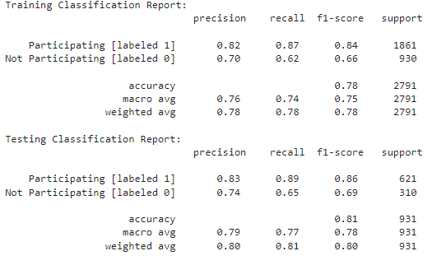
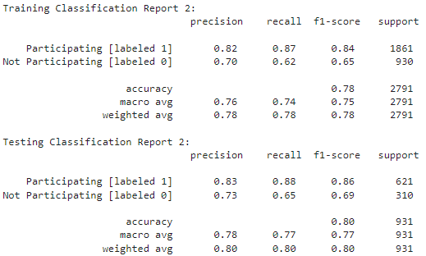
Logistic Regression
First Iteration
Second Iteration
(after removal of two features)

Slide 3
Logistic Regression
First Iteration
Second Iteration
(after removal of two features)
The model predicts with an average accuracy of 78%

Slide 4
Logistic Regression
First Iteration
Second Iteration
(after removal of two features)
The model predicts with an average accuracy of 78%
The model struggles to accurately predict "Not Participating" instances

Slide 5
Logistic Regression
First Iteration
Second Iteration
(after removal of two features)
The model predicts with an average accuracy of 78%
The model struggles to accurately predict "Not Participating" instances
CONCLUSION: No improvement to model accuracy by removing features, namely fah_paid and fafh_paid

Slide 6
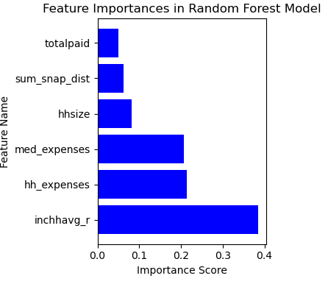
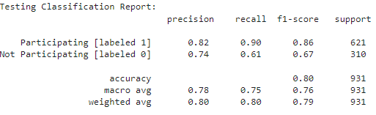
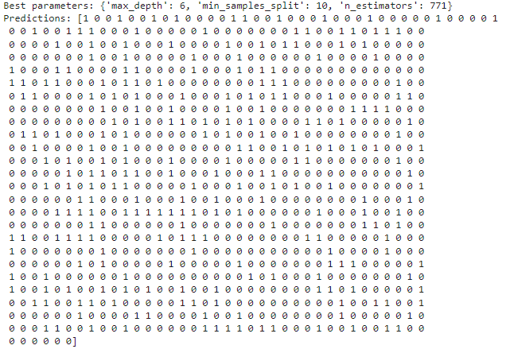
Random Forest
Classification Report
Feature Importance
Best parameters and predictions:

Slide 7
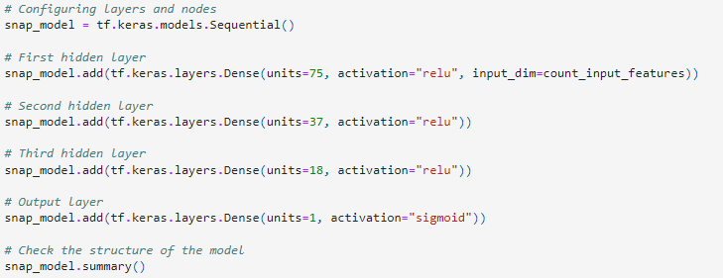
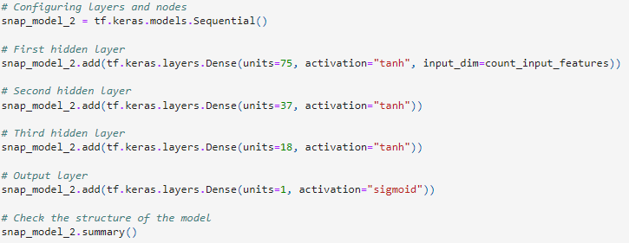
Neural Network
First Iteration w/ relu
Second Iteration with tanh
0.782
0.802
CONCLUSION: Changing to activation function to tanh may be advantageous because tanh is centered around 0 [-1 to 1], whereas relu is less centered [0 to infinity]. This may be because our y feature is binary in nature (1 = yes, 0 = no).

