Slide 1
Lung Cancer Detection using Neural Networks

Slide 2
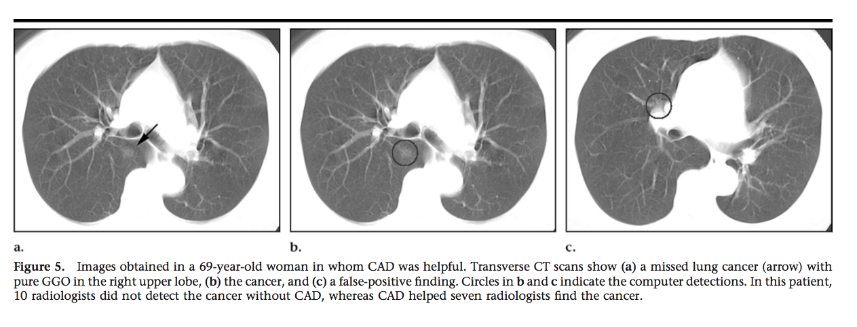
CAD Lung Nodule Detection

Slide 3
Problem Statement
Cancer has become huge threat in human life .there are many types of cancer, Lung cancer is one of the common types causing very high mortality rate.
The best way of protection from lung cancer is its early detection and prediction
The detection of lung cancer in early stage is a challenging problem, due to the structure of the cancer cells, where utmost of the cells are overlapped with each other.

Slide 4
Project Overview
The project aims to enhance the automated detection of potentially cancerous lung nodules in these scans.
Approach:
By training and using convolutional neural networks to increase the sensitivity and accuracy of the classification of potential lung nodules.

Slide 5
Custom CNN
Develop a CNN to analyze CT scans
With higher accuracy
With lower minimum data requirement
fully automated
takes 2D image slices along x, y and z axes of a 3D input

Slide 6
Tasks Accomplished
Familiarization with topic
Library installations
Data Preparation
Locate all nodules for each image
Understanding Pre-trained CNN

Slide 7
Project Preparation
Background Information
Neural Networks and Deep Learning
Radiography and CT Patterns
Reticular/Linear, Nodular, Consolidation, GGOs, Cavities, Mixtures (Tree-in-Bud)
Feature Extraction
Low level, high level, clinical parameters
Programs/Installations
AWS and g2 Instance
Keras
Python
TensorFlow

Slide 8
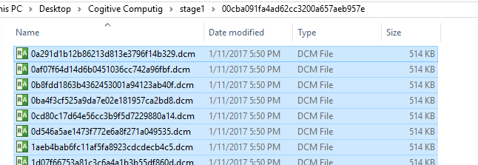
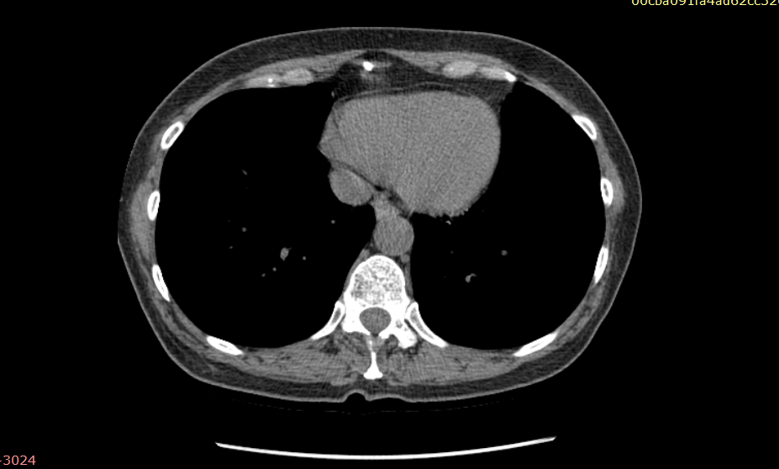
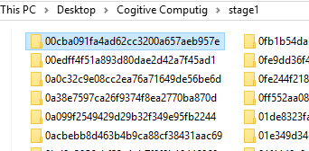
Dataset
The input to the model is a set of CT scans of different patients in the DICOM format.
The CT scans of a partiuclar patient are arranged in a DICOM format with the folder name specifying the patient id.
Goal: detect all nodules for a patient
The images are of size 512* 512 pixels.

Slide 9
Algorithm
Raw data set for this competition provided by Kaggle is pre-processed where all DICOM images are resized to 64 x 64
The model is a convolutional neural network (with max-pooling and dropout), and only 1 output neuron and convolutions2D, max-pooling layers, ReLU nonlinearities.
The first layer and the second layer are the convolutional layer followed by max pooling and the second layer is a densely connected layer into softmax regression.

Slide 10
Loss Function:
In our convolutional models, we chose to use a Softmax classifier, which produces normalized probabilities
Activation:
In our CNNs, we chose to use ReLU nonlinearities. The ReLU (Rectified Linear Unit) essentially thresholds an activation to 0.
Stochastic Gradient Descent with Momentum:
Hyperparameters:
In terms of batch size, we used a relatively small size, due to limited memory resources of 32. Dropout was tried in ranges from 0.25 to 0.75, and learning rate was tuned using a coarse-to-fine sweep from 0.01 to 0.00001.

Slide 11
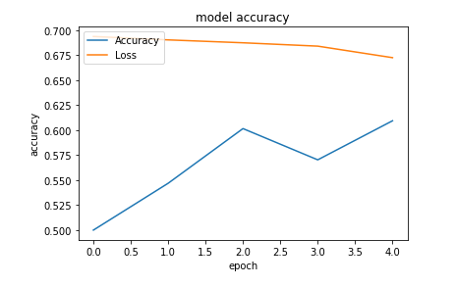
Results
Based on the algorithm, , images have been preprocessed and the neural network model has been trained.
For each patient id present in the CSV file, the dicom files are analysed and a submission is made to the csv file for the test data with a value which shows the probability of cancerous nodules in the patient.
With the help of AWS server and a g2 instance(for GPU), the model gave an accuracy of about 75% with the
computational time of
l less than 10 mins

