Slide 1
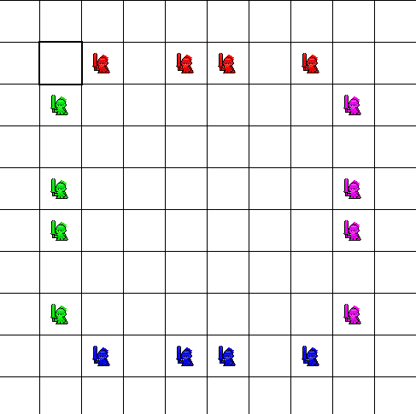
Dungeon Game
Finnegan Carroll, S. Asher Charleston, Matthew Erter
Description
Code Structure & Data Structures
The first role playing games originated from war simulation games. In the vein of Dungeon Keeper and similar games, while also being influenced by tabletop war games, this program will simulate small scale combat scenarios. It will put two players into the seat of a general – with the ability to distribute their forces, but not to have direct control over the flow of the battle. The game will start with a setup phase, and once both players have placed their units, the battle will begin. The sides will take turns moving towards each other, attacking and navigating the battlefield – without the guidance of the players. Eventually, through chance or superior planning, one side will prevail.
A considerable amount of the work involves extending Gridworld classes. For example, one piece of terrain, Steelwall, extends rock, but has additional code to allow a certain unit type to move over it. Adding a GUI would be a separate class.
The project is based on Gridworld, which is a challenge in its own right. It has many, many complexities that have been solved on the go as work progresses. The fact that much of Gridworld is inside a compressed .Jar file is inconvenient, at the least. It is also difficult to find complete documentation of the depths of Gridworld.
Target Users
What’s Next
There is a large demographic of gamers. A subset of gaming is the RTS(real time strategy) and grand strategy, which is one massive war game, often involving resource and base management. There are also more humble war games, and there is a large demographic that is very dedicated to these games. Those are the people that this game is being directed toward – people who will spend entire weekends setting up a scenario and debating over vast rulebooks. Although this program does not reach the scale of most war games, its convenience makes it more accessible to the larger strategy gaming crowd.
The project is far from done. It is still missing two or three units for each side, actors for terrain, and win conditions. Implementing a GUI is also in the works.
Work Progress
We have created one custom creature, a knight, which will interact with the environment. In terms of the environment, we have a steel wall that the sprites will walk over, or around.
Project Tagline
The offspring of Dungeon Keeper and War games.

