Slide 1
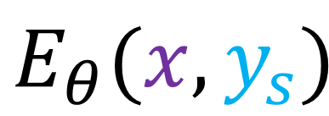
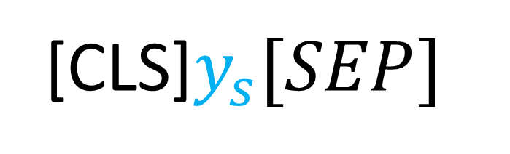



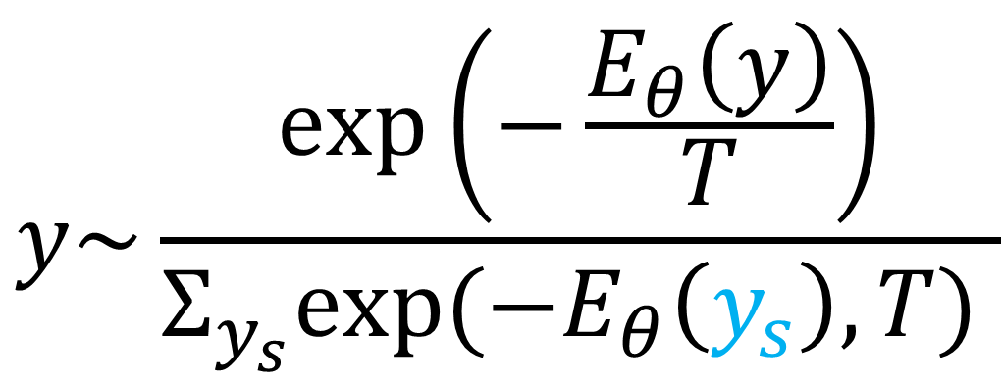
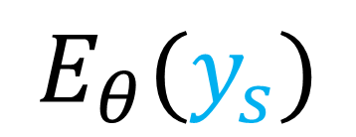
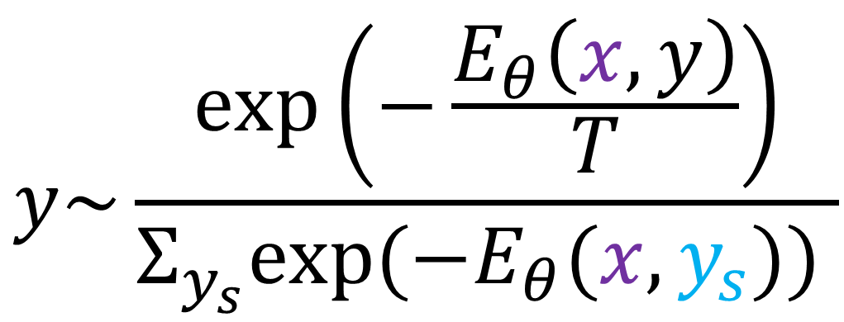
$$y\sim \frac{\exp\left(−\frac{E_{θ}\left(y\right)}{T}\right)}{Σ_{y_{s}}exp⁡(−E_{θ}\left(y_{s}\right),T) }$$
$$y\sim \frac{\exp\left(−\frac{E_{θ}\left(x,y\right)}{T}\right)}{Σ_{y_{s}}exp⁡(−E_{θ}(x,y_{s})) }$$
$$E_{θ}(y_{s})$$
$$E_{θ}(x,y_{s})$$
Bert
Multi-Bert
[CLS]$y_{s}[SEP]$
[CLS]x$\left[SEP\right]y_{s}$[SEP]
$$y_{s}\sim P_{NMT}(x)$$
$$y_{s}\sim P_{NMT}(x)$$
Base NMT
Base NMT
X
X
Marginal EBR
Conditional EBR

