Slide 1
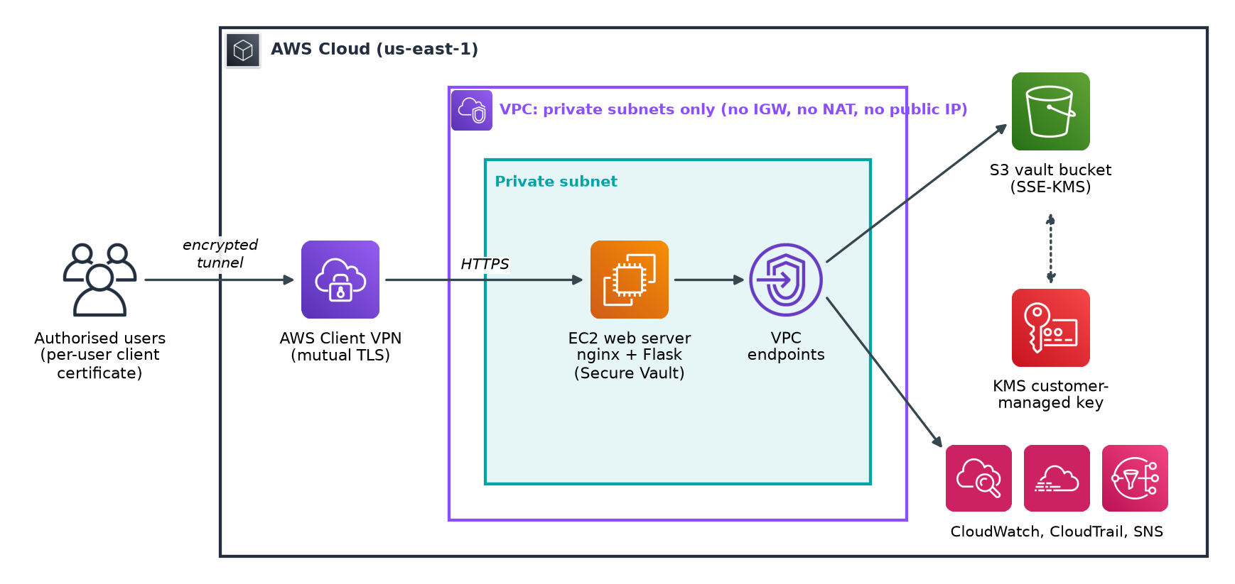
Secure AWS VPN-Based Internal Web Service
with encrypted storage and automated monitoring
21CSE333P Essentials in Cloud and DevOps
Pranav Sairam RA2311026010195
Ajayraj R RA2311026010214
Srivishal S RA2311026010227
Guide: [Guide name, designation]
Notes:
Introduce the team and the project. One sentence: an internal document vault on AWS that nobody can reach without a VPN certificate, with all data encrypted under our own key, and monitoring that fixes common problems automatically.

Slide 2

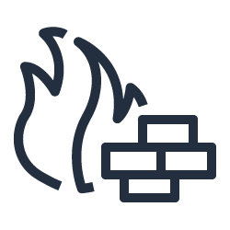


Internal tools are one setting away from the internet
Teams host document stores and admin portals in the cloud. Under the shared responsibility model, network rules, keys and monitoring are the customer's job, and one wrong setting exposes the service to scanning and credential attacks.
Public IP or internet gateway
The server is reachable by anyone who finds it
Security group open to 0.0.0.0/0
A single rule exposes a port to the whole internet
Bucket reachable from anywhere
Encryption alone does not stop a valid credential
Our goal: an internal service with no internet-facing surface, encrypted data, and monitoring that repairs common faults.
Leaked access keys
Long-term keys work from any network by default
Notes:
Explain the problem. Most cloud incidents come from customer-side settings: public addresses, open security groups, buckets and leaked keys. Each of these four is a control we address in the design.

Slide 3
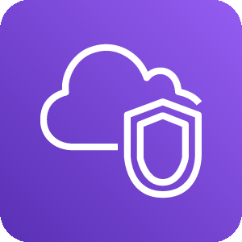

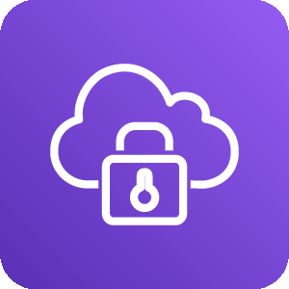
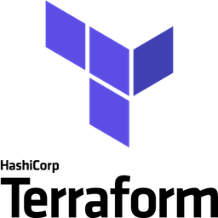


Seven objectives
Network isolation
No internet gateway, NAT, public IP or SSH
Monitoring and self-healing
Alarms, synthetic check, automatic remediation
Certificate-based access
Per-user mutual TLS certificates, revocable
DevOps delivery
Terraform, immutable deploys, CI on every push
Encryption everywhere
One customer-managed key; TLS 1.2 or higher
Cost control
Under USD 5 per day, full teardown from code
Exfiltration resistance
Objects readable only through the VPC endpoint
Notes:
Walk through the objectives O1 to O7 from the report. Each one maps to a Terraform file and to at least one verification check later in the deck.

Slide 4
Three sprints over twelve weeks
W1-2
W3-5
W6-8
W9-10
W11-12
Inception
Sprint I
Sprint II
Sprint III
Verify and demo
Literature survey, backlog, architecture and cost estimate
VPC, endpoints, KMS key, private CA, Client VPN
Secure Vault app, nginx TLS, S3 policy, offline bundle, CI
12 alarms, synthetic check, sg-guard, CloudTrail, budget
Validation, unit tests, Checkov, shellcheck, report
Each sprint ended with a working increment that passed terraform fmt, terraform validate and the unit tests, followed by a retrospective.
Notes:
Explain the agile process. Point out that security was built in from Sprint I, not added at the end.

Slide 5
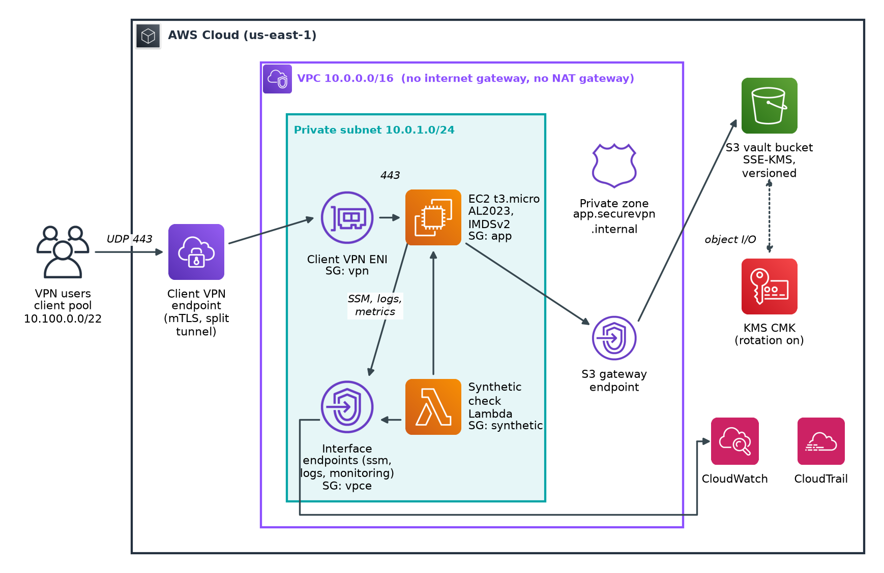

Architecture: a VPC with no route to the internet
One private subnet
VPC 10.0.0.0/16, subnet 10.0.1.0/24, no IGW or NAT
Groups reference groups
No security group allows 0.0.0.0/0 inbound
Private AWS APIs
1 S3 gateway and 5 interface endpoints
Notes:
Trace a request: the user connects to Client VPN, the ENI in the private subnet forwards HTTPS to EC2 only. EC2 reaches S3 through the gateway endpoint and SSM and CloudWatch through interface endpoints. Nothing in the VPC can reach the internet.

Slide 6
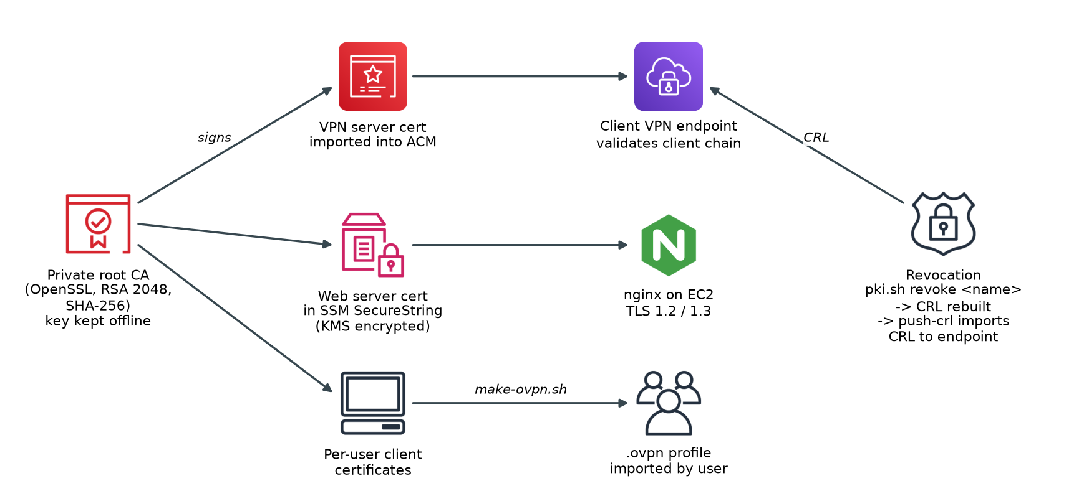
Access needs a certificate from our own CA
Managed with scripts/pki.sh
make client NAME=alice issues a certificate and a ready-to-import .ovpn profile
make revoke NAME=alice rebuilds the CRL and pushes it to the VPN endpoint
RSA 2048, SHA-256, X.509 extensions per RFC 5280
Split tunnel: only 10.0.0.0/16 traffic uses the VPN
Every connection, successful or failed, is logged to CloudWatch; 3 failed attempts in 5 minutes raise an alarm.
Notes:
Explain mutual TLS: both server and client prove their identity with certificates signed by our CA. Revocation is immediate once the CRL is imported. Demo step 8 in the README shows a revoked user being rejected.

Slide 7
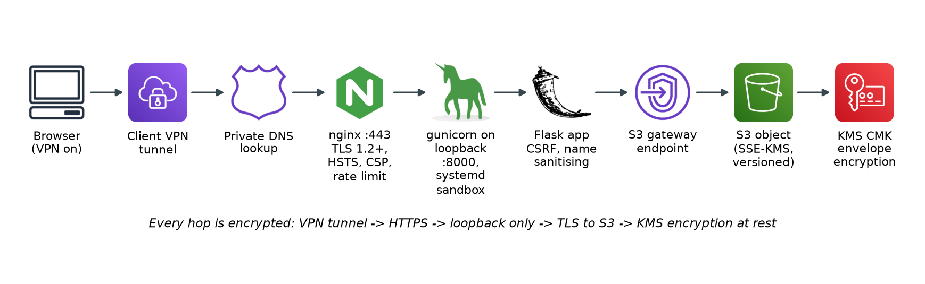





Every hop is encrypted, every store uses one key
One KMS CMK
rotated every 365 days
EBS volume
S3 bucket
CloudWatch Logs
CloudTrail
SNS topic
SSM parameters
Notes:
Data in transit: VPN tunnel, then HTTPS with TLS 1.2 or 1.3, then loopback only to gunicorn, then TLS to S3. Data at rest: every store is encrypted with one customer-managed KMS key whose policy grants each AWS service only the operations it needs.

Slide 8
Stolen AWS keys cannot read the vault
"Sid": "DenyObjectAccessOutsideVpc",
"Effect": "Deny",
"Action": ["s3:GetObject", "s3:PutObject",
"s3:DeleteObject", ...],
"Condition": {
"StringNotEquals": {
"aws:SourceVpce": "<project S3 endpoint>"
}
}
Three deny statements on the bucket
Any request without TLS is refused
Uploads asking for weaker encryption are refused
Object reads and writes from outside the VPC endpoint are refused, even with valid credentials
Exception: the deploying IAM principal, so Terraform can upload the app bundle and remove the bucket.
Notes:
This is the key differentiator. Normally encryption does not help if an attacker has valid keys, because S3 decrypts for them. The aws:SourceVpce condition means the attacker must also be inside our VPC, which requires a valid VPN certificate.

Slide 9
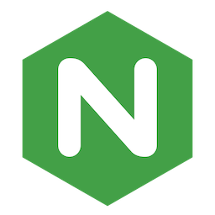


The application: Secure Vault
Hardening
TLS 1.2 and 1.3 only, HSTS, CSP, 20 requests per second rate limit
gunicorn listens on loopback only
systemd sandbox: no new privileges, read-only system, no capabilities
IMDSv2 required with hop limit 1
CSRF tokens and filename sanitising
No SSH key; admin shell through SSM Session Manager
Route | Purpose
GET / | List files and their encryption
POST /upload | Upload to S3 with SSE-KMS (10 MB limit)
GET /files/<name> | Download (path traversal blocked)
POST /files/<name>/delete | Delete; previous version kept 30 days
GET /health | Health check for the synthetic monitor
GET /api/security | Live security posture report
Notes:
Describe the app briefly and focus on the layers of hardening. The /api/security endpoint reads the live bucket and instance settings, which is useful during the demo.

Slide 10
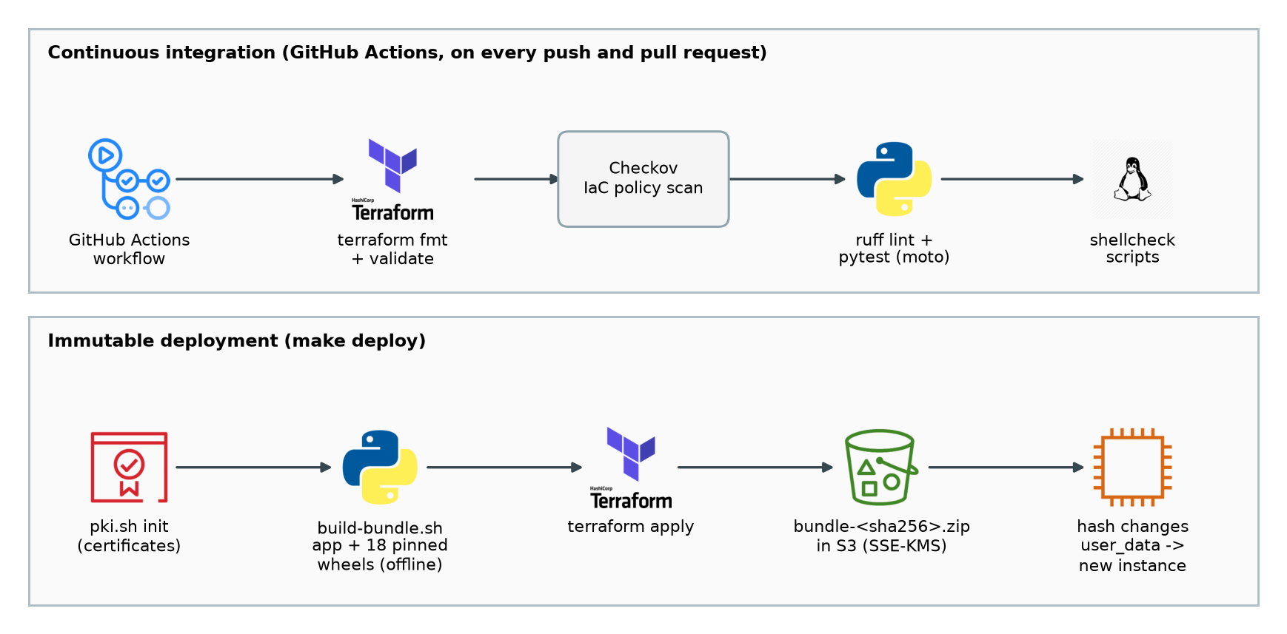

Delivery: infrastructure as code, immutable releases
Everything in Terraform
VPC to dashboard; destroy and rebuild in about 15 minutes
Offline bundle
18 pinned wheels; no PyPI access needed at boot
Immutable instances
A new bundle hash replaces the server, so no drift
Notes:
The server has no internet, so it cannot pip install. We ship a bundle with all wheels. Because the bundle hash is part of the user data, any code change replaces the instance. CI runs four jobs on every push.

Slide 11
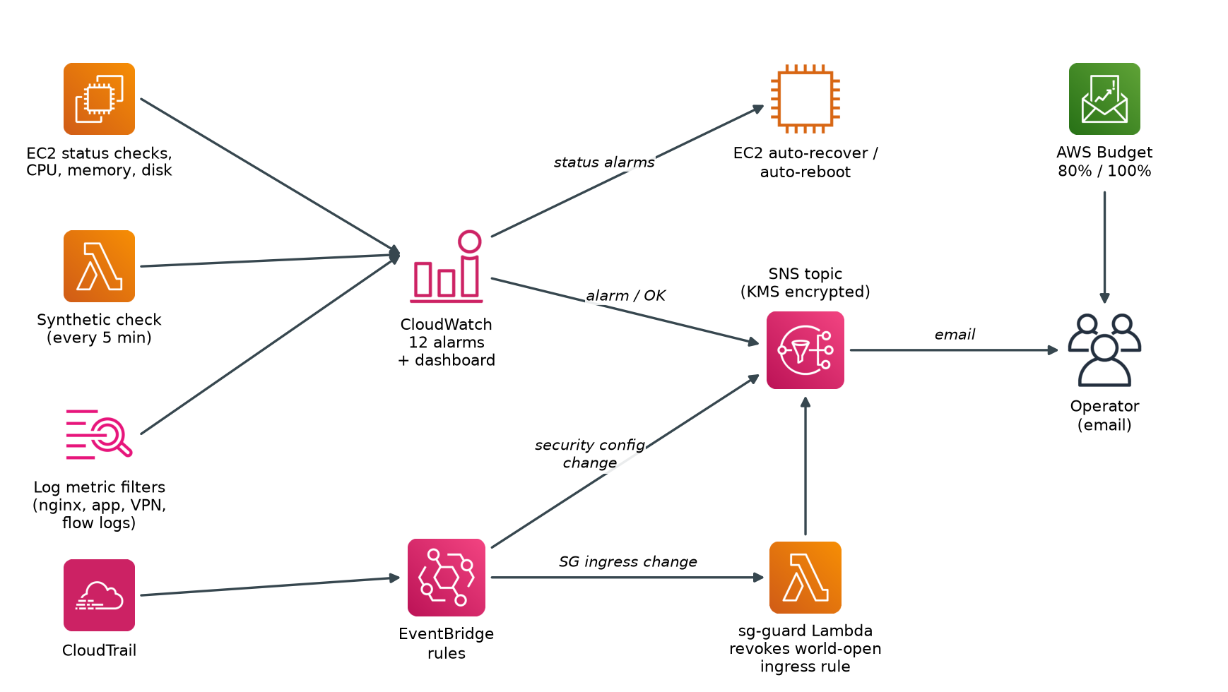
Monitoring that also repairs
12
CloudWatch alarms, all emailed through an encrypted SNS topic
5 min
Synthetic HTTPS check from inside the VPC
3
Automatic repairs: recover, reboot, revoke open rule
Notes:
Signals: EC2 status and resources, the synthetic check, log metric filters for 5xx errors, app errors, bootstrap failure, VPN failures and rejected packets, plus CloudTrail events. Missing synthetic data counts as down, so a broken check also alerts.

Slide 12
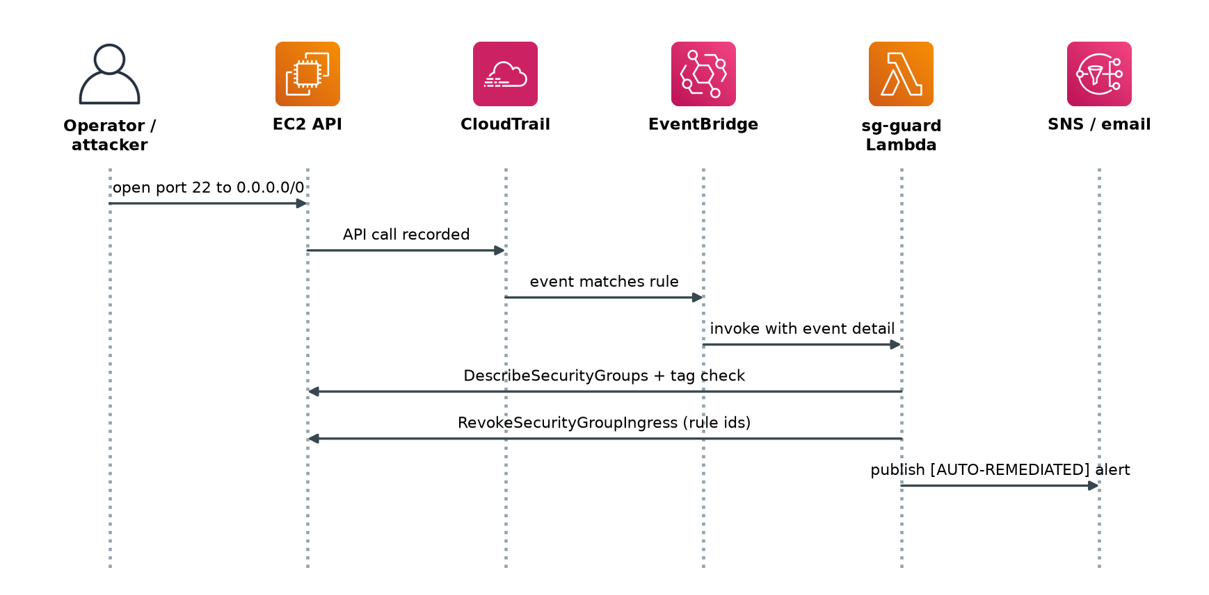
A port opened to the world is closed automatically
How sg-guard decides
Acts only on groups tagged Project=securevpn
Revokes ingress from 0.0.0.0/0 or ::/0
Emails who made the change and from which IP
Safe to run twice: the second run finds nothing
Notes:
Demo step 6: make demo-sg-guard opens port 22 to the world. CloudTrail records the call, EventBridge invokes the Lambda, and the rule disappears within minutes, followed by an email.

Slide 13
Verification results
13/13
326/334
Valid
0
Unit tests passed (pytest with mocked AWS)
Checkov IaC policy checks passed
terraform validate and fmt clean
shellcheck warnings in 5 scripts
The 8 Checkov findings, reviewed one by one
4 are false positives or expected: the port 80 rule comes from the VPN security group, and Resource "*" in a KMS key policy means this key
4 are small hardening items for future work: encrypt the agent config parameter, add a CloudTrail SNS topic, pin AZ identity, GuardDuty org setup
The live smoke test (23 checks) runs after deployment with make smoke and make smoke-novpn
Notes:
All four numbers were produced by running the tools on the final code. Be clear that the smoke test needs a live deployment; it checks network isolation, VPN, encryption and monitoring settings in the real account.

Slide 14
Running cost: about USD 4.35 per day
55%
of the cost is the Client VPN subnet association
Destroy when idle
make destroy; rebuild in about 15 minutes
Budget alerts
Email at 80% actual and 100% forecast spend
Notes:
A NAT gateway is not needed. The biggest cost is the VPN association, so the endpoint is associated with one subnet only. Because everything is code, the environment is destroyed when it is not being used.

Slide 15
What we delivered
Next steps
A vault reachable only with a valid, revocable VPN certificate
All data encrypted under one customer-managed key, readable only from inside the VPC
12 alarms and 3 automatic repairs, defined in the same Terraform code
Verified: valid IaC, 13/13 tests, 326/334 policy checks
SSO through IAM Identity Center alongside certificates
Two Availability Zones behind an internal load balancer with WAF
AWS Backup and S3 Object Lock
AWS Config and Security Hub for continuous CIS scoring
Questions
Notes:
Summarise the four outcomes, mention the next steps, and open for questions. If asked about cost, the stack runs at about USD 4.35 per day and is destroyed when not in use.

