Slide 1
Smol_thesis
Matteo Regge
2023/2024

Slide 2
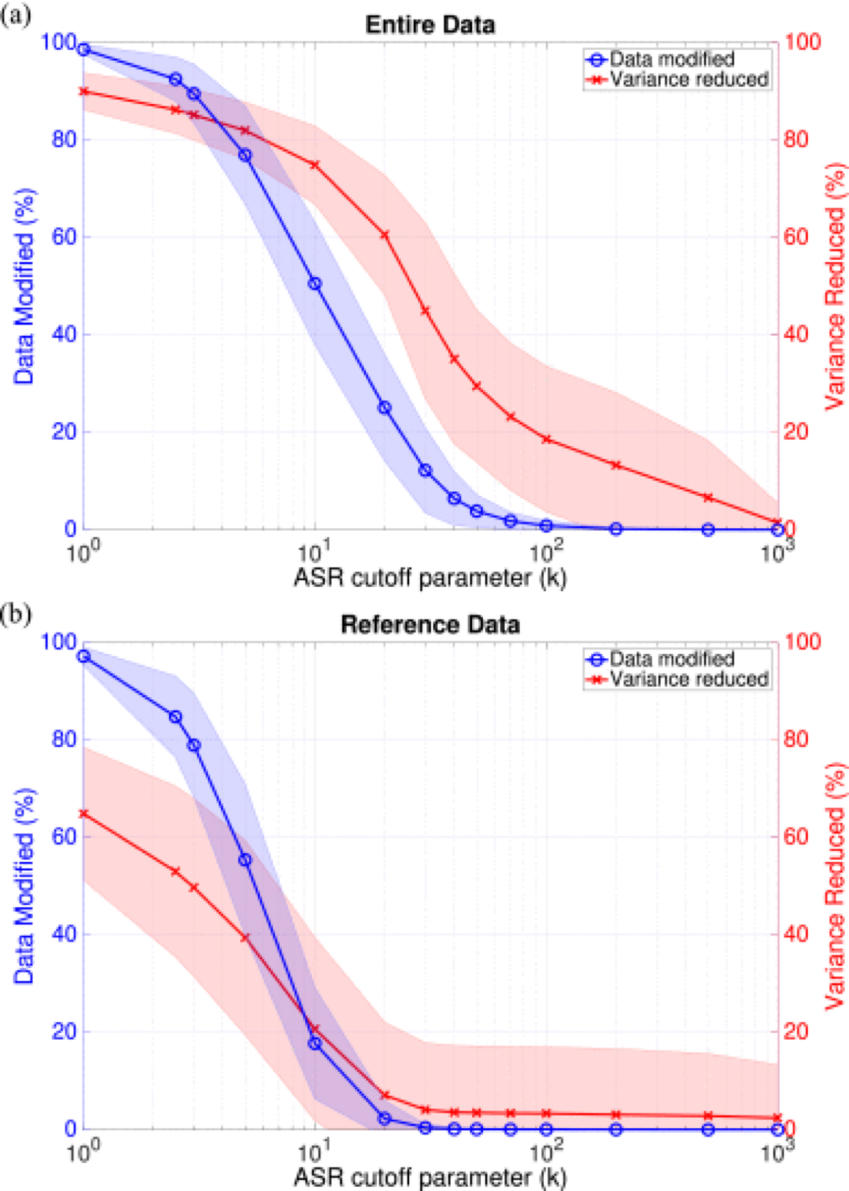
Artifact Subspace Reconstruction
Traditionally, these artifacts were removed manually by visual inspection, this approach better suits a real time approach. Results vary depending on model architecture and dataset.
Get raw data and compute variance metrics
IIR(infinite impulse response ) filter to suppress specific frequencies associated with brain oscillation
Compute thresholds based on given signals (after projecting in principal components space)
Reject artefacts and reconstruct data

Slide 3
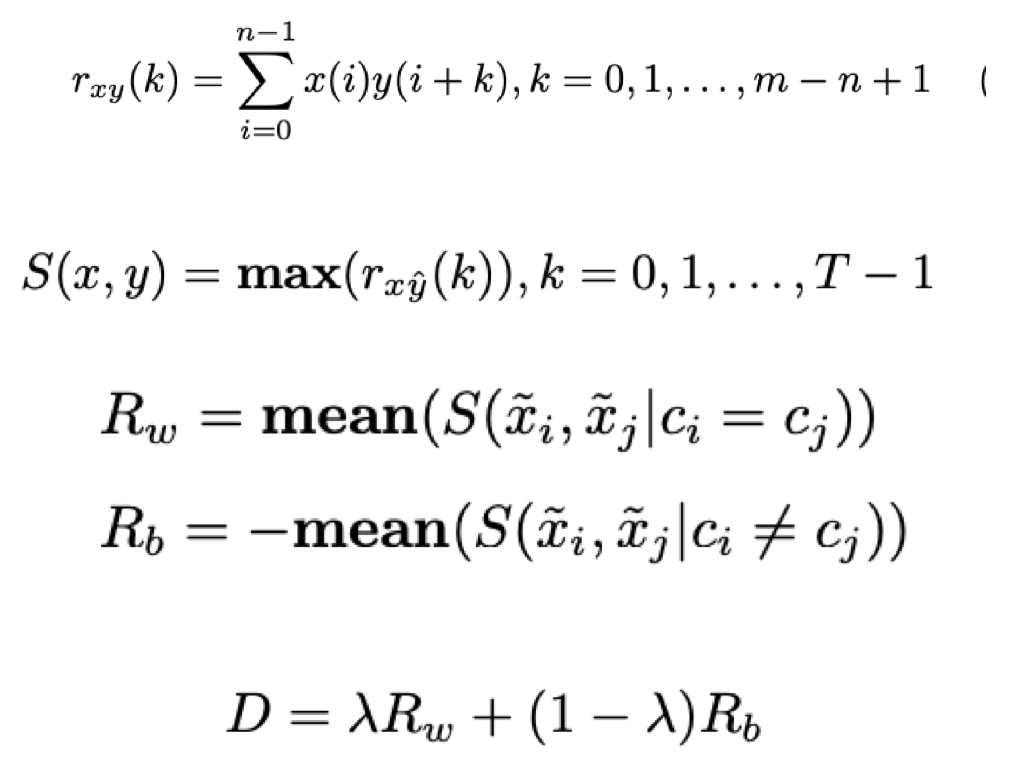
Cross-correlation based discriminant criterion
Score channels and select subset of them
In the procedure of motor imagery EEG classification, signals of the same class of MI task should contain similar features and vice versa. Therefore, we can assess a channel’s discriminative ability based on the similarity between signals of multiple classes from that channel.
Channels are ranked in a descending order according to their discriminant score D after obtaining D for every channel

Slide 4
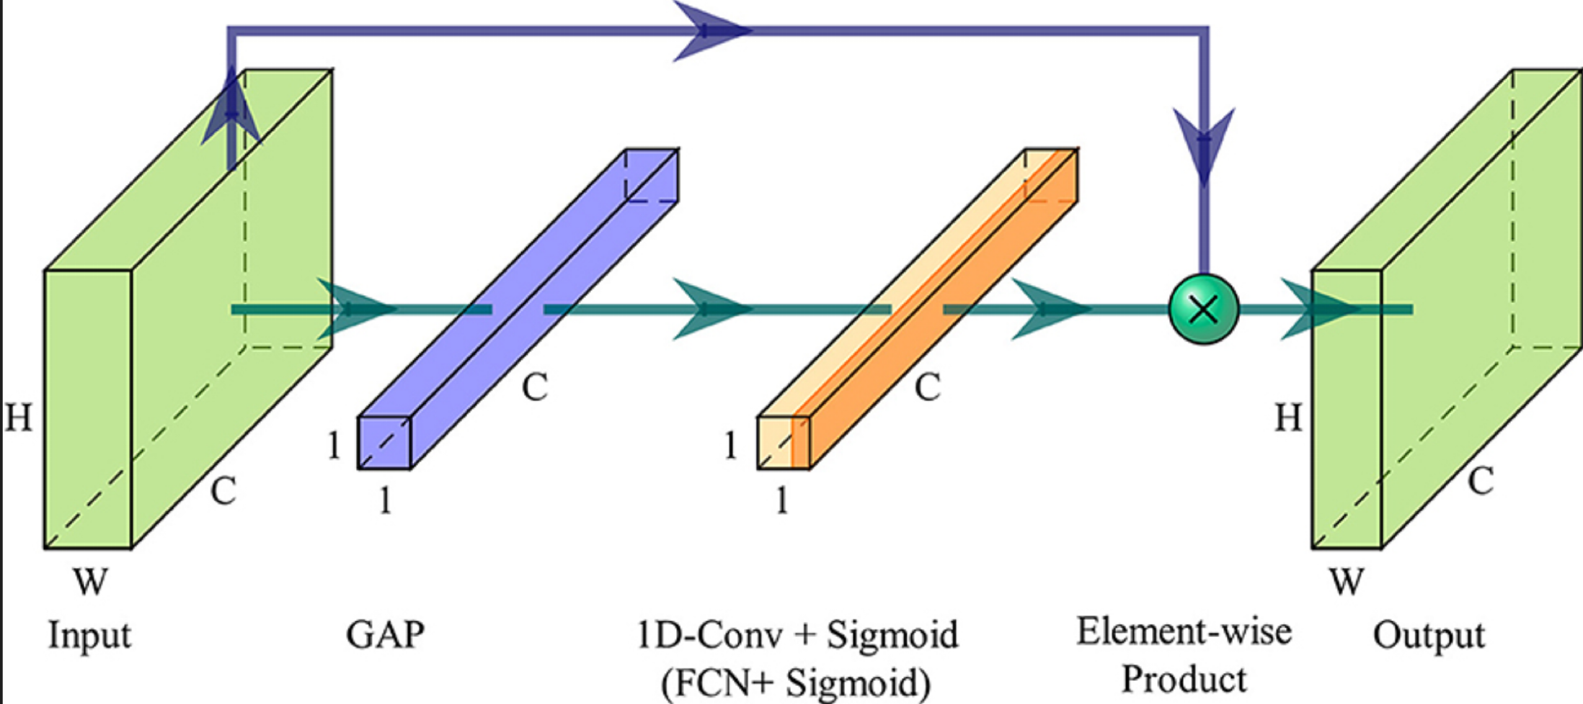
Channel Attention Layer
Add one dense layer to get the weights for each channel
Evaluating the weights we know how relevant each channel is for the learning of the EEGNet
16 x 16 weights + 16 base coefficients

Slide 5
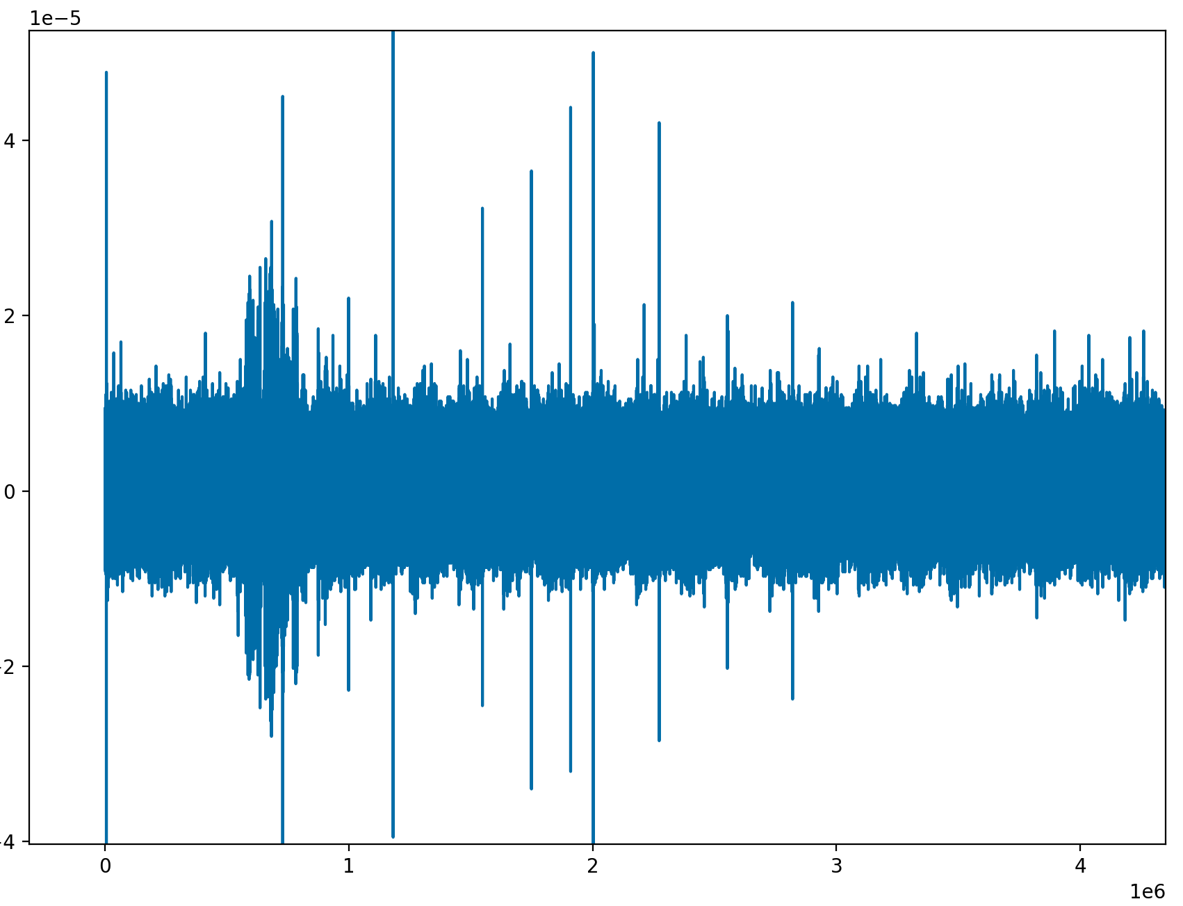
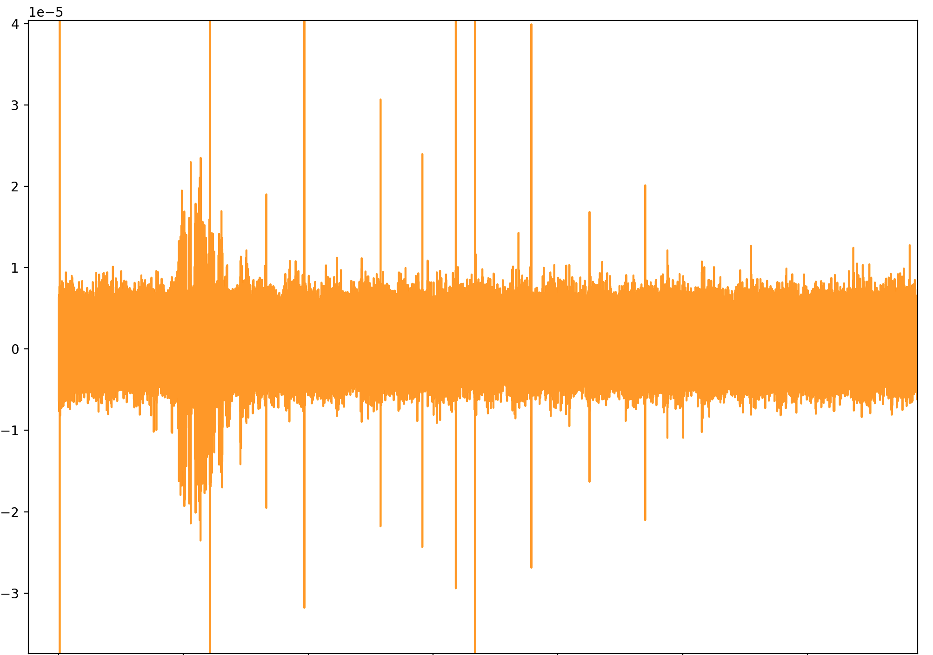
Downsample
We downsample the signal to reduce calculation complexity without losing too much information from the origianl signal
30Khz
5Khz

Slide 6
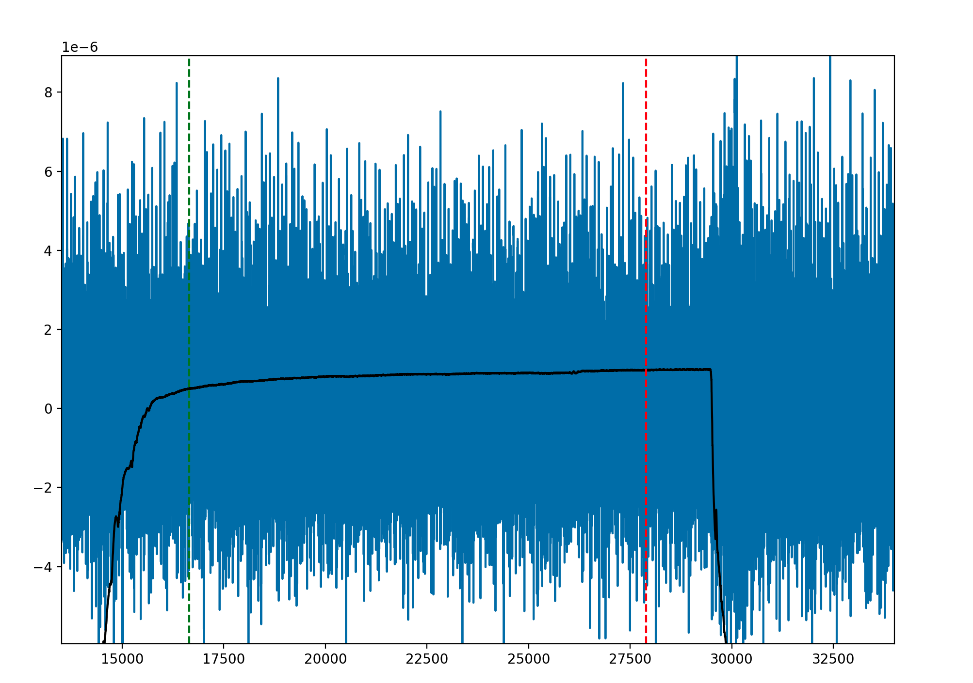
Time on / Time off
We have downsampled the signal but we still need to find the part of the signals where the actual actions happens.
For Proprioception and Touch we can start by reading the .nev files included in the dataset
For Noci… we must use a different approach by detecting when the signal is higher than a certain thresholds we find empirically

Slide 7
Time on / Time off
For Proprioception we add 250ms to the time-on data point and take 2.5 seconds from there
For Touch we add 500ms to the time-on data point and then take 2.5 seconds.
We can use the 17th channel to have an idea of the movement. (Shown in black in the image)

Slide 8
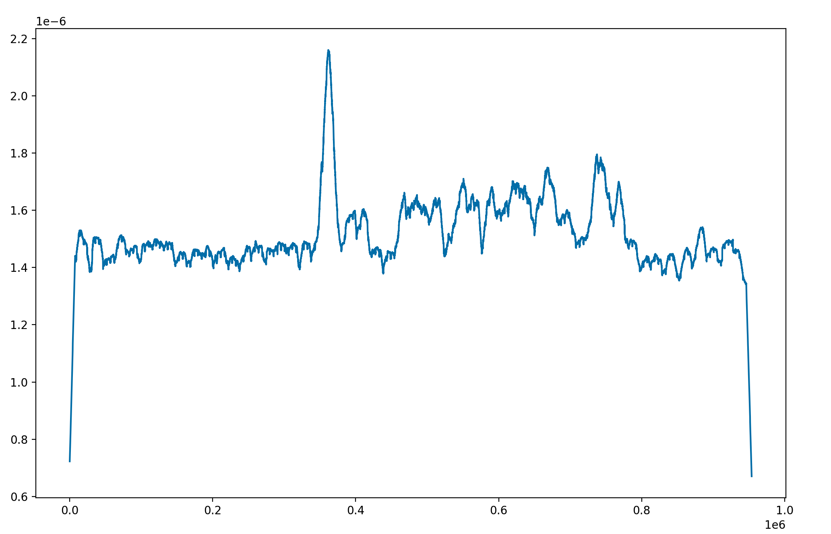
Time on / Time off

Slide 9
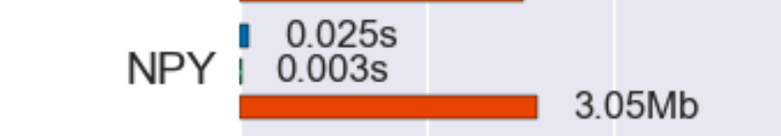
Save data after timeons and offs

Slide 10
EEG Model

Slide 11
Data imbalance

Slide 12
5-Fold Validation

Slide 13
Ensamble method
Maybe keep big well-trained general models to ensamble with the one we train fast with the patient

Slide 14
Results

