Slide 1
Smol_thesis
Matteo Regge
2023/2024

Slide 2
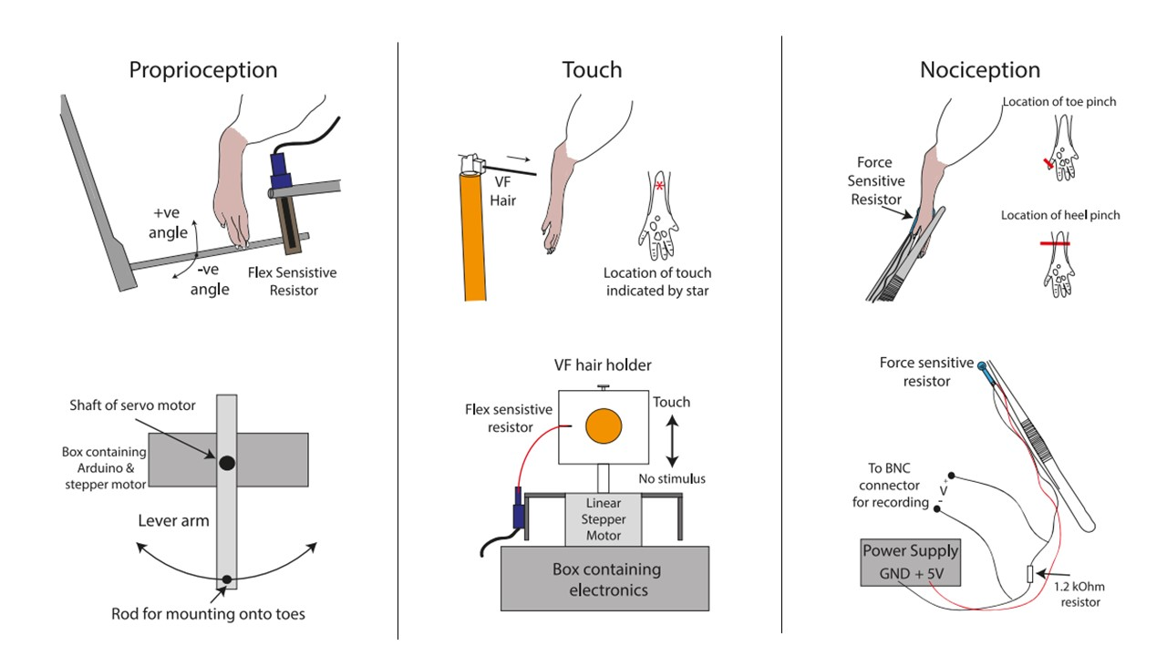
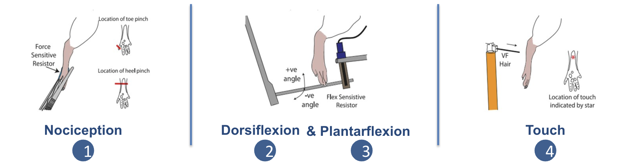
Dataset
Nociception
Dorsiflexion
Touch
& Plantarflexion
1
2
3
4
8th Order Butterworth Filter
Between 0,8 and 2,45 kHz
Supress Electromyography (EMG) and high frequency noises
Bandpass
Downsample
From 30 kHz to 5kHz
Reduce Computational Burden
Outliers removal
Threshold set at ±30μ

Slide 3
Methods

Slide 4
Issues
We need to retrain part of the model.
But overall need an online method

Slide 5
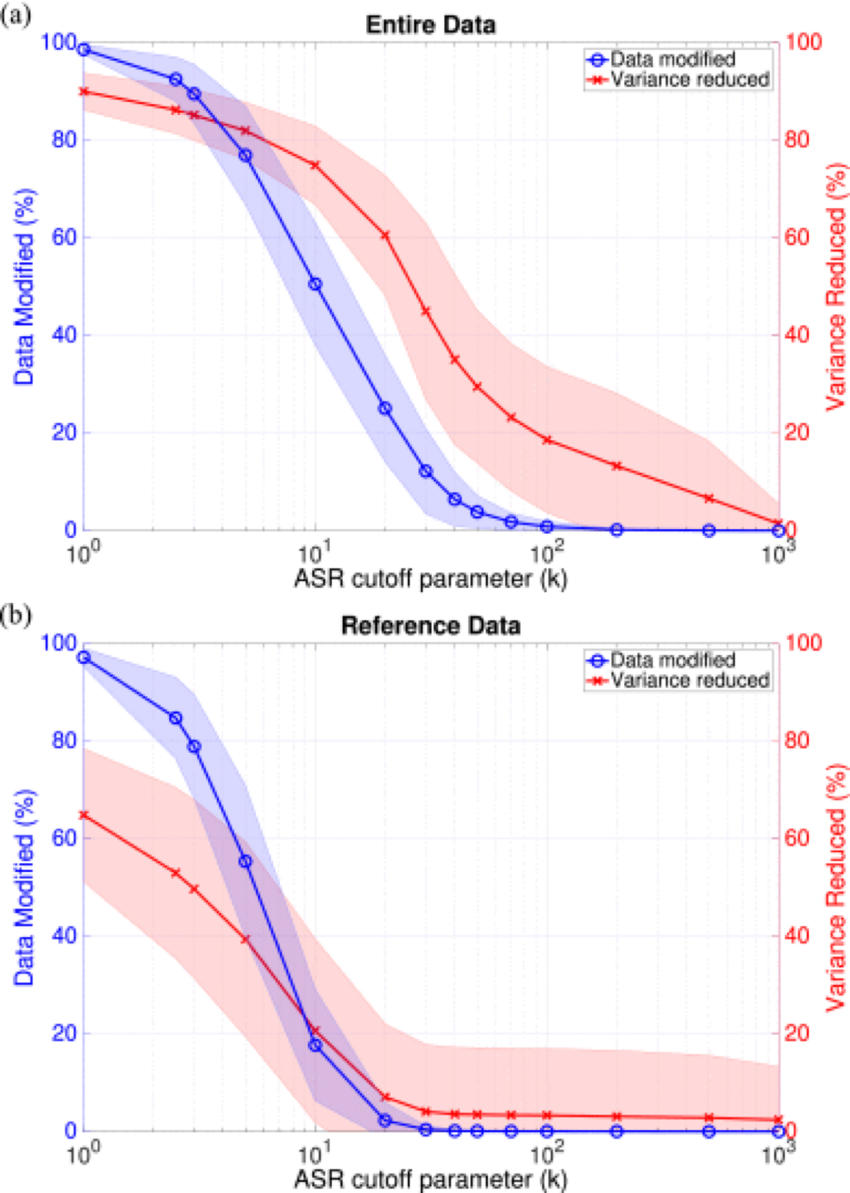
Artifact Subspace Reconstruction
Traditionally, these artifacts were removed manually by visual inspection, this approach better suits a real time approach. Results vary depending on model architecture and dataset.
Get raw data and compute variance metrics
IIR(infinite impulse response ) filter to suppress specific frequencies associated with brain oscillation
Compute thresholds based on given signals (after projecting in principal components space)
Reject artefacts and reconstruct data

Slide 6
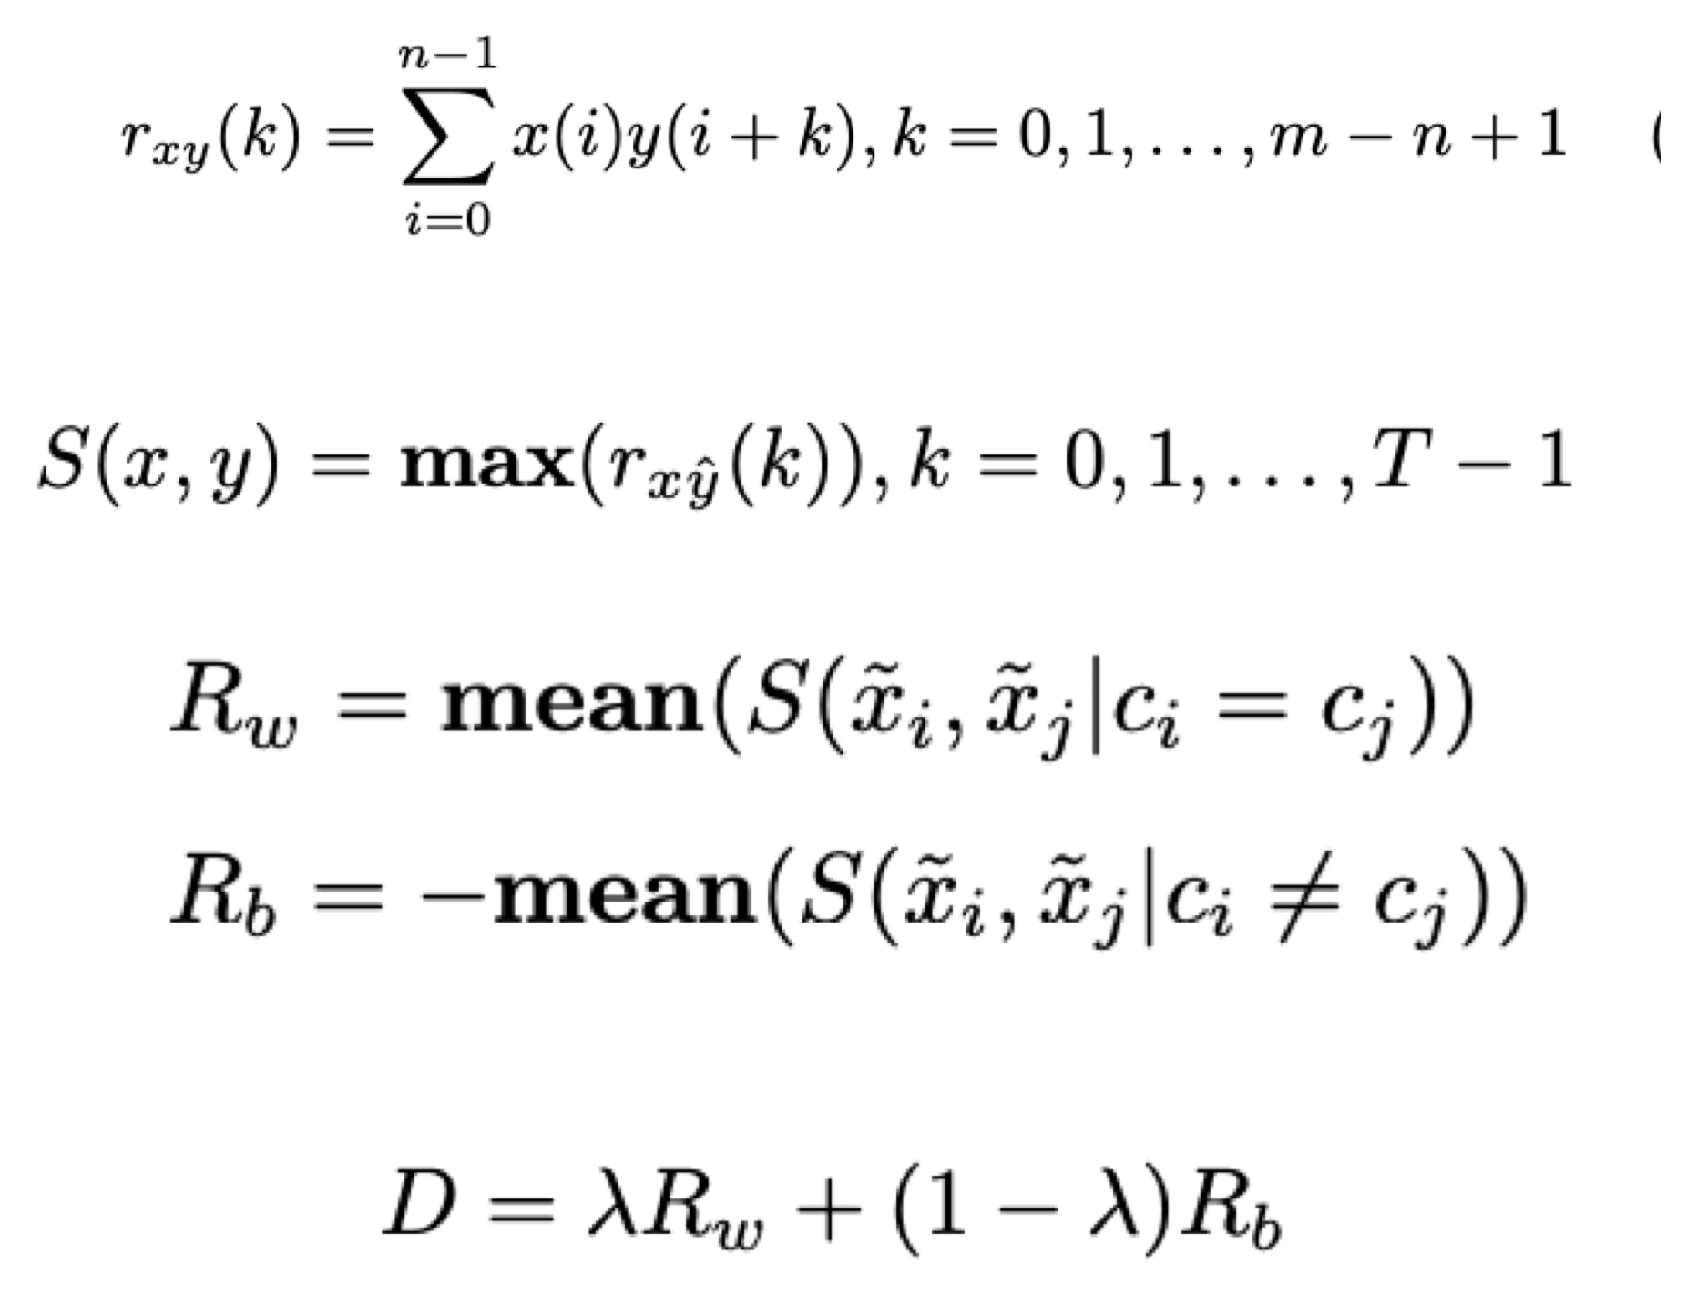
Cross-correlation based discriminant criterion
Score channels and select subset of them
In the procedure of motor imagery EEG classification, signals of the same class of MI task should contain similar features and vice versa. Therefore, we can assess a channel’s discriminative ability based on the similarity between signals of multiple classes from that channel.
Channels are ranked in a descending order according to their discriminant score D after obtaining D for every channel

Slide 7
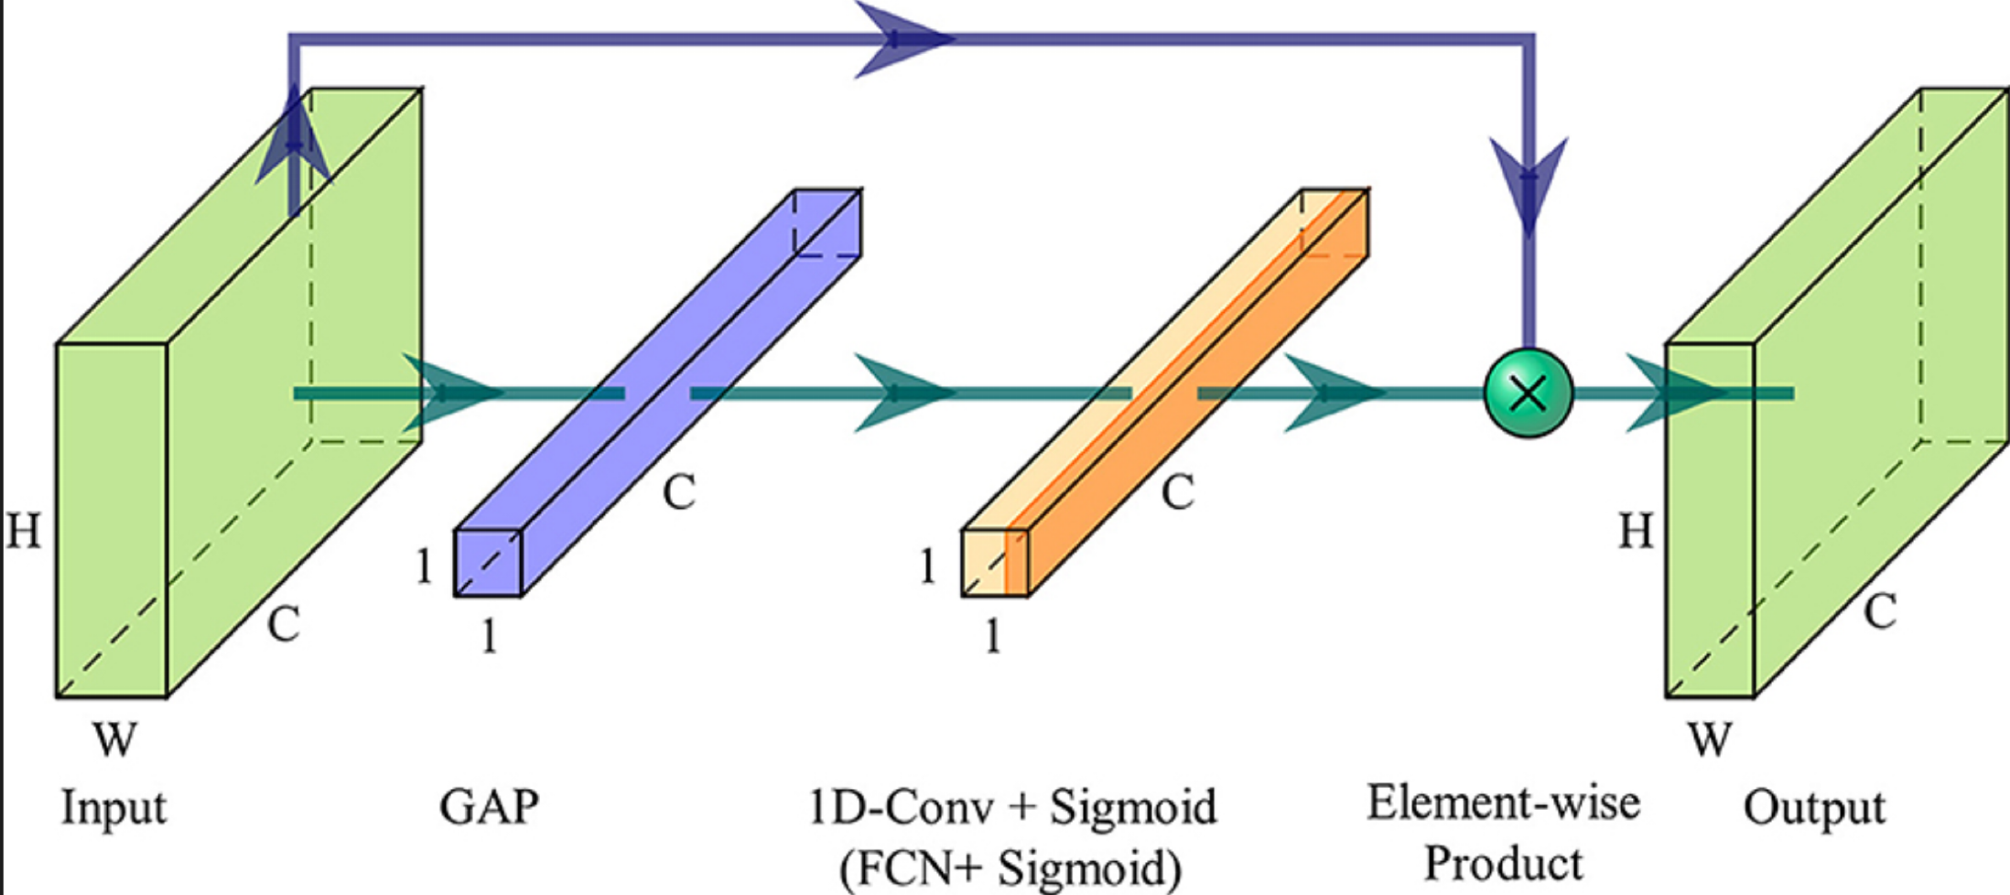
Channel Attention Layer
Add one dense layer to get the weights for each channel
Evaluating the weights we know how relevant each channel is for the learning of the EEGNet
16 x 16 weights + 16 base coefficients

Slide 8
Ensamble method
Maybe keep big well-trained general models to ensamble with the one we train fast with the patient

Slide 9
EEG Model

Slide 10
Data imbalance

Slide 11
Results

Slide 12
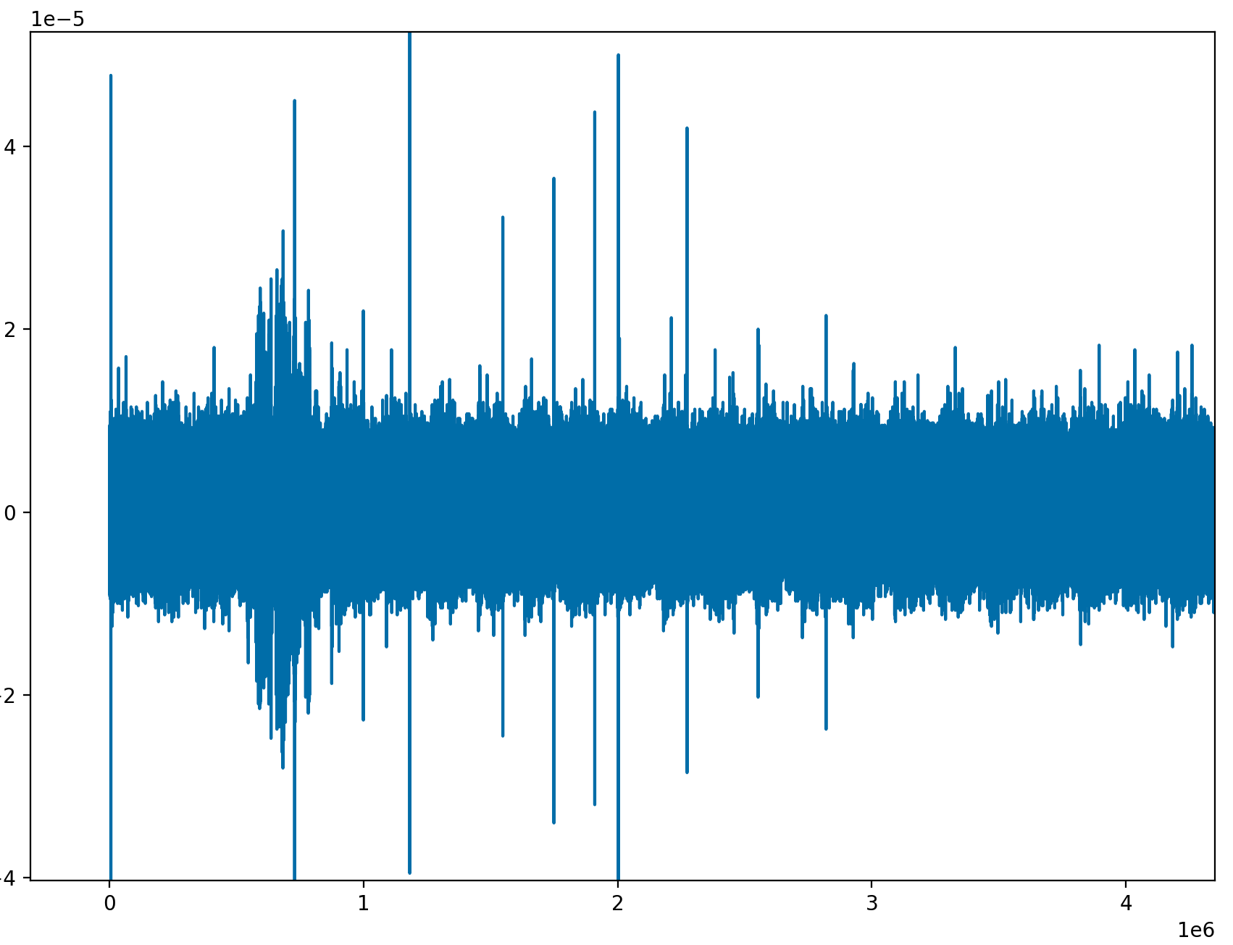
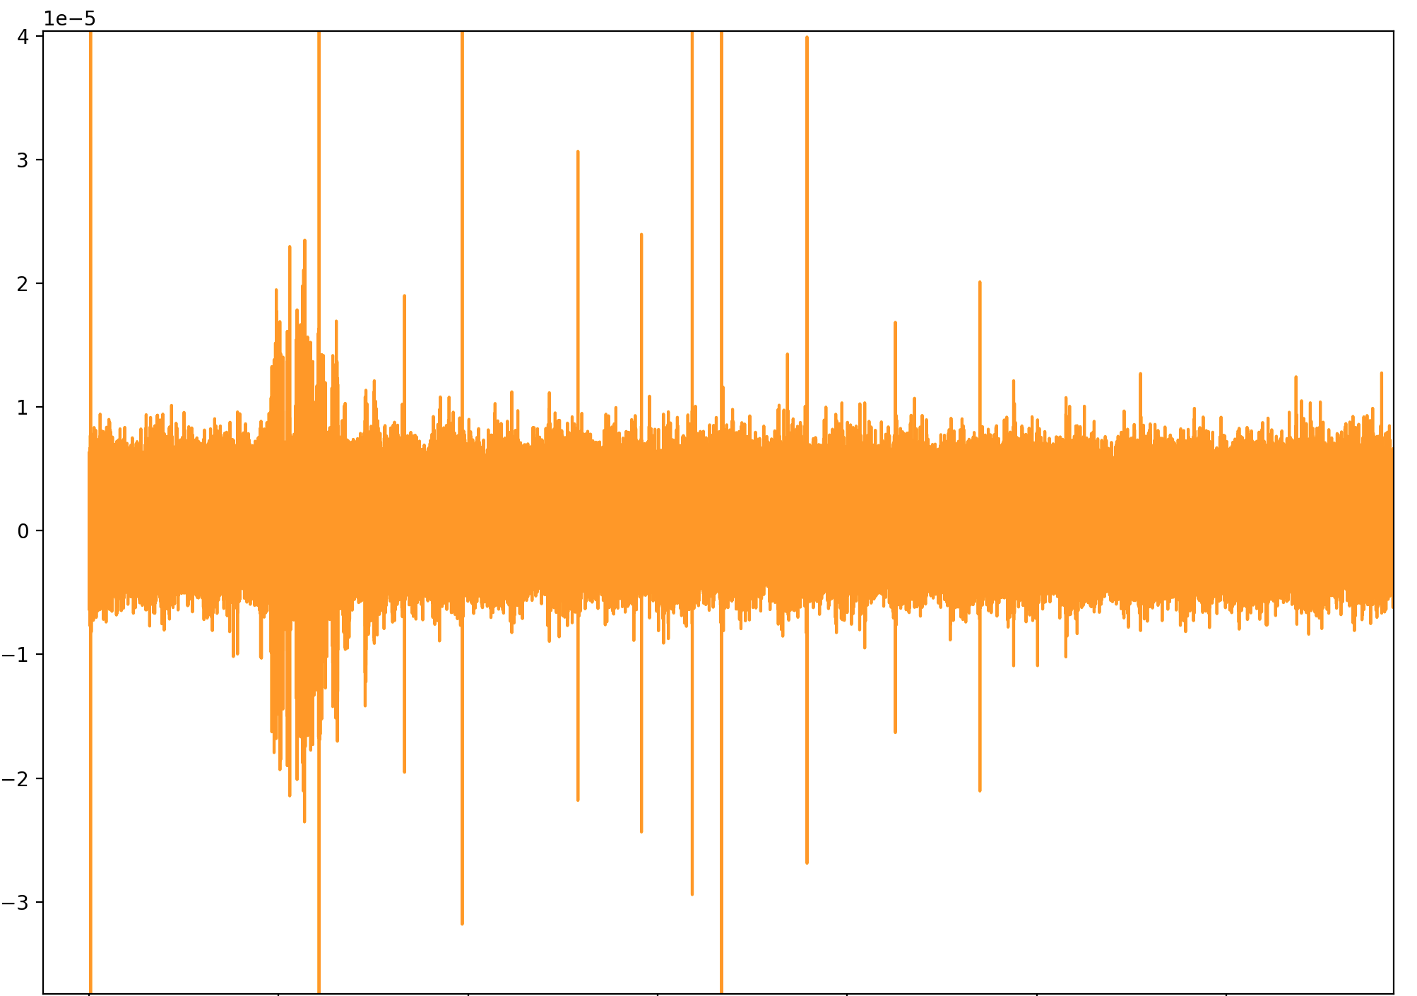
Downsample
We downsample the signal to reduce calculation complexity without losing too much information from the origianl signal
30Khz
5Khz

Slide 13
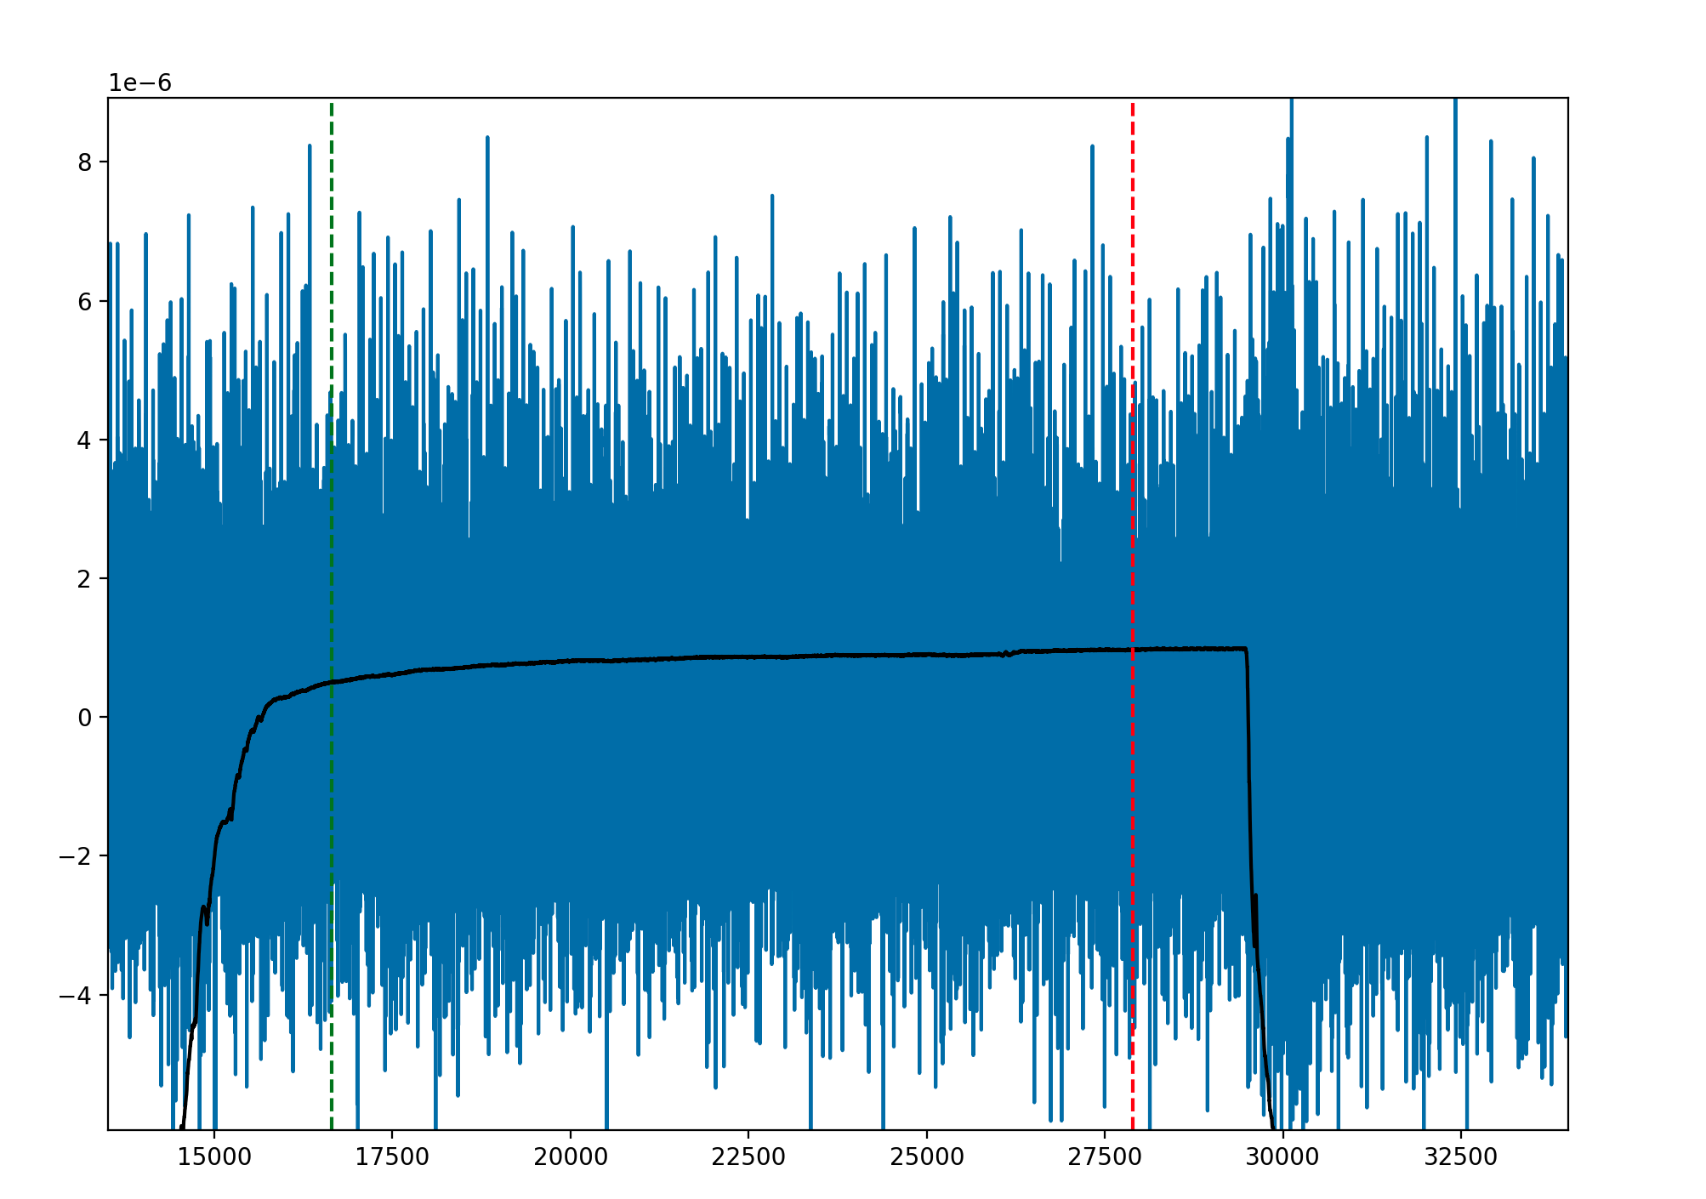
Time on / Time off
We have downsampled the signal but we still need to find the part of the signals where the actual actions happens.
For Proprioception and Touch we can start by reading the .nev files included in the dataset
For Noci… we must use a different approach by detecting when the signal is higher than a certain thresholds we find empirically

Slide 14
Time on / Time off
For Proprioception we add 250ms to the time-on data point and take 2.5 seconds from there
For Touch we add 500ms to the time-on data point and then take 2.5 seconds.
We can use the 17th channel to have an idea of the movement. (Shown in black in the image)

Slide 15
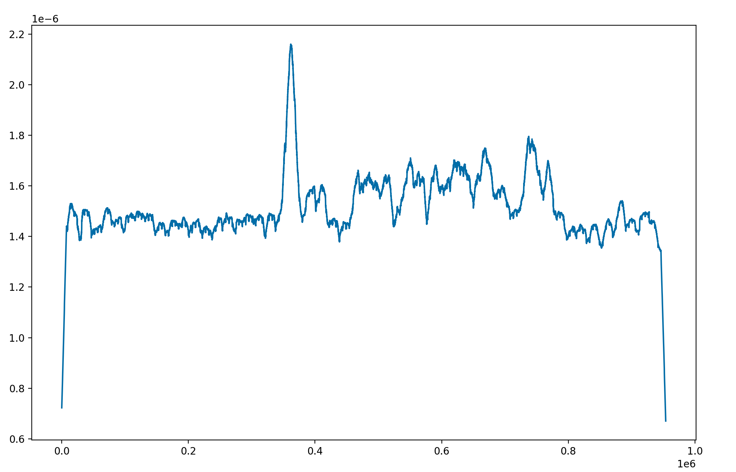
Time on / Time off

Slide 16
EEG Model

Slide 17
5-Fold Validation

