Slide 1
Learning to Sense Sparse Signals: Simultaneous Sensing Matrix and Sparsifying Dictionary Optimization
Julio Martin Duarte-Carvajalino, and Guillermo Sapiro
University of Minnesota
IEEE Transactions on Image Processing, Vol. 18, No. 7, July 2009
Presented by Haojun Chen

Slide 2
Outline
Introduction
Sensing Matrix Learning
KSVD Algorithm
Coupled-KSVD
Experiment Results
Conclusion

Slide 3




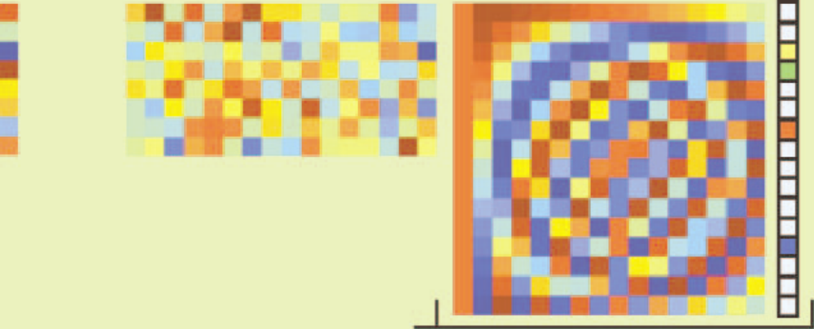


Introduction
Compressive Sensing(CS)
Two fundamental principles
  Sparsity
  Incoherent Sampling
  Gramm Matrix:
  is with all columns normalized
  Gramm matrix should be as close to the identity as possible
=
S non-zero
m x 1
m x N
N x N
N x 1
Image source: www.usna.edu/Users/weapsys/avramov/Compressed%20sensing%20tutorial/cs1v4.ppt

Slide 4









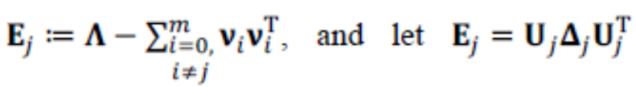
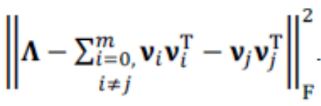

Sensing Matrix Learning
Assume the dictionary is known, the goal is to find the sensing matrix such that
Let be the eigen-decomposition of , then
Define
Objective is to compute to minimize
Let be the eigenvalues of , ,
,
Solution: ,

Slide 5





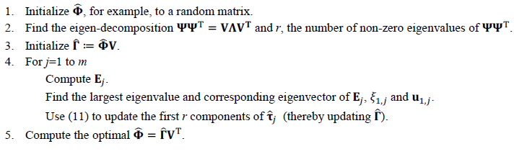
Sensing Matrix Learning
Replacing back in terms of (rows of )
Once we obtain ,
Algorithm summary

Slide 6


KSVD Algorithm
The objective of the KSVD algorithm is to solve, for a given sparsity level S,
Two stages in KSVD algorithm
  Sparse Coding Stage: Using MP or BP
  Dictionary Update Stage
Let and

Slide 7





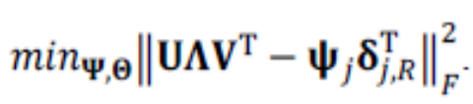

KSVD Algorithm
Define the group of examples that use the atom
Let , then
Let be the SVD of and define
Solution:

Slide 8









KSVD Algorithm
KSVD algorithm consists of the following key steps:
  Initialize
  Repeat until convergence:
    Sparse Coding Stage:
    For fixed, solve using OMP to obtain
    Dictionary Update Stage:
    For j=1 to K
      Define the group of examples that use this atom
      where P is the number of training square patches and
      Let
      where
      Obtain the largest singular value of and the corresponding singular vectors
      Update using

Slide 9


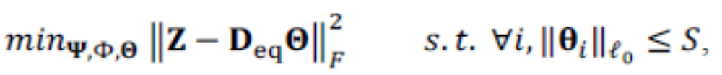



Coupled-KSVD
To simultaneously training a dictionary and the projection matrix , the following optimization problem is considered
Define , then the above equation can be rewritten as
Solution obtained from KSVD:
where and

Slide 10



Coupled-KSVD
Coupled-KSVD algorithm consists of the following key steps:
  Initialize
  Repeat until convergence:
    For fixed, compute using the algorithm in sensing matrix learning
    For fixed, solve using OMP to obtain
    For j=1 to K
      Define the group of examples that use this atom
      where P is the number of training square patches and
      Let
      where
      Obtain the largest singular value of and the corresponding singular vectors
      Update using

Slide 11
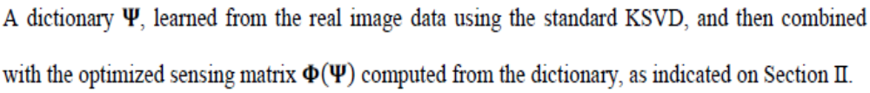
Experiment Strategies
Uncoupled random (UR)
Uncoupled learning (UL)
Coupled random (CR)
Coupled learning (CL)

Slide 12

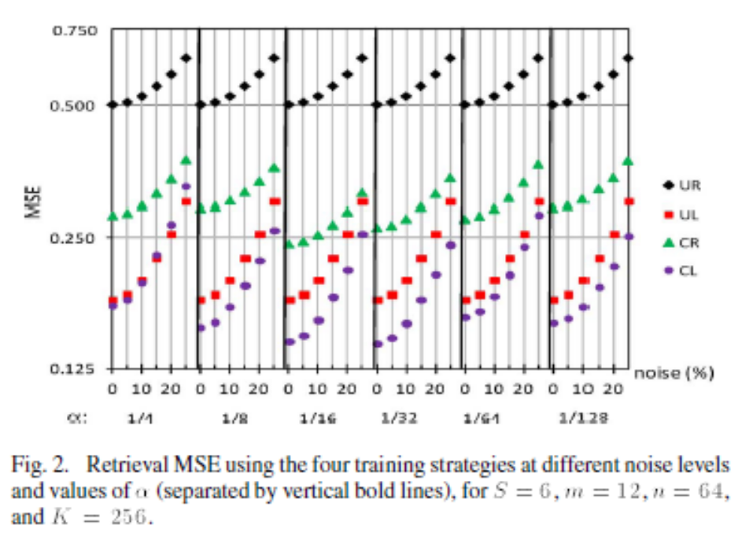
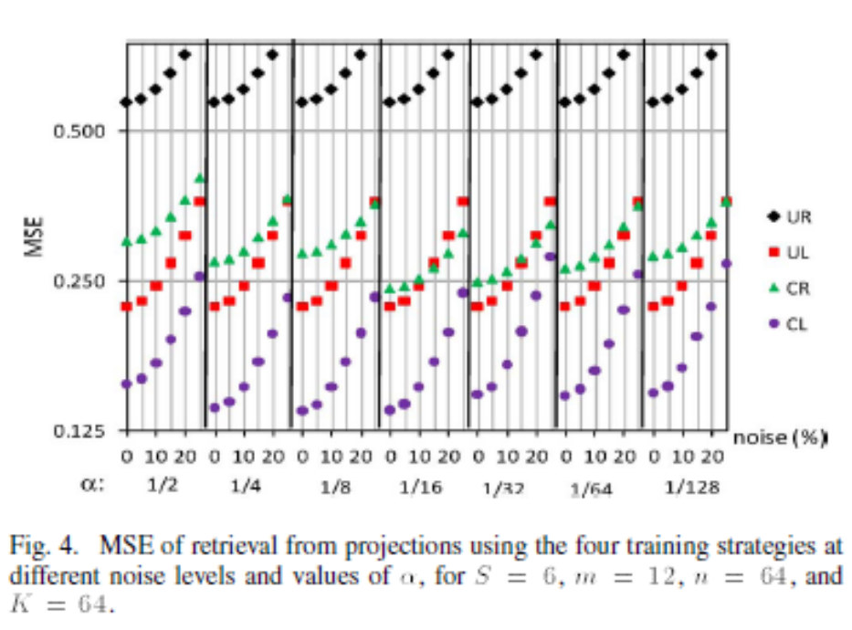
Experiment Results
Training data:
6600 8 x 8 patches extracted at random from 440 images
Testing data
120000 8 x 8 patches from 50 images
Comparison of the average MSE of retrieval for the testing patches
at different noise level and α
K=256 Overcomplete
K=64 Complete

Slide 13
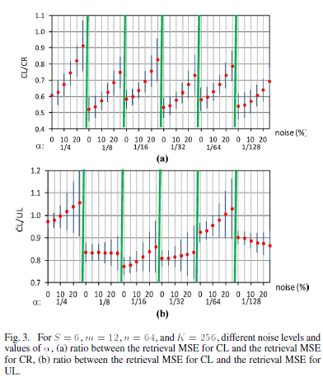
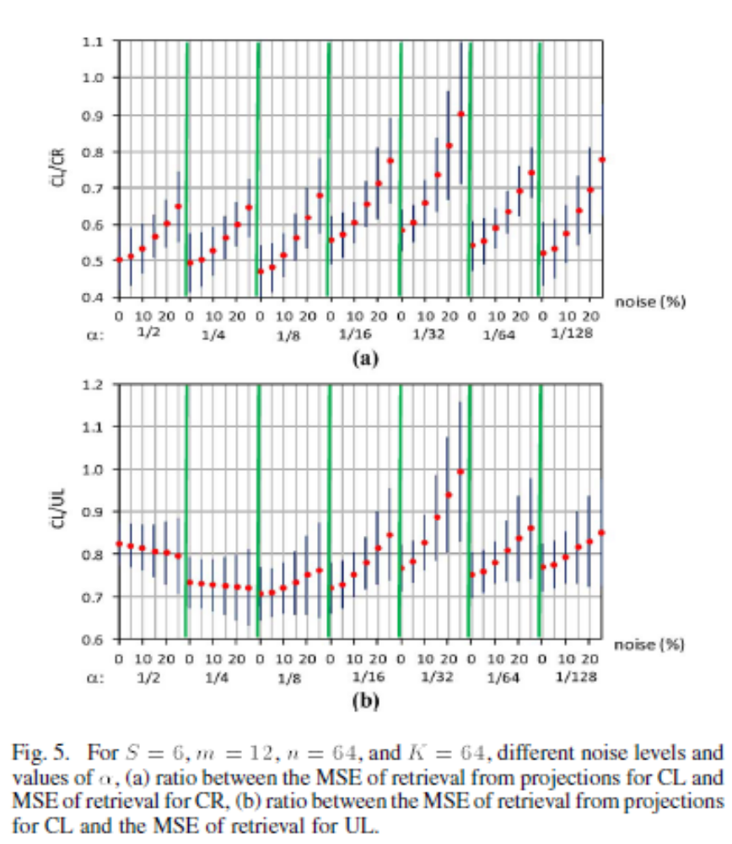
Experiment Results
Comparison of the retrieval MSE ratio for CL/CR and CL/UL at different noise
level and α
K=256 Overcomplete
K=64 Complete

Slide 14
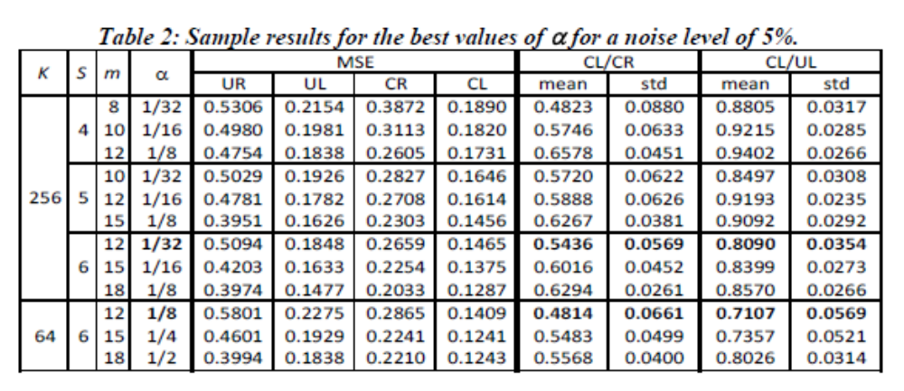
Experiment Results
Best values of that produced the minimum retrieval MSE and at
the same time the best CL/CR and CL/UL ratios, for a representative noise level of 5%.

Slide 15
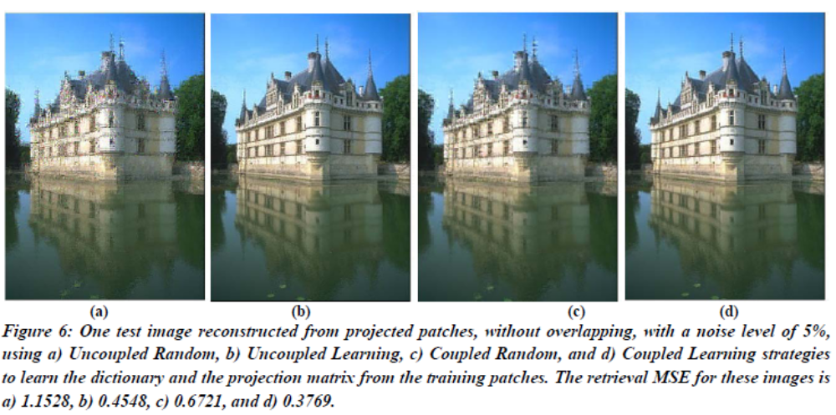
Experiment Results
Testing image consisting of non-overlapping 8 × 8 patches reconstructed from their noisy projections (5% level of noise)

Slide 16
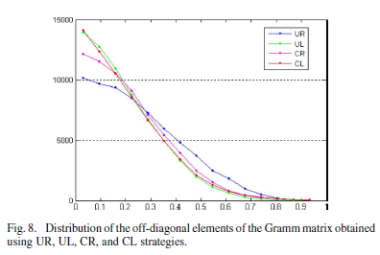
Experiment Results
Distribution of the off-diagonal elements of the Gramm matrix for each one of four strategies

Slide 17
Conclusions
Framework for learning optimal sensing matrix for given sparsifying dictionary was introduced
Novel approach for simultaneously learning the sensing matrix and sparsifying dictionary was proposed

