Slide 1

Opinion mining using UNSUPERVISED
Machine Learning algorithms
MSc Computer Science Vitalii Duk

Slide 2
Opinion mining / Sentiment analysis
1. Aim of this research
2. Why?
2.1 Customers opinion analysis
2.2 Public opinion tracking
3. Dataset
1600 hotel reviews from TripAdvisor website 800 – positive, 800 - negative

Slide 3
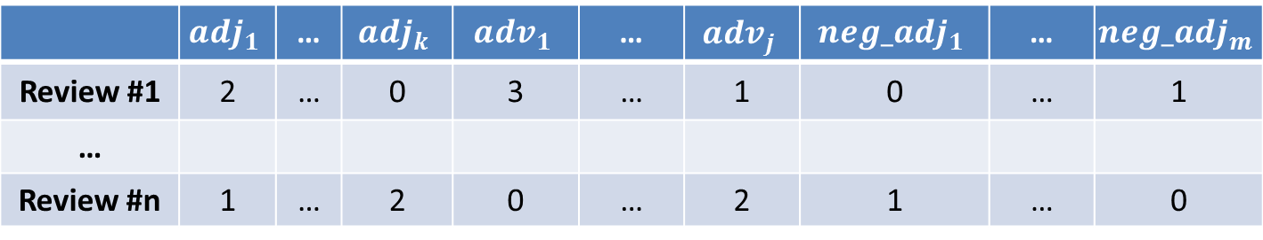
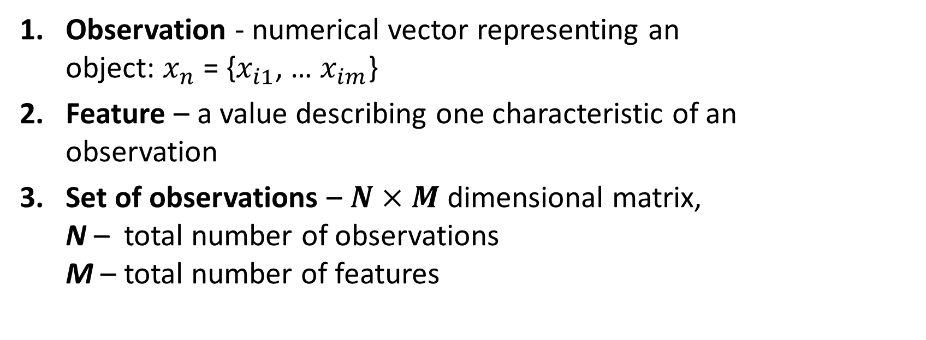
Theoretical background
Observation - numerical vector representing an object: $x_{n}$ = {$x_{i1}$, … $x_{im}$}
Feature – a value describing one characteristic of an observation
Set of observations – $N×M$ dimensional matrix, N – total number of observations M – total number of features
 | $${adj}_{1}$$ | … | $${adj}_{k}$$ | $${adv}_{1}$$ | … | $${adv}_{j}$$ | $${neg_adj}_{1}$$ | … | $${neg_adj}_{m}$$
Review #1 | 2 | … | 0 | 3 | … | 1 | 0 | … | 1
…
Review #n | 1 | … | 2 | 0 | … | 2 | 1 | … | 0

Slide 4
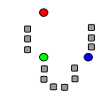
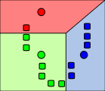
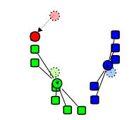
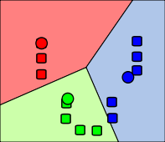
K-means
1. Divide n observations into k clusters.
2. Each observation belongs to the cluster with the nearest center (centroid).
1
2
3
4

Slide 5
Distance metrics
1. Euclidean & squared Euclidean (most used)
2. City block / Manhattan
3. Correlation
4. Cosine

Slide 6
Other algorithms
Intelligent K-means
Hierarchical clustering
K-nearest neighbors (Supervised):
Prepare the training set.
Define K value.
Assign each element in testing set to the most frequent label, which appears in K-nearest elements in supervised set.

Slide 7
Methodology
Assign Part-of-Speech label to each word in the review.
Use the frequency of each adjective, adverb and negated adjective as a feature.
Prepare datasets with different parameters: standardized/not standardized, frequency of features (>= 1, 10, 20, 50, 100)
Run clustering algorithms.
Calculate accuracy (confusion matrix).

Slide 8
Implementation
Python:
Text preprocessing
Features extraction (POS-tagging)
Combining and saving results
MATLAB:
Data standardization (normalizing/rescaling)
Running machine learning algorithms (K-means, Hierarchical clustering, K-nearest neighbors)
Accuracy check (confusion matrix)

Slide 9
Review features
Group of features | Number of features
Adjectives | 1930
Adverbs | 607
Negated adjectives | 119
Total: | 2656
Feature frequency | Number of features
>= 1 | 2656
>= 10 | 360
>= 20 | 232
>= 50 | 114
>= 100 | 64

Slide 10
Most frequent features (words)
Word | Part of speech | Frequency
great | Adjective | 700
nice | Adjective | 393
good | Adjective | 316
very | Adverb | 1212
just | Adverb | 511
even | Adverb | 416
worth | Negated adjective | 41
sure | Negated adjective | 15
clean | Negated adjective | 15

Slide 11
Clustering: results
Algorithm | Standardization | Distance metric | Feature frequency | Accuracy
K-means | Yes | Correlation | >= 10 | 85.9375%
iK-means | Yes | Correlation | >= 10 | 85.6250%
Hierarchical Ward method | No | City block | >= 10 | 79.9375%

Slide 12
Results of Supervised approach (K-nearest Neighbors classification)
Feature frequency | Standardization | Distance metric | Accuracy
>= 10 | Yes | Correlation | 88.38%
>= 20 | Yes | Correlation | 87.44%

Slide 13
Conclusion
Better results can be achieved with feature frequency >= 10 and >= 20.
Intelligent selection of K-means centroids can give almost the same accuracy as standard K-means algorithm (85.62% vs 85.93%).
Hierarchical clustering: Ward’s method gives better results.

Slide 14
Future work
Use adverb-adjective pairs (bi-grams) as features. Example: very beautiful, extremely bad.
Investigate other unsupervised algorithms:
Hidden Markov Model (HMM)
Gaussian Mixture Model (GMM)
3. Multi-language support.
4. Include neutral opinion.

Slide 15


