Slide 1

DSbD Programme – Digital Catapult
Cohort 2 Tier 1
KATLAS Technology
WEB3 - Privacy wallets
Marcos Mayorga
CTO at KATLAS Technology

Slide 2
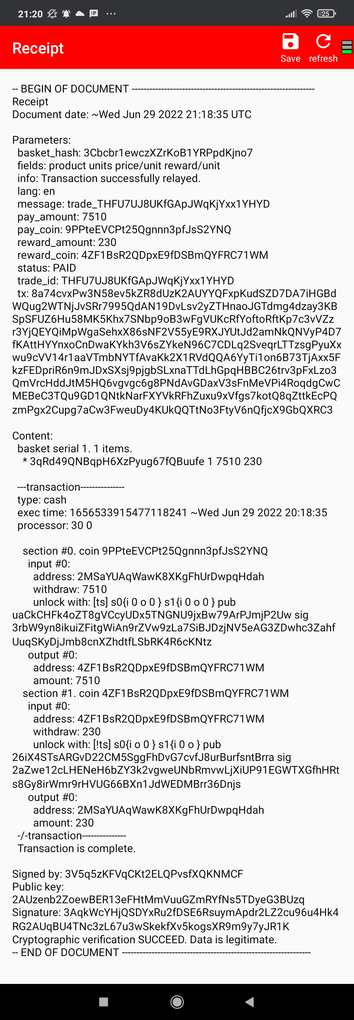
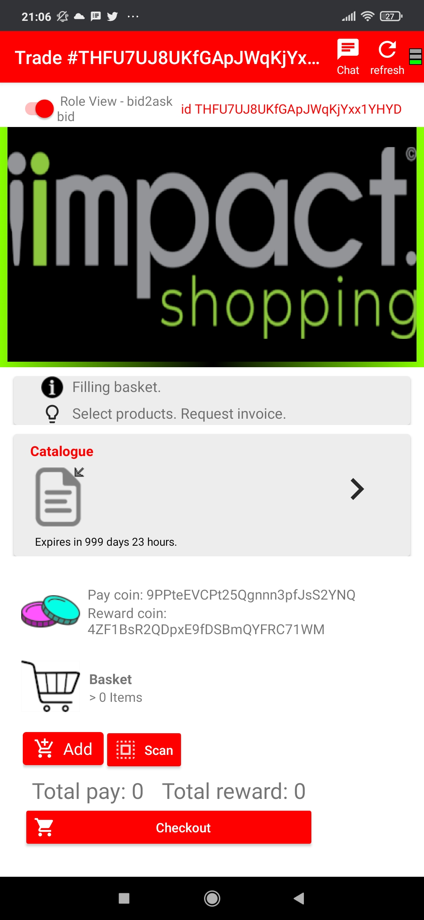
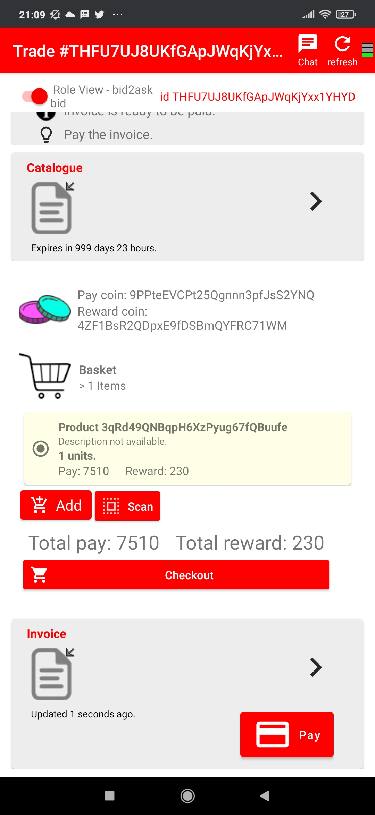

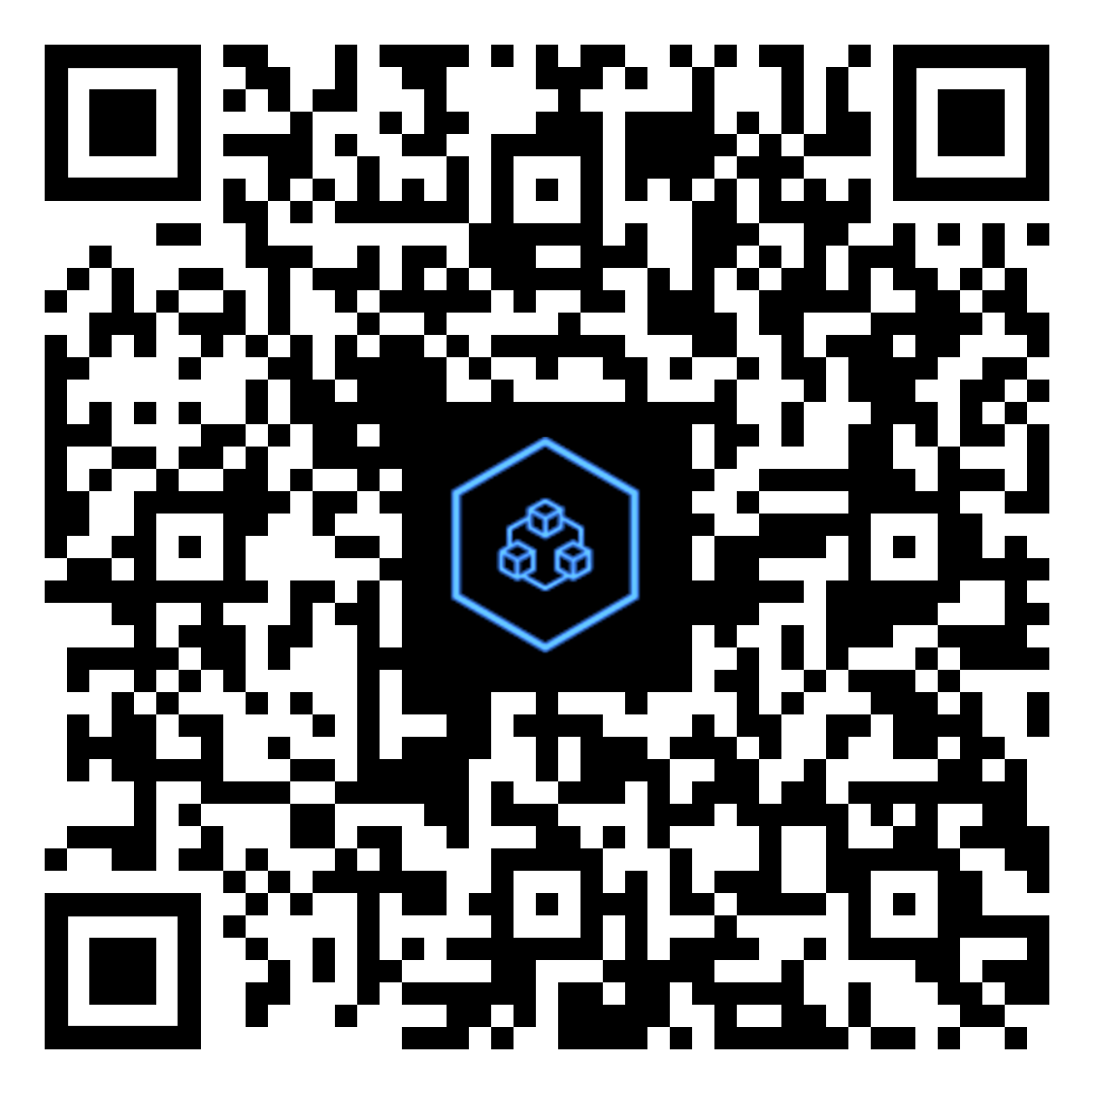


KATLAS network
Cryptocurrency protocol. Settlement.
Smart wallets with trading role-2-role trading protocols.
Source Code
Android App
https://github.com/root1m3/plebble
KATLASNET

Slide 3
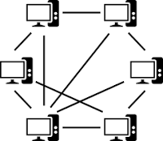


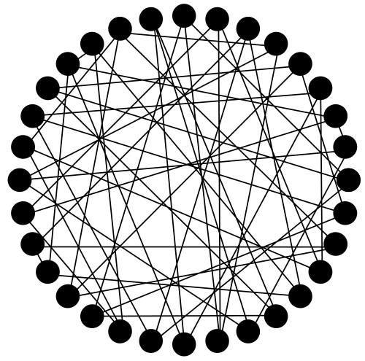
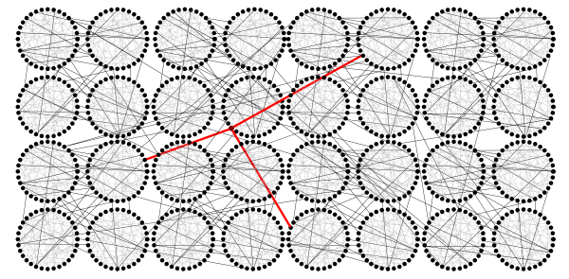
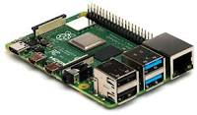
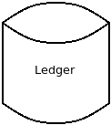
KATLAS network
P2P Network
Node

Slide 4






wallet
Front-End
Back-End
Daemon process
user
RPC-process

Slide 5
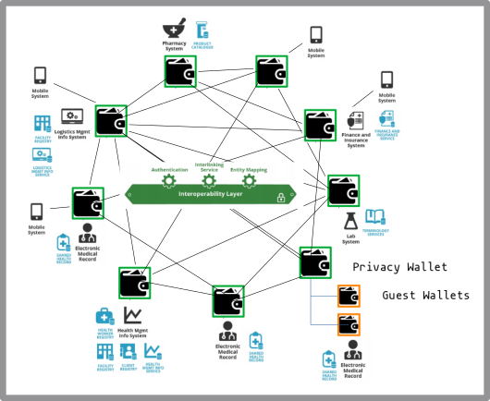
wallet

Slide 6

wallet
Daemon - user private data
1- User authentication → 64 bit id → Worker thread.
2- API request → Access to user wallet → Response
Risks:
Code flaw could leak data from other user’s wallet.
Today’s flawless code could contain a flaw tomorrow.

Slide 7
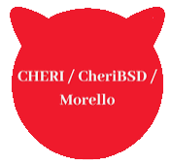

System tests - purecap
RPC API calls
Threads
TCP/IP sockets
Cryptography (ECC, DSA, AES, HASH)
B58 Encoder/decoder. Binary serialization.
String manipulation (trim, split, replace, ...)
Detected transmission of pointers via IPC. Got provenance failure exception.
Once fixed...

Slide 8

package zstd
root@cheripleb:~ # zstd /etc/motd.template
zstd: error 11 : Allocation error : not enough memory
morello/cheribsd
qemu-riskv64-purecap/cheribsd

Slide 9
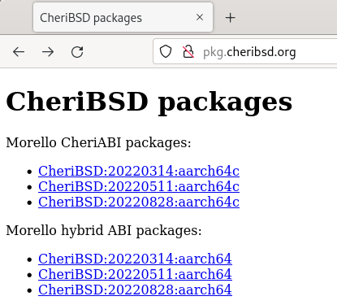
cheribuild.py - riscv
git clone https://github.com/CTSRD-CHERI/cheribuild
./cheribuild.py run-riscv64-purecap -d
root@cheribsd-riscv64-purecap:~# pkg64c install git
Error fetching http://pkg.CheriBSD.org/CheriBSD:20220828:riscv64c/Latest/pkg.txz
Only aarch64/aarch64c ports are available

Slide 10

wallet
Risks we’d like to reduce using compartmentalization:
Code flaw could leak data from other user’s wallet.
Today’s flawless code could contain a flaw tomorrow.
How to guarantee that users can only access the right wallet...
Even when evil users take advantage of current (or future) flaws in the code, gaining -anyhow- access to other’s wallet.

Slide 11
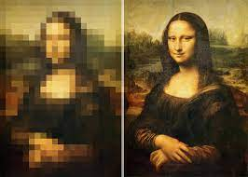



Compartmentalization models
Shared library compartments.
We need more granularity → C++ Objects.
Enclaves, Protection domains, trampolines
Requires a significant software refactoring effort.
→ allocators, sealed capabilities
We are figuring out how to achieve a model that:
mitigates aforementioned risks
minimizes development effort, easiest change

Slide 12
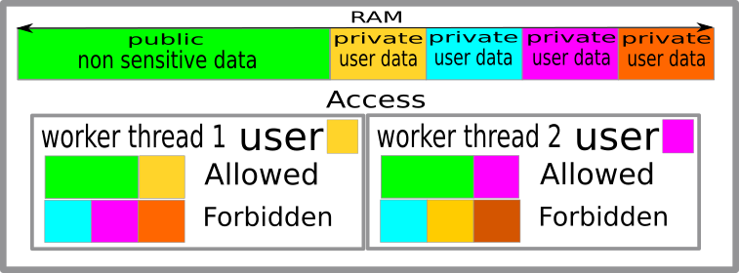

wallet
Coloured compartments

Slide 13
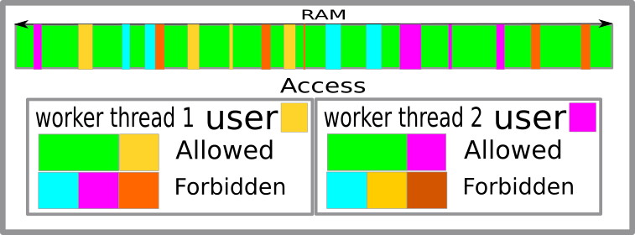
wallet
Coloured fragmented compartments

Slide 14
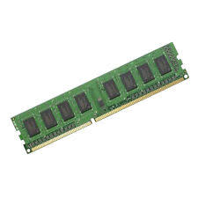
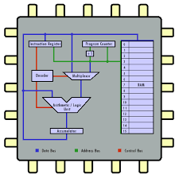
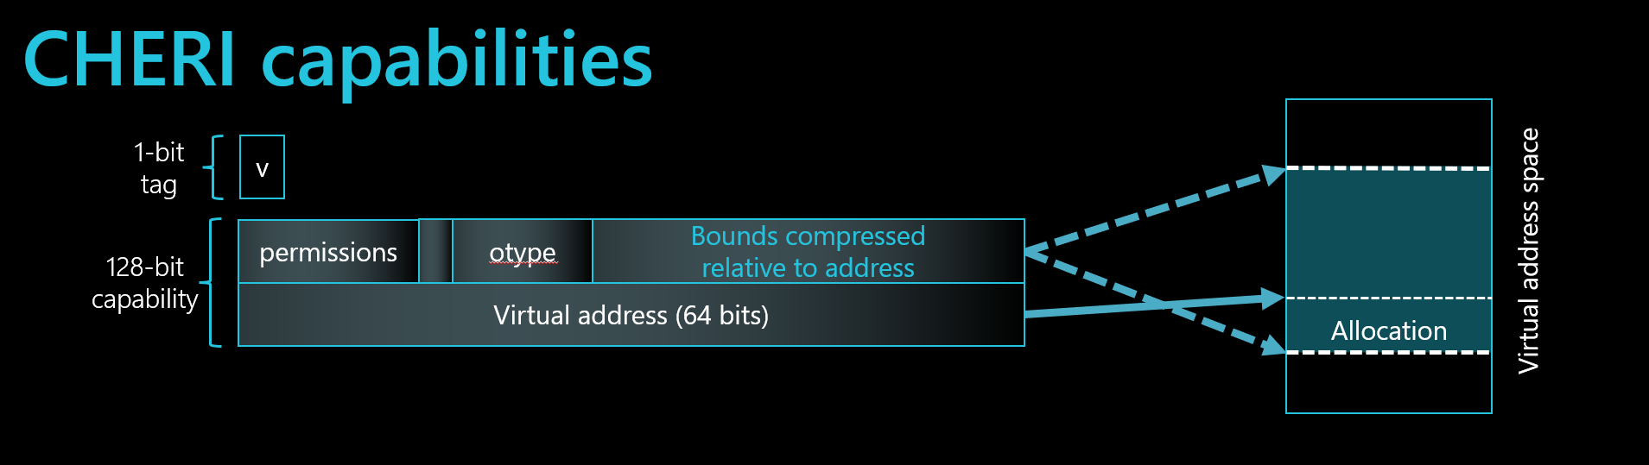
CPU
RAM
Execution thread
Load 64 bit id into register
New C++ object – encode id
Access/dereference C++ object
Reg Id !- cap Id ?
→
raise PROT Exception

Slide 15


Continuity
Privacy++ wallets
featuring compartmentalized wallets with CHERI
KATLAS W3 Privacy router.
Internet router + P2P Node + family/business wallets
in one computer.

Slide 16

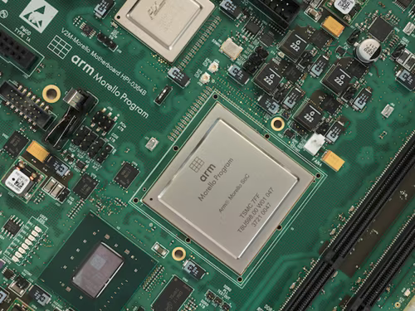


Thank you !
https://katlastechnology.com

