Slide 1

DSbD Programme – Digital Catapult
Cohort 2 Tier 1
KATLAS Technology
WEB3 - Privacy wallets
Marcos Mayorga
CTO at KATLAS Technology

Slide 2
Morello / CheriBSD
Issues porting our codebase (+50K LOC C++)
GNU Compiler → clang/LLVM
configuration bash scripts → sed
Tests: Detected transmission of pointers via IPC. Got provenance failure exception.
Purecap tests passed.
Zstd issue.

Slide 3


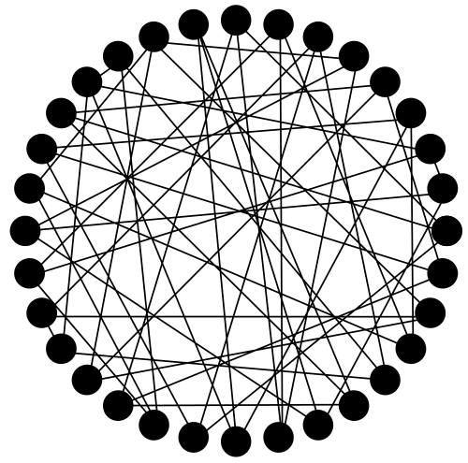
Network - ring

Slide 4
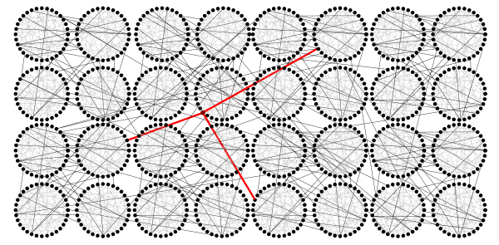
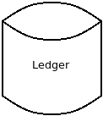
Network - shard

Slide 5
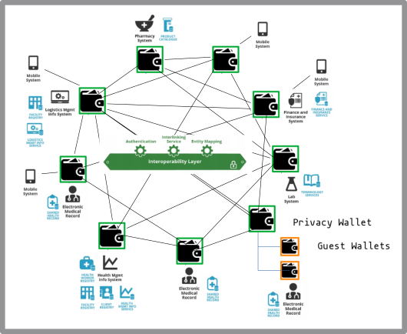
Wallet - P2P trades

Slide 6

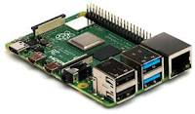


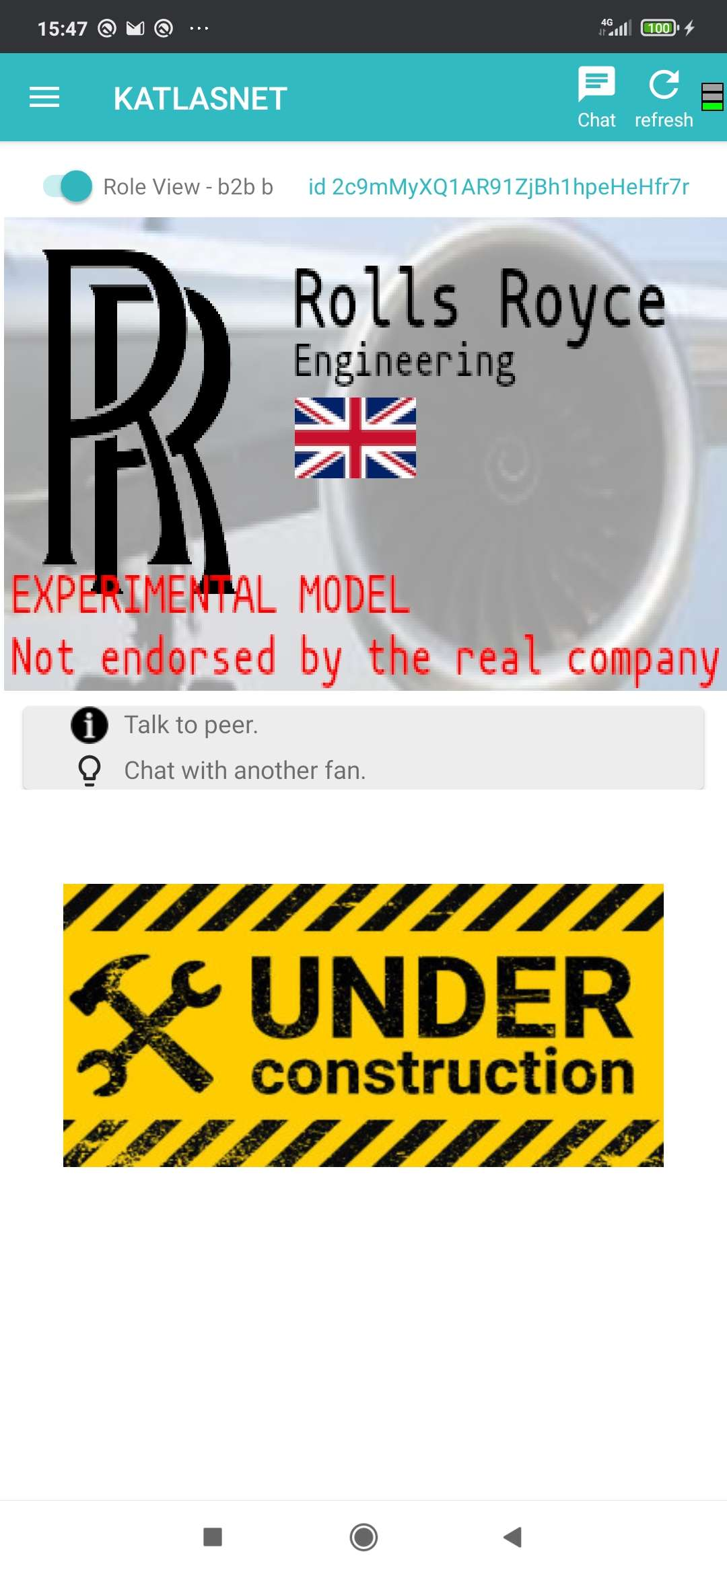


katlas-wallet
Front-End
Back-End
Daemon process
user
RPC-process

Slide 7
Protecting users private data
Software design pattern:
Worker threads are assigned jobs for authenticated users.
Only user’s wallet is allowed to be accessed.
Currently we only rely on glitch-free code.

Slide 8
Enhanced protection
How to guarantee that users can only access the right wallet...
Even when evil users take advantage of current (or future) flaws in the code, gaining somehow access to other’s wallet.

Slide 9
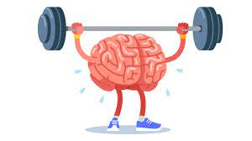
Compartmentalization model
Shared library compartments.
Enclaves, Protection domains,

Slide 10
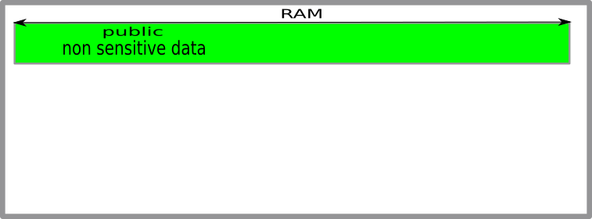

Slide 11
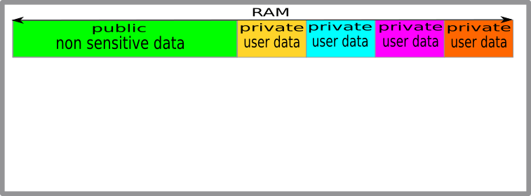
Coloured compartments

Slide 12
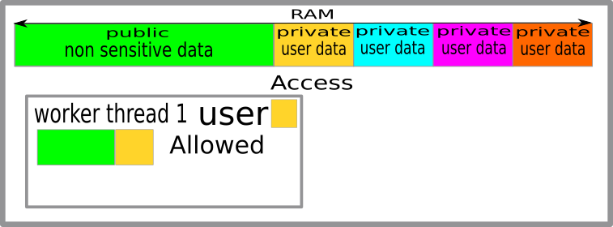
Coloured compartments

Slide 13
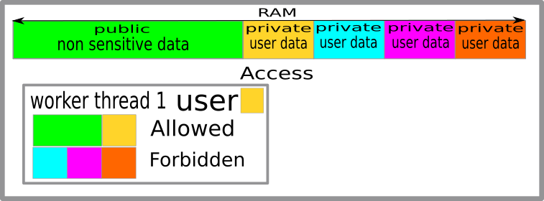
Coloured compartments

Slide 14
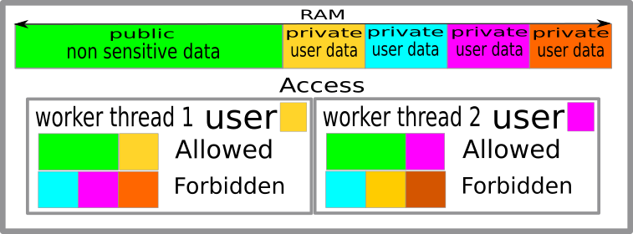
Coloured compartments

Slide 15
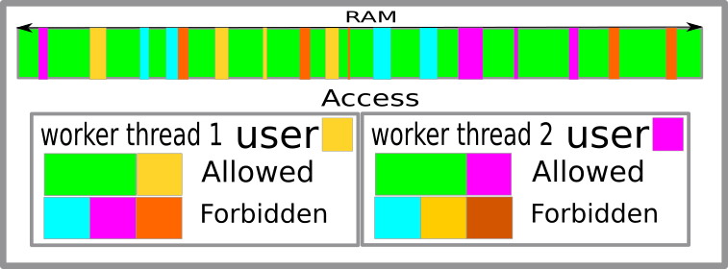
Coloured fragmented compartments

Slide 16
Compartmentalization model that would require minimum changes in our existing codebase
Set CPU color
If CPU color is set
* new capabilities acquire such color
* CPU raises exceptions based on color

Slide 17
Thought way
Capabilities have a special unused otype value ‘C’, (or permission mask).
meaning that the value in field ‘bounds’ shall be interpreted differently, as a color.
special register R. Its value cannot be changed once set (!=0).
If R>0 malloc encodes in new capablities, instead of bounds in new capabilities
On dereferenciation of a capability, the Coprocessor would emit an exception IF
* otype==C, and
* R>0 and
* R!=color encoded in the dereferenced capability

Slide 18
Continuity
Privacy++ wallets, running on CHERI
Privacy internet router. Router+Node in one computer.

Slide 19

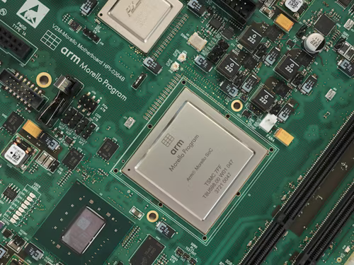



Thank you !
https://katlastechnology.com

