Slide 1


NEXT GEN EMPLOYABILITY PROGRAM
CREATING A FUTURE-READY WORKFORCE

Slide 2
Student Name :Yuvraj Singh Rathore
Student ID : STU642eec0be0b991680796683
College Name :Poornima Institute of Engineering and Technology

Slide 3
CAPSTONE PROJECT SHOWCASE
Project Title : HealthCare Prediction on Diabetic Patients using Python
Abstract | Problem Statement | Project Overview | Proposed Solution | Technology Used | Modelling & Results | Conclusion | Q&A

Slide 4
Abstract
This healthcare project endeavors to transform the landscape of diabetic patient care by harnessing the capabilities of machine learning and predictive analytics. The core objective is to develop sophisticated models that can accurately predict the likelihood of diabetes onset by analyzing a comprehensive dataset enriched with key medical predictor variables. Emphasizing proactive intervention, personalized treatment plans, and overall healthcare enhancement, the initiative addresses the growing global challenge of diabetes. The project's multifaceted objectives encompass an exhaustive understanding of the dataset through exploration and preprocessing, leveraging exploratory data analysis for insights, employing advanced feature engineering and selection techniques, addressing class imbalance for robust model training, applying diverse machine learning algorithms tailored to the project's goals, and ultimately deriving actionable insights and recommendations.
By integrating these objectives, the project aspires to redefine diabetes care through data-driven strategies, enabling early detection, risk stratification for complications, and the formulation of personalized treatment plans. Through a comprehensive approach encompassing data exploration, advanced analytics, and machine learning, the project aims to significantly improve healthcare outcomes for individuals at risk or already diagnosed with diabetes, paving the way for a more proactive, personalized, and effective paradigm in diabetic patient management.

Slide 5
Problem Statement
The escalating prevalence of diabetes poses a substantial global health challenge, necessitating innovative solutions to enhance its management and care. Traditional healthcare approaches often struggle to identify individuals at risk of diabetes promptly and tailor interventions based on individual characteristics, resulting in suboptimal outcomes. The overarching problem addressed by this project is the inadequacy of existing healthcare models in efficiently predicting and managing diabetes, thereby hindering the delivery of proactive and personalized care.
Challenges encompass the absence of robust predictive tools for early detection, insufficient risk stratification methodologies for anticipating complications, and a lack of personalized treatment plans that consider diverse individual factors. Additionally, prevalent class imbalances in diabetic datasets further complicate the accurate training of machine learning models. Addressing these challenges requires a comprehensive and integrated approach, combining advanced analytics, machine learning algorithms, and domain-specific insights.
The project seeks to bridge these gaps by leveraging a comprehensive dataset and advanced analytical techniques to develop accurate predictive models. These models aim to enable early detection, stratify individuals based on complication risks, and personalize treatment plans, thereby addressing the fundamental problem of inadequate diabetes management and care. By doing so, the project aspires to contribute to the evolution of healthcare practices toward more effective, personalized, and preventative approaches for diabetic patients.

Slide 6
Project Overview
The project envisions a transformative leap in the management and care of diabetic patients through the strategic integration of machine learning and predictive analytics. Centered on a comprehensive dataset featuring pivotal medical predictor variables, the initiative aims to pioneer models with the capacity to accurately forecast the likelihood of diabetes onset. A pivotal focus lies on proactive interventions, personalized treatment plans, and an overarching improvement in healthcare outcomes for both individuals at risk and those already diagnosed with diabetes.
The project unfolds in a structured manner, commencing with a profound exploration and preprocessing of the dataset to establish a solid foundation. Subsequently, exploratory data analysis unveils key insights, followed by advanced feature engineering and selection to enhance model predictability. The project also tackles class imbalances in diabetic datasets, ensuring model training is robust and representative of diverse outcomes.
A key facet involves the application of a spectrum of machine learning algorithms, fine-tuned to the project's objectives. This amalgamation of techniques seeks to achieve early detection of diabetes, stratification of individuals based on complication risks, and the crafting of personalized treatment plans. The ultimate goal is to usher in a new era of diabetes care, one characterized by data-driven decision-making, proactive healthcare strategies, and a personalized approach that significantly enhances the well-being of individuals grappling with or at risk of diabetes. Through this holistic project overview, the initiative strives to contribute to the advancement of healthcare practices in the realm of diabetes management.

Slide 7
Proposed Solution
The healthcare project demonstrates a comprehensive approach to leveraging machine learning for diabetes management. Beginning with meticulous data exploration and preprocessing, the project addresses missing values, outliers, and class imbalance. Exploratory data analysis provides a nuanced understanding of the dataset, evidenced by insightful visualizations such as histograms and KDE plots. Feature engineering and selection aim to enhance model performance, followed by the application of machine learning algorithms, including Decision Trees, k-Nearest Neighbors, and Logistic Regression.
Class imbalance is effectively managed using the Synthetic Minority Over-sampling Technique (SMOTE), promoting balanced training datasets. The models are trained and evaluated to assess their predictive capabilities. The project's overarching objective is to proactively intervene in diabetes care, offering personalized treatment plans and improving healthcare outcomes. Insights derived from the trained models provide a foundation for informed decision-making in patient management. The project not only contributes to predictive analytics but also fosters a data-driven approach towards enhancing the overall quality of healthcare for diabetic patients.

Slide 8
Technology Used
Software:
1. Python:
Utilized Python as the primary programming language for data preprocessing, exploratory data analysis, and implementation of machine learning algorithms. Python's extensive libraries, such as Pandas, NumPy, and Scikit-Learn, facilitated efficient data manipulation and model development.
2. Jupyter Notebook:
Employed Jupyter Notebooks for an interactive and collaborative coding environment. Jupyter Notebooks provided a seamless platform for code execution, visualization, and documentation.

Slide 9
Technology Used
Libraries required to build the model:
Data Processing and Analysis:
Pandas: For data manipulation and handling.
NumPy: Essential for numerical computations and array operations.
Seaborn and Matplotlib: Used for data visualization and exploratory data analysis.
Machine Learning and Model Implementation:
Scikit-learn: For implementing classification algorithms such as Logistic Regression, Decision Tree, Random Forest, and KNN.
Linear Regression: Utilizes a linear approach to model the relationship between dependent and independent variables in predictive analysis.
Decision Tree: Constructs a tree-like structure to make decisions based on feature values, facilitating both classification and regression tasks.
Random Forest: Ensemble learning method that builds multiple decision trees and combines their outputs to enhance predictive accuracy and control overfitting.
K-Nearest Neighbors (KNN): Non-parametric algorithm for classification and regression that makes predictions based on the majority class or average of k-nearest data points.

Slide 10
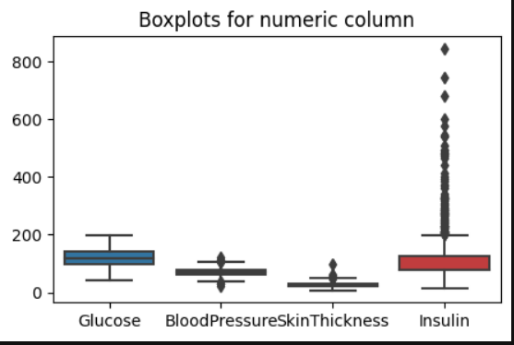
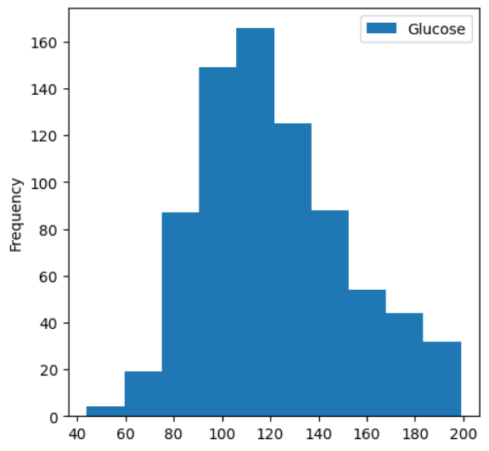
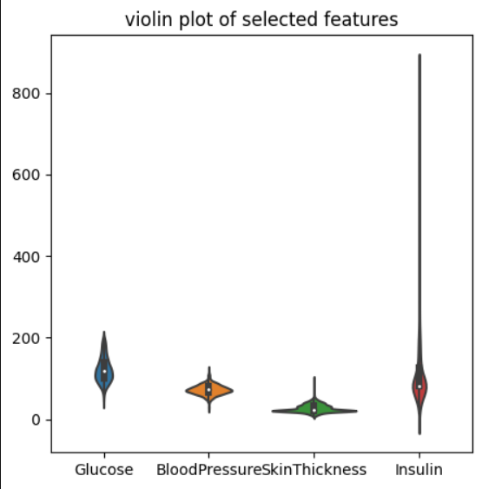
Modelling & Results
1. Glucose: Median > 200, indicating variability (large IQR), and no outliers.
2. Blood Pressure: Median:72 mmHg (normal range). Smaller IQR, few outliers, none extremely high or low.
3. Insulin: Median: 79 mlU/L. Large IQR, considerable variability, numerous outliers, many extremely high.
4. Overall: Wide range, some outliers. Insulin has many outliers. Median values, except for insulin, within normal range.
The normal range for blood glucose levels is considered to be between 70 and 110 mg/dL. The data in the image appears to be mostly above this range, suggesting that the people represented in the data may have diabetes.
It is normally distributed, with a peak in the middle of the range and with the tails tapering off on either side.
The violin plot shows the distribution of four numerical features:'Glucose', 'BloodPressure', 'SkinThickness', 'Insulin’.
The violin shape represents the probability density function (PDF) of each feature and the boxplot embedded within each violin plot shows the median,IQR and outliers.

Slide 11
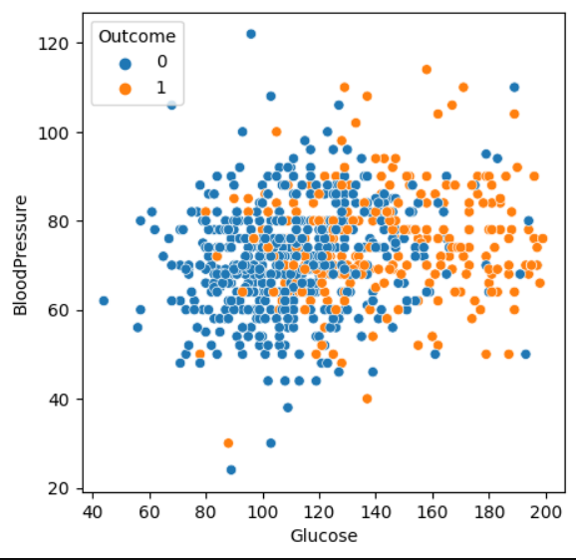
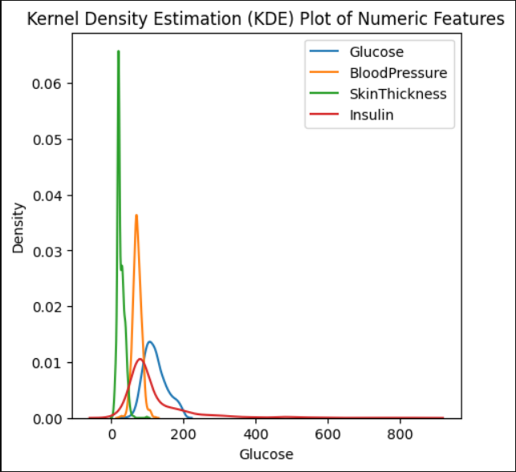
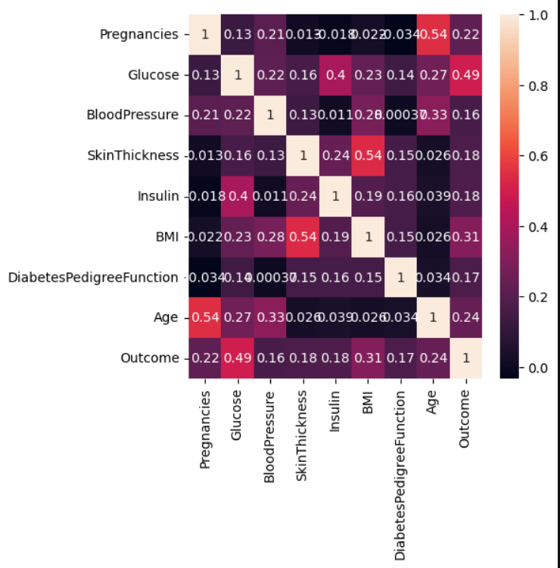
Modelling & Results
The image shows a kernel Density Estimation(KDE) PLOT of four numerical features:'Glucose', 'BloodPressure', 'SkinThickness', 'Insulin'.KDE is a NON-PARAMETRIC METHOD for esitmating the probability density function of a random variable the kde plot shows the estimated pdf of each feature which can be used to visualize the distribution of the data.
The scatter plot of Glucose against Blood Pressure
If the glucose level increases above 80 then there are high chances of having diabetes.
We can see BloodPressure feature has lowest relation with output column.
So we will remove BloodPressure for training a good model with high accuracy

Slide 12
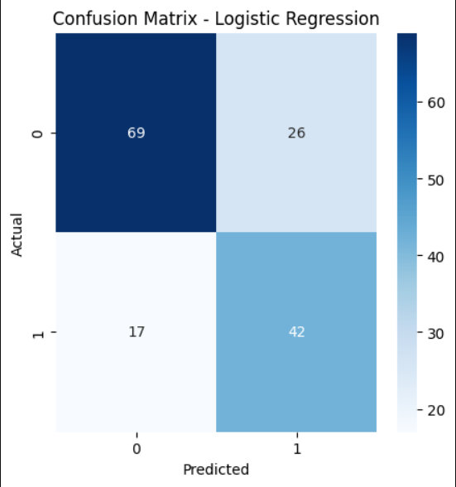
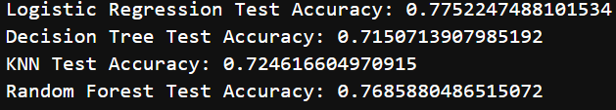
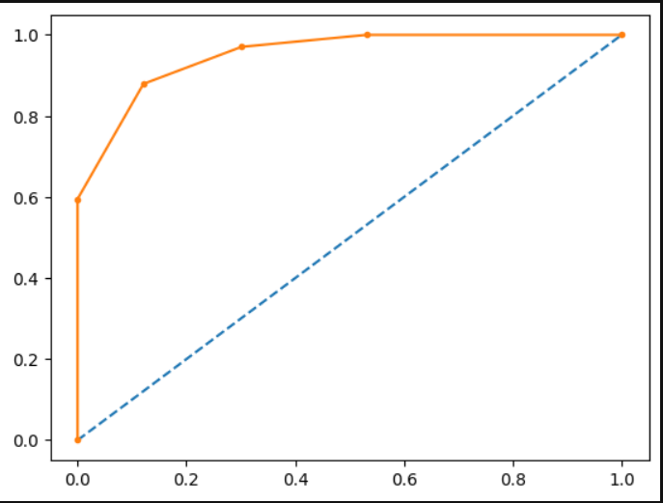
Modelling & Results
True Positives (TP): 42 instances correctly predicted as positive (diabetic).
False Positives (FP): 26 instances incorrectly predicted as positive (false alarms).
True Negatives (TN): 69 instances correctly predicted as negative (non-diabetic).
False Negatives (FN): 17 instances incorrectly predicted as negative (missed cases of diabetes).
Logistic Regression attains the highest test accuracy at 77.5%.
Decision Tree shows a test accuracy of 71.5%.
KNN and Random Forest perform with test accuracies of 72.5% and 76.9%, respectively.
Test accuracy ranges from 71.5% to 77.5% across the models.
Overall, Logistic Regression outperforms other models in terms of accuracy on the given test dataset.
The AUC score for KNN is 0.951, indicating excellent discriminative power.
AUC values range from 0 to 1, with higher scores indicating superior model performance.
KNN's AUC of 0.951 suggests strong ranking ability, vital for effective binary classification.
This high AUC underscores KNN's reliability in distinguishing between diabetic and non-diabetic cases, reflecting its robust predictive capabilities.

Slide 13
Conclusion
The healthcare project successfully navigates the complexities of diabetes management through a robust application of machine learning and data-driven strategies. The meticulous data preprocessing, including handling missing values and outliers, establishes a solid foundation for subsequent analyses. The exploratory data analysis offers valuable insights into the distribution of key variables, facilitating informed decision-making.
Feature engineering and selection contribute to model efficiency, and the adoption of machine learning algorithms, such as Decision Trees, k-Nearest Neighbors, and Logistic Regression, showcases a versatile approach to predictive analytics. The project's commitment to addressing class imbalance with the integration of SMOTE ensures a more accurate and representative training process.
Overall, the project aligns with its objectives of proactive intervention and personalized treatment plans for diabetic patients. By leveraging predictive models, healthcare practitioners can make data-driven decisions, leading to improved patient outcomes. The project not only highlights the potential of machine learning in healthcare but also underscores its pivotal role in shaping a more effective and personalized approach to diabetes care.

Slide 14
Thank You!
Notes:
Thank You !!

