Slide 1



Capstone Project on Employee Data Retrieval
Submitted By | :
Name | : | Tushar Bawankar
Submission Type | : | Individual
Batch | : | HDFC Bank-01
LMS Id | : | tusharb1406@gmail.com
Program | : | HDFC API Developer Program
Date | : | 28/04/2023
Guided by | : | Javeed Sir

Slide 2


Table of Contents
Introduction
Project Overview
Architecture Design
Back-end Development
Testing
Deployment
Conclusion
Future Work
References

Slide 3
Introduction
Problem Statement: Many companies have sensitive employee data that needs to be accessed securely. Traditional methods of storing and accessing sensitive employee data can be cumbersome and time-consuming.
Research Question: How can we create a more efficient and secure way to store and access employee data?
Objectives:
Design and implement a secure database solution for storing employee data.
Develop a secure web service for accessing employee data.
Create a client program for seamless interaction with the web service.
Importance and Relevance: Our project helps companies better manage information and protect employee privacy.
Importance of CI/CD and DevOps: Implementing these practices saves time, reduces errors, and ensures high-quality, scalable software.
Our project aims to create a secure, efficient, and scalable solution for managing sensitive employee data.

Slide 4
Project Overview
The Spring Boot framework provides the foundation for the web service, allowing for easy development and integration with other Spring frameworks.
The web service API receives requests from clients, which are secured using AES-256 encryption algorithm.
The service layer interacts with the database to retrieve employee data and returns it in JSON format to the client.
A logging feature records the date-timestamp for every service call, and log files are rotated based on size and time.
JUnit is used for testing the service layer, ensuring that it functions as expected and catching any potential issues early on.

Slide 5
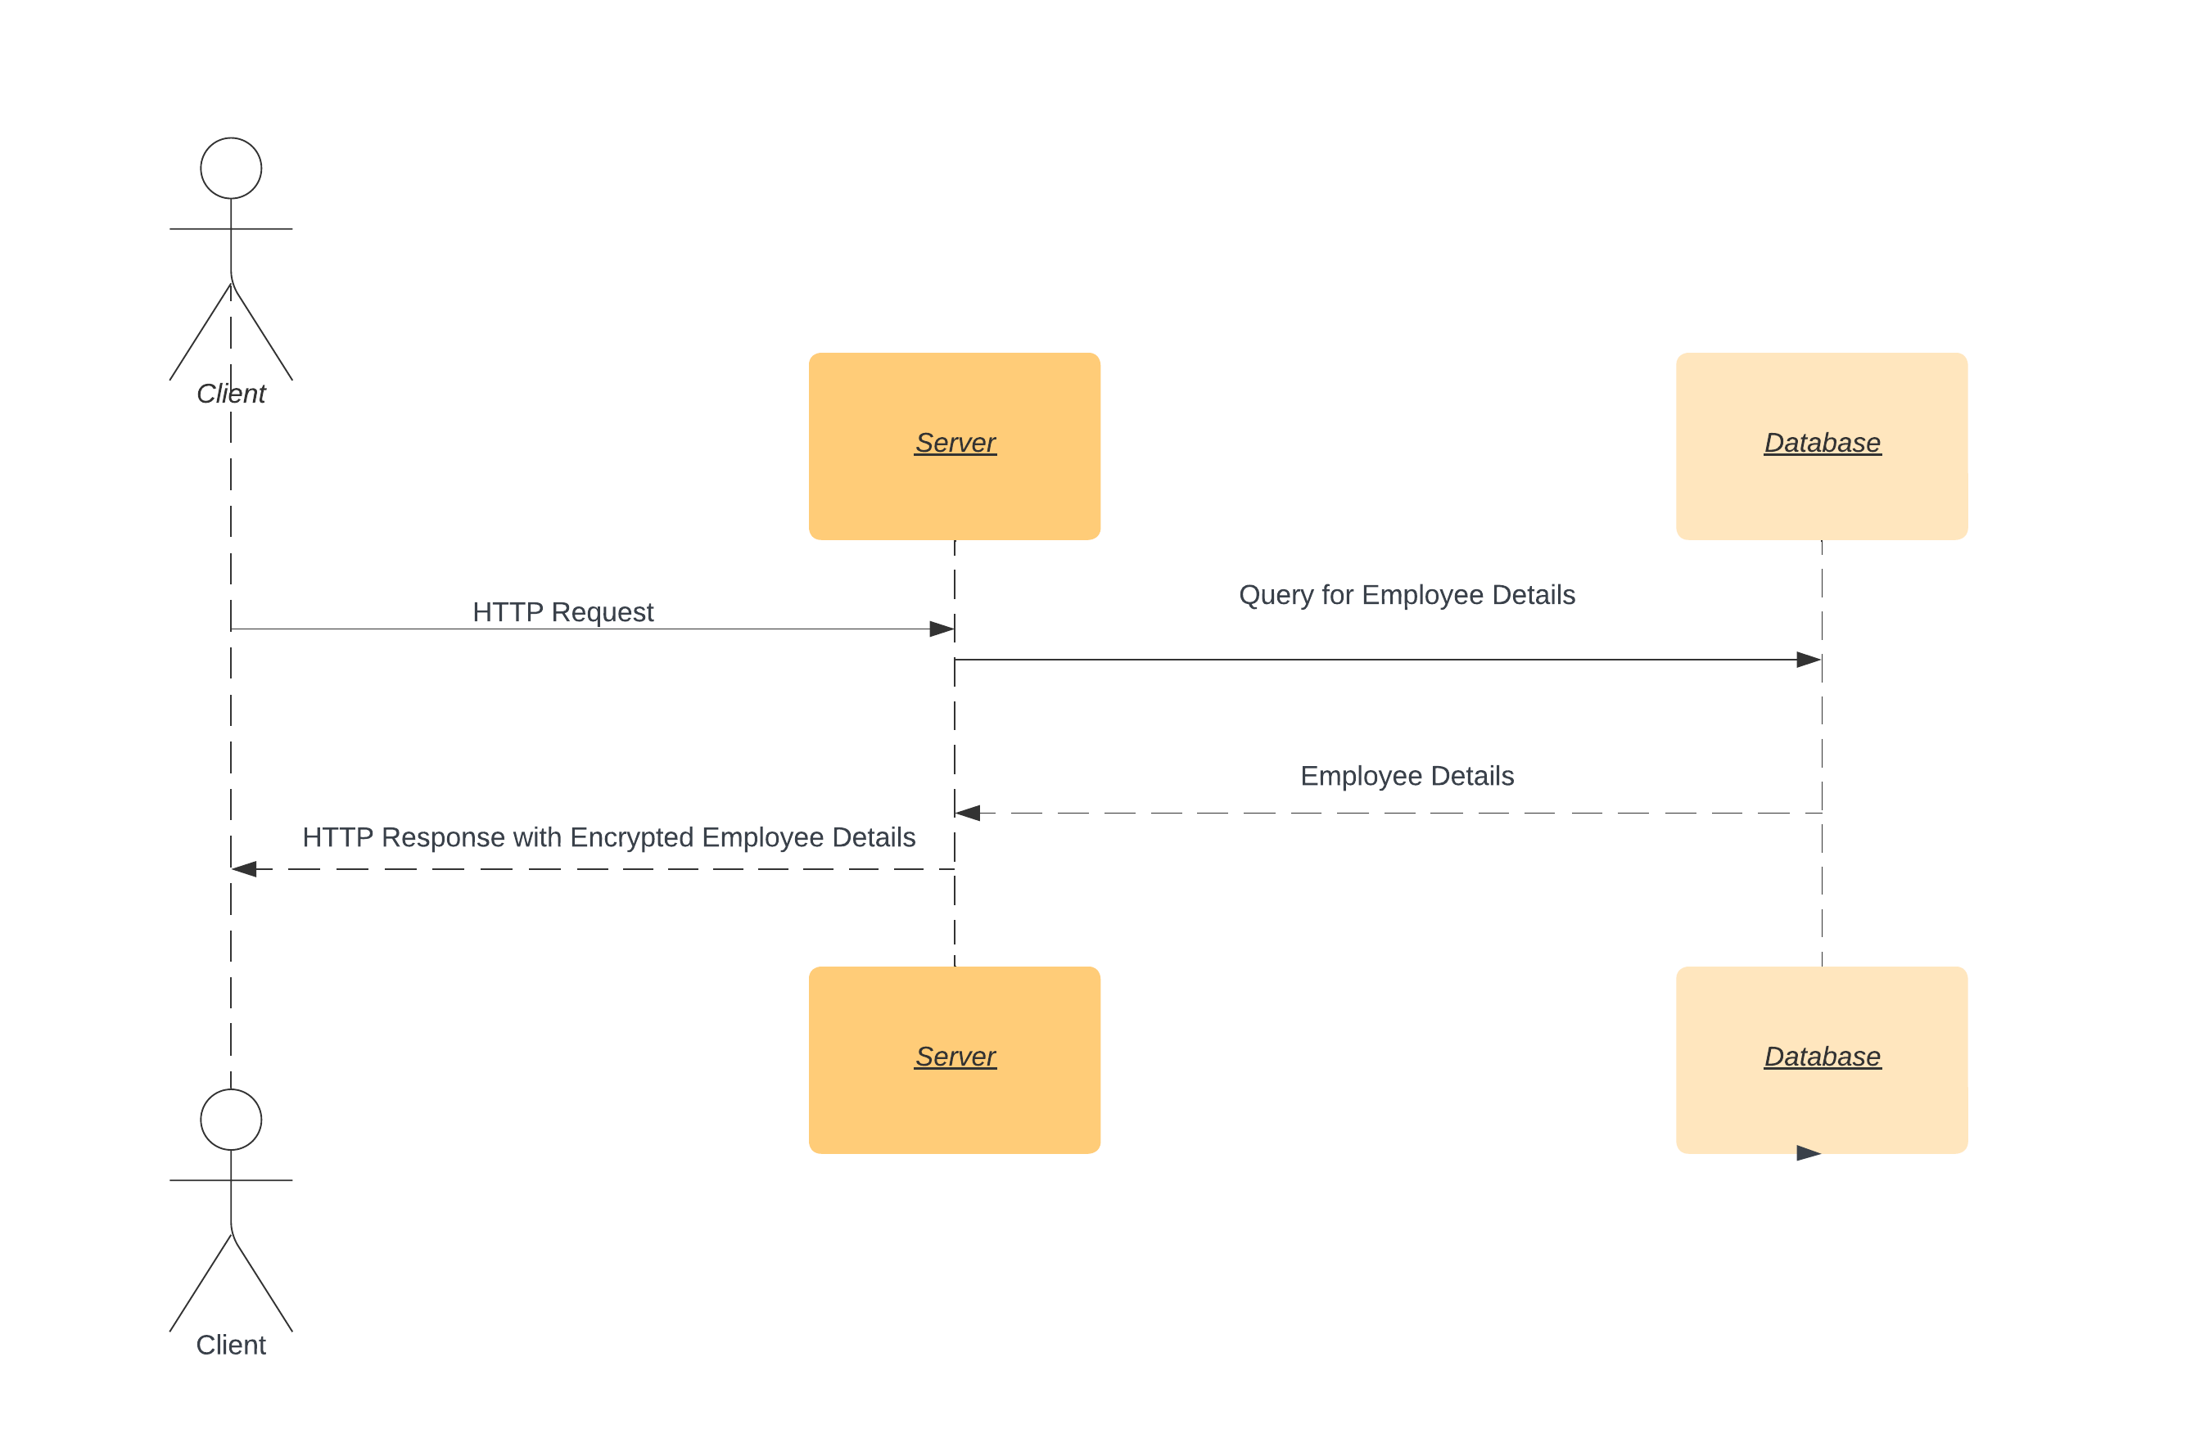
Architecture Design
Sequence Diagram

Slide 6
Back-end Development
Technologies used for backend development:
Spring Framework: A Java framework for building enterprise applications, including web apps and RESTful services.
MySQL: An open-source relational database management system.
AES-256: A widely-used encryption algorithm for securing data at rest.
RestController: A class in Spring for handling HTTP requests and returning JSON data.
HTTPS: A protocol for secure communication over the internet using SSL/TLS certificates.
Components Involved:
Database
Web Service
Client Web Service

Slide 7
Integration and Testing
Integration:
Jenkins is a popular tool used for continuous integration and deployment of web applications.
It can be used to automate the build, test, and deployment processes of web applications.
Jenkins integrates with Git Hub to retrieve code changes and automatically trigger builds.
Testing:
Postman is a powerful tool used for testing web APIs.
It provides an intuitive interface for creating and executing API requests and evaluating their responses.
CURL is a command-line tool used for sending HTTP requests and retrieving responses.

Slide 8
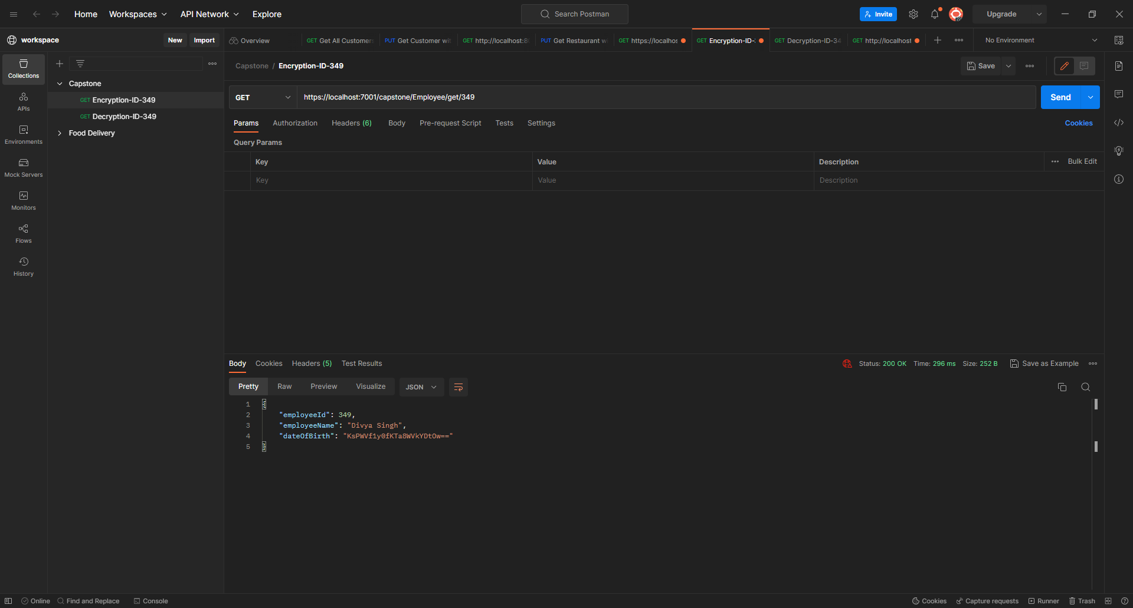
Integration and Testing
Postman:

Slide 9

Integration and Testing
Postman:

Slide 10
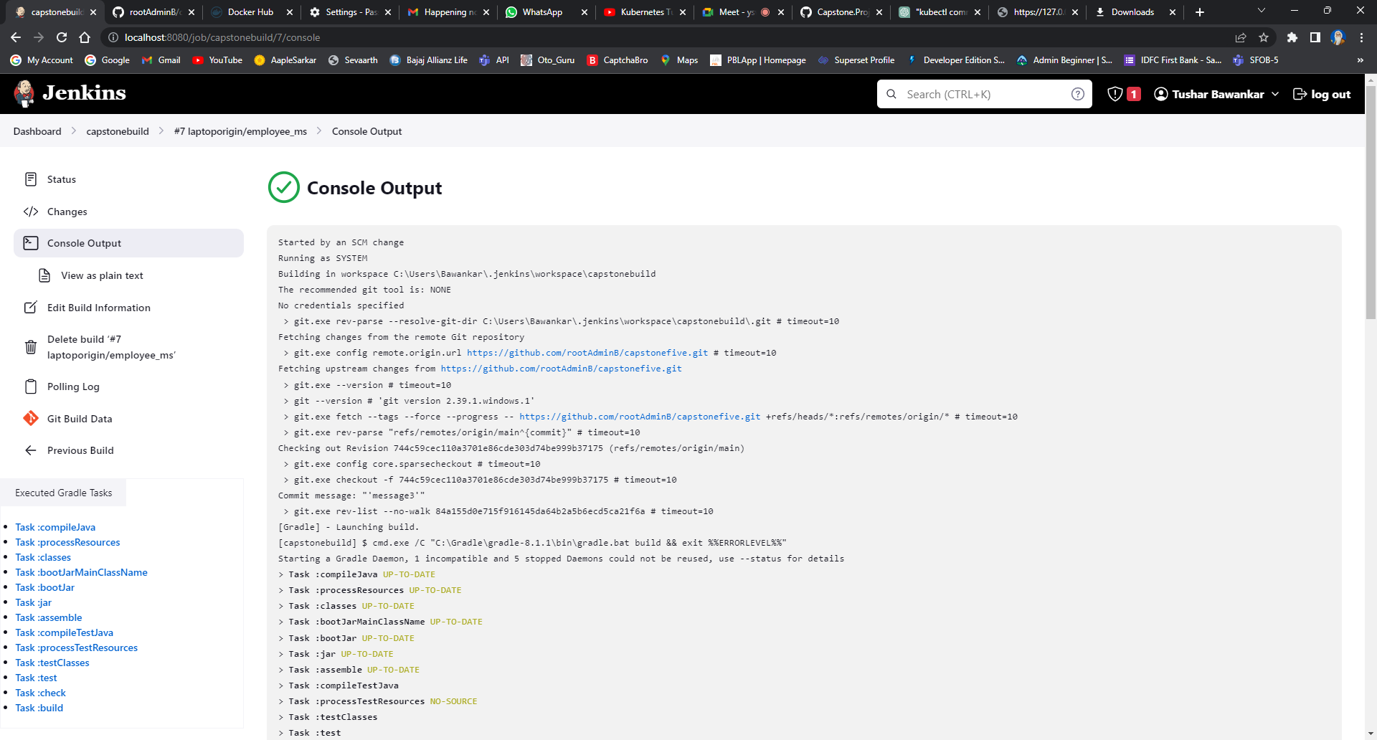
Integration and Testing
Jenkins:

Slide 11
Deployment
Containerizing a Spring Boot web service makes it easy to deploy and scale.
Kubernetes automates the deployment, scaling, and management of containerized applications.
Deploying a containerized Spring Boot web service on Kubernetes involves creating a deployment object and a service object.
Kubernetes provides advanced features for scaling, load balancing, and updates.
This deployment approach simplifies application management and reduces costs.

Slide 12
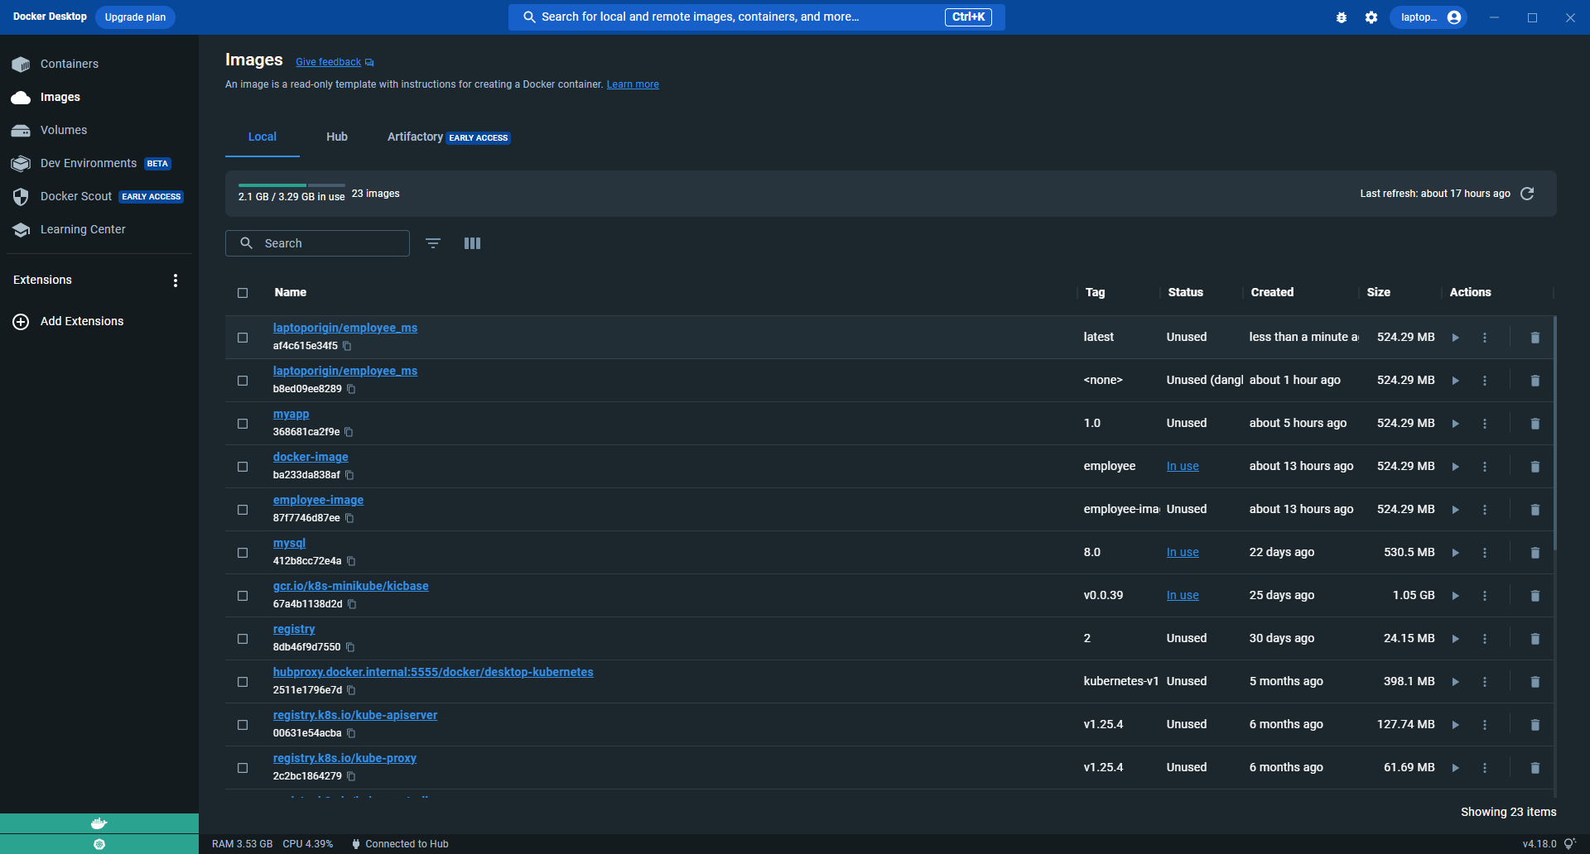
Deployment
Docker Desktop:

Slide 13
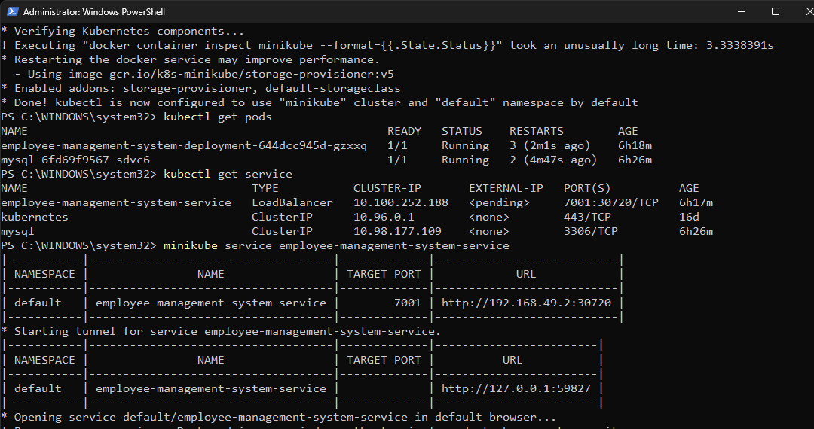
Deployment
Kubernetes:

Slide 14
Conclusion
Capstone project successfully developed and deployed a secure and scalable RESTful web service. We created a database table for Employee with EmployeeID, Employee Name, and DateOfBirth columns, developed a Java program for querying a single record based on EmployeeID, and utilized Spring boot and Jenkins for continuous integration and deployment. Our containerized web service was deployed on Kubernetes and we ensured security using HTTPS with a self-signed certificate and encryption with AES-256. Through our project, we gained valuable experience in developing and deploying secure and scalable web services.

Slide 15
Future Work
Implement additional functionality to the web service such as the ability to query multiple records and update employee information
Incorporate machine learning algorithms to automate tasks such as employee onboarding and performance evaluation
Explore integrating the web service with other applications and systems to improve efficiency and streamline processes
Focus on enhancing the security features of the web service by implementing advanced encryption methods and utilizing secure communication protocols
Future work presents exciting opportunities to further develop and expand the web service capabilities.

Slide 16
References
Spring Boot: Official documentation - https://spring.io/projects/spring-boot
Rest Template: Official documentation - https://docs.spring.io/spring-framework/docs/current/javadoc-api/org/springframework/web/client/RestTemplate.html
Jenkins integration with Docker: Docker plugin for Jenkins - https://plugins.jenkins.io/docker-plugin/
Jenkins integration with Kubernetes: Kubernetes plugin for Jenkins - https://plugins.jenkins.io/kubernetes/
Docker: Official documentation - https://docs.docker.com/
Kubernetes: Official documentation - https://kubernetes.io/docs/home/

