Slide 1
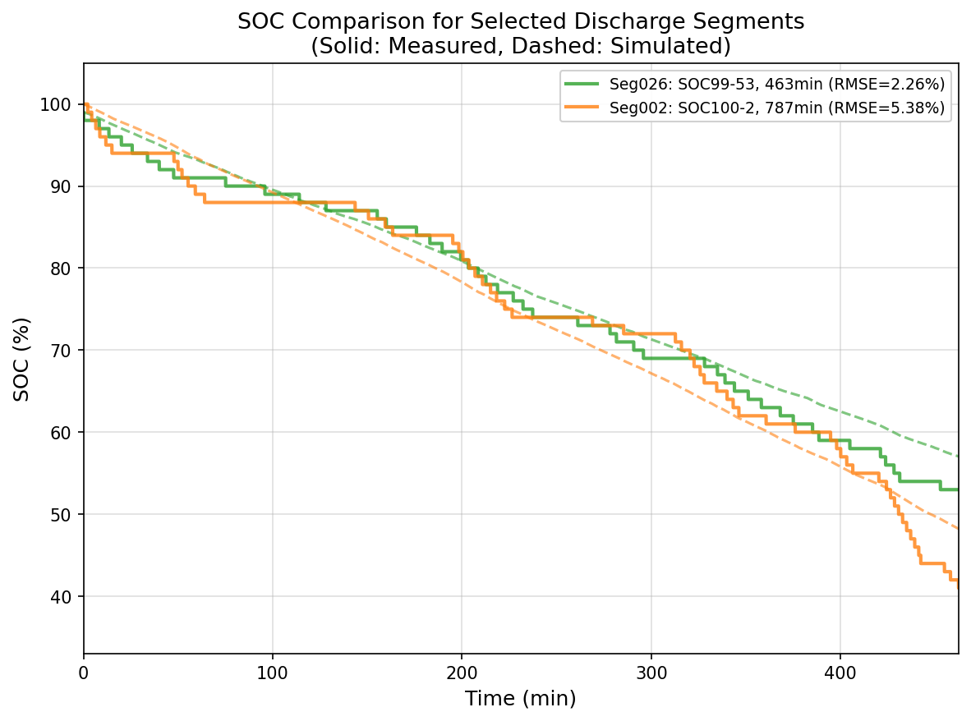

$$T=31.2$$
Group 26
Real Data
Group 2
Prediction
Group | Avg Brightness | CPU Usage (%) | Avg Freq (MHz) | WiFi On (%) | WiFi Intensity (dBm) | GPS Status
2 | 30 | 67 | 1683 | 100 | -48.8 | 3
26 | 12 | 41.9 | 1364 | 100 | -55.5 | 3

