Slide 1



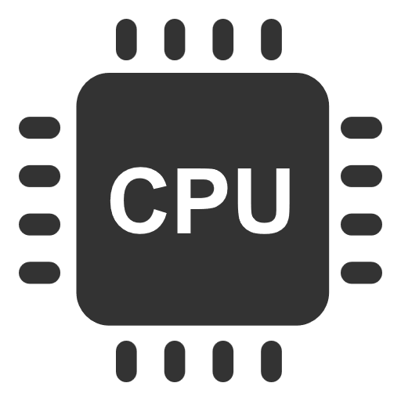



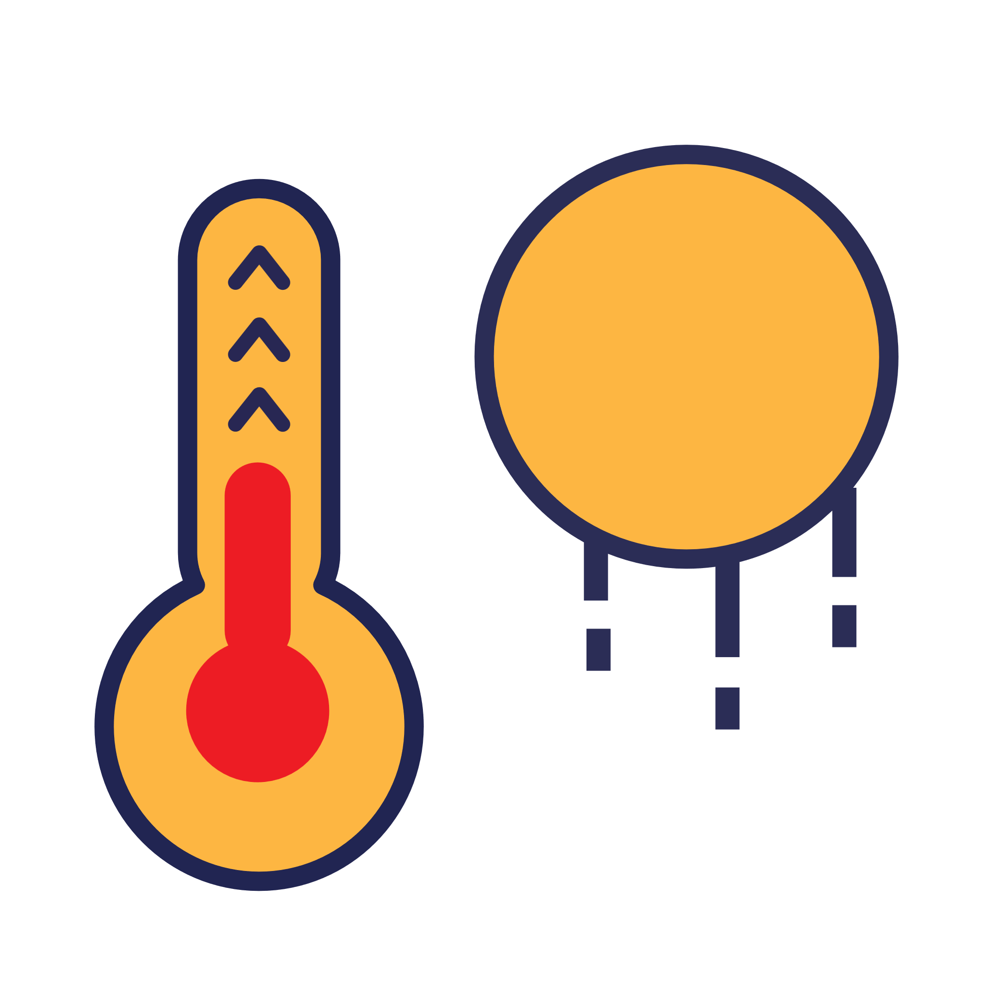

low CPU utilization
OS
heat dissipation
increase CPU utilization

