Slide 1
THE IMPACT OF THE CORONAVIRUS PANDEMIC ON 5 DEVELOPMENT COUNTRIES’S ECONOMY

Slide 2

The spread of the Coronavirus Pandemic all over the world has adversely affected the production, working population and economy in the countries.

Slide 3
Analysis of Graphs
If we look at the pre-pandemic period, the GDP gap of countries is small. The low rate shows that the countries provide sufficient employment to the population who want to work and that the production is functioning.

Slide 4
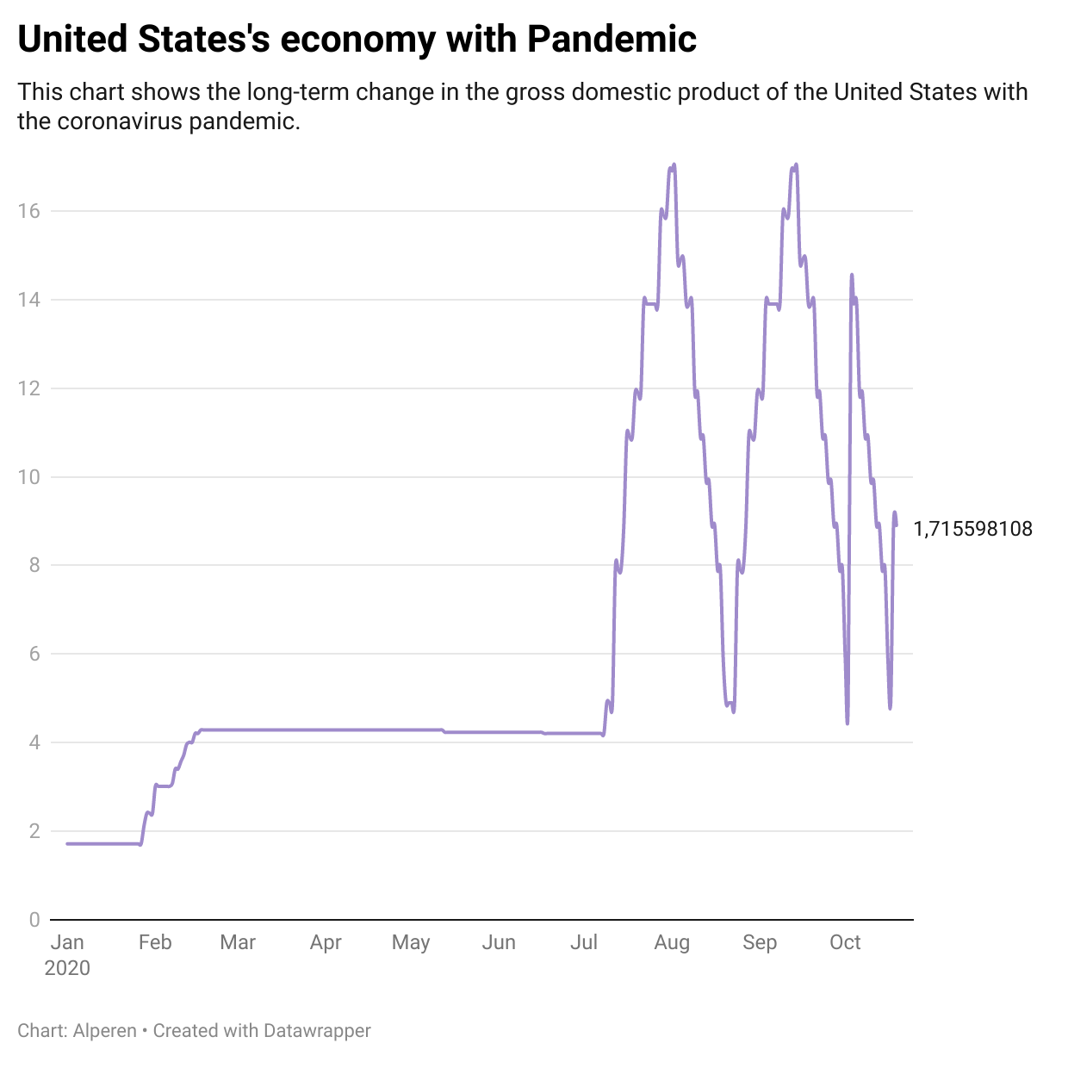
United States
When we look at the graph of the United States, we see serious increases in summer due to production and other factors after July.

Slide 5
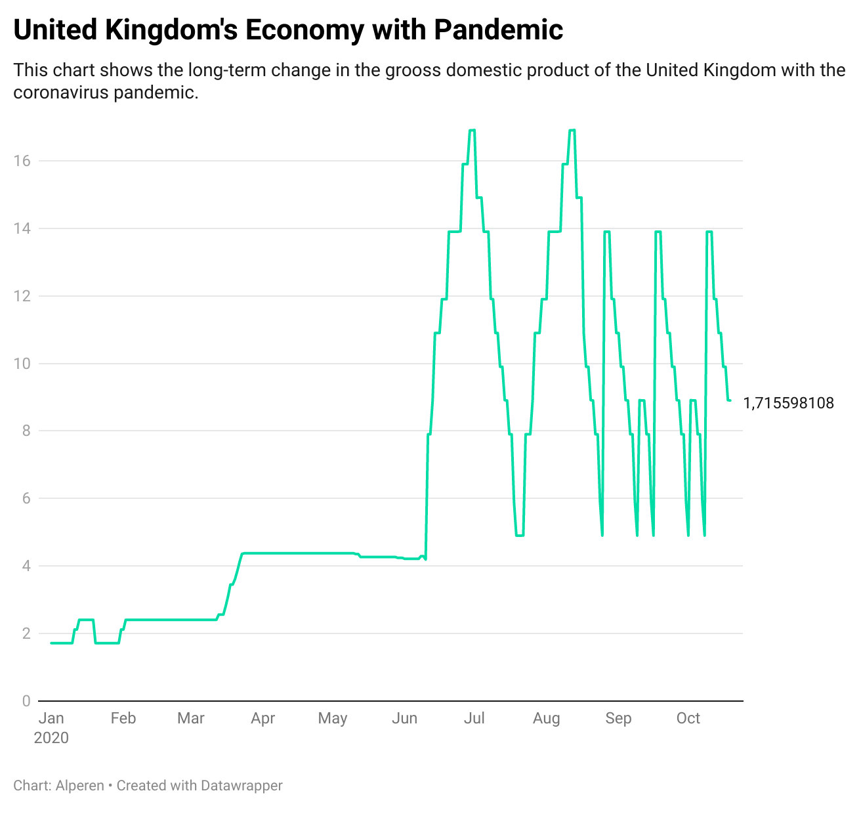
United Kingdom
When we look at the chart of united kingdom's, the gross domestic product deficit has increased and decreased thanks to the serious increases and changes in the frequency of production after June

Slide 6
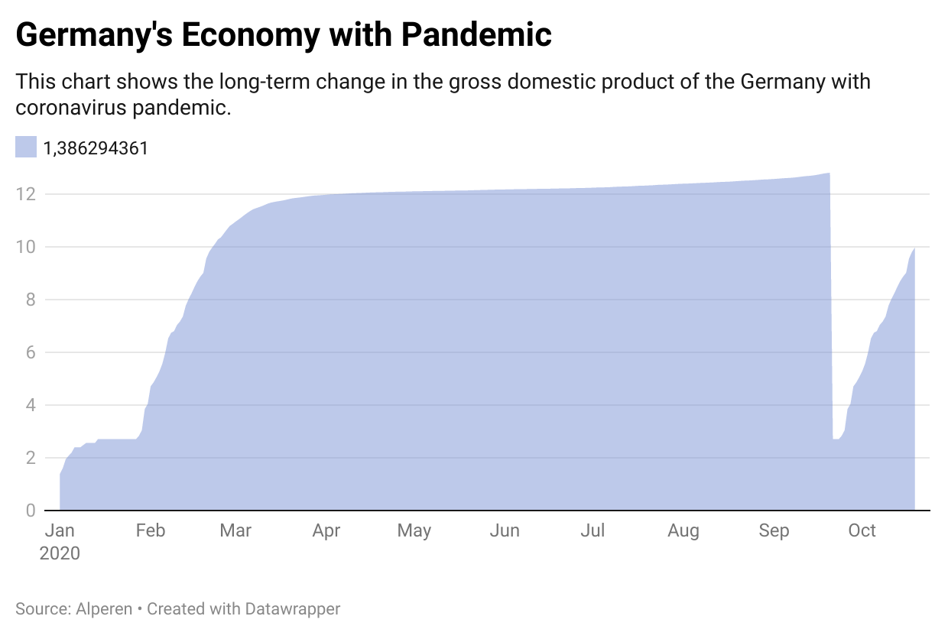
Germany
The German government has taken serious measures due to the increase in the number of cases. These measures had a direct negative impact on production. These effects caused the gross domestic product deficit to remain high for a period of time.

Slide 7
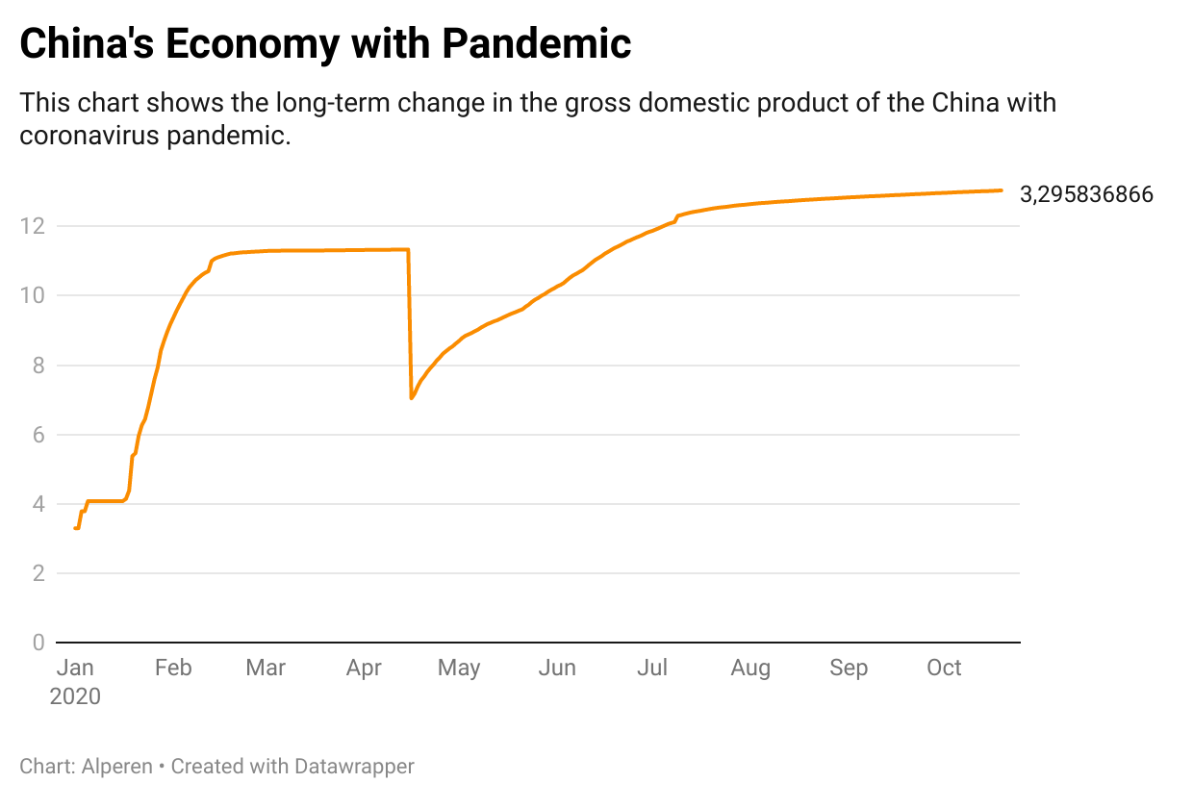
China
Since the coronavirus epidemic first started in China, the Chinese government's effective measures and the rotation of production ensured that the gross domestic product remained at similar levels.

Slide 8
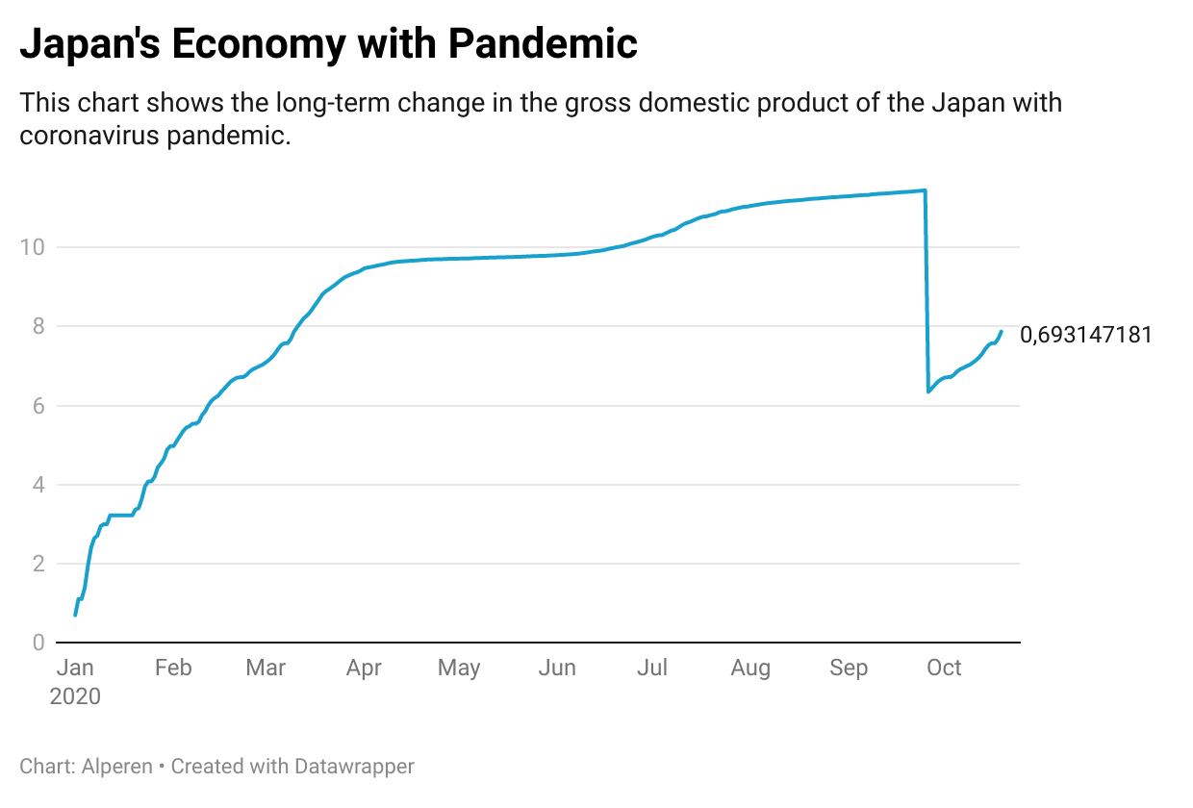
Japan
The gross domestic product deficit remained at an average level due to Japan being the technology giant of the world and the continuous decrease in production throughout the year.

