Slide 1
Work Report Reproducibility report of PENCIL
Yingying Cao, Tiangen Chang
Jul 10, 2023
Notes:
Hi everyone, today I will present our recent work on predict pan-cancer ICB response using machine learning.

Slide 2
Pipeline
Step 0: Raw data preprocessing, QC, normalization, cell annotation (use original annotation if provided with paper, e.g. GSE120575 CD8T)
Step 1: Add phenotype info. to Seurat object
Step 2: Subset to cell types of interest (e.g., CD4T, CD8T, B cells), and save to .h5ad
Step 3: Run PENCIL
Step 4: Downstream analysis of phenotype-related cells

Slide 3
Results
1. Ratio between phenotype-related cells (yes/no) may be used to predict phenotype of a patient (e.g. ICB response)
2. Marker gene analysis of phenotype-related cells
3. functional (GO/pathway) analysis of genes/cells
4. Simple

Slide 4
Idea
Predicting phenotype using phenotype-related cells
1. Regarding GSE120575, there are 44 samples. Using 30 to train the model, 14 to evaluate the predictive power. Stratifying R/NR during train/test splitting.
2. Use a simple method as a comparison: calculate R/NR ratio in each cluster to identify “phenotype related cluster”
saf

Slide 5
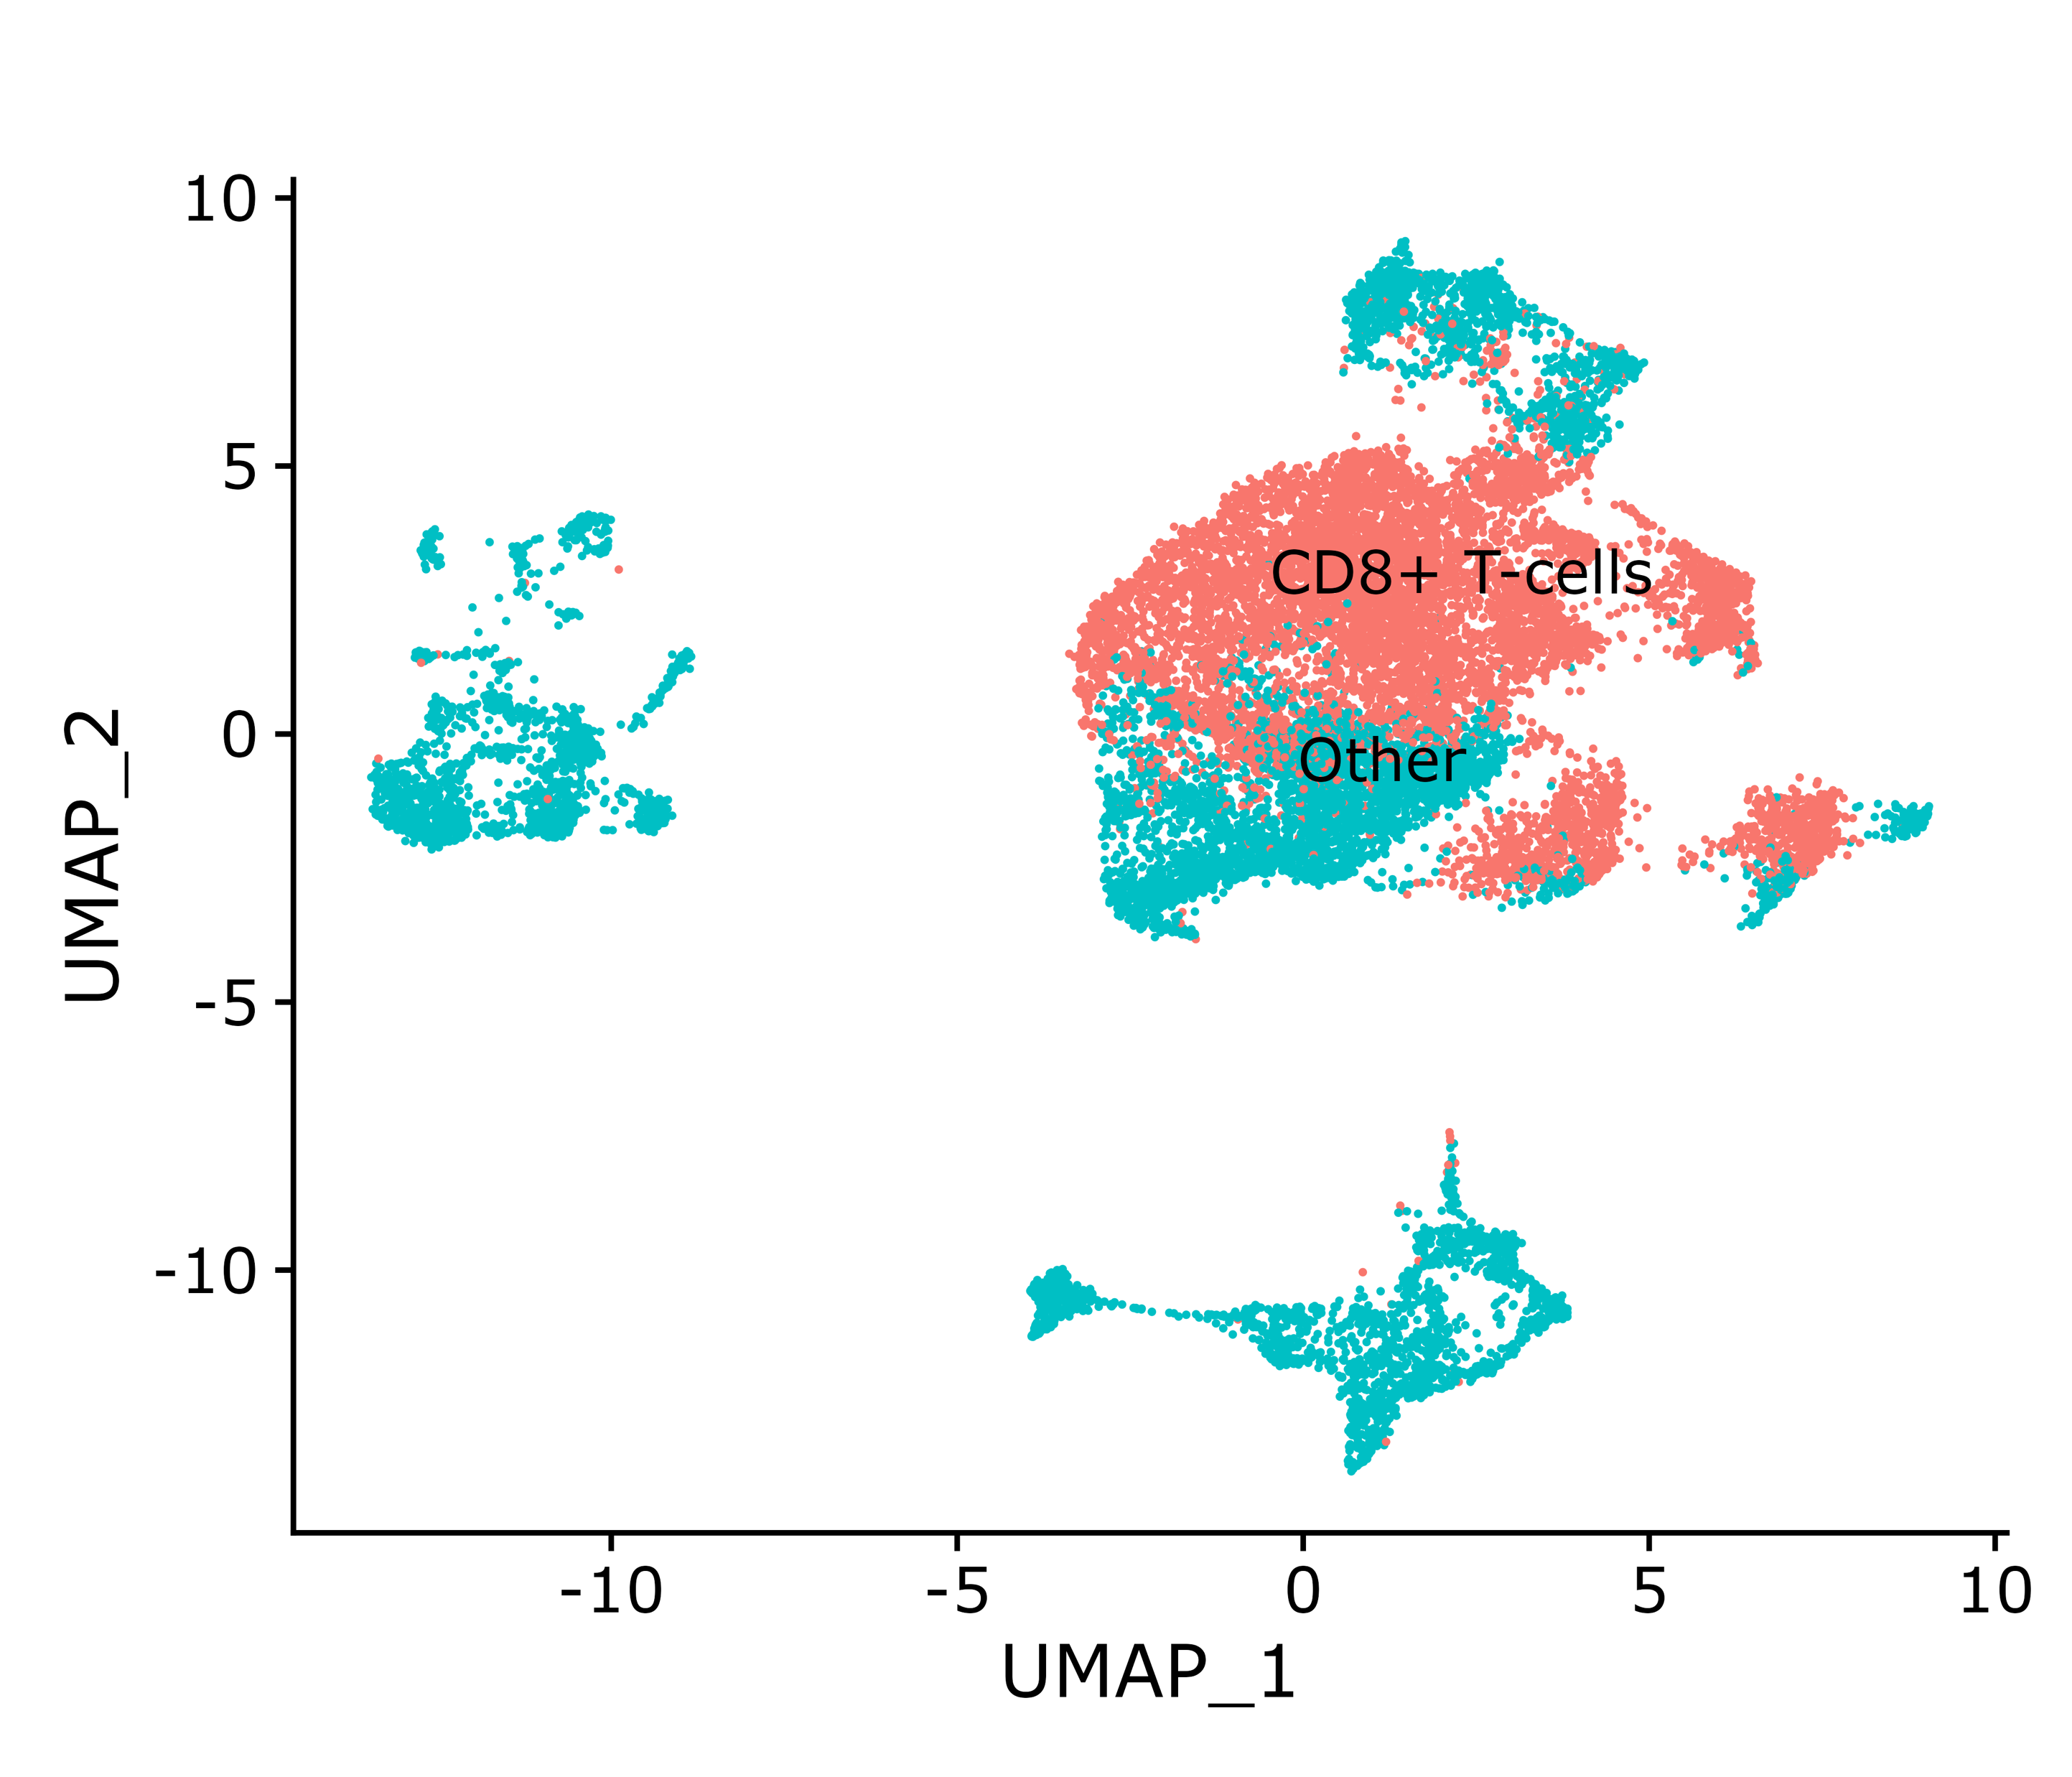
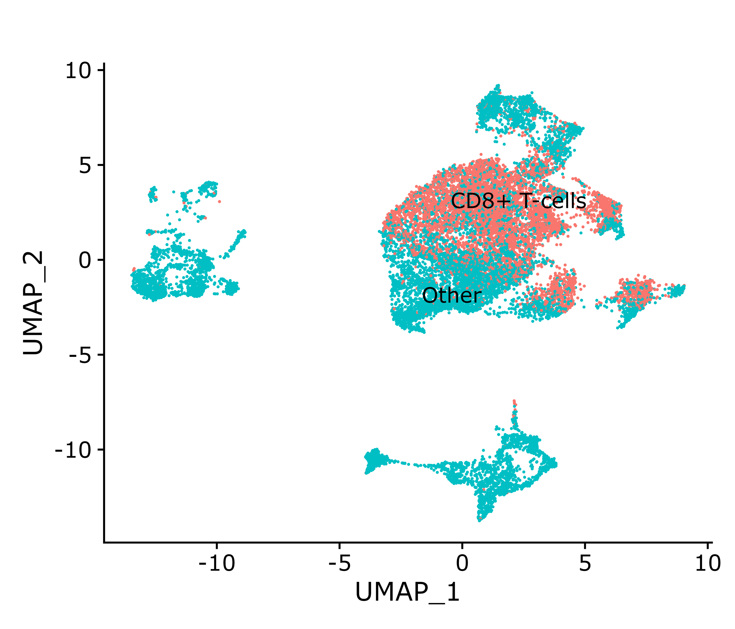
GSE120575: extracting CD8T cells
New pipeline (8056 CD8T cells)
Original paper (6350 CD8T cells)

Slide 6
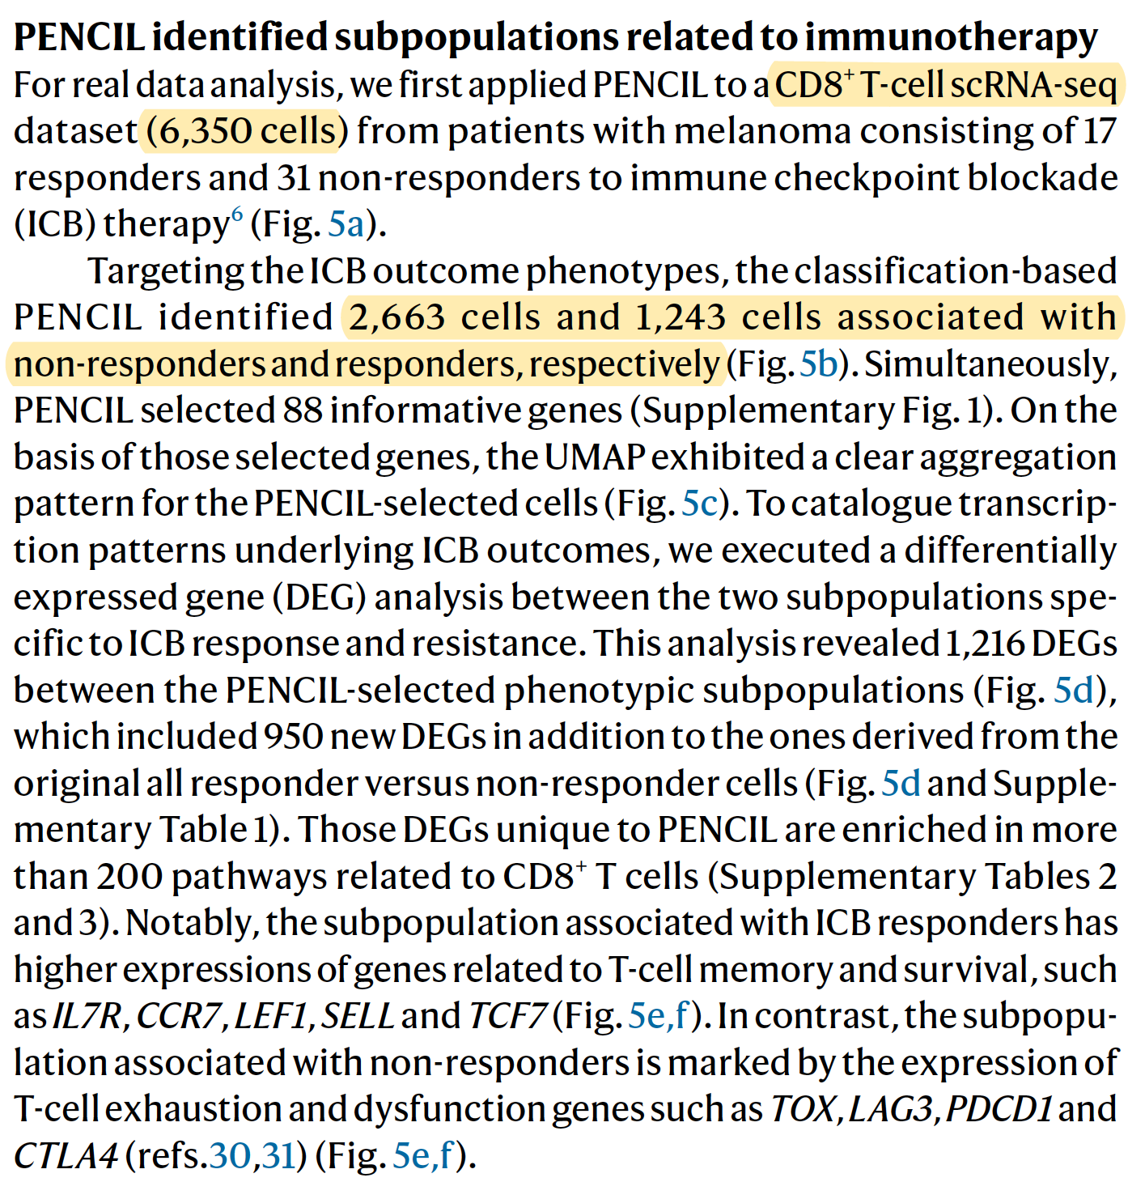
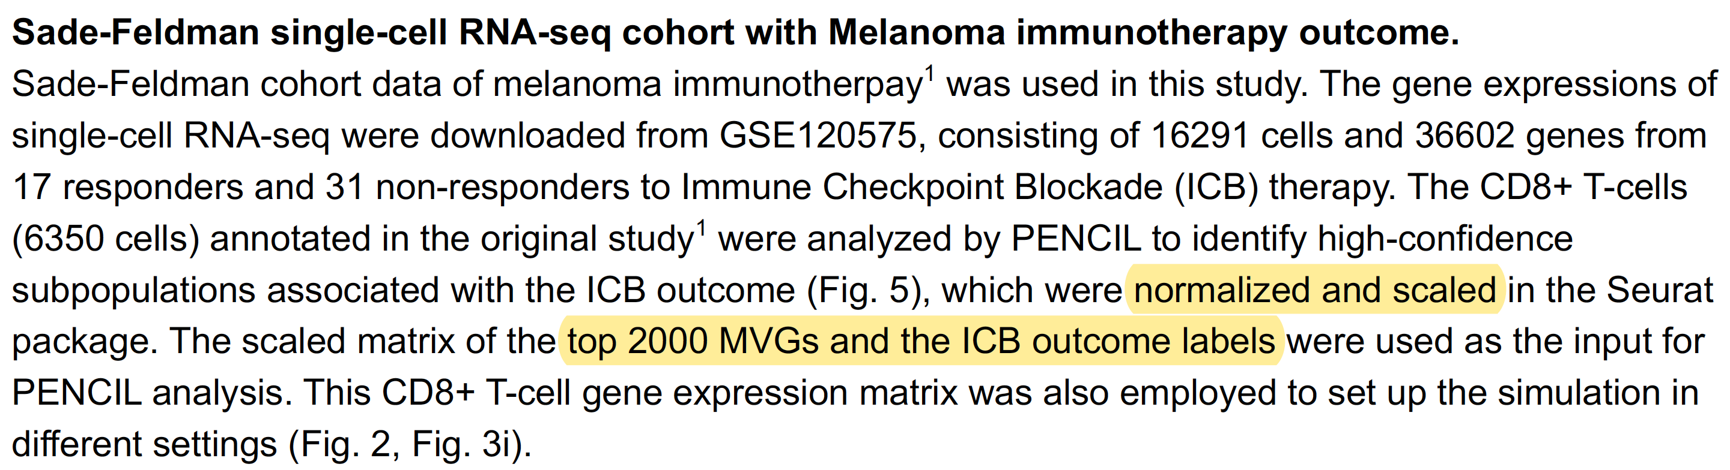
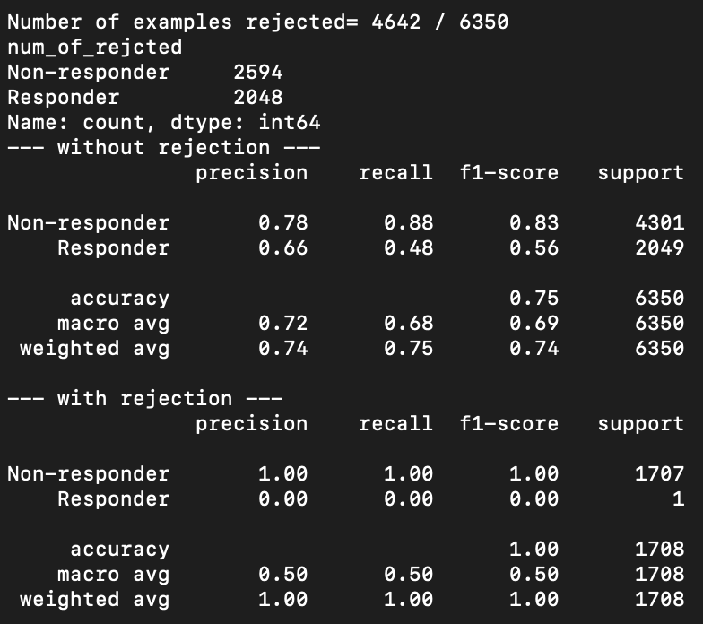
GSE120575: CANNOT reproduce PENCIL result with default parameters

