Slide 1
Work Report Reproducibility report of PENCIL
Yingying Cao, Tiangen Chang, Sahil Sahni
Jul 10, 2023
Notes:
Hi everyone, today I will present our recent work on predict pan-cancer ICB response using machine learning.

Slide 2
To do list
Get response from the PENCIL authors about the reproducibility on the melanoma data GSE120575
Get at least one scRNAseq dataset with ICB response information for HNSCC or TNBC or melanoma
Functional analysis of phenotype-related cells identified by PENCIL to get biological insights from the results

Slide 3
Pipeline
Step 0: Raw data preprocessing, QC, normalization, cell annotation (use original annotation if provided with paper, e.g. GSE120575 CD8T)
Step 1: Add phenotype info. to Seurat object
Step 2: Subset to cell types of interest (e.g., CD4T, CD8T, B cells), and save to .h5ad
Step 3: Run PENCIL
Step 4: Downstream analysis of phenotype-related cells

Slide 4
Planned results for the manuscript
1. Ratio between phenotype-related cells (yes/no) may be used to predict phenotype of a patient (e.g. ICB response)
2. Marker gene analysis of phenotype-related cells
3. functional (GO/pathway) analysis of genes/cells
4. Optional: Compare with intuitive methods such as counting the cells from R/NR in each cluster and identify phenotype-related clusters and the marker genes

Slide 5
Idea
Predicting phenotype using phenotype-related cells
1. Regarding GSE120575, there are 44 samples. Using 30 to train the model, 14 to evaluate the predictive power. Stratifying R/NR during train/test splitting.
2.
s

Slide 6
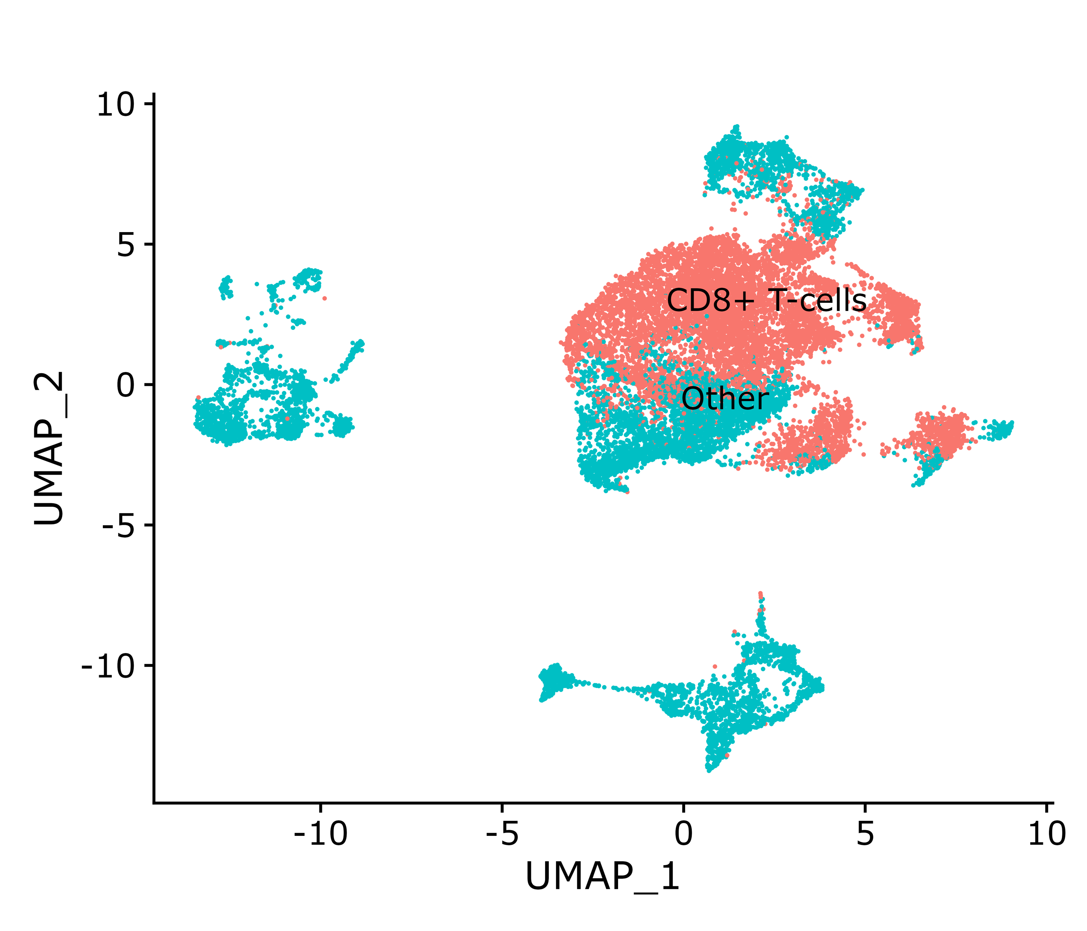
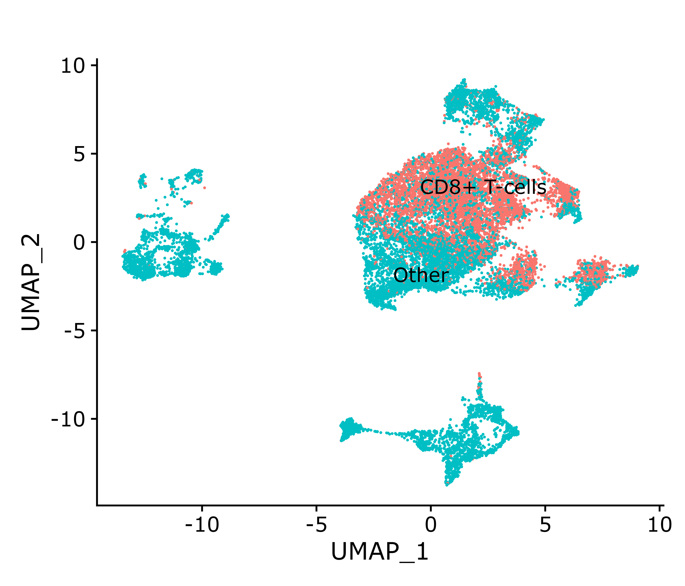
GSE120575: extracting CD8T cells
New pipeline (8056 CD8T cells)
Original paper (6350 CD8T cells)

Slide 7
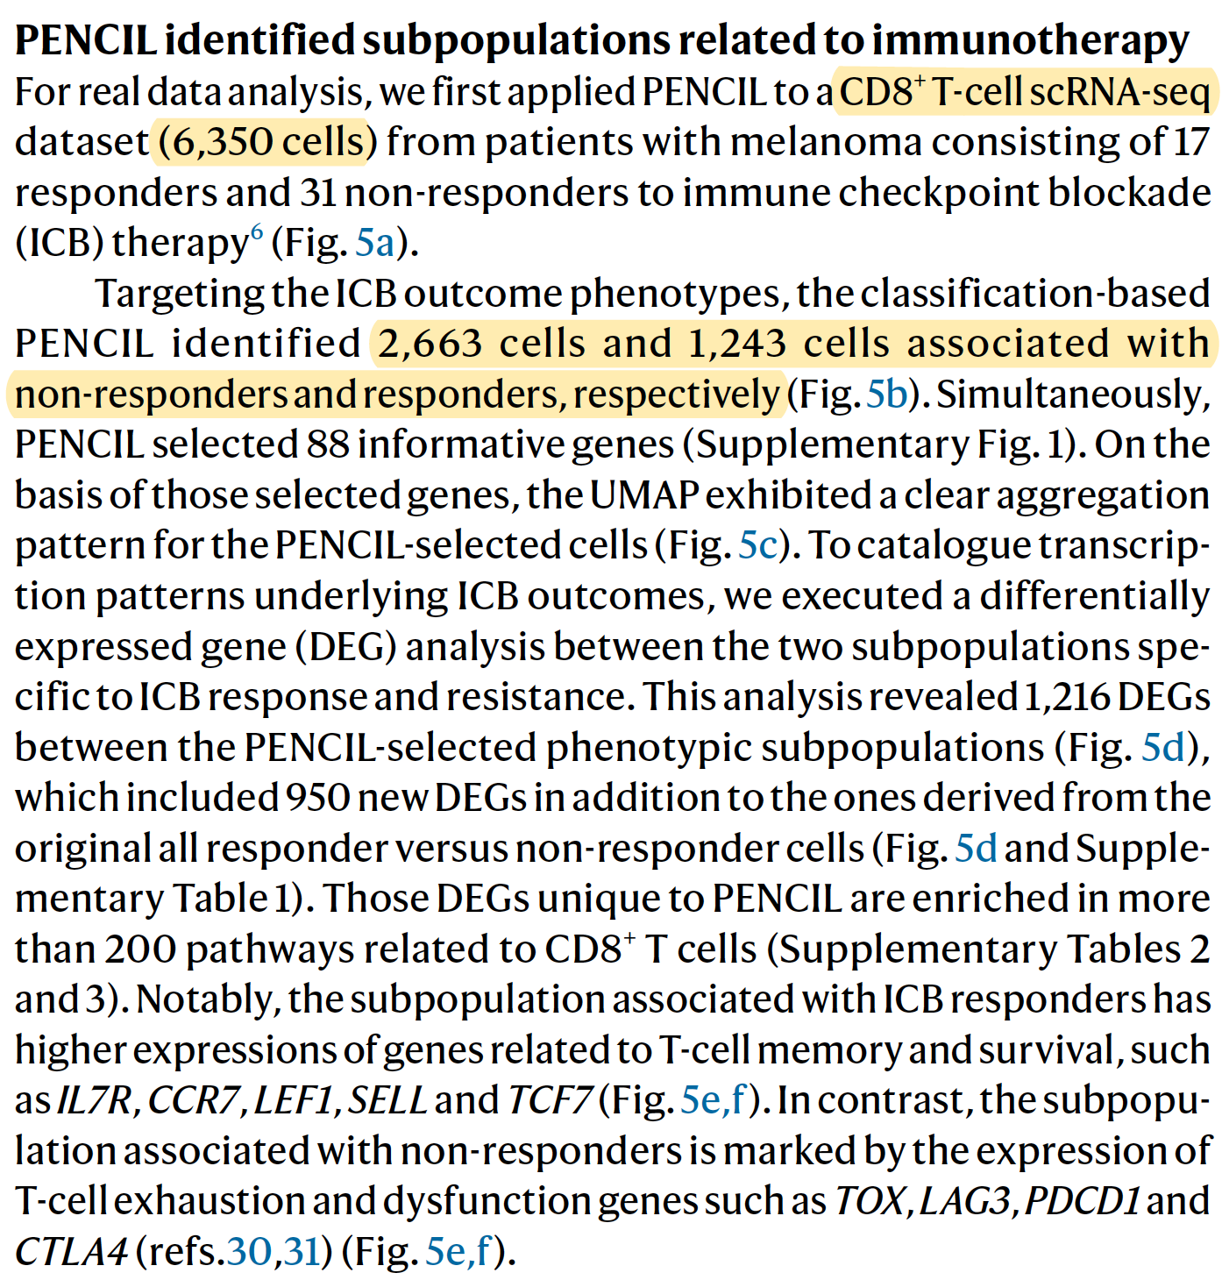
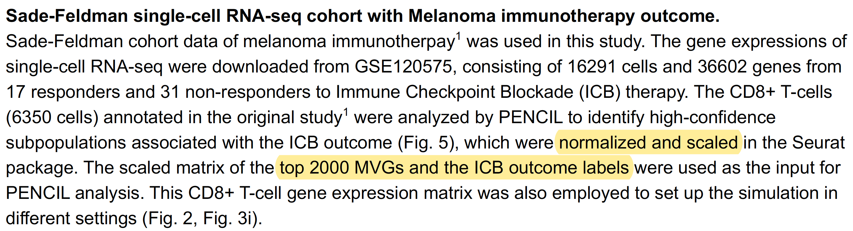
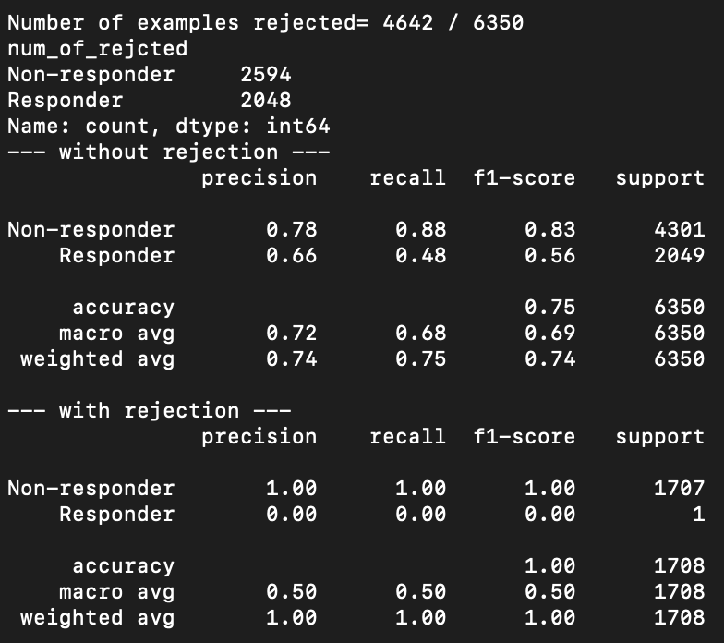
ISSUE: CANNOT reproduce PENCIL result with default parameters GSE120575

Slide 9
Logic and result of GSE200996 analysis
Predicting phenotype using phenotype-related cells
Logic
1. Using tissue CD8T, CD4T, B cells respectively
2. Using PBMC CD8T, CD4T, B cells respectively
Result
Tissue immune cells better correlate with ICB response (measured by >10% tumor reduction), where B cells have the best correlation. PBMC CD4T and B cells barely have correlation with ICB response. Interestingly, PBMC CD8T cells still have strong correlation with ICB response. See more details on the next slide.

Slide 10
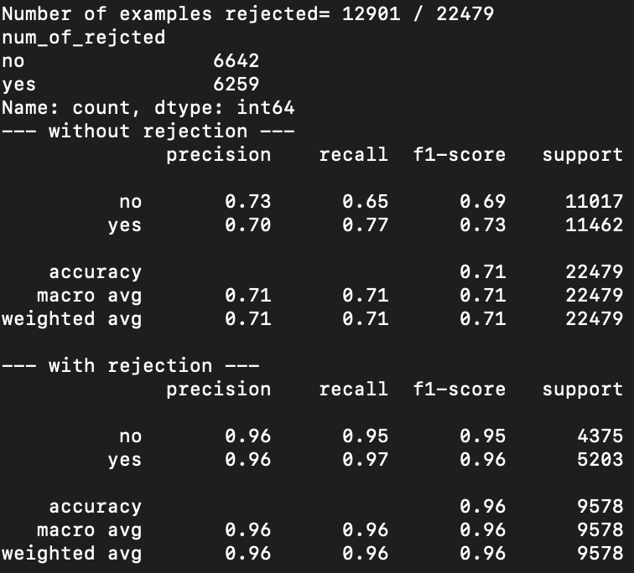
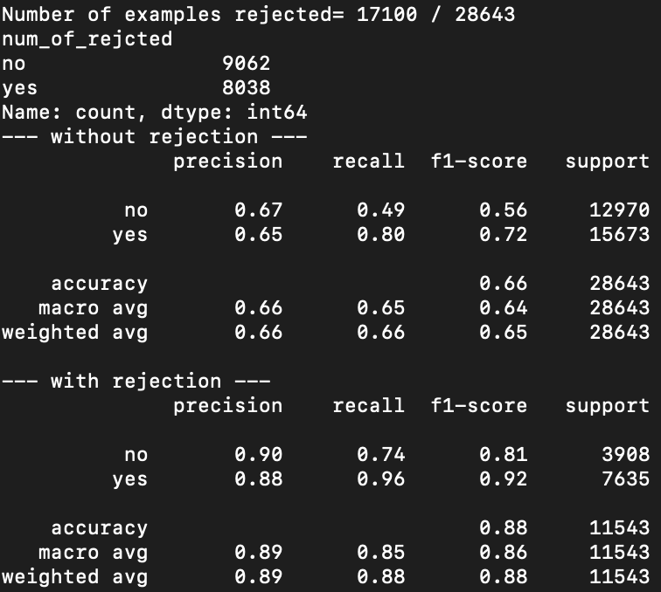
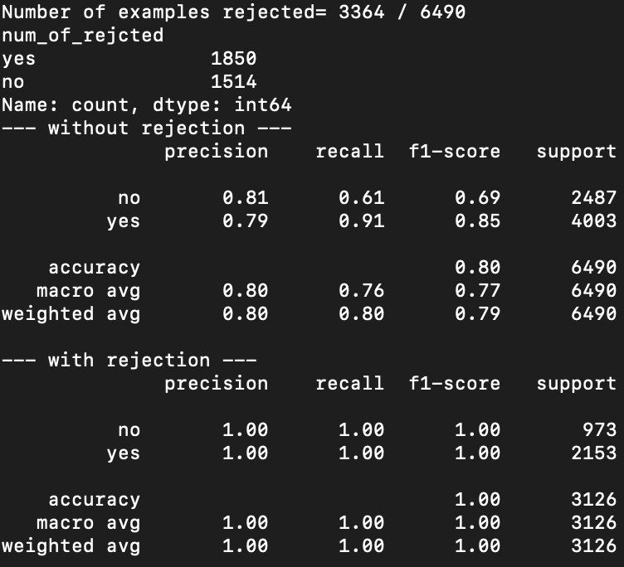
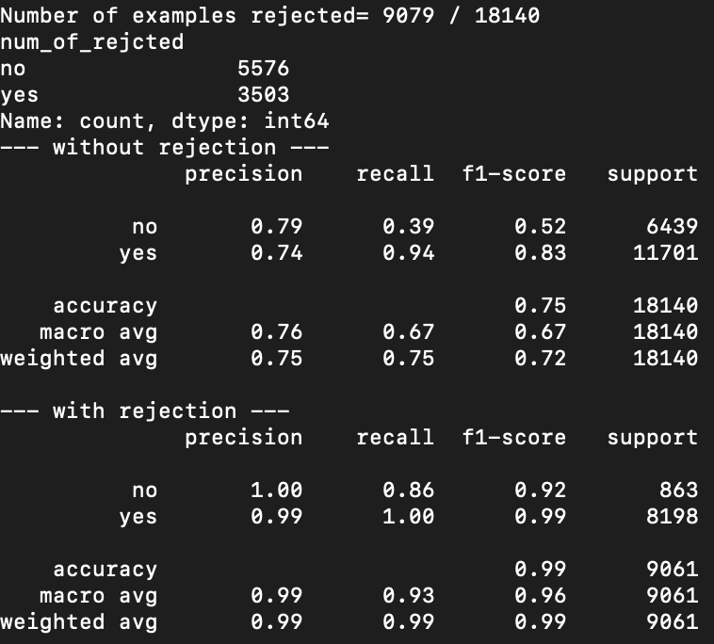

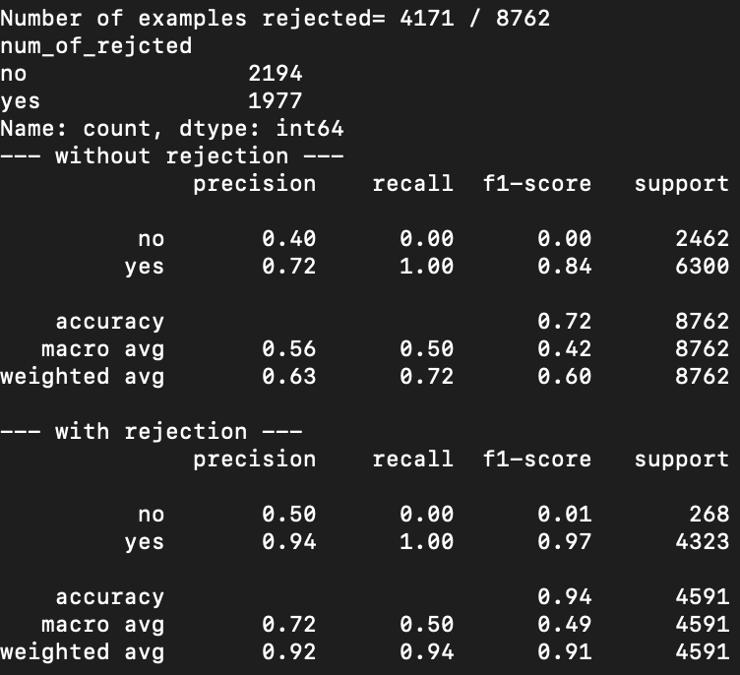
GSE200996: PENCIL result (Incorrect: did not re-do normalization, scaling and PCA for the subset of data)
Tissue CD8T
Tissue CD4T
Tissue B cells
PBMC CD8T
PBMC CD4T
PBMC B cells

Slide 11

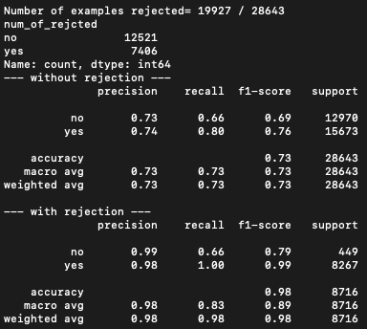
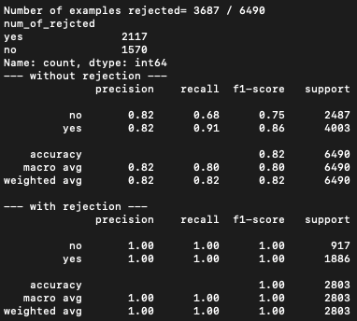



GSE200996: PENCIL result (corrected result)
Tissue CD8T
Tissue CD4T
Tissue B cells
PBMC CD8T
PBMC CD4T
PBMC B cells

Slide 12
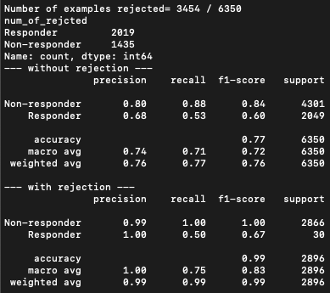
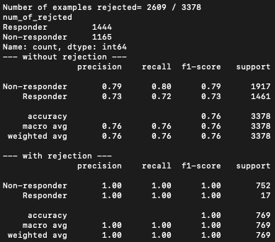
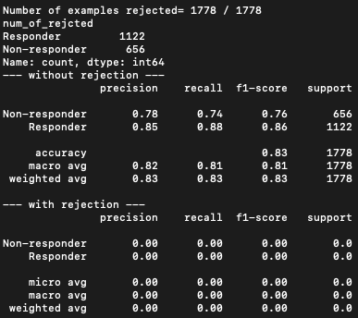
GSE120575: PENCIL result (corrected result: still CANNOT reproduce the result in the PENCIL paper)
Tissue CD8T
(use original anno.)
Tissue CD4T
Tissue B cells

