Slide 1


Slide 2
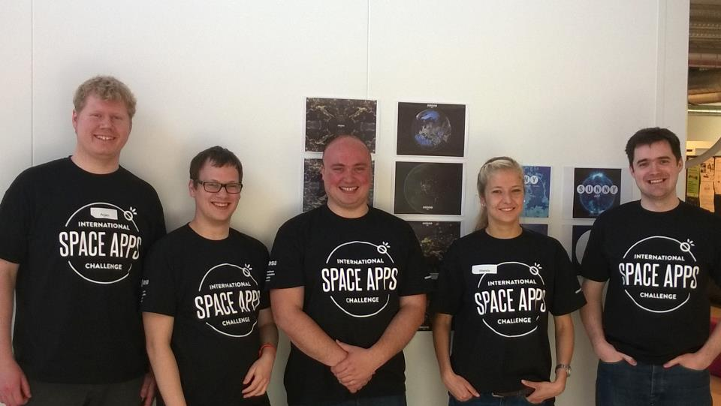
The Sunny Team
Challenge:
Space Mission Road Map
Notes:
The team!
From left to right:
Arjan
Robbert
Jeffrey
Wendy
Hans

Slide 3



About Sunny App 2014
Notes:
The Sunny app has been made for Android, iPad and Windows 8!

Slide 4






Notes:
The used tools.
We used Xamarin and MvvmCross to share code between platforms using C# and .NET. This allows us to share a lot of code between the platforms using the best language (C#)! Also allows us to create platform specific UI’s and all native functionality.
SignalR has been used to implement the live chat feature.

Slide 5

Screens

Slide 6
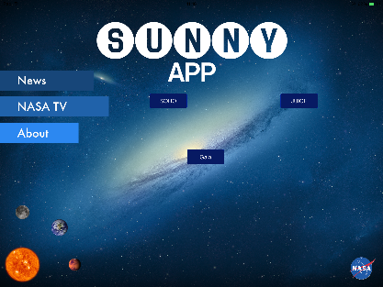

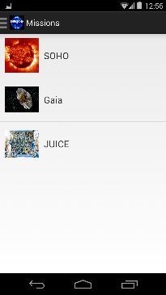
Notes:
Home/Main screen of the App.
Top left: iPad version
Top right: Windows 8 version
Bottom: Android version

Slide 7
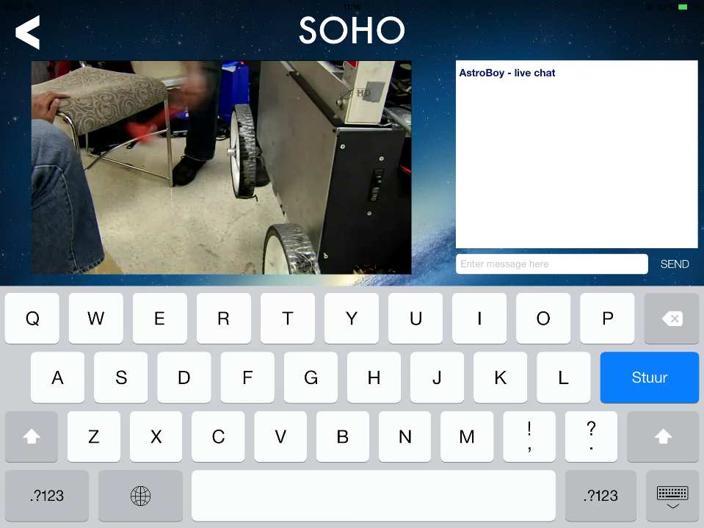
Notes:
Example screen for live chat on iPad

Slide 8
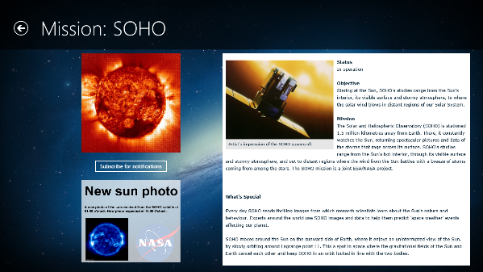
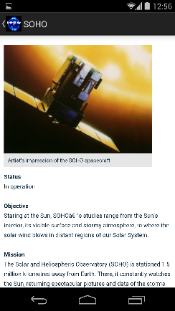
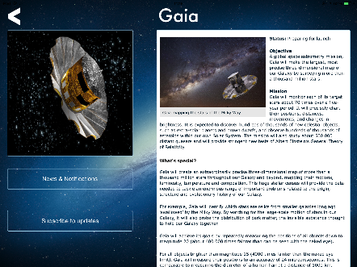
Notes:
Information screens

Slide 9
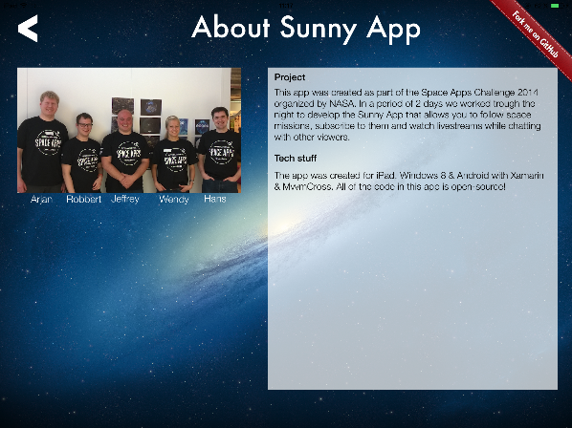
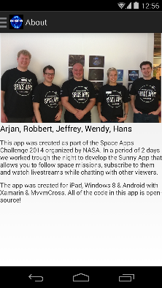
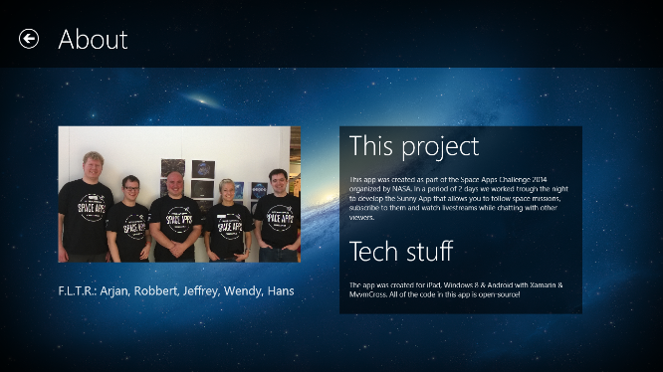
Notes:
About page!

Slide 10
Live demo!
Notes:
Live demo!

Slide 11

Our vision of Sunny App 2014
Product roadmaps
More collaboration
Gamification
Detailed maps/visualizations
More media and social integration
Becoming the mission data exchange platform
Notes:
Our vesion what the Sunny app might become!

Slide 12

Resources
http://www.github.com/rootdevelop/sunny
https://2014.spaceappschallenge.org/
http://www.xamarin.com/
https://github.com/MvvmCross/MvvmCross
http://www.asp.net/signalr
http://azure.microsoft.com/
https://www.facebook.com/sunnyapp2014
Notes:
Some resources

